Slide 1
Wife Who Smashed Television Set Gets Jail
Paul Durcan

Slide 2
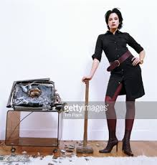
Wife Who smashed television gets jail
This poem is unusual in that it takes the form of a newspaper report. The poem reports how the woman’s husband testified against her, telling the judge how “She came home, my Lord, and smashed in the television”.
Midway through an episode of Kojak, his wife returned from the pub and “marched” angrily into the living room.
She seems enraged by the fact that families spend all their time watching television rather than engaging in conversation.

Slide 3
Wife Who smashed television gets jail
He refuses to turn it off and she makes good on her threat, using her boots as a hammer to smash the appliance. “I didn’t turn it off, so instead she turned it off”.
Television sets, she suggests, have infiltrated family life and now play the role of parents and spouses: “I didn’t get married to a television”. In her opinion, the family would be better spending their time in the pub as it is at least a place of human interaction.

Slide 4
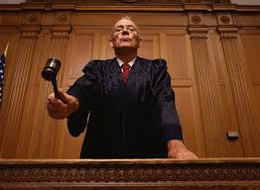
Wife Who smashed television gets jail
The report switches from reporting the husband’s testimony to describing the reaction of the presiding judge. He suggests televisions should be considered members of the families who own them: “the television itself could be said to be a basic unit of the family”.
The judge deems that any wife who shows a preference to the pub rather than watching television is a “threat to the family”. He sentences her to an unspecified time in jail with no chance for an appeal.

Slide 5
THEME: FAMILY
This poem highlights the negative impact of technology can have on family life. The wife laments how the family sit stupefied in front of the screen while the old traditions of eating together, talking, sharing news and opinions are all gone.
TV is portrayed as an insidious addiction – the husband’s response to his wife’s attack on the TV is to rush off elsewhere so he and his kids don’t miss a moment of Kojak. Though they have differing opinions on TV sets, both the wife and the judge make clear that televisions have become part of the family.
The poem, then, presents a conflict between human interaction on one hand and machine interaction on the other. This is especially clear when the wife declares she’d rather have her children in the pub than in front of the television. Pubs may be considered inappropriate for children but she feels at least there people engage with each other.

Slide 6
THEME: marriage
Durcan’s poetry often presents a gritty and realistic view of marriage. However the relationship presented in this poem is likely the most dysfunctional of all.
The wife comes to feel so ignored and marginalised that she’s provoked into the violent attack on the television set.
This surely is marital breakdown in the extreme. Then to make matters even worse, the husband appears to report the wife’s action to the police, testifies against her in court and effectively gets her locked up.

Slide 7
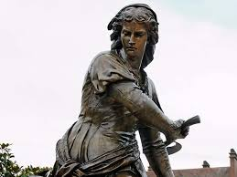
THEME: the strength and power of women
Durcan’s poetry is full of strong and impressive women. Yet among these women, the woman who smashed the television stands out.
This is a woman not afraid to rebel. She has been ignored in favour of the television for long enough. She has watched the television destroy family life across the country for long enough. She responds with her own small but unforgettable act of rebellion.
It’s unsurprising then that she is compared with Queen Maeve, who in Irish legend was the fierce and powerful ruler of Connaught, and the equal of any king.

Slide 8
THEME: Ireland and Irish history
This poem presents Ireland as an oppressive place – especially towards women. The role of women is to maintain the stability of the family unit, and thereby the stability of society itself.
In such an environment women must function as loyal and obedient wives who look after the household and their husbands needs. Any women who rebel against this role, like the wife in the poem, will be regarded as a social menace and dealt with severely by the authorities.

Slide 9
Tellingly, there is no mention in the report of the wife’s testimony. Perhaps the judge felt her husband was the only one worth listening to and was happy to convict on his evidence alone. Or perhaps she was invited to speak but the reporter felt her words were not worth sharing. Either way, her silencing reflects the marginalised status of women in Ireland at that time.
The bias against women is also suggested when the husband describes how Kojak shoots a woman who happens to share his wife’s name: “After shooting a dame with the same name as my wife”. We’re left with the impression that this is a world where women are controlled and oppressed.

Slide 10
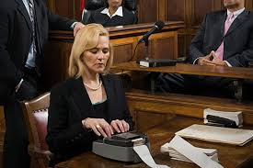
Style: Language, tone, structure etc.
Form:
The poem’s most notable feature is its presentation as a newspaper report. The title is written in the style of a newspaper headline, while the body of the poem mixes quotes and reportage just as a real court report would.
The husband’s testimony is quoted verbatim, while in the last six lines Durcan skilfully captures the clipped, neutral style of the court reporter.

Slide 11
Style: Language, tone, structure etc.
Tone:
Durcan brilliantly captures the tone of the husband’s speech as he gives his testimony. There is something very realistic about the way he moves from a casual style of conversation (“me and the kids”, “my mother’s place”, “my mother has a fondness”) to a more formal one (“peaceably”, “my Lord”, “whereupon”).
We are left with a vivid impression of a man used to speaking in a casual manner who throws in a few big words to try to impress the judge and win his favour.

Slide 12
Style: Language, tone, structure etc.
Language:
It’s important to look at the words used by the husband to describe his wife’s behaviour.
He frames her outburst in emotionally charged language, designed to make her actions seem violent and unreasonable and uses words like “marched”, “smashed”, “declared”, “disappeared”.

Slide 13
Style: Language, tone, structure etc.
Humour:
This poem is rich in the surreal humour that flavours much of Durcan’s poetry . We see this in the wife’s attack on the television and the husband’s equally bizarre response as he rushes his kids to his mother’s place to catch the end of Kojak.
We also see it in the judge’s overreaction as he imprisons the wife for breaking what is, after all, her own appliance.
Durcan uses this bizarre scenario to make a serious point, attacking bot the destructive influence of television and the oppression of women in the Ireland of the day. Although the poem is very quirky, it is also a powerful piece of social criticism.

Slide 14
Personal response
This poem was written at a time when televisions were the only form of electronic entertainment. Yet its message is even more relevant today in our world of smart phones, laptops and games consoles. We now have so many different screens to get lost in – so many different ways to ignore each other.

Slide 15
QUESTIONS
The wife feels it is better for a family to drink in the pub together than watch television together. Why do you think she believes this? Do you feel that she has a point?
Given that this poem was written in the 1970’s is it still relevant to the Ireland of today? Give a reason for your answer.
Write a personal response to this poem.

