Slide 1
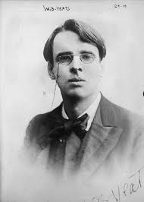
WB Yeats
1865-1939

Slide 2
Born Dublin
Father was an artist, mother was a member of a well off Sligo family
At nine they moved to London
Returned to Dublin to attend Secondary School
Studied at the College of Art in Dublin but soon realised his love of literature

Slide 3
Wrote poetry as a teenager (heavily encouraged by his father)
Interested in the occult, particularly Indian mysticism
He became involved in the Irish Literary Revival – revival of interest in Ireland’s literary heritage

Slide 4
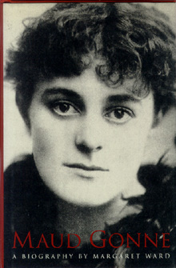
Yeats’ Ladies!
In 1888 he met Maud Gonne (an Irish Nationalist) – she had a strong influence on his work
Yeats developed an obsessive infatuation with her beauty and outspoken manner, and she was to have a significant and lasting effect on his poetry and his life thereafter

Slide 5
He even proposed to her after her husband had been executed for his involvement in the 1916 Rising.
Following her refusals he proposed to her daughter Iseult (without success)
In 1917 he finally successfully proposed to a lady named George Hyde-Lees (She was 25, he was 52)

Slide 6
He began as a romantic poet but his work gradually became less decorative and musical, to become more harsh and realistic, and, above all, more in tune with contemporary realities and public issues.

