Slide 1
Ty Creative Writing
Looking at a picture for inspiration

Slide 2
The best students in all the land…

Slide 3
The second best…

Slide 5
The most impressive writers

Slide 6
The still picturesque mountain lake glimmered in the sun of a beautiful day as the sweet smell of the ancient mountains. I looked over the lake to the thick luscious spruce tree forests that seemed to stretch for miles. The old raged cabin which seemed to have been built hundreds of years ago stood weakly on its stilts. Could hear the distant howl of a gale sweeping through the climbing peaks.

Slide 9
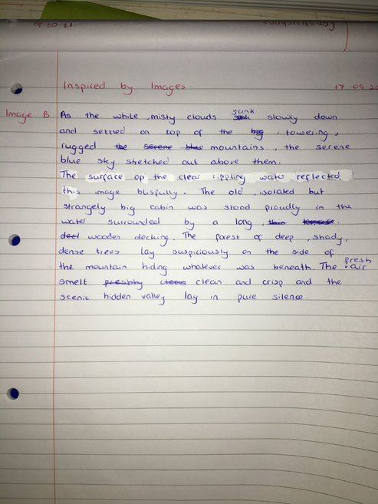

Slide 10
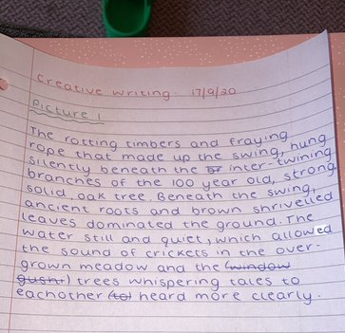

Slide 11
The old, lonely cabin sat isolated in the beautiful, picturesque fjord. Like a blanket the snow covered the jagged mountains piercing the clouds as they stood watching over the gorgeous, vivid lake. Around the mountains lay scattered green trees standing proudly as the cold, bitter wind wisped through their branches. Birds chirping echoed throughout the landscape accompanied by the refreshing smell of pine. All around the air was still waiting for the morning sun to creep over the mountain.

Slide 12
The old broken-down wooden dwelling surrounded by the glowing gleaming lagoon floating on its flat calm surface looked like something out of a movie. The colossal forest camouflaged the mountains. The silky clouds where raised above the mountains. The aged wooden swing swayed from side to side attached to the tree by two ropes covered in mud with forestry in back with a lake over shadowing the swing.

Slide 13
The clouds are crashing against the mountain. The water in the lake ripples. The snow rests on the mountain. There is small wooden house on the still lake. There is an old wooden boat at the side of the wooden house. The blue sky is fulfilled with clouds. The mountain is an attractive sight to see. The house is very homey. The land is very picturesque and peaceful. The captivating clouds slide over the bright blue sky. The fog gives the lake an ethereal appearance. The trees bring a vibrant green colour as it reflects of the lake. Light passes through the clouds lighting up the lake.

Slide 14
In this picture we can see a swing made of rope and a plank of wood, attached to a tree. There is also a clear lake with the shadow of trees giving it a greenish colour. I would imagine this image has a strong smell of fresh air and wood. It seems peaceful with no one around. It looks like a quiet place which would be ideal for spending some alone time. There are a lot of nice evergreen trees looking out on the lake. There is also a little boat on the patch of grass beside the lake.

Slide 16
The Log cabin stood in isolated in the middle of the forest surrounded by soaring snowcapped mountains that scraped the sky. You can hear the calming sounds of the leaves brushing past each other and the tranquil lake swishing round.
You can smell the fresh, cold water and pine trees. You can feel the refreshing cold air in your lungs when you inhale and feel your worries leaving your mind as you exhale.
You can feel the damp fallen leaves under your feet and the slow creek the wood makes as you walk towards the lonely but serene cabin.

Slide 17
The peaceful wooden cabin is situated on a relaxing glade. A glamourous reflection of beautiful mountains and cold clouds shine on the still water. A lonely boat sits unused on the calm, silent body. A cold, crisp air fills my lungs as I breathe in and as I breathe out there is a cloud of smoke, identical to the white puffy clouds coming from my dry lips. The lush forestry fills a mountain view in the corner of my eye. And a dainty church sits in the background of the forestry. There is a breeze whistling through the iridescent view of the mountains. I pick up a fresh smell of trees and wood whilst listening to birds happily chirping from a far-off distance. Their musical voices echo through the glade as the clear, blue sky sits coldly above me.

Slide 18
As I approached the lone cabin, I felt a sense of calmness as I watched the still water of the lake reflect the humongous mountain behind it with the lush green forest by its side I remembered why I came to this place and approached the welcoming yet dilapidated cabin and got into the the boat and travelled to the center of the great lake the cabin was built on I felt relaxed with the sound of wind rushing down from the mountains to cool the land beneath it as I came to a stop I took in the sights around me and became fulfilled

Slide 19
Name your CHAMPION:

