Slide 1
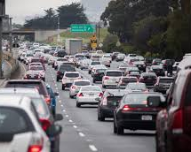
TY Creative Writing Assignment – Stuck in Traffic-
30/9/20

Slide 2
This Photo by Unknown Author is licensed under CC BY-NC

Slide 3
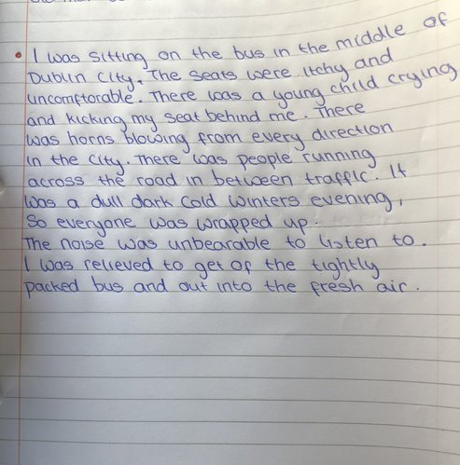
This Photo by Unknown Author is licensed under CC BY-SA-NC

Slide 4
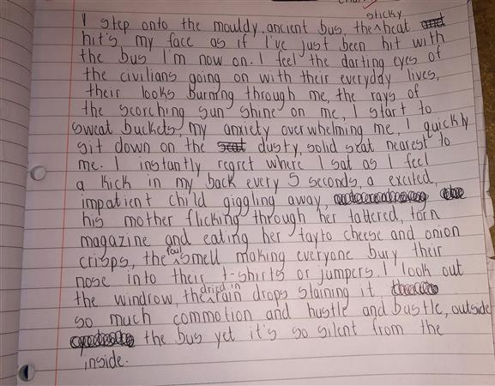

Slide 7
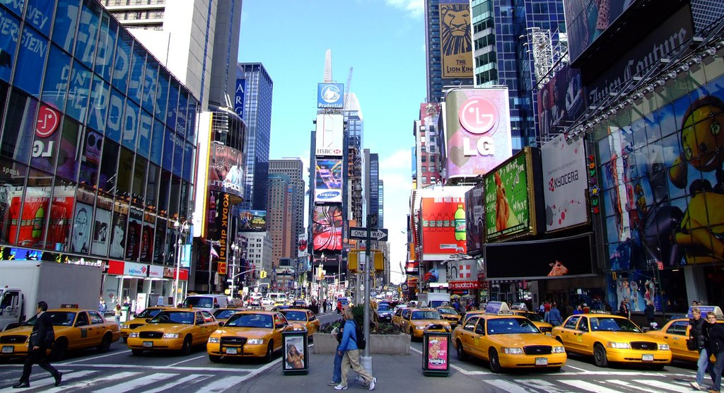
The buzz of New York’s notorious traffic had woken me up. Car horns blaring, engines growling and brakes screeching bled through the tinted windows of the yellow taxi. Without the sight of 4 lines of steel and rubber snaking around the humongous buildings I could’ve easily mistaken it for a warzone. The gritty taste of cigarette smoke and recycled hot air forced me to stick my head out of the claustrophobic taxi. Apart from the mouthwatering smell of fresh pizza, it was putrid. Cars swam in their own cough inducing fumes bumper to bumper. Each car sat impatiently, begging the traffic light to turn green. Around us people swarmed the litter strewn pavements moving in unison like an army of ants. It was just another day in New York City.
This Photo by Unknown Author is licensed under CC BY

Slide 8
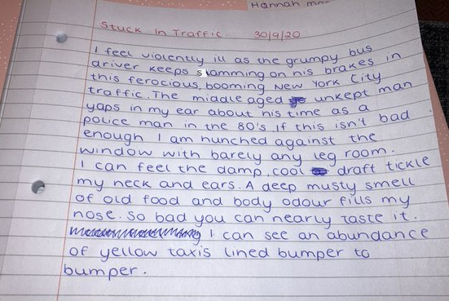

Slide 9
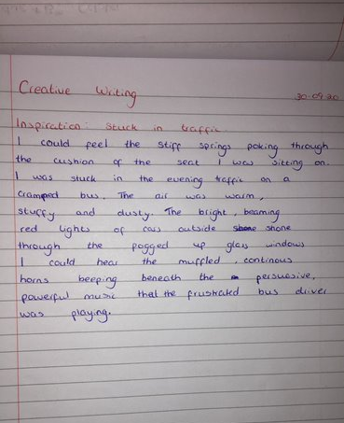
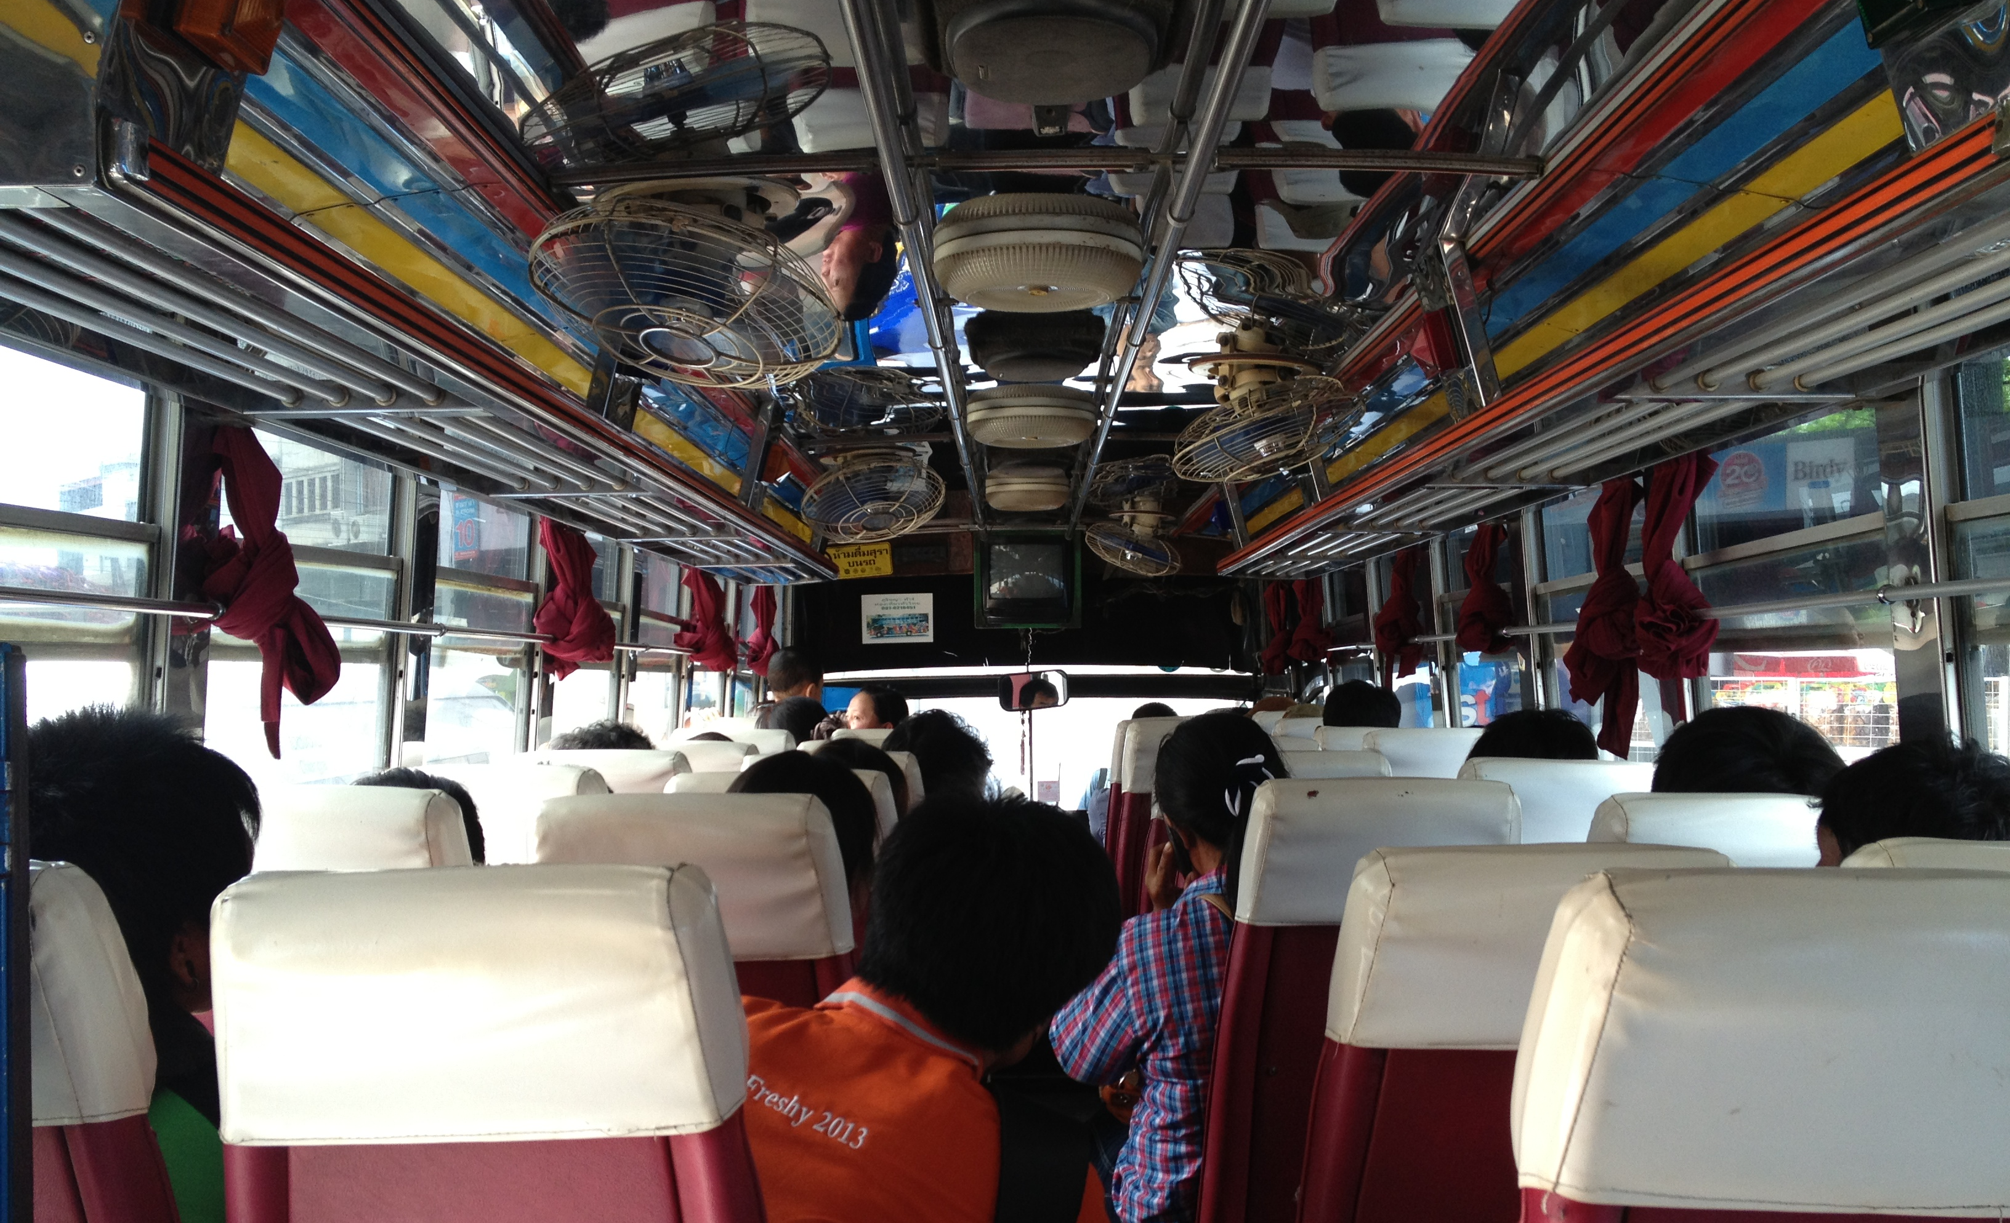
This Photo by Unknown Author is licensed under CC BY-NC-ND

Slide 10
