Slide 1
Tich Miller by Wendy Cope

Slide 2
Tich Miller wore glasses
with elastoplast-pink frames
and had one foot three sizes larger than the other.
When they picked teams for outdoor games
she and I were always the last two
left standing by the wire-mesh fence.
We avoided one another's eyes
stooping, perhaps, to re-tie a shoe-lace
or affecting interest in the flight
of some fortunate bird, and pretended
not to hear the urgent conference:
'Have Tubby!' 'No, no, have Tich!'
Usually they chose me, the lesser dud
and she lolloped, unselected,
to the back of the other team.
At eleven we went to different schools.
In time I learned to get my own back,
sneering at hockey players who couldn't spell.
Tich died when she was twelve.

Slide 3
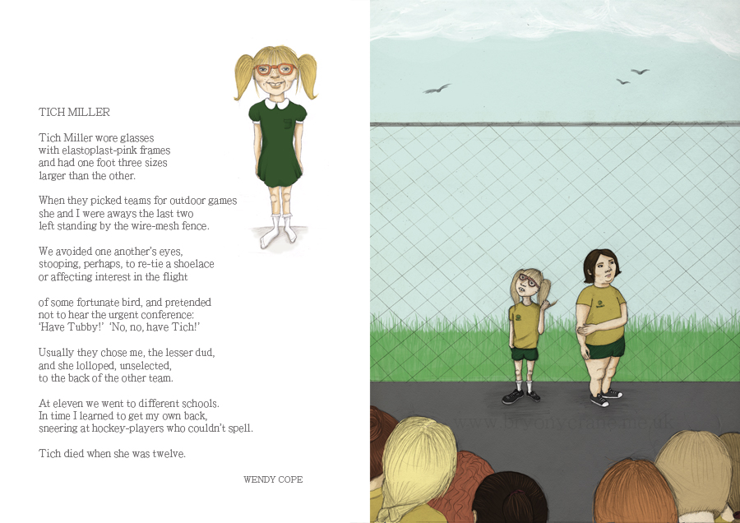

Slide 4
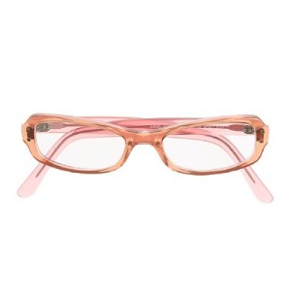
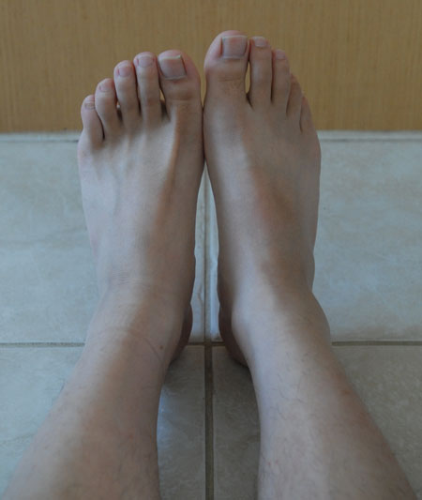
Tich has some form of disability. She has poor eyesight. Her feet are different sizes. She does not fit in. There is nothing attractive about these images.
The opening lines introduce Tich immediately.
We feel connected with the poem. The poet brings Tich to life for us.
Tich Miller wore glasses
with elastoplast-pink frames
and had one foot three sizes larger than the other.

Slide 5
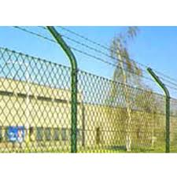
Themes:
The misery of being left out and alienated at school.
The cruelty of schoolchildren
Embarrassment/Humiliated –The girls are embarrassed they are picked last.
When they picked teams for outdoor games
she and I were always the last two
left standing by the wire-mesh fence.
“Wire-mesh fence” Makes us think of a prison or a cage. The girls are trapped.
Tich and Tubby are always the last two to be selected.

Slide 6
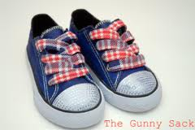
The girls are embarrassed. They feel awkward, embarrassed and humiliated.
“Retie” suggests being uneasy. The shoe-lace does not need to be tied.
Anything to keep busy.
We avoided one another’s eyes
stooping, perhaps, to retie a shoe-lace
or affecting interest in the flight

Slide 7
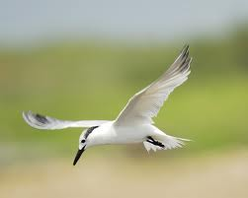
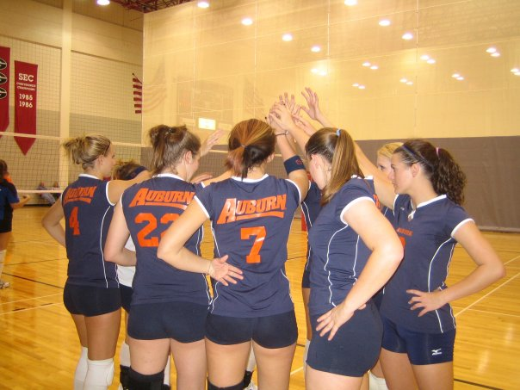
“urgent conference”; the students argue among themselves; within earshot of the rejected girls. They pretend not to hear to avoid facing the fact that they are rejected by their classmates.
The bird is “fortunate” because it can fly away and be free. The bird is graceful unlike Tich and the poet.
By being left out they may have formed a tentative friendship. The fact the poet wrote the poem shows that she cared about Tich. They are united in their distress but they are not close.
of some fortunate bird, and pretended
not to hear the urgent conference:
“Have Tubby!” “No, no, have Tich!”
The nickname “Tubby” would suggest that the speaker was somewhat overweight.

Slide 8
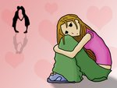
Words like “Usually” and “always” emphasise how the girls misery was on going.
“Lolloped” is a good example of onomatopoeia as we can imagine the sound her feet make when Tich walks in her graceless way.
Usually they chose me, the lesser dud
and she lolloped, unselected,
to the back of the other team.
“the lesser dud” Tubby is seen as a more desirable team member than Tich.

Slide 9
Things changed for the poet. She learned to use her academic ability to get her revenge on the sporty types who had jeered at her.
At eleven we went different schools.
In time I learned to get my own back
sneering at hockey players who couldn’t spell.
It is interesting to note that the poet found a different way to bully. She did not learn that mockery is cruel and should be avoided. Like so many people who are picked on, she found her own way to do that to others.

Slide 10
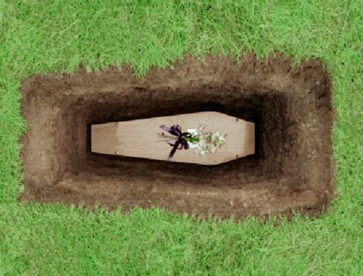
Tich’s death is sudden, shocking and sad.
She never found a way to fight back.
The stand alone verse shocks us and emphasises the tragic reality of her death.
Language
The simplicity of the language throughout the poem reflects the simplicity of the language and thought process of young children. There is no flowery language, no euphemisms to hide the harsh reality.
Tich died when she was twelve.

Slide 11
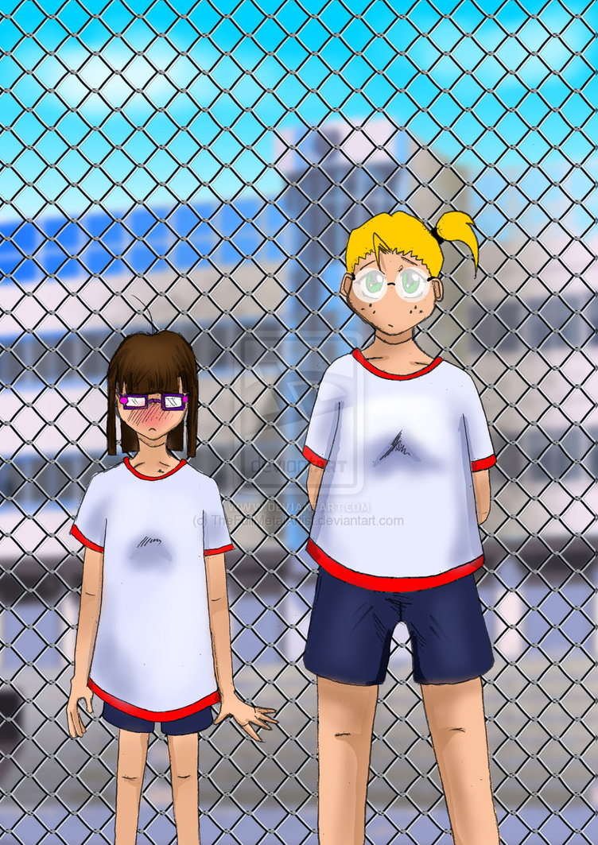

Slide 12
Pick out some examples of how the writer appeals to the senses.

Slide 13
Write a conversation:
Write a conversation between Tich and Tubby.
This conversation could take place in the changing room after games.
Tubby: Gosh, I’m exhausted after all that running around.
Tich: My mother will ground me. My glasses are broken again.

Slide 14
PQE- Point/Quote/Explain
Remember to ALWAYS USE PQE

Slide 15
PQE example:
Using PEE paragraphs leads to good writing. Make clear points which are proven by evidence. Then explain your point.
POINT
(Make a statement; say something about the topic)
In Tich Miller, the poet shares a personal experience with us.
For example, in line 4 and 5 the poet says
“She and I were always the last two left standing by the wire mesh fence”.
The use of the first person (I) allows the poet to speak from personal experience.
The poet recalls how uncomfortable she felt when teams were being chosen.
Quote
(Where is the proof for what you have said above?)
EXPLANATION
(How does the proof – the EVIDENCE – prove what you have said?)

Slide 16
Exploring viewpoints in the poems Using the images below, choose lines from the poem which reflect the different voices. The phrase or line which reflects the dominant voice should be written in the biggest speech bubble, and the other voices in the others depending on their significance. Present your speech bubbles to the class.

Slide 17
Descriptive Words
Pick out five descriptive words from the poem.
Define the word (use your dictionary)
Put each word into a sentence to demonstrate your understanding.
Word
Definition
My sentence

Slide 18
Interview
Prepare an interview with the speaker of the poem, ten years later.
Ask her to discuss her school life and what she is doing now.

Slide 19
News Paper Article
Looking at newspaper headlines and stories
A few journalistic tips before you start on a newspaper article
The story
Before you begin writing your story, remember that your readers will want to know the answers to the ‘five Ws’:
Who?
What?
Where?
When?
Why?
You will also need to tell them how the events happened.

Slide 20
News Paper Article
Journalists use what is sometimes called ‘the inverted pyramid’.
Imagine what an upside-down pyramid would look like: a lot of stone at the top, tapering to a point.
When you write your story, start with the main items and work towards the less important.

Slide 21
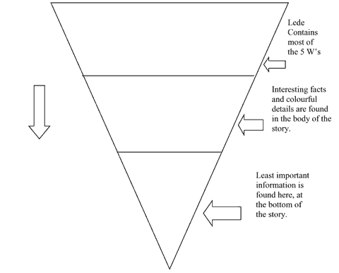
Inverted Pyramid Structure

Slide 22
News Paper Article
The first paragraph should include the 5 Ws (plus ‘how’)
The second paragraph contains the details
The third (and any more) paragraphs contain the background information.
This is easy to read and makes it easy to edit – the later paragraphs can more easily be cut out by an editor with little room on the page, but the essentials of the story will still be in first two paragraphs.
So: put the real news in the first paragraph. Make sure your readers know at once why this story is in the paper instead of beginning with what the family had for breakfast that morning.
Now you are ready to write an eye-catching headline to grab your readers’ attention.

Slide 23
Write Your Own Article
Write a newspaper article about the death of tich miller.
Fill in the following table to help you.
Use at least two quotations
Who
What
Where
When
Why
Quotation 1
Quotation 2

Slide 24
Tich Miller by Wendy Cope Use full sentences. Back up the points that you make with quotes from the poem!
How did you feel when you realised that Tich died so young? Explain your answer.
________________________________________________________________________________________________________________________________________________________________________________________________________________________________________________
Tich Miller shows how small things that are said or done can make school miserable for some pupils. List the actions in the poem that you think are hurtful.
________________________________________________________________________________________________________________________________________________________________________________________________________________________________________________
Do you think the other students in the yard realised just how hurtful their behaviour was? Explain your answer.
________________________________________
________________________________________________________________________________________________________________________________________________________________________________________________________________________________________________
What do you think the theme of this poem is? Explain your answer.
________________________________________________________________________________________________________________________________________________________________________________________________________
What do you think the most powerful image in the poem is? Explain your answer.
________________________________________________________________________________________________________________________________________________________________________________________________________________________________________________________________________________________________________________________________

Slide 25
Tich Miller
Tich Miller wore __________
with __________-pink frames
and had ___________ three sizes ________ than the other.
When they picked ________ for outdoor games
she and I were always the last two
left standing by the ____________ fence.
We avoided one another’s eyes,
stooping, perhaps, to re-tie a __________,
or affecting __________ in the flight
of some fortunate _________, and pretended
not to hear the urgent __________:
‘Have _________!’ ‘No, no, have Tich!’
Usually they chose me, the lesser ______,
and she __________, unselected,
to the back of the other ________.
At eleven we went to ___________ schools.
In time I learned to get my own back,
___________ at hockey-players who couldn’t spell.
Tich _________ when she was __________.
Wendy Cope

