Slide 1
Romeo and Juliet Theme of Parental Love

Slide 2
Parental Love
The love of parents for their children should also be considered. For example, the Montagues show great concern for Romeo’s mood at the start of the play and it is obvious they want to help him:
“Could we but learn from whence his sorrows grow,
We could as willingly give cure as know”.
(Act 1, Scene 1, lines 147-8)

Slide 3
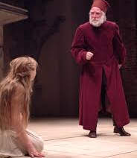
The main parent-child relationship in the play is the one between Juliet and the Capulet’s. Looking at his angry treatment of Juliet in Act 3, Scene 5, some audience members may feel that Capulet is a tyrant, But the play as a whole shows him to be a father who loves is daughter and who is deeply concerned to ensure her future welfare.

Slide 4
For example, when Paris mentions the possibility of marriage to Juliet, Capulet’s first thought is to protect her from the dangers of marriage at too young an age. He does not want his only child to marry before she is sixteen. His deep regard for her is clear: “Earth hath swallowed all my hopes but she; she’s the hopeful lady of my earth.” (Act 1, Scene 2, lines 14-15)

Slide 5
Capulet’s love for Juliet is best shown in his concern for her future happiness. This hope is frustrated when Juliet marries Romeo without his knowledge or his permission.
She continues to deceive her parents by keeping them in ignorance of this marriage.
Knowing nothing about it, Capulet encourages Paris, a good and virtuous man, to regard Juliet as a future wife.
Capulet does this in good faith, not because he wants to control Julier, but because he wants the best for her.

Slide 6
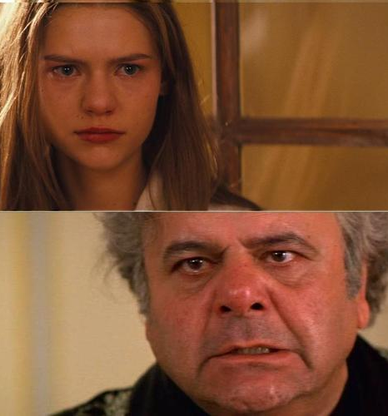
Capulet can not be faulted for promoting Paris as Juliet’s future husband. He does not know that Juliet has married Romeo. He firmly believes that Paris is likely to make an ideal husband for Juliet, and is frustrated that Juliet appears not to realise what her best interests are.
It is because he loves her that he becomes angry.

Slide 7
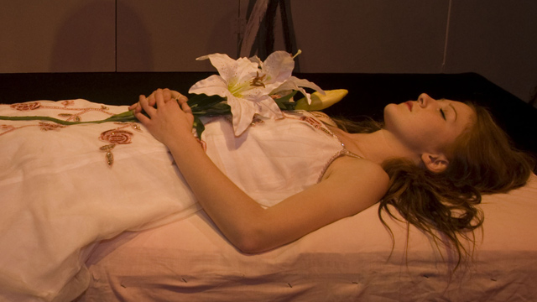
Both Capulet and Lady Capulet express genuine shock and sorrow when their daughter is found “dead” in bed at the start of Act 4, Scene 5.
The loss of their only child affects them deeply. Similarly, Montague reports that Lady Montague has died of a broken heart after Romeo’s banishment.

Slide 8
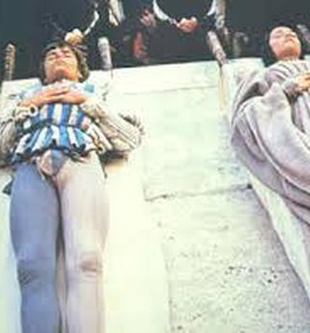
When they discover the truth about Romeo and Juliet, the love of these parents for their children proves stronger than their families’ feud, and so their children’s deaths bring about their reconciliation.

