Slide 1
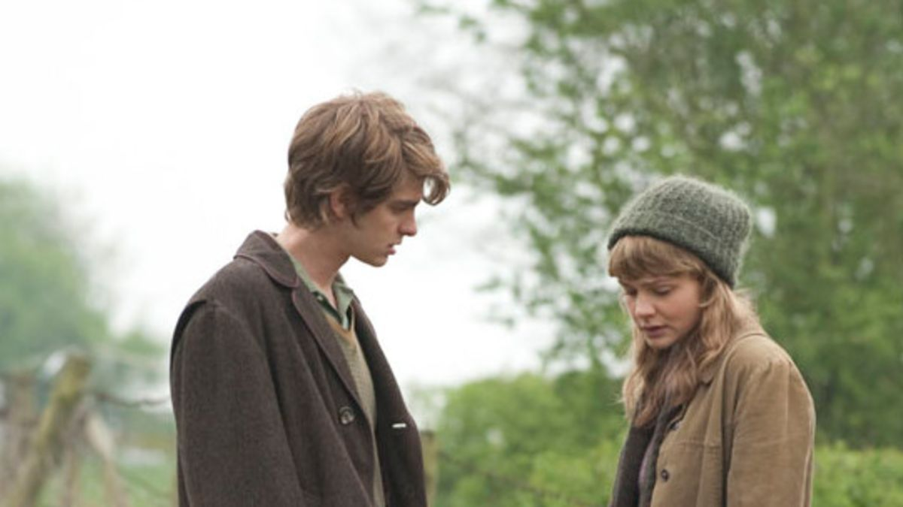
Theme of Identity ‘Never Let Me Go’
By Kazuo Ishiguro

Slide 2
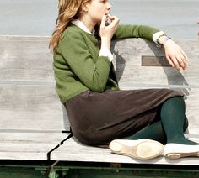
While most young people question their place in the world, Kathy and her friends have to wrestle with a unique problem in terms of their identity.
She and all the other donors have been cloned in order to provide organs. Therefore, they must come o terms with the fact that “normal” people believe the clones have no identity of their own.
Kathy spends most of the book struggling with the confusion surrounding her sense of self. Is she merely a copy of the person from whom she was cloned or does she have the ability to be her own person?

Slide 3
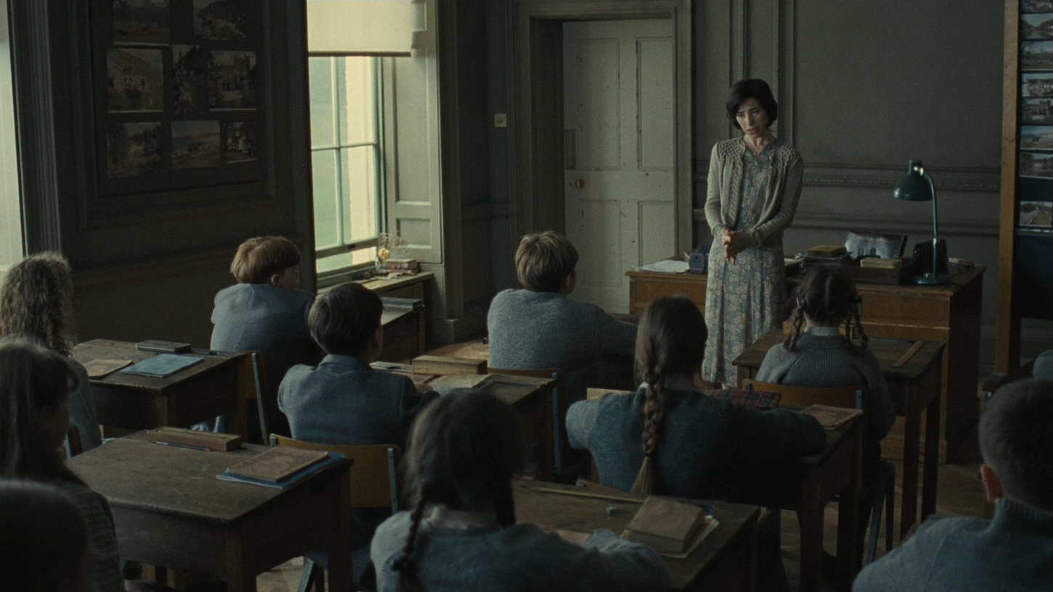
From a young age, the students of Hailsham are raised to believe they are different, but they are not told exactly why. When Miss Lucy warns the children against smoking because they are “special”, they do not ask her to explain further.
Looking back on that moment, Kathy thinks that it was because, even at the age of nine or ten, they knew enough to make them “wary of that whole territory”.
The children realise they are not the same as their guardians or the “normal people outside” but they are unwilling to face who – or what – they really are.

Slide 4
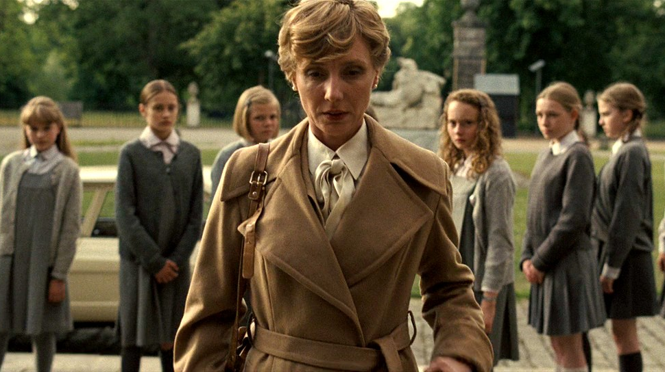
A key moment early in the novel forces the children to face an unpleasant truth about their identities. Kathy and her young school friends are intrigued by the regular visit of a woman known simply as Madame. They believe she comes to the school to view their artwork and select pieces for her “Gallery”.
Madame avoids any contact with the students, and they begin to think she is afraid of them.

Slide 5
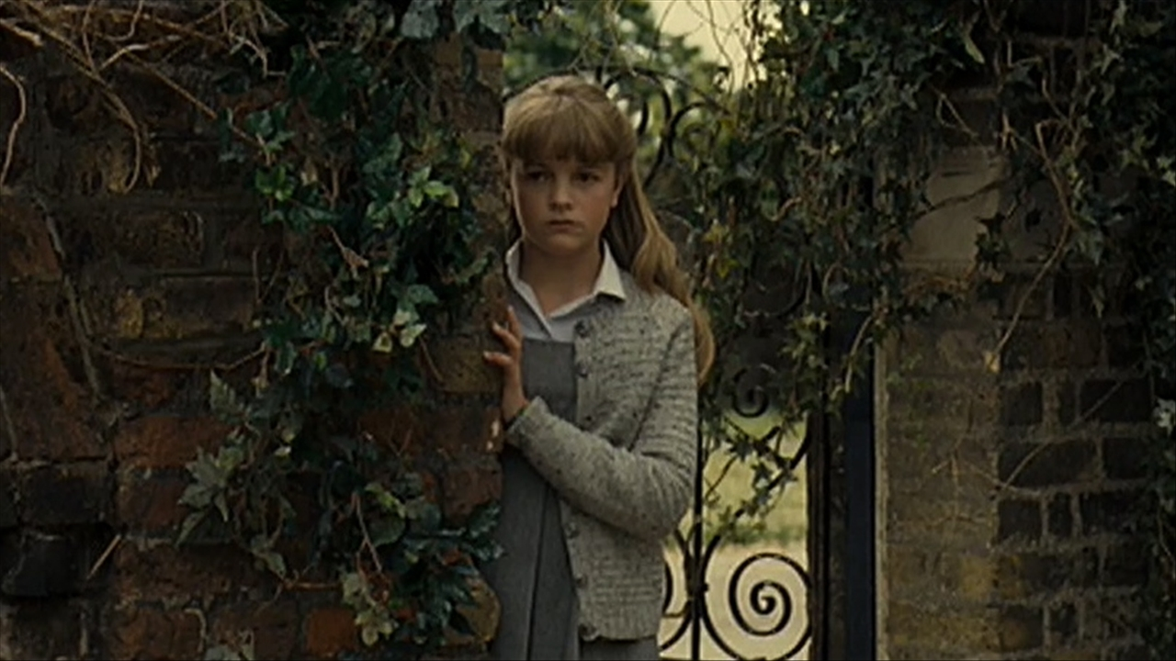
Kathy, Ruth and some of the other children come up with a plan to swarm around Madame when she next visits. Their scheme works too well and they are shaken to discover that Madame is genuinely afraid of them “in the same way someone might be afraid of spiders”.
This is a blow to the children’s sense of self because, as Kathy says, it had never occurred to them to wonder how they would feel, “being seen like that, being the spiders”.
For the first time, the children see themselves through someone else’s eyes and they realise that they are truly different from their guardians and “the people outside.”

Slide 6
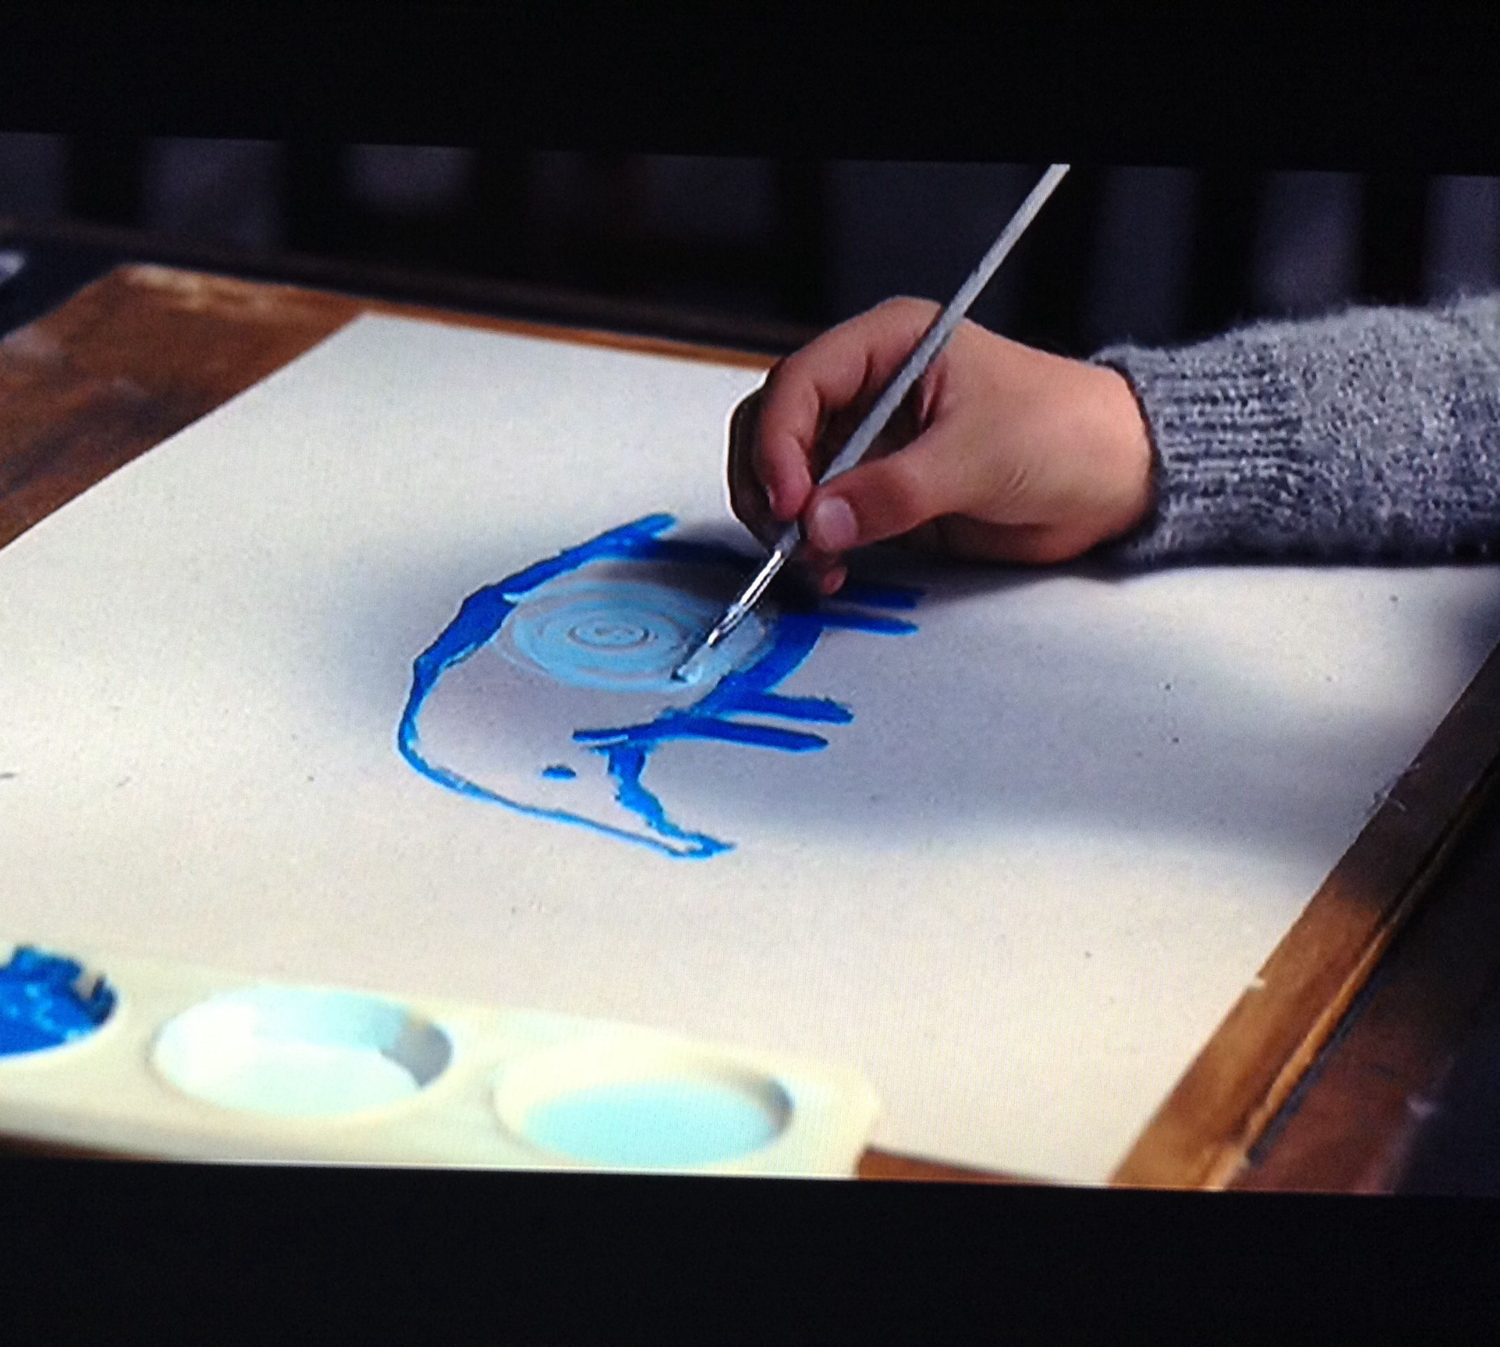
The students at Hailsham are encouraged to work on their artistic talents because they are part of Madame and Miss Emily’s experiment to prove to the outside world that the clones are “fully human”.
The children do not realise this is the reason they are required to produce artwork, but they are aware that their pieces are an important aspect of their identities.

Slide 7
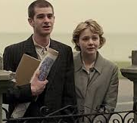
Tommy has very little artistic ability and worries that his lack of ability means he is somehow seen as less of a person than the other students. After he left Hailsham, Tommy begins to work on his art once more because he wants to prove that he has an inner self.
He brings his pieces to Madame’s house to seek a deferral. He hopes that his art will help her to see he has a soul and that he and Kathy are therefore capable of love and deserving of life.

Slide 8
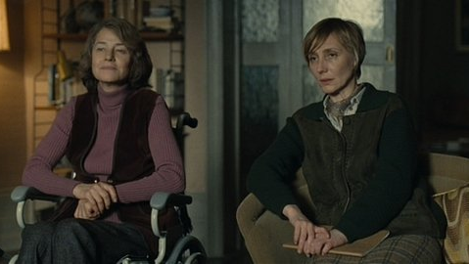
Tragically, proof of their humanity is not enough to spare the young couple their inevitable donations and early death.
Madame and Miss Emily explain to Tommy and Kathy that deferrals do not exist and it is not in normal people’s interests to see the clones as individuals worthy of life because if they did so, they could not harvest their organs.

Slide 9
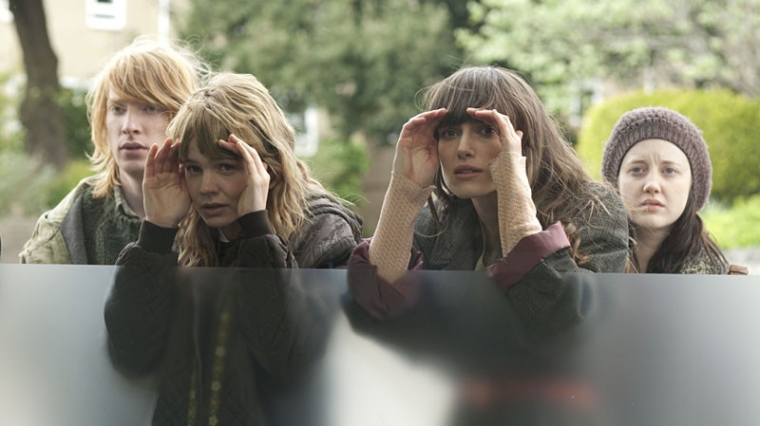
Kathy and the others call those from whom they might have been closed “possible”. After they have left Hailsham and are living in the Cottages, the clones have the opportunity to see more of the outside world, and there are occasional, and unconfirmed sightings of possibles.
There is great excitement if one of the clones believes their “possible” has been spotted. Kathy says that “Weeks would go by with no one mentioning the subject, then one reported sighting would trigger off a whole spate of them.”

Slide 10
The clones naturally want to learn as much as they can about their possibles because they see the as a way of connecting with their identity. They also see their possible as a way of holding out hope for a different life, one in which they might have a place in the “normal” outside world.
Ruth learns from Rodney, one of the other occupants of the Cottages, that her possible may have been spotted working in a office in Norfolk. Rodney organises a trip to see if they can find the woman. Unfortunately for Ruth, the woman only bears a partial resemblance to her, and her hopes are crushed.

Slide 11
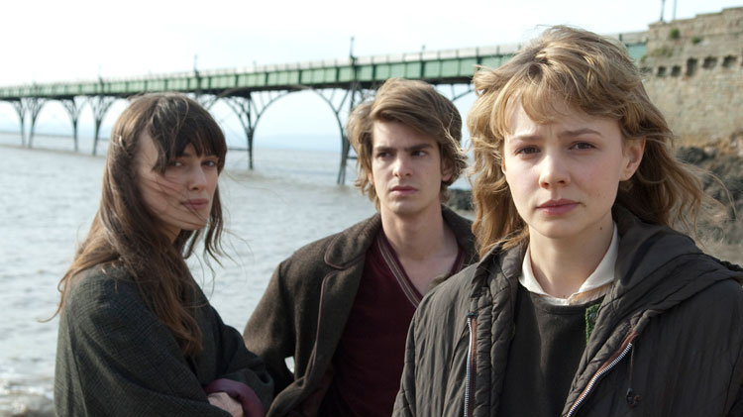
Ruth’s bitterness turns to anger when Rodney tries to tell her that the search for a possible had been nothing more than a “bit of fun” anyway. She tells the others that her failure to find her possible living a desirable life has simply confirmed what she always suspected about the clones’ identities: “We’re modelled from trash”.
Ruth says that no respectable person would allow themselves to be cloned, and if the others are looking for their identity through possibles, they should do so in the gutter, rubbish bins, and toilets where they might find the drug addicts, prostitutes, alcoholics, tramps and convicts on which they are modelled.

Slide 12
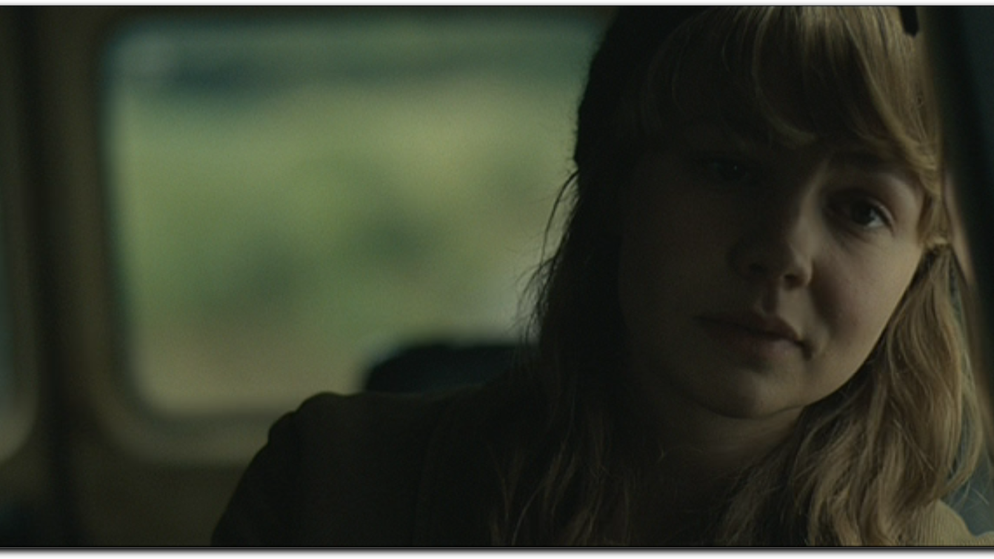
Ruth is not alone in thinking this. Kathy worries that her sexual urges might be too strong and that such feelings must be something to do with the person from whom she is cloned.
Kathy searches through pornographic magazines in the Cottages to see if she can find her possible. She explains to Tommy that she doesn’t want to find the woman but simply wants an explanation for her feelings.
Kathy struggles to determine whether she is simply an exact copy of someone else and therefore must behave a certain way, or whether she is a person in her own right and free to shape her identity and sense of self. She can not see that by simply reflecting on her place in the world, she is asserting her individuality and humanity.

Slide 13
Ultimately, however, Kathy and the others have to accept their fate. Their destiny has been mapped out for them, and no matter what they do during their short lives, society will refuse to see them as individuals.
At the end of the book, Kathy is about to begin her donations and she knows she will soon die. The entire novel is Kathy’s reflection on what has been important and valuable in her life: friendship, love and creativity.
It is clear that no matter what society thinks of her, Kathy is far more than a cloned organ donor. She is an individual as worthy of life as any of the “normal” people who continue to deny her humanity and her strong sense of self.

