Slide 1
Section 1: Characters in each of the texts have a moment of revelation about their IDENTITY
Theme : Identity
Key Moments

Slide 2
‘Never Let Me Go’
A key moment early in the novel ‘Never Let Me Go’ forces the children to face an unpleasant truth about their identities.
Kathy and her young school friends are intrigued by the regular visits of a woman known simply as Madame. They believe she comes to the school to view their artwork and select pieces for her “Gallery”.
Madame avoids any contact with the students, and they begin to think she is afraid of them.

Slide 3
Kathy, Ruth and some of the other children come up with a plan to swarm around Madame when she next visits. Their scheme works too well and they are shaken to discover that Madame is genuinely afraid of them “in the same wat someone might be afraid of spiders”.
This is a blow to the children’s sense of self because, as Kathy says, it had never occurred to them to wonder how they would feel, “being seen like that, being the spiders”.
For the first time, the children see themselves through someone else’s eyes and they realise that they are truly different from their guardians and “the people outside.”

Slide 4
‘Brooklyn’ + ‘Never Let Me Go’
Unlike Kathy and her friends, Eilis’s moment of revelation about her identity comes when she is a grown woman rather than an innocent young child. This moment is not as negative or devastating as the one Kathy and her friends experience in ‘Never Let Me Go’. The only real similarity between the moments of revelation in both texts is that it is a third party who forces the characters to face up to who they are and where they belong.

Slide 5
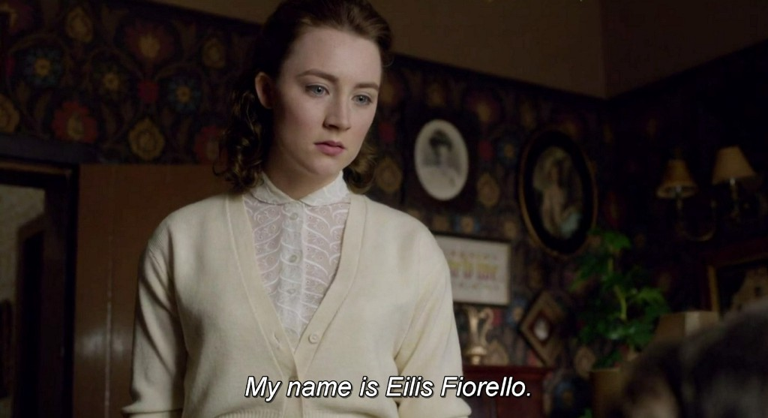
In Eilis’s case, her uncertainty abut her identity occurs when she returns to Ireland after her sister’s death. Suddenly she is unsure about who she is and where she belongs. Is she Eilis Fiorello, with a future mapped out for her in New York, or is she Eilis Lacey who is being primed to take over her sister’s office job and settle down with Jim Farrell?
The answer comes when Miss Kelly confronts her about her marriage to Tony. At that moment, Eilis knows exactly who she is and where she must be.

Slide 6
Unlike Kathy and the other children, who are deeply shaken when confronted with their identity, Eilis is not shaken and distressed by her experience.
She says proudly, “My name is Eilis Fiorello” and takes the next sailing back to America to be with Tony.

Slide 7
‘Eclipsed’+ ‘Brooklyn’ + ‘Never Let Me Go’
Sister Virginia struggles with her identity throughout the play ‘Eclipsed’. She is constantly torn between her role as an obedient novice nun and a woman with strong views of her own that run counter to the views of the Catholic Church. However, matters come to a head for Sister Virginia just as they do for the characters in the other two texts, and she comes to a realisation about her identity. This is neither as devastating an experience as that of the characters in ‘Never Let Me Go’ nor as positive as that of Eilis in ‘Brooklyn’.

Slide 8
Instead, it is more of a final confirmation of what Sister Virginia has long known to be true in her heart of hearts. The incident that triggers this realisation comes when Sister Virginia learns of Cathy’s death during her attempt to escape. This is a turning point for the novice nun and she gives in to Brigit’s demand to hand over the keys and allow the women to leave if they want to.

Slide 9
As she leaves, Brigit accuses Sister Virginia of being dead inside. Knowing Sister Virginia’s determination to care for those in her charge, we can easily imagine what a blow this is to her sense of self.
Just as in the other two texts, it is the judgement of a third person that brings the question of a character’s identity to a head.
Although we never learn if Sister Virginia actually left the church after this, the implication is that she did, and in doing so, became her own person once more in the outside world.

Slide 10
Section 2: Each of the characters have a different degree of success in establishing their IDENTITY
Theme : Identity
Key Moments

Slide 11
‘Never Let Me Go’
Despite their struggles to learn who they are and to find their place in the world, Kathy and her friends ultimately have to accept that no matter what they do in their short lives, the society in which they live will never accept them as individuals or even human beings.
Kathy realises this when she and Tommy visit Miss Emily to see if they can be considered for a “deferral”. Miss Emily and Madame explain to the young couple that no matter how much in love they might be or how much they can display their humanity, the “normal” people will always view them as less than human.

Slide 12
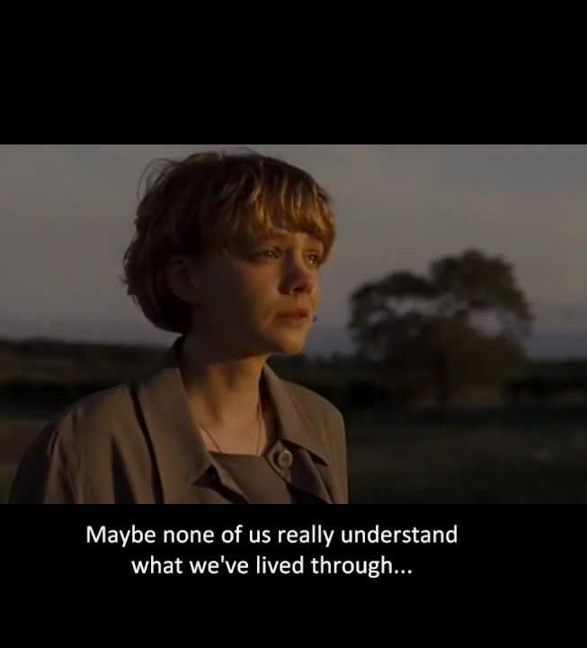
However, despite the terrible fate that awaits her, Kathy refuses to sacrifice her own sense of self.
At the end of the novel Kathy is about to begin her donations and she knows she will soon die. The entire novel is Kathy’s reflection on what has been important and valuable in her life: friendship, love and creativity.
It is clear that no matter what society thinks of her, Kathy is an individual who is sustained by her precious memories of all the experiences and relationships that have made her who she is.

Slide 13
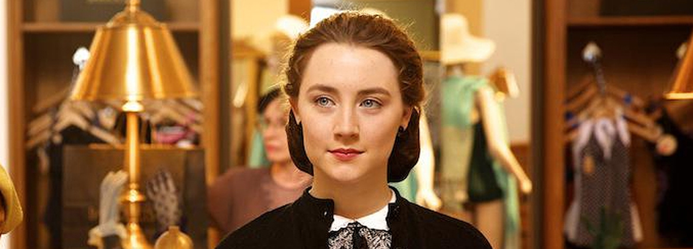
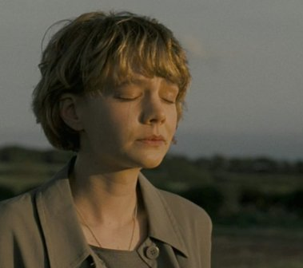
‘Brooklyn’ + ‘Never Let Me Go’
Eilis is more successful than Kathy in establishing her identity and becoming a happy and fulfilled individual. Of course, Eilis has a chance of a future and a long, happy life, so she is not subjected to the same restrictions as Kathy.
The only antagonistic force determined to deny Eilis her chance to be who she wants to be is Miss Kelly. However, Miss Kelly is nit as powerful as the entire weight of society in ‘Never Let Me Go’.

Slide 14
Eilis is more than strong enough to stand up to Miss Kelly and return to America to be with the man she loves. As a result, the ending of the film is much more positive than the novel in establishing the central character’s identity. Kathy is left with her treasured memories, which are some consolation, but they are no substitute for a situation like Eilis’s.
Eilis is successful in becoming the person she wants to be, and the happy ending of the film convinces us that she has made the right decision and is living life on her own terms.

Slide 15
‘Eclipsed’ + ‘Brooklyn’ + ‘Never Let Me Go’
The ending of the play ‘Eclipsed’ is more similar to ‘Never Let Me Go’ than it is to ‘Brooklyn’ because it seems to say societal pressures can deny a person or group pf people a chance of establishing their identity.
However, the characters in the play are even less successful in coming to terms with who they are than the characters in the novel. At least Kathy is left with her happy memories, which make life worth living, but the same cannot be said for the characters in ‘Eclipsed’.

Slide 16
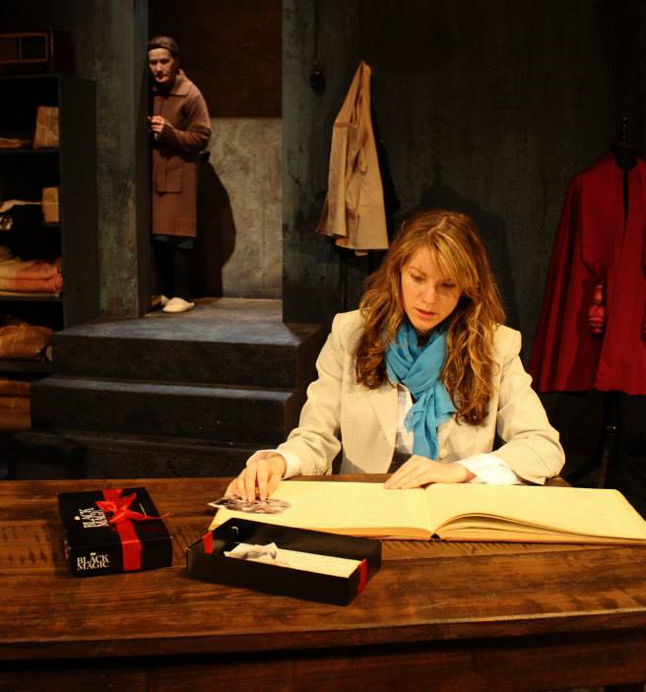
This is made clear by the return of Rosa and Nellie-Nora in the final scene. Rosa is struggling with the realisation that she will probably never learn more about her mother than she already has. All she is left with is a baby photo that is not even of her.
Far from reaching a resolution in her search for all the details about who she is and where she comes from, Rosa is left confused and saddened by the visit.

Slide 17
As she leaves, Rosa invites Nellie-Nora to visit, but the older woman is terrified to leave the only home she has ever known.
The cruel legacy of the laundry lives on in Rosa’s unfulfilled longing to know exactly who she is and Nellie-Nora’s sad acceptance that she has been so shaped by institutional life that she will never be anything more than one of the ‘eclipsed’ women.
Unlike Eilis in ‘Brooklyn’, the women in the play have no happy resolution of their quest to establish their identity, nor are they left with even the peace of mind that Kathy has when she reflects on what has made her who she is.

