Slide 1
Theme of Identity ‘Eclipsed’
By Patricia Burke Brogan

Slide 2
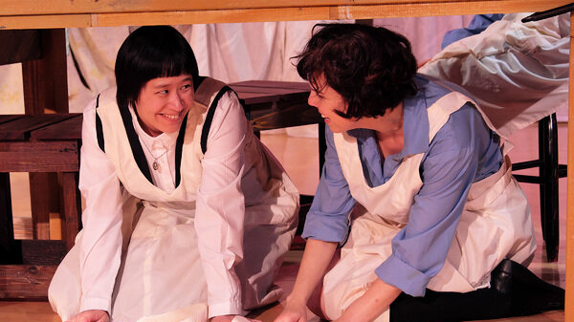
The play opens with Rosa, Brigit’s daughter, visiting the former Magdalene laundry in order to find out as much as she can about her birth mother.
She explains to Nellie-Nora that when she found Brigit’s name and the address of the laundry, she “had to come”.
Identity – having a sense of where one has come from and where one is going – is a central theme in the play.
Through Rosa’s quest, we are brought back in time to 1963, when Brigit, Nellie-Nora and the other unmarried mothers were held as virtual prisoners in the laundry, out of sight of the rest of the community.

Slide 3
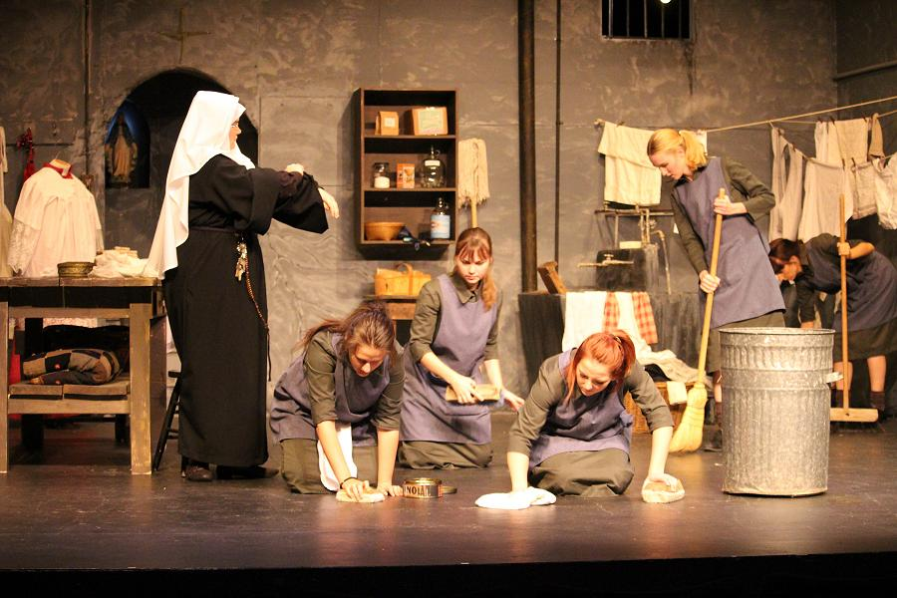
The women in the laundry are regarded as inferior to the general population. Once they enter the laundry, the women are “eclipsed”. They are hidden from view and cast into the shadows because they are seen to have broken the rules of the society in which they live.
They no longer have an identity. Even if they were to escape, they are forever marked because they are identified as “fallen women”, and their individual stories do not matter compared to their lowly status.
When Cathy returns after her failed escape, she says that children in the community “pointed at me, laughed and called me names.”

Slide 4
In order to escape the dreadful hopelessness of their lives, some of the women retreat into a fantasy world in which they are different people.
Mandy believes that Elvis will visit her and allows herself to dream they will be married. The other women in the laundry encourage Mandy in her dream. After all, if she can be a different person, so can they.

Slide 5
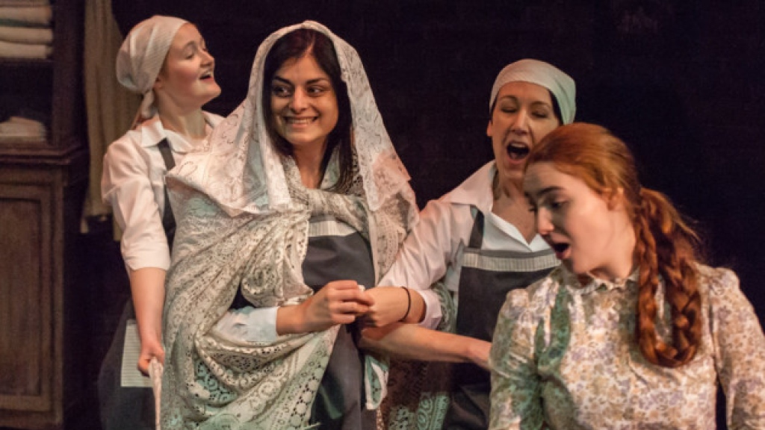
Brigit alone resists the impulse to retreat into a fantasy world of a different identity. She may be willing to play along to some extent, pretending to be the Bishop and imitating his condescending manner, but she avoids losing herself in visions of a happier, romantic version of herself.
Ultimately, Brigit insists on facing the harsh reality of her life and who she is. When Mandy writes a letter to Elvis, Brigit forces her to face the fact that her return address is “Saint Paul’s Home for Penitent Women! Home for the unwanted! The outcasts! Saint Paul’s Home for the women nobody wants!”

Slide 6
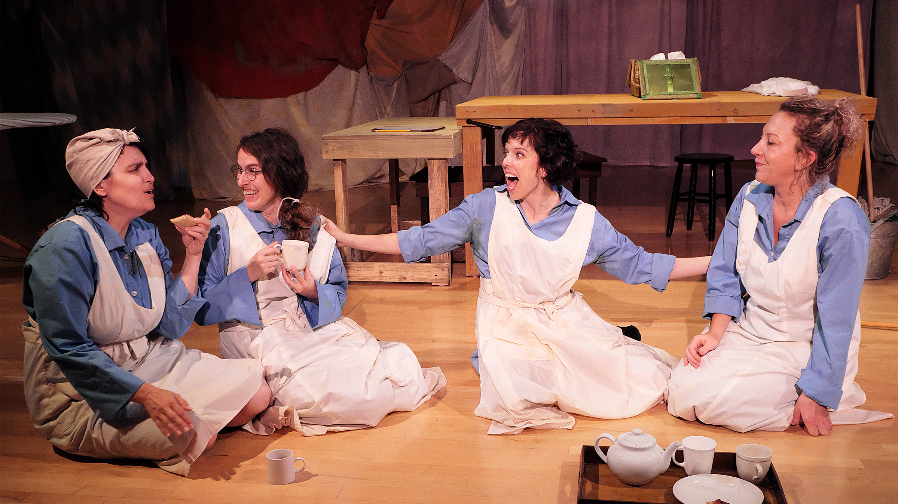
Cruelly, Brigit tells Mandy that Elvis will have no interest in her once he knows who she really is. Although Brigit repents of her harshness and tries to make up for it by indulging Mandy in her dream of being Elvis’s girlfriend, she maintains her own fierce sense of identity and this fuels her determination to leave the laundry and not give in to a life of slavery.

Slide 7
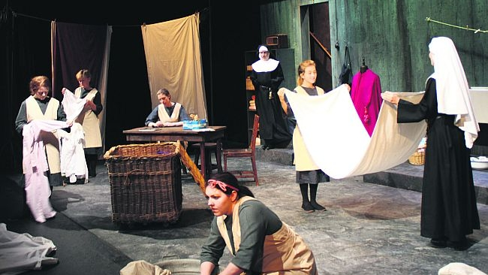
The arrival of 17 year old Juliet reinforces the idea that life in the confined setting of an orphanage or laundry will shape a person so thoroughly that their identity will be forever tied to the institution.
Sister Virginia tries to encourage Juliet to consider a life in the outside world, but Juliet recoils in horror at the prospect.
She is as much a part of convent life as if she were a nun, telling Sister Virginia, “My mammy lived here until she died. I want to stay in here.”
Sister Virginia recognises that Juliet has no real sense of who she is or what she could become, but she fights a losing battle in her efforts to persuade the frightened, immature girl to seek a life in which she could develop her potential and be independent.

Slide 8
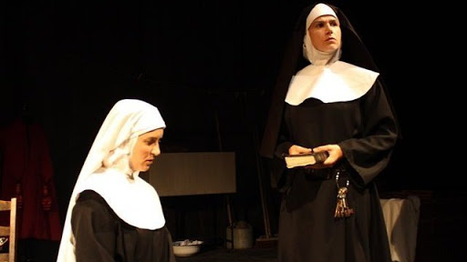
Sister Virginia also struggles with an identity crisis. She is a white-veiled novice nun, torn between being an obedient servant of the Catholic Church and, on the other hand, expressing her true feelings. As she prays for guidance, she hears the voices of Brigit and the other women in her head, but she also hears the voice of Mother Victoria reminding her that she has taken a vow of “Blind Obedience”.
The idea of such a vow is to submit one’s will and sense of self entirely to God and – more importantly in Mother Victoria’s view – to submit to the orders of the nun in charge.

Slide 9
Sister Virginia worries that if she stays too long in the laundry, she will eventually become “Brain-washed” and “dehumanised”.
Mother Victoria believes the solution to such doubts about religious life is to completely abandon one’s identity and become an unquestioning servant of God.
She reminds Sister Virginia that “We are Eclipsed” and that she must work hard to change herself and get rid of her pride and independent thought.

Slide 10
When Mother Victoria discovers that Sister Virginia has written to the Bishop urging him to see for himself the cruel treatment of the women in the laundry, she is shocked and furious. Her response is to refuse Sister Virginia permission to see her brother when he visits the convent to say Mass.
Mother Victoria believes that by isolating and punishing Sister Virginia in much the same way that the women in the laundry are isolated and punished, she will eventually bend to her will and accept her new identity as an unquestioning member of the religious order.

Slide 11
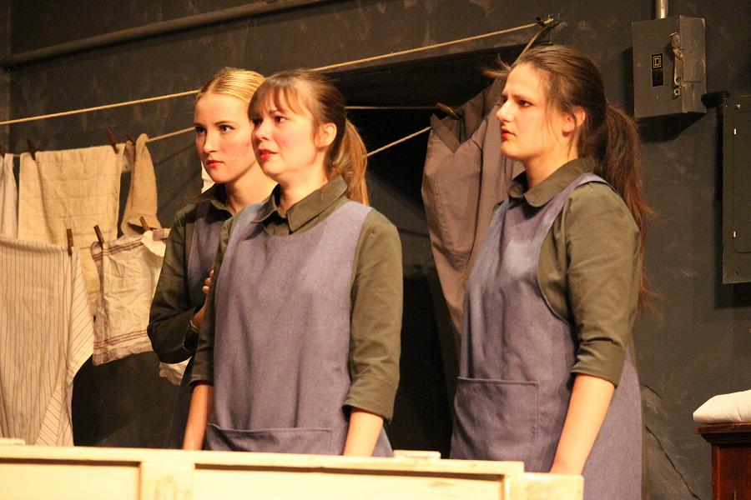
Sister Virginia tries to do as Mother Victoria asks but her strong sense of who she is, and what she thinks is right, wins out in the end.
Brigit plays a role in making Sister Virginia face up to what she is in danger of becoming. Aggressively, she accuses Sister Virginia of being as bad as “the rest o’ them” and says that she keeps the women locked up so they will “forget about living” while their heads go “soft and mushy from hymns and prayers.”

Slide 12
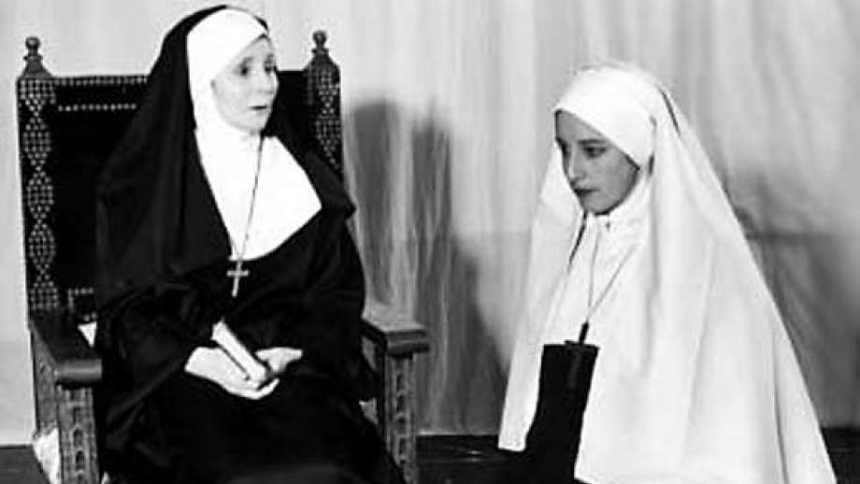
The turning point for Sister Virginia comes when she learns of Cathy’s death during her attempt to escape. She gives into Brigit’s demand to hand over the keys and as Brigit leaves, she accuses Sister Virginia of being dead inside.
Although we never learn Sister Virginia’s fate, the implication is that she eventually leaves the convent and becomes her own person once more in the outside world.

Slide 13
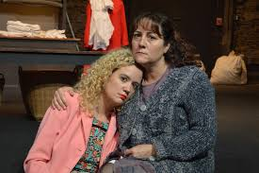
At the end of the play, we meet Rosa again. She is struggling with the realisation that she will probably never learn more about her mother than she already has.
Nellie-Nora tells Rosa that the photograph on which Brigit wrote “My baby, Rosa” is just a picture she found in a pocket of some clothes she was washing.
Far from reaching a resolution in her quest for learning all the details about who she is and where she came from, Rosa is left confused and saddened by the visit: “So – It’s not – me. A paper-baby? She called me Rosa! Everyone calls me Caroline.”

Slide 14
All Rosa can do is take the picture and the consolation Nellie-Nora offers that Brigit loved her and wanted to find her.
As she leaves, Rosa invites Nellie-Nora to visit, but the older woman is terrified at the thought, saying she rarely goes out.
The cruel legacy of the laundry lives on in Rosa’s unfulfilled longing to know exactly who she is and Nellie-Nora’s sad acceptance that she has been so shaped by institutional life that she will never be anything more than one of the “eclipsed” women.

