Slide 1
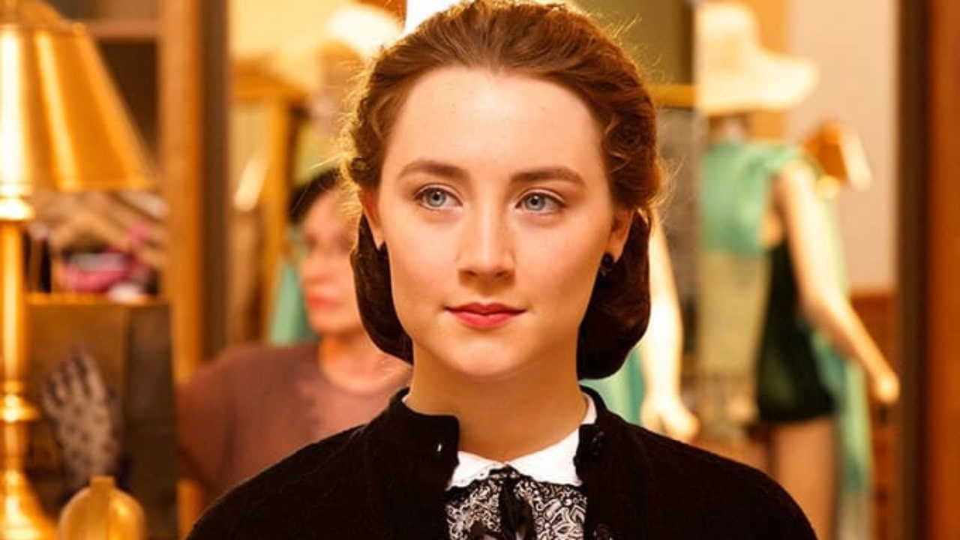
Theme of Identity ‘Brooklyn’
Directed by John Crowley

Slide 2
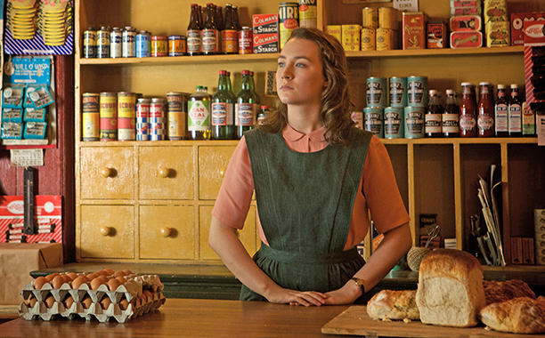
Eilis sees little future for herself in Enniscorthy. She has no proper job, only part-time work in the local grocery, and she finds the local social scene depressingly limited. Her beautiful friend, Nancy, is desperately hoping to catch the attention of a boy from the rugby club, which makes Eilis despair of her hometown. She feels instinctively that the world has more to offer than this.

Slide 3
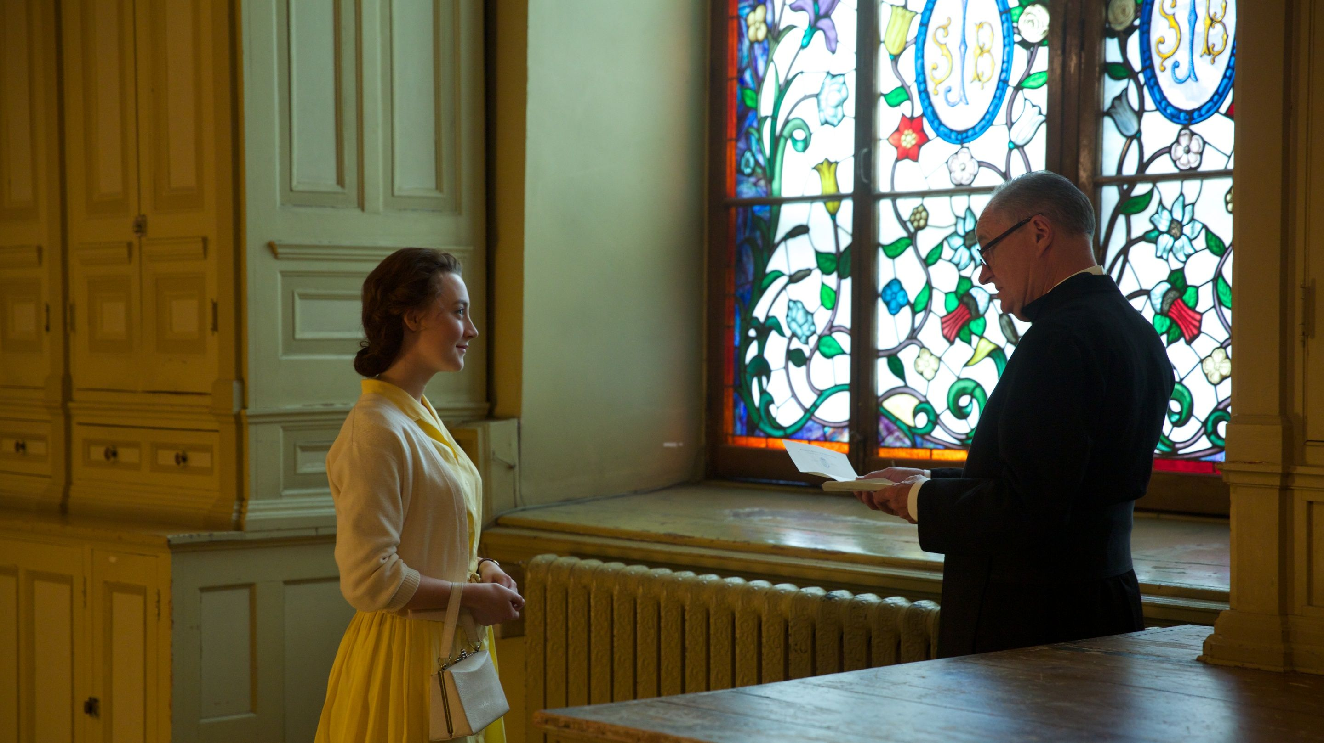
Eilis’s chance to have a new future and a new life appears in the form of a ticket to America. Her sister, Rose – through her friend Father Flood- has organised a job for her there and Eilis sails to New York to begin afresh.
At first, Eilis struggles with her identity. When Father Flood tries to comfort her during a bout of homesickness by telling her that Brooklyn needs Irish girls like her, she says that she can’t help wanting to be “an Irish girl in Ireland”.
Father Flood arranges a bookkeeping course for her and Eilis excels in her studies.

Slide 4
She also finds love in the form of Tony Fiorello, an Italian-American plumber.
It appears that Eilis has become a happy, successful Irish-American whose future lies in New York. Father Flood says she is not the “miserable young girl who wanted to go home last winter”. Even her employer notices a change in her, saying she is a “different person” and Eilis happily agrees.

Slide 5
Eilis’s life is turned upside down by the sudden death of her sister. She feels she must return to Ireland with her mother for a while. Tony fears that, once there, she will forget him and her new life in America. As he says, “Home is home”. In an effort to ensure that she returns, Tony persuades Eilis to marry him in secret before she leaves.

Slide 6
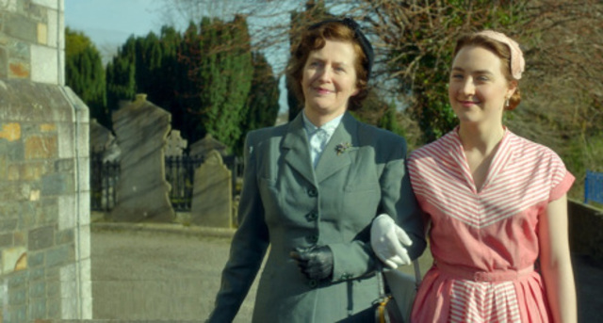
Once back in Ireland, Eilis’s life becomes very complicated. It seems as if her mother, her friends and all the townspeople have conspired to convert her back to an Irish girl with a future in her home town.
She finds herself being swept along on a tide of organisation and plotting and before long she has taken over her sister’s office job and is being courted by the eligible and charming Jim Farrell.
Eilis’s newfound independence and courage mean that she is no longer the shy girl who left Enniscorthy and she is therefore able to make the most of her life there.
She thinks that Ireland has changed, telling Jim that there was no future for her when she left, but in reality it is Eilis who has changed.

Slide 7
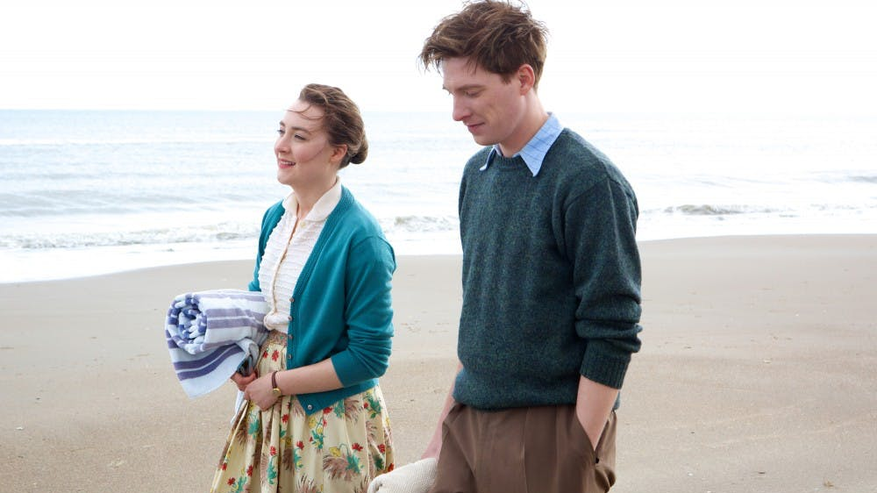
Eilis’s life with Tony in Brooklyn now seems a distant memory. She stops opening his letters as she becomes more and more drawn into work and her social life.
Her mother is clearly delighted with this turn of events and hopes Eilis will stay at home for good.
The expectations of those around her, including Jim and his family, are a sort of gentle pressure and Eilis finds herself conforming to their ideas.
Her American identity is gradually eroded. Jim tells her that he wants her to stay in Ireland, with him, and Eilis replies, “It’s just… I had imagined a different life for myself”. Jim understands, but he tells her, “Your life here could be just as good. Better, even, maybe.”

Slide 8
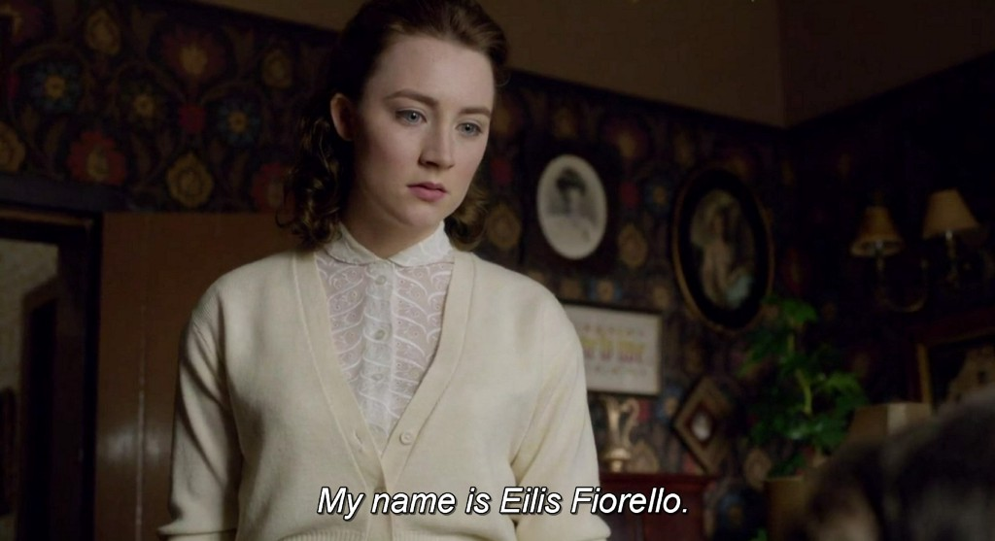
Eilis does not know what to do and is unsure who she is or who her future self might be. Her decision is helped, oddly, by the spiteful Miss Kelly, who tells Eilis that she has heard of her marriage in New York. She is delighted to have the chance to ruin Eilis’s life, and this enables Eilis to see clearly for the first time since she came home.
She tells Miss Kelly that she had forgotten what life was really like in Ireland, stands up to go and says proudly and defiantly, “My name is Eilis Fiorello.”
Stating her identity in this way clarifies everything for Eilis and she immediately books a sailing back to New York. She tells her mother about Tony and admits, through tears, “I want to be with him. I want to be with my husband.”

Slide 9
On the ship back to America, Eilis gives advice to a young girl who is emigrating from Ireland and planning to live in Brooklyn.
Her advice provides the voice-over for her reunion with Tony.
As they embrace delightedly, we hear Eilis’s final words to the girl, telling her that someday she will meet a person “who has no connection with the past, someone who’s only yours, and you’ll realise that this is where your life is.”

