Slide 1
Robert Frost
The Tuft Of Flowers

Slide 2
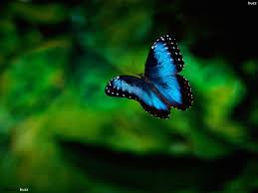
The Tuft of Flowers
The speaker comes to a field to turn the grass another man has cut.
Before beginning his work, the speaker looks for the mower but he is already gone. The speaker resigns himself to the fact that he must get on with his work alone, just as the mower had to do.
He is left feeling dejected and comes to the conclusion that we are all ultimately alone.
However, just as he thinks this a butterfly goes by and distracts him.

Slide 3
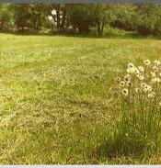
The Tuft of Flowers
The speaker watches the butterfly and it brings a tuft of flowers to his attention.
He realises that the mower did not cut them down because he thought they were beautiful and they gave him great joy.
The flowers inspire the speaker and he begins to think differently about his circumstances. The fact that the mower spared the flowers makes him a kindred spirit.
He has made a connection with this man even though he has never met him and this changes his opinion on man’s condition.
Now he believes men always work together, whether together or apart.

Slide 4
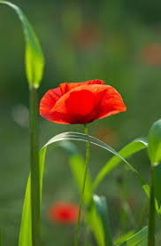
THEMES
Nature
This poem celebrates the beauty and power of the natural world. The speaker is inspired and delighted by the beauty of the flowers.
In a vivid image he describes the flower’s dramatic colours in terms of flames leaping from the ground: “A leaping tongue of bloom”.
The mower too had appreciated the beauty of the natural world. He decided to spare the tuft of flowers because the sight of them made him feel good.

Slide 5
THEMES
Nature
The natural world consoles the speaker, allowing him to get over his gloomy mood.
Before spotting the flowers he had been preoccupied with his own thoughts, thinking about “questions that have no reply”.
However, once he sees them he suddenly engages with the world around him and his eyes are opened to all the beauty in nature.

Slide 6
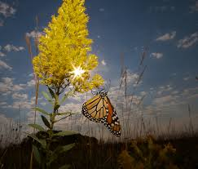
THEMES
Nature
The natural world also acts a guide for the speaker. The butterfly draws the speaker’s attention to the flowers and is ultimately responsible for the speaker overcoming his sad mood.
The tuft of flowers acts as a “message from the dawn”, or a signal that others share his appreciation of beauty. The flowers allow the speaker to overcome his loneliness.
They teach him the lesson that nobody is truly alone in this world.

Slide 7
THEMES
Isolation and Community
The speaker’s initial loneliness and isolation leads to a rather depressing conclusion regarding the human condition, stating that all must be alone.
As such, he denies the concept of community, of people working together to enrich each other’s lives and suggests we are solitary beings, concerned with only our own lives.
However, the discovery of the flowers changes the speaker’s mind.

Slide 8
THEMES
Isolation and Community
The mower clearly appreciated the beauty of the flowers, as does the speaker. They experience the same joy.
These flowers give the speaker a sense of community and shows him how the actions of others have a bearing on our lives.
The mower’s decision to spare the flowers has enriched the speaker’s day and allowed him to overcome his loneliness.
In the end, he must acknowledge that we cannot operate independently from others and that all “men work together … Whether they work together or apart”.

Slide 9
LANGUAGE
Vivid Imagery:
This poem features vivid and beautiful nature imagery. Nature not only acts as a guide for Frost but its beauty also lifts his spirits and allows him to appreciate the beauty of the world: “A leaping tongue of bloom”.
Can you think of another example?

Slide 10
LANGUAGE
Mood:
The poem begins with a mournful mood or atmosphere as the poet struggles to come to terms with his loneliness and dwells on deep questions that “have no reply”. This depressed mood is also reinforced by the image of the butterfly searching for the flower that has been cut down.
However, there is a change of mood which is signalled by the repetition of the word “turned”. With the appearance of the tuft of flowers the mood/atmosphere changes dramatically. The poet seems renewed and the mood becomes hopeful rather than despairing.
The imagery also reinforces this turn in mood as the field seems to come alive with the dramatic colour of the flowers and the sound of the birds singing in the trees.

Slide 11
Questions
Describe the speaker’s view of life as expressed in lines 8 – 10.
What effect does the appearance of the butterfly have upon the speaker?
“I thought of questions that have no reply”. What sort of questions “have no reply”? What sort of mood is the speaker in?
Though he is still the only person in the field, why does the speaker say at the end that he “worked no more alone”?

Slide 12
Questions
Describe the theme of this poem and explain your personal response to it. Use quotes to provide evidence.
How did Frost’s use of language (poetic techniques, style etc.) help bring the poem to life for you?

