Slide 1
The Soul’s Loneliness
Brendan Kennelly

Slide 2
People’s names and place names – common features of Kennelly’s poetry – are absent from this poem.
Rather, he presents us with a lucid, meditative poem about the speaker’s search for meaning in life.
The title and form seem to contradict each other.
Its title recalls Romantic- era poetry: it is literal and vulnerable.
The form of the poem, however, is distinctly modern: 15 lines written in five tercets, it opens with a small letter and its only full stop is at the very end.
All of which makes it a challenging work, atypical of the poet, and a poem which rewards multiple readings.

Slide 3
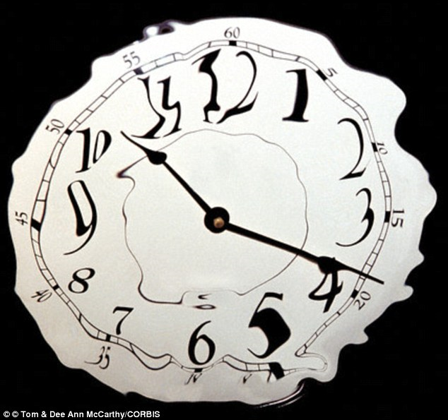
The speaker seems to be milling about town, mulling over his ideas.
“its nothing to go on about,” he begins, using a familiar ironic tone.
Despite this opening statement he very much intends to expand on the poem’s title.
This verse is rich with the assonance we’ve come to expect from Kennelly: “…when I hear it / in the ticking…” he continues, giving the soul mechanical characteristics.
Use of the first person viewpoint adds an immediacy to the tone – one which is retained and reinforced throughout.

Slide 4
This poem is notable for how it evokes three of the five senses – at first we hear, and in the second stanza the poet tells us about what he sees.
Pondering his soul’s loneliness he can “… see it in the shine ? Of an Eason’s plastic bag…”, the soft sibilance highlighting his solitude.
His reference to a well-known Irish bookshop is his only specific reference to setting here; even when Kennelly is focussed on interior feelings he is aware of his place in the exterior world.
This shows us the broad view the poet has on his spirituality; it is not something that he simply feels, but instead it is something that is shaped by the world he is living in.

Slide 5
The soul’s loneliness cannot only be heard or seen in the world around him but in religion too, when the speaker comments he can “touch it in the tree I call / Christ.”
Kennelly is taking the abstract idea of the title and making it concrete.
At this point, the rhythm of the poem changes as Kennelly introduces rhyme.
This creates a sense of order.
Perhaps he is coming to some conclusion about what form his questions must take. “… there outside my window / swaying in the day’s afterglow…”

Slide 6
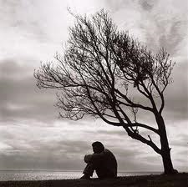
Many of Kennelly’s studies poems use enjambment, and here he employs the technique again.
The fourth stanza merges the ideas of the previous three – the speaker’s focus.
“ I shiver a little at the strangeness,” he writes, again stressing his isolation with sibilance, before running this line into the next: “of my flesh, the swell of sweat,” creating an unappealing, intense atmosphere.

Slide 7
These images of the skin and perspiration haunt Kennelly; he is deeply uneasy as he considers his morality, and it feels like he doesn’t recognise himself.
In the 12th line Kennelly is revitalised by a memory of the “child’s poem I’ll never forget.”
This moment seems to inspire him to reconnect with himself as the poem moves to a conclusion.
This is why enjambment is so significant; it encourages students to continually look backwards and forwards to discover new meanings in his poetry.

Slide 8
He concludes his poem with some certainty, if not quite fully satisfied.
We see the speaker in the final stanza “searching the floor / for a definition of grace,” and we understand from this second religious image that he has been on a journey, a mission of sorts, to express the melancholy of the poem’s title.
He has mentioned home, the streets, his childhood – now perhaps he has returned home, though significantly home is not named.

Slide 9
Perhaps this is because the poet’s journey is more spiritual that literal, and a reference to Dublin or Kerry would add little here.
Ultimately, he seeks to find “a trace if yourself I’ve never noticed before”.
We are left to interpret this ending freely but I believe that the journey exploring the soul’s loneliness is more important to the poet than defining or placing it in a single location.

