Slide 1
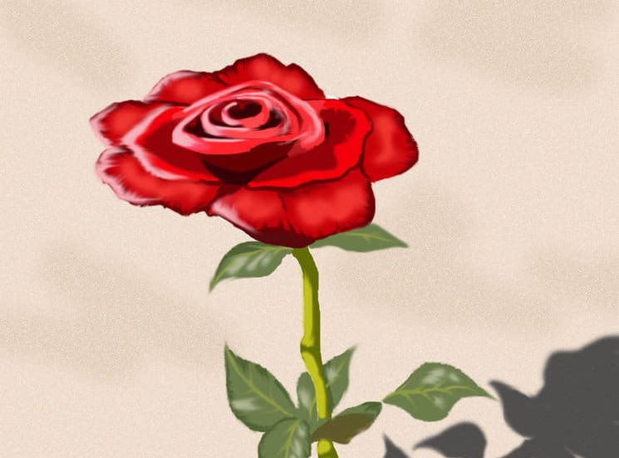
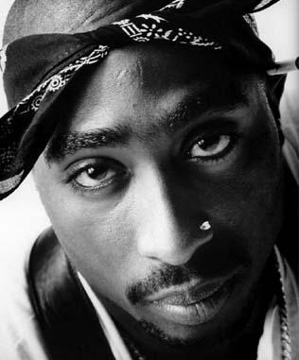
The Rose that Grew from Concrete
Tupak Shakur
This Photo by Unknown Author is licensed under CC BY-SA
This Photo by Unknown Author is licensed under CC BY

Slide 2
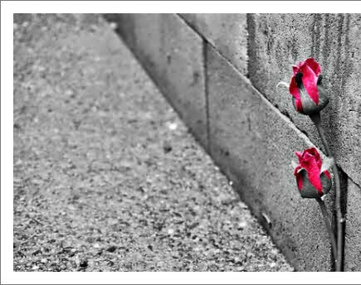
Poem
Did you hear about the rose that grew from a crack in the concrete? Proving nature's law is wrong it learned to walk with out having feet. Funny it seems, but by keeping its dreams, it learned to breathe fresh air. Long live the rose that grew from concrete when no one else ever cared.
This Photo by Unknown Author is licensed under CC BY-NC-ND

Slide 3
Summary
The Rose that Grew from the Concrete by American rapper Tupac Shakur is about reaching our goals in life despite the hardships and conflicts that we face on the way. The poem is highly inspirational and motivating the readers to focus and realize their dreams to make them come true.

Slide 4
The poet begins the poem with a question that whether we have heard about the rose that has grown out from a crack in the concrete. Refuting the laws of nature, the rose has learnt how to walk without having feet. Although it seems funny, but by focusing and realizing his dreams, it finally learnt to survive by breathing the fresh air around him.
The lack of care and surrounding did not prove to bring hindrance to the rose’s growth. In the last lines, the poet expresses support by saying ‘long live’ and he claims that as the rose focused on keeping his dreams, it was able to live a long life.

Slide 5
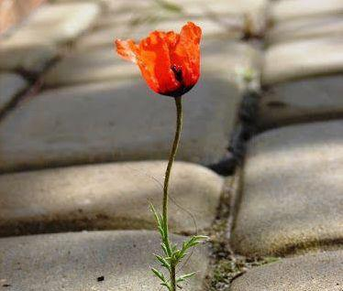
Symbolism:
Symbols or symbolism is an artistic expression used in poetry to express mystical ideas, emotions and states of mind. The poem, The Rose that Grew from the Concrete, is about a rose that grows from a crack in the concrete. Tupac uses symbolism concrete symbolizes the ghetto in which he belonged. The poem, therefore symbolizes the poet’s own life.
This Photo by Unknown Author is licensed under CC BY-NC-ND

Slide 6
In this poem, the concrete symbolises the “Ghetto”, or slum area, occupied by poorer people. Crimes, scarcity, disease and violence are quite common in such an area.

Slide 7
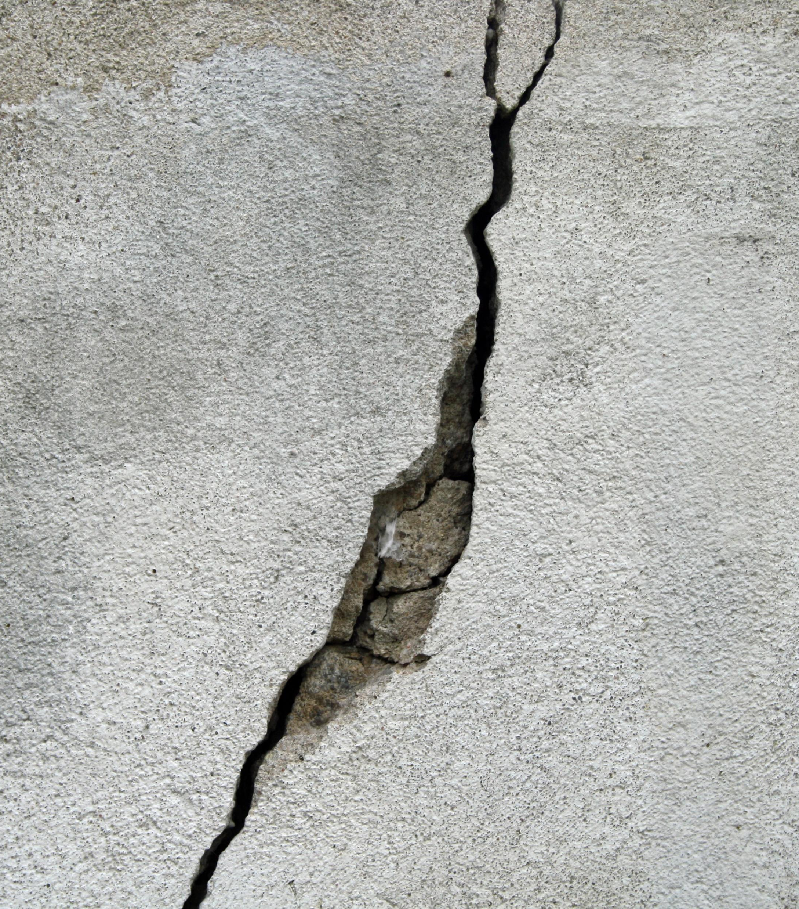
The crack could be the opportunity that is available to all of the people, but for some, it is easy to grasp, while for others, it is difficult.
Thus, the growing up from a crack in the concrete was quite difficult for the rose and symbolically growing up from the ghettos was quite difficult for the poet and would be difficult for others as well.

Slide 8
Symbolism: Nature’s Law
The rose has proven that “nature’s law is wrong”.
Nature’s law here means the way the rose existed (it needs soil, air, sunlight,

Slide 9
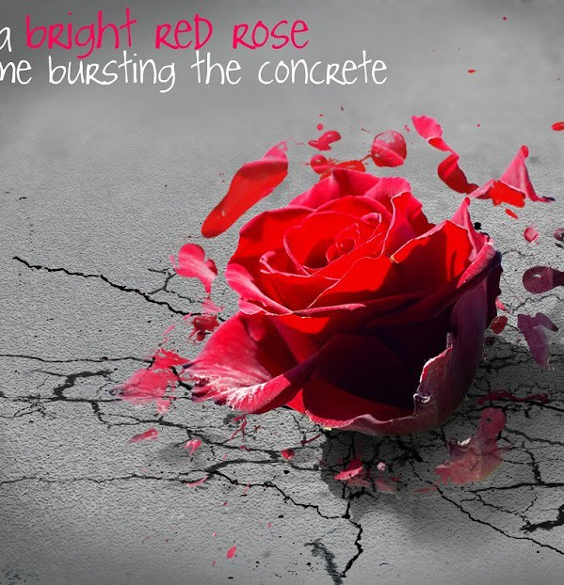
Metaphor:
A metaphor is a figure of speech in which a word or phrase is applied to an object to which it is not literally applicable.
In this poem, the rose is a metaphor for the poet himself who was able to come out of the ghetto and make something of himself.
This Photo by Unknown Author is licensed under CC BY-SA-NC

Slide 10
Alliteration:
The examples of alliteration in this poem are:
Crack in the concrete
Long live

Slide 11
Personification
The poet personifies the rose saying it can “walk”, it has “dreams” and can “breathe”.

