Slide 1
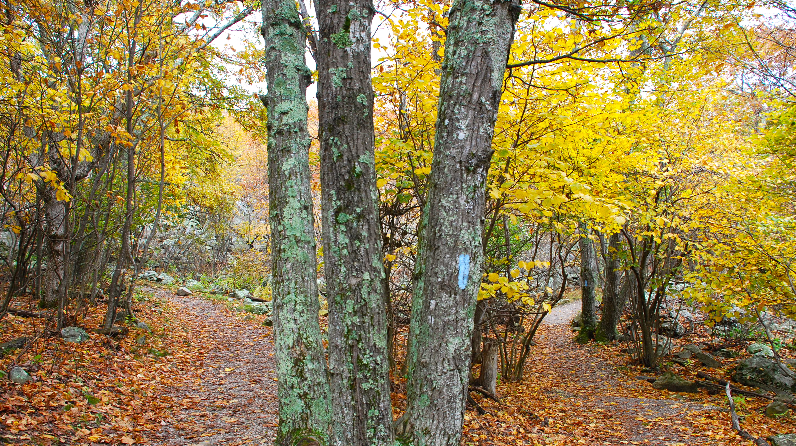
The Road not Taken By Robert Frost
Ms Deasy
This Photo by Unknown Author is licensed under CC BY-NC-ND

Slide 2
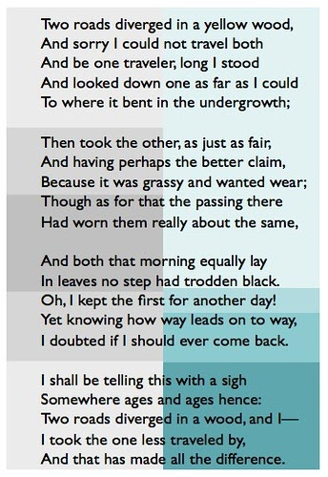
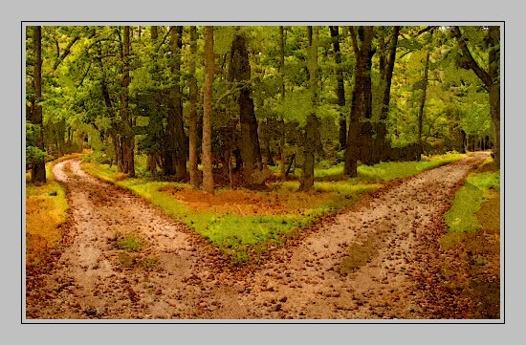
YouTube link
This Photo by Unknown Author is licensed under CC BY-NC-ND
This Photo by Unknown Author is licensed under CC BY-SA

Slide 3
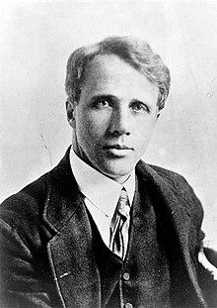
About the poet:
Robert Lee Frost (March 26, 1874 – January 29, 1963) was an American poet. His work was initially published in England before it was published in America.
Frost was honoured frequently during his lifetime and is the only poet to receive four Pulitzer Prizes for Poetry . On July 22, 1961, Frost was named Poet Laureate of Vermont . Frost was nominated for the Nobel Prize in Literature 31 times.
This Photo by Unknown Author is licensed under CC BY-SA

Slide 4
Brainstorming Activity
Sometimes the choices we make have far reaching consequences. Think about any four choices you make on daily basis, and the importance of these choices.
1.
2
3
4

Slide 5
Complete the web chart showing choices and decisions you may have to make in the next few years and the factors that affect these choices.
Choices
Friends
Interests

Slide 6
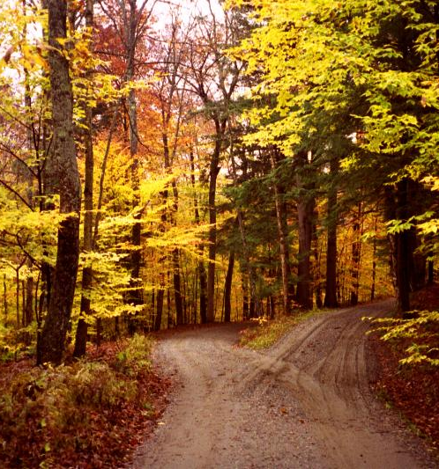
The Title
The Road’ is the symbol of the choice made by us in life. Many times we regret the choice we make but what is done once cannot be undone.
The word ‘road’ not only means ‘way’ , it also means ‘journey’ or a ‘stage of journey’. Here ‘road’ does not signify any ordinary road, but functions a metaphor of a vital decision in our life.
This Photo by Unknown Author is licensed under CC BY

Slide 7
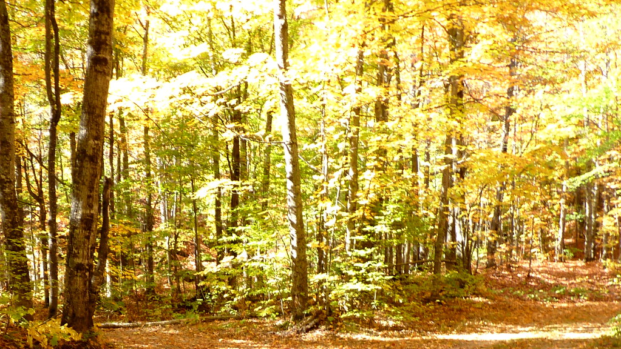
Summary
In the poem - ‘The Road Not Taken’, the road symbolizes our life. The poet says that the path that we don’t choose in our life is ‘the road not taken’. He describes his feelings about that choice that he had left in the past. The path which we have chosen, decides our future, our destination.
The important message that the poet wants to give is that the choice that we make has an impact on our future and if we make a wrong choice, we regret it but cannot go back on it. So, we must be wise while making choices.
This Photo by Unknown Author is licensed under CC BY-NC-ND

Slide 8
Looking closer:
A real road in a wood may have prompted the poem, but its appeal lies in the extended metaphor offered by the fork: The speaker is not sure which road to choose. Life is full of such dilemmas, and how we choose will affect our future.
The poem opens with a simple statement: 'Two roads diverged in a yellow wood ‘.
The speaker of the poem is suddenly faced with a choice.

Slide 9
We wonder whether the 'yellow‘ refers to an autumn wood or to his 'autumn' - was the decision one made in his middle age?
He finds the decision difficult; he is 'sorry' not to be able to experience both routes ahead but recognises the impossibility of this for 'one traveller’.
Instead, his decision takes time 'Long I stood' but he can only see so far before the way ahead is obscured by 'undergrowth’. None of us can see our future, the experiences which lie ahead of us.

Slide 10
He looks for something to help him decide, as we all do when faced with a decision, the consequences of which are unknown. He takes the 'other road', which is equally 'fair', and perhaps it seems more exciting as, at first, he says it 'wanted wear’. This indicates he made a choice most people might have found more challenging.
The last two lines of the second verse however tell us that it did not prove a less usual choice: both were equally used and 'worn'. His first impression seems to imply that he does not want to make a common choice, he sees himself as not a follower, as more individual than that.

Slide 11
He begins the third stanza by stressing both are unworn - the leaves that lie upon the roads are not ‘trodden black', so it may seem that both paths are unusual. Not many people have travelled either road.
The exclamation which opens the third line indicates what we all know - it is impossible to go back in life; both we and circumstances change; a choice has its own consequences once we make it. He recognises this - 'way leads on to way' - and it is difficult both literally and metaphorically to retrace one's steps exactly.
This Photo by Unknown Author is licensed under CC BY

Slide 12
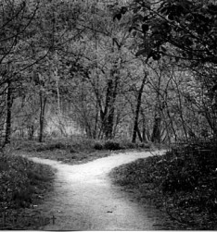
• He anticipates telling the story of his choice 'with a sigh' which seems to imply regret at this decision, but it might be a sigh of relief - it is deliberately ambiguous.
He repeats the opening line of the poems omitting only the adjective 'yellow' which provides a splash of colour in the otherwise plain poem.
He ends this line with 'I‘ and begins the fifth with 'I', perhaps stressing that he alone is responsible both for the decision and its consequences.
This Photo by Unknown Author is licensed under CC BY

Slide 13
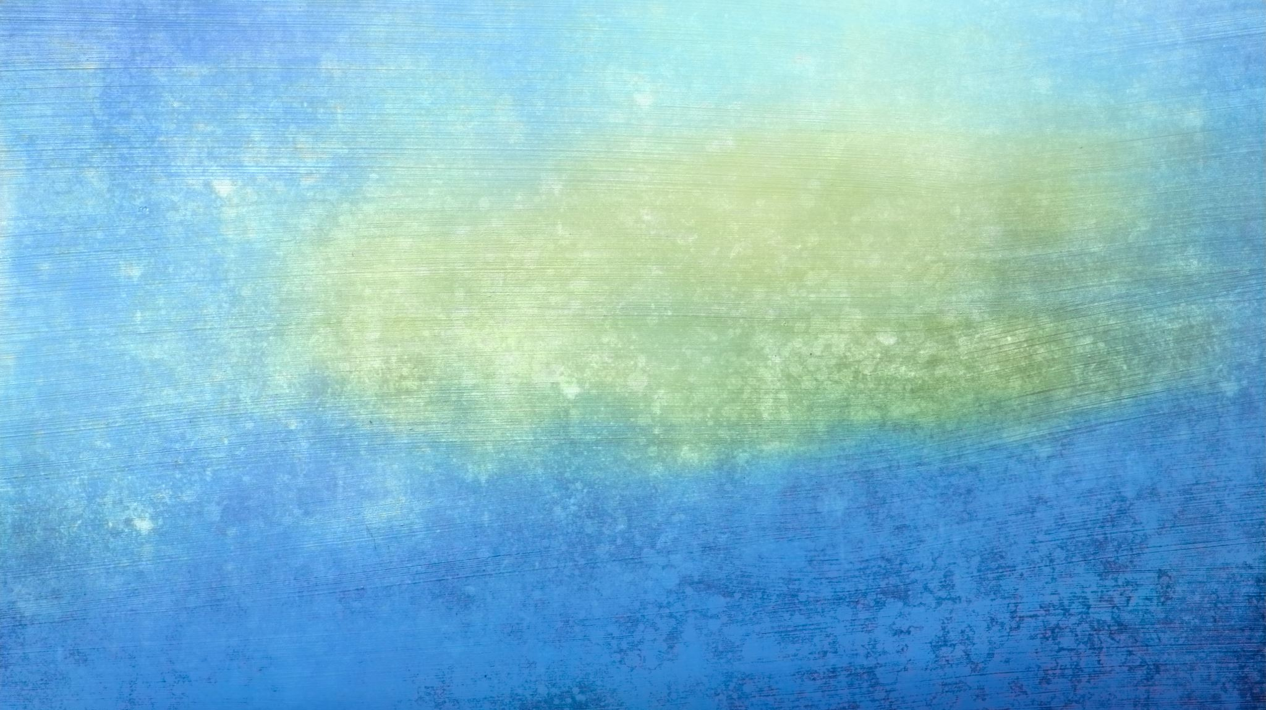
He has now decided that he did make the less usual choice - his chosen road was 'less travelled by', and it has also 'made all the difference '. It is impossible to tell if this difference was for good or ill - again Frost is deliberately ambiguous.
We know it affected his life/his journey greatly one way or another. The road not taken is a metaphor for all the opportunities missed in life.
The language the poet uses is simple and everyday. It is the central image, the extended metaphor which is striking: the fork in the road representing a decision to be made. We can all identify with this.

Slide 14
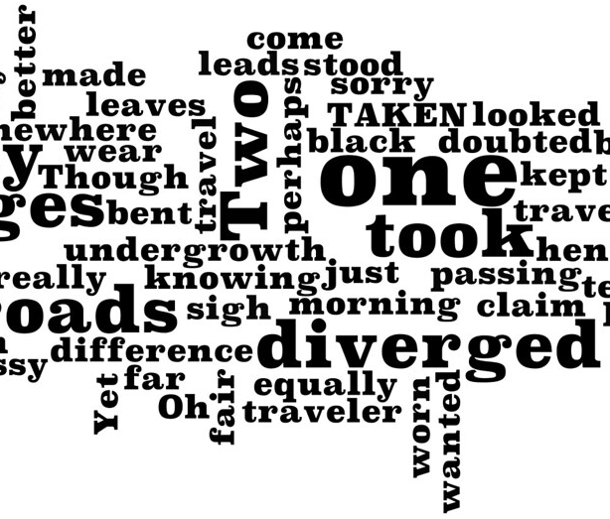
Questions
What is the message/ theme of the poem ‘The Road not Taken’?
How does one way lead to another? Is it easier to come back to the path we have left for another day?
Describe the significance of good decisions. In what manner do they support life?
This Photo by Unknown Author is licensed under CC BY-NC

