Slide 1
The Prodigal
Elizabeth Bishop

Slide 2
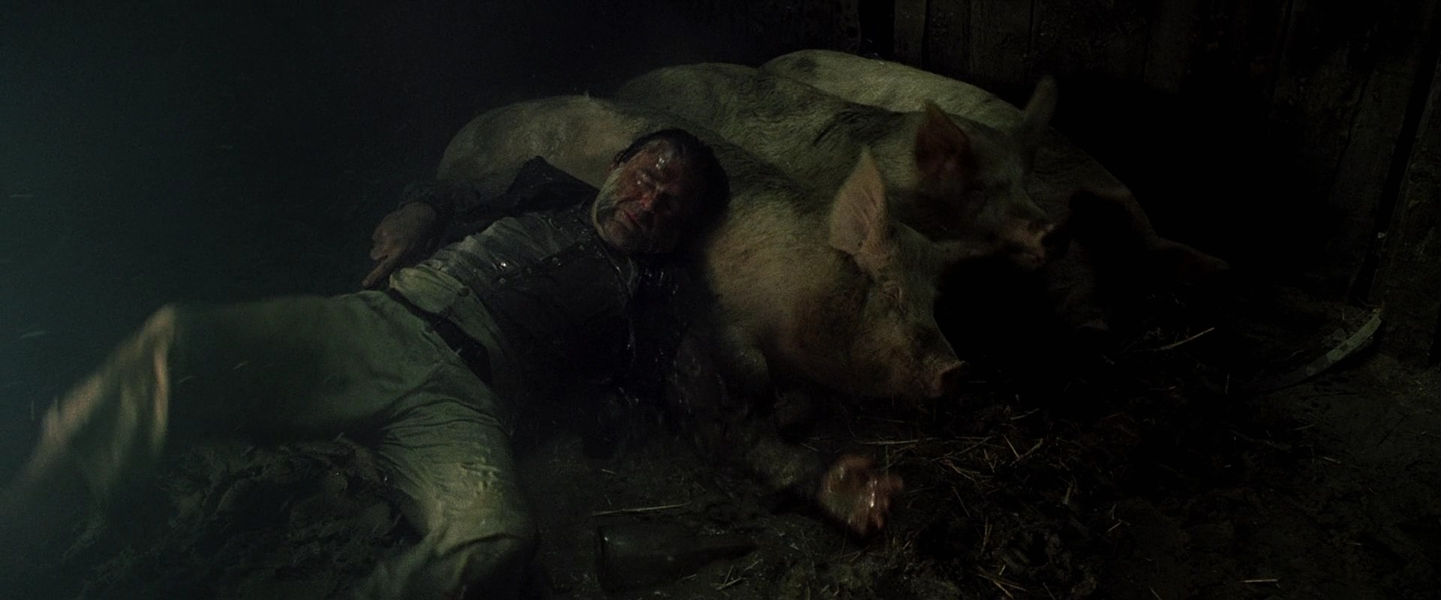

Slide 3
Based on the biblical story of the Prodigal Son.
Deeply personal poem because the poet was herself an alcoholic.
In the poet’s detailed description of the Prodigal’s miserable, meaningless existence, we see the degradation and isolation of the alcoholic.

Slide 4
Essentially positive – even the most debased human beings can rise above the dark depths of addiction and despair and achieve redemption.
Structure – two sonnets

Slide 5
Sonnet 1
Poet focusses on lowest and most repulsive part of the Prodigal’s life.
Her graphic descriptions effectively evoke a scene of depressing squalor and self-abasement.
Sensuous imagery

Slide 6
Memorable imagery:
“Glass smooth dung” – depressingly realistic
Alliterative description of the pigs “light-lashed” = memorable
The “sow that always ate her young” – memorably repulsive

Slide 7
Lying, self-deceiving nature obvious when he hides the alcohol.
But he is aware there is a brighter world outside the pigsty.
Sunrise transforms world of filth.
Prodigal is still moved by the beauty of nature.

Slide 8
Here, as in The Fish and Filling Station, the poet presents the reader with an insight into the endurance and resilience of the human spirit.

Slide 9
Sonnet 2
The BUT at the beginning signifies a change in the Prodigal’s life.
The stars warning him is as if he is being reminded of the need to take action to change the course of his life.

Slide 10
Memorable imagery:
Vivid description of the lantern (halo)
Animals are “safe and companionable as in the ark.”
Even though the animals are safe, it is clear that no human being should be reduced to living at the level of an animal.

Slide 11
Just like the sun in the first sonnet, the lantern (halo) reassures and comforts the Prodigal.
Bat’s staggering flight suggests the Prodigal’s gradual, stumbling acquisition of self-awareness.

Slide 12
Conclusion
Concludes on a positive note with the lonely exile finally returning to the love, warmth and support of his family.

Slide 13
