Slide 1
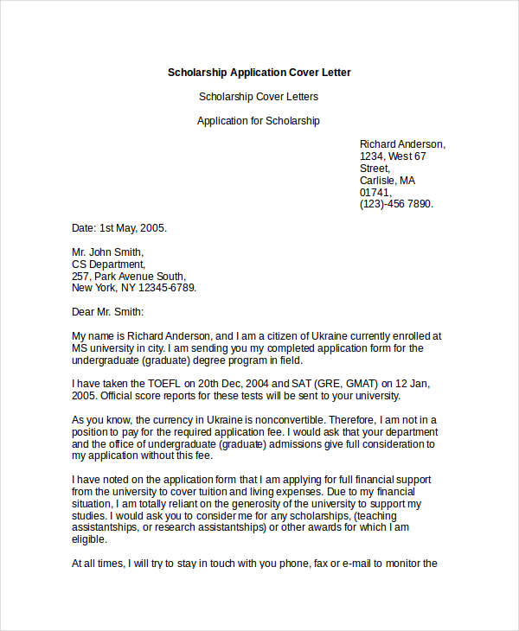
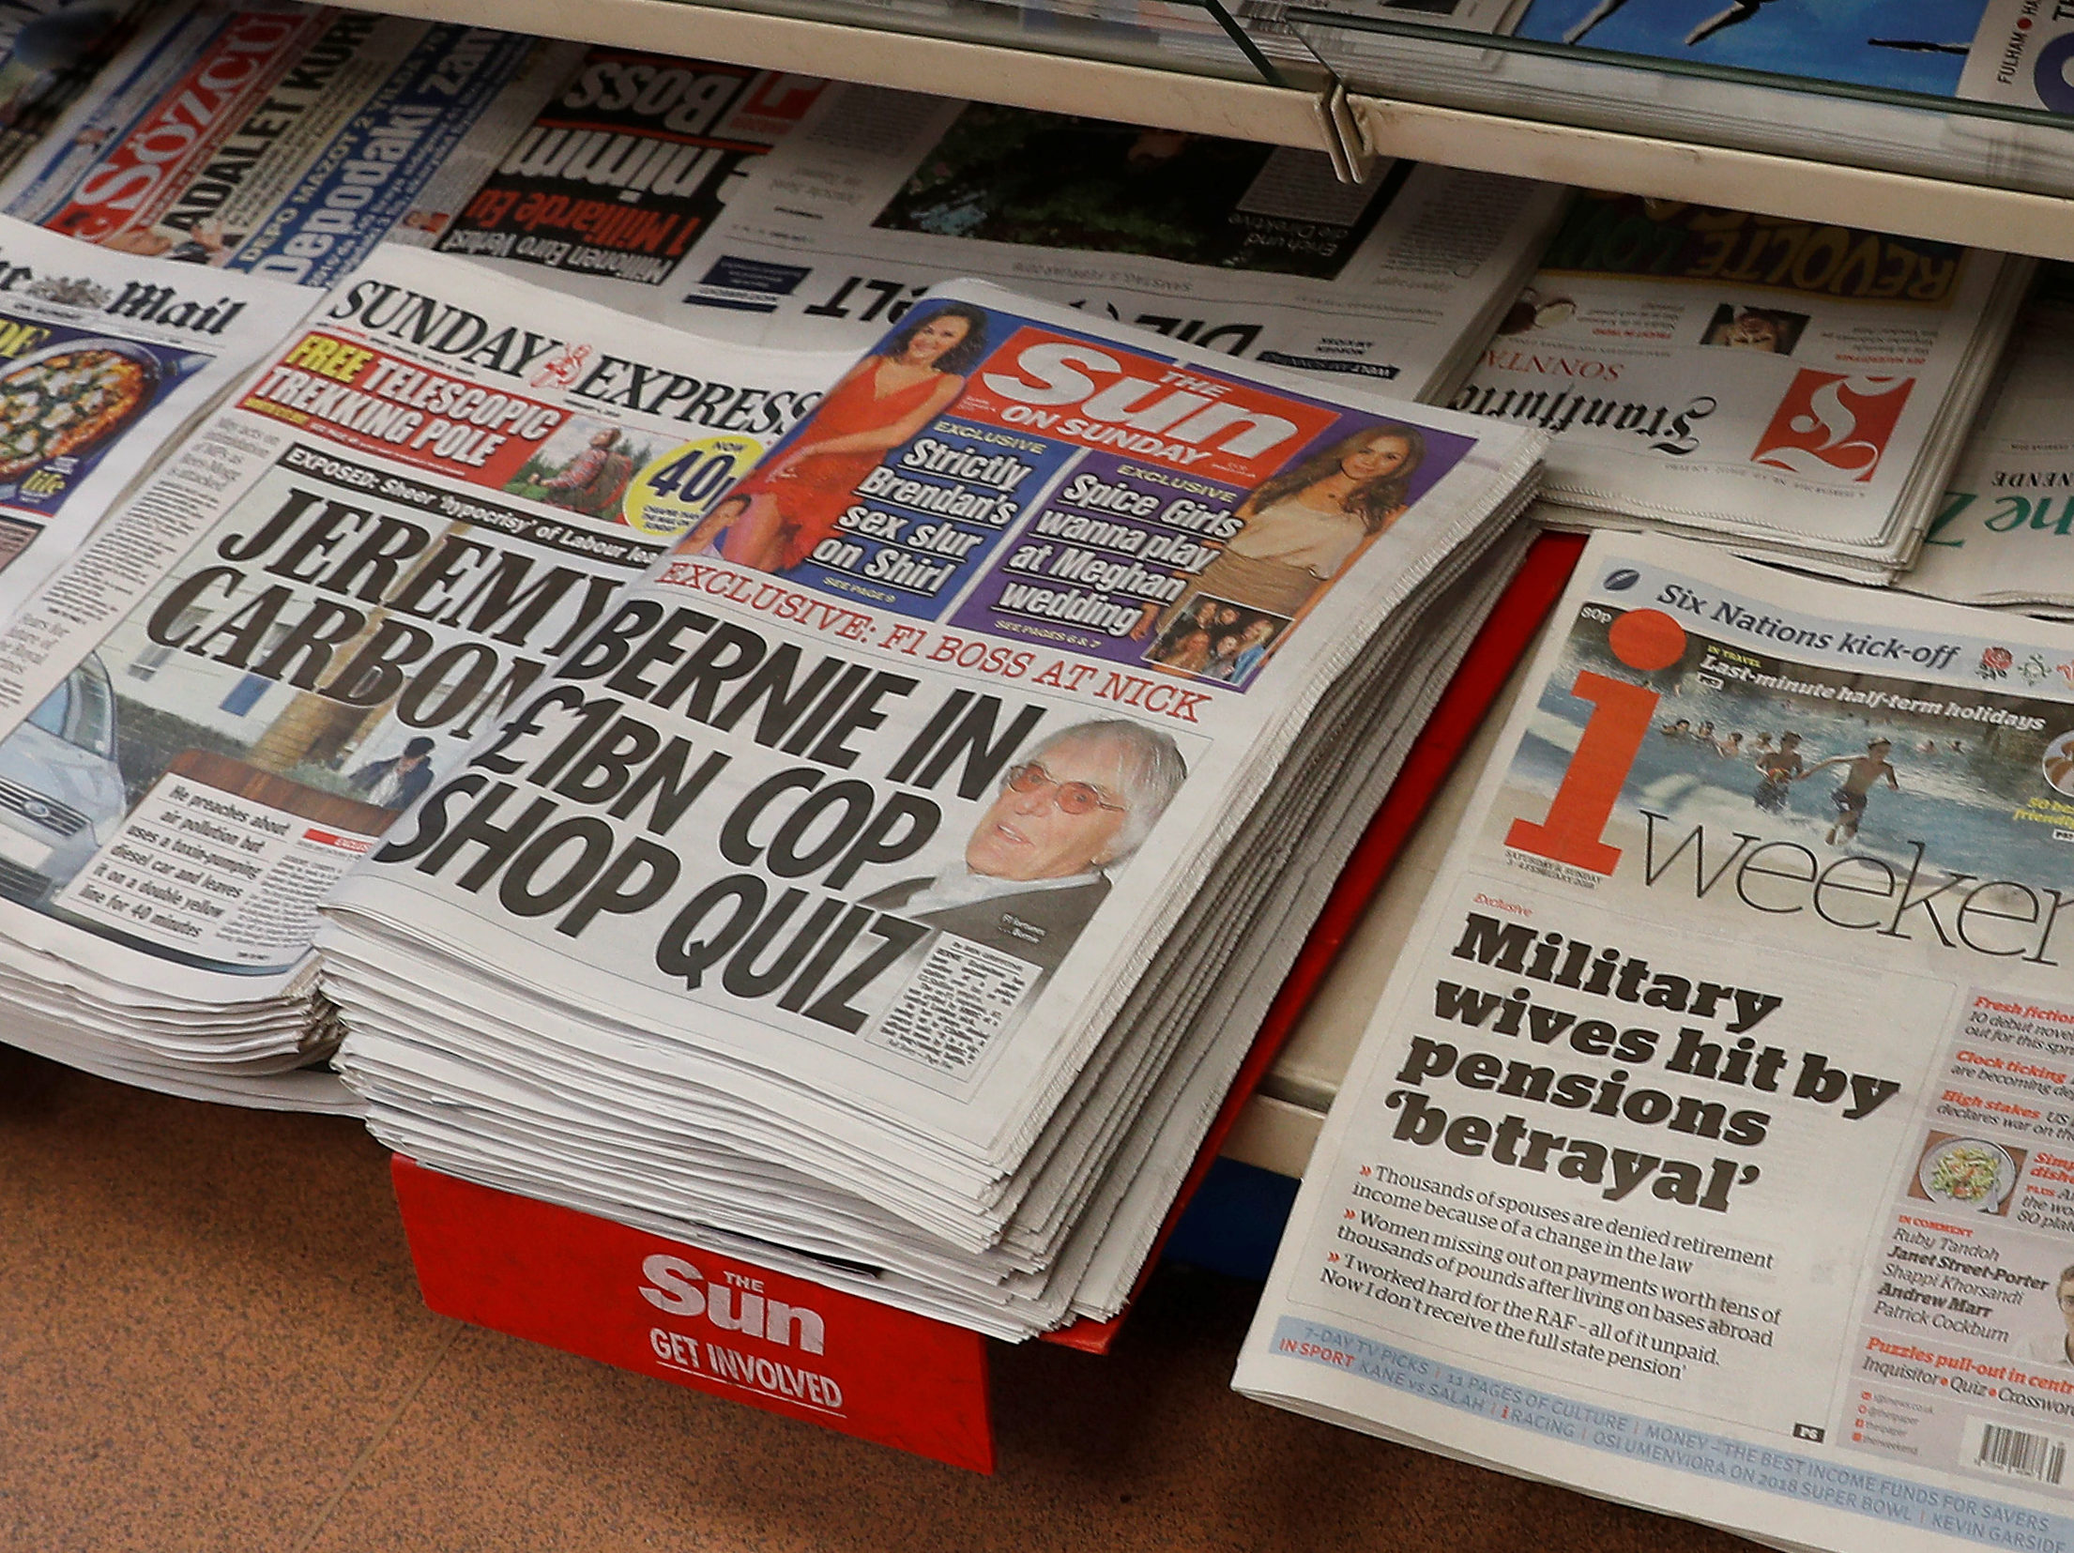
The Language of Information

Slide 2
Where do we see this language being used?
Objective media reports
Memos
Summaries
Instructions
Information Leafets
Formal Letters
Reviews

Slide 3
Features:
The information should be given in as straightforward a way as possible.

Slide 4
Be clear. Give facts and figures wherever possible and avoid vague descriptions.

Slide 5
It is not necessary to use many adjectives or adverbs as these can make your writing subjective.
Keep your personal opinions out of it.

Slide 6
It should not be long winded; the facts should be presented without embellishment.

Slide 7
It should be as objective as possible. Stay neutral. Don’t choose one side over another.
Personal opinions and anecdotes should not be included.

Slide 8
It is difficult to make a piece written in the language of information really gripping, particularly if the subject matter is one in which your reader has very little interest. Don't assume that the hobby you enjoy will be equally riveting to others.

