Slide 1
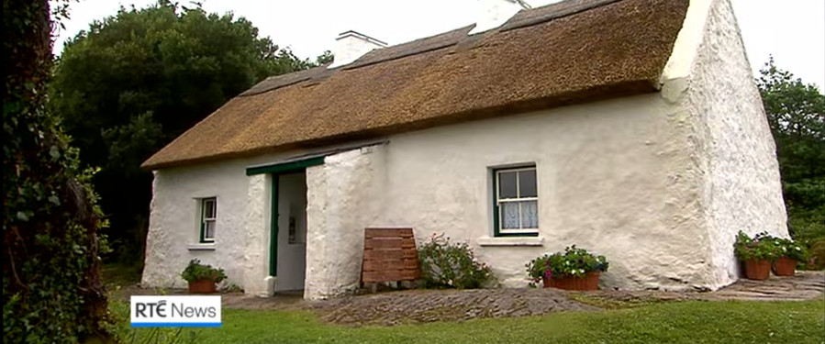
The Girl with the Keys to Pearse’s Cottage
Paul Durcan

Slide 2
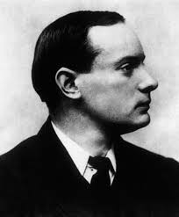
Padraig Pearse was a poet, barrister and one of the leaders of the 1916 Rising.
During the Rising, Pearse read aloud the Proclamation of the Irish republic on the steps of the GPO.
Pearse also gave a speech/ eulogy at the funeral of fenian Jeremiah O’Donovan Rossa (an event referenced to in ‘Six Nuns Die in a Convent Inferno’).
Pearse built a modest cottage in Rosmuc, Connemara, where this poem is set.

Slide 3
On the surface, this poem is about unrequited teenage love. The speaker loves a girl from afar, but for unstated reasons does not – or can not- bridge the gap between them.
This fits with a larger pattern in Durcan’s work, that of a man trying and failing to communicate across great gulfs of time (personal or national history), space (the Atlantic Ocean), or emotional distance (the anxiety that otherworldly beauty can evoke in a young man).

Slide 4
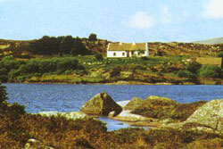
Thinking of the cottage, he visualises “two windows and cosmic peace.
The cottage is humble: “bare brown rooms and (…) whitewashed walls”. It is adorned with some heroic remnants: “Photographs of the passionate and pale Pearse”.
However, as with hero-worship in general, the cottage looks better from a distance: “I recall wet thatch and peeling jambs/ And how all was best seen from below in the field.”

Slide 5
Cait is a virtual alien in her own land. She looks “toward our strange world wide-eyed./ Our world was strange because it had no future”.
The “our” is also unclear here. It could refer to the futureless romance between her and the poet, or it could mean “our” in the sense of people living in the West of Ireland, or Ireland in general.
This poem was written in the 1970s when Ireland was on the brink of a significant economic recession. Many people would soon have “no choice” but to emigrate to countries like England or, in Cait’s case, America.

Slide 6
The final stanza aches with the pang of dashed teenage love, but also with the heartache of losing so many fellow countrymen and women to other shores.
The notion that she has “gone with your keys from your own native place” suggests that the emigrants and those who remain somehow locked out of the home that should be the source of cosmic peace to all.

Slide 7
Themes: Relationships
The poem is noteworthy for Durcan’s age, as this introduces his youthful approach to relationships.
later we see the realization that his desired relationship was never a realistic possibility.
Exploring the poem shows Durcan representing this through stylistic measures.

Slide 8
Stylistic Features:
Repetiton:
Durcan is reflecting on past events as an adult when writing this poem.
He now realises the relationship was never meant to form or be longlasting, and thus from the offset realises his intended relationship with Cait will never have the constancy required for permanence: this is represented through the changing use of repetition, which by its very nature is a technique dependent on monotony.
He uses an unusual repetition where his phrase changes form: “When I was sixteen I met a dark girl;/ Her dark hair was darker because her smile was so bright”.

Slide 9
Imagery:
The intense description of the titular cottage is not mere technique, but representative of the poet’s mindset when he was sixteen.
He wishes to not just communicate events of the past but also reflect a childish desire to connect with the girl.
This is represented by intense description, conveying an intent to retain memories of the past which are naturally irreconcilably linked to an unrequited love: “I recall two windows and cosmic peace/ Of bare brown rooms and on whitewashed walls/ Photographs of the Passionate pale Pearse”

Slide 10
Symbolism and alliteration:
Durcan makes excellent use of symbolism and alliteration.
The keys that the young girl holds symbolise freedom and power.
His use of alliteration accentuates the beauty of both the landscape and the young girl: “Compiling poems of passion for Cait Killann.”

Slide 11
Allusion to Painters:
Durcan references El Greco, the nickname of a genius artist who left his native Crete in Greece to live in what were then the centres of power (Venice and Rome) and who died in Spain far from his native land.
His figures were known for their extreme elongated features and other-worldly appearance.
Durcan blends the otherworldly beauty of Cait’s eyes with the “Connemara postman’s daughter’s proudly mortal face”.

Slide 12
Even though the young poet is tempted to celebrate her as a mythic being – or an ideal frozen in time like Pearse – it is her humanness, her grounded working-class roots, that ultimately speaks to him.
Her face is “mortal”, meaning that unlike a symbol, it will suffer and die. Perhaps here there is more than a celebration of living over the legend.

