Slide 1
The Forge
Seamus Heaney

Slide 2
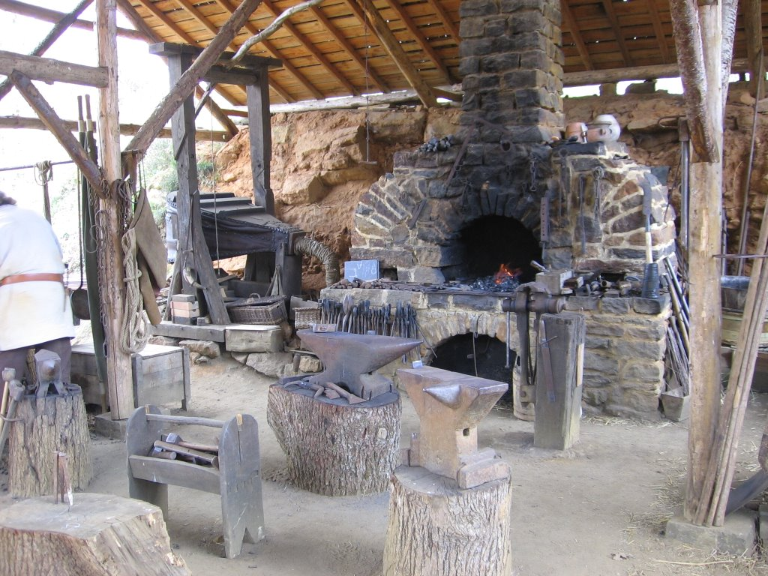

Slide 3
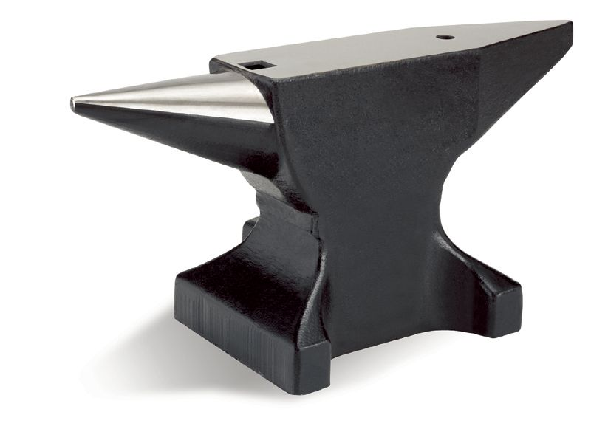

Slide 4
Themes: Craft
‘The Forge’ is a celebration of the blacksmith’s craft.
Describes him with an almost childish sense of wonder.
It is
Magical and mysterious
Beautiful
Something marvellous

Slide 5
The poet is drawn to the physicality of the blacksmith’s work.
Sense of manliness.
Such physical work with raw materials appeals to the poet.
There is a sense perhaps in which he might feel inadequate in comparison being a poet, working with a pen and paper.

Slide 6
Poetry
‘The Forge’ can be read as an allegory for the poet and the creation of poetry.
Blacksmith taking scraps of metal and beating them into beautiful shapes – like the poet creating a poem
The place where poetry and art originates is a mysterious and unknowable place
Poetic inspiration is ‘unpredictable’ just as the appearance of sparks can never be foretold. But when it occurs it is wonderful.
Anvil = poets desk.

Slide 7
Changing World
‘The Forge’ describes a world that is changing.
The ‘clatter of hoofs’ is being replaced with the sound of cars.
The poem suggests that in the modern world the blacksmith’s craft will soon be lost.
There is also a suggestion that the cars are not being made from ‘real iron’, but cheaper, flimsier materials.

Slide 8
Childhood
The poem evokes a childhood mentality. We see this in the child’s reluctance to venture inside the forge.

Slide 9
Religion
Like a church, the forge is a mysterious and almost sacred place where fantastic things can happen.
Anvil = alter.
Like the church, the forge and the blacksmith’s work seems like a solid feature in the community: “Set there immovable”.
However, both are vanishing features of the modern world.

Slide 10
Language
Sonnet (14 lines)
ABBACDDCEFGFEF rhyming scheme
Poem is full of sounds – onomatopoeia
Anvil is central and Heaney uses a simile and a metaphor to describe it.

