Slide 1
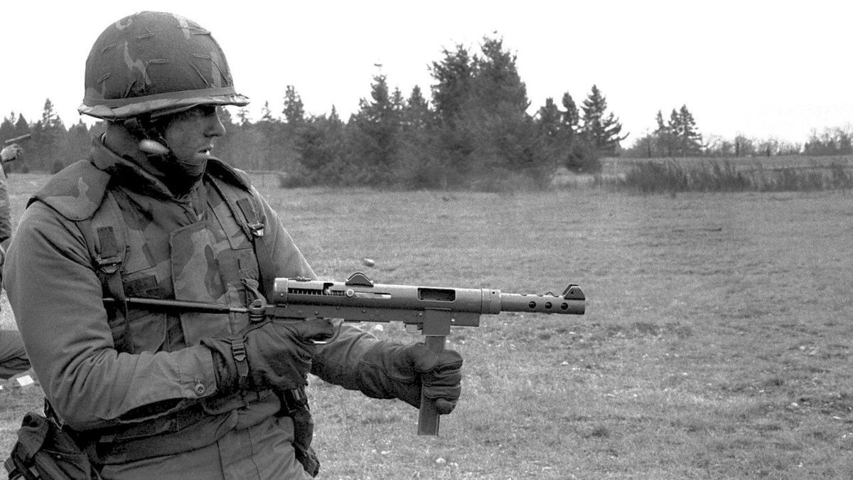
The Deserter
Winifred Letts
This Photo by Unknown Author is licensed under CC BY-SA

Slide 2
What is the poem about?
The poem tells the story of a man shot for cowardice – that is, trying to escape from the army. It details how the man goes to his death and asks how we can judge such a person.
It highlights the emotions the man goes through and, like “The Hero”, looks at the lack of information about the war back home.
The poem is written in the first person and the reader is forced to consider these issues through the use of rhetorical questions (“But who could judge him, you or I?”)

Slide 3
Structure
The poem is written as one long stanza.
This makes it almost impossible for you as the reader to stop reading and escape from the inevitable – the man dying. This mimics how his fate is inescapable once he has become “The Deserter”.

Slide 4
Language
This poem’s main character is anonymous: “don’t mind his name” – this soldier is representative of all 306 British soldiers shot for deserting.
The poet makes us feel sympathy for the soldier by emphasising his youth and innocence: “Was scared as any frightened child” – (he wouldn’t have been that old).
The descriptions of him, with his knees “shaking”, breathing “fast”, “wild” eyes, emphasise his fear.
This Photo by Unknown Author is licensed under CC BY-SA

Slide 5
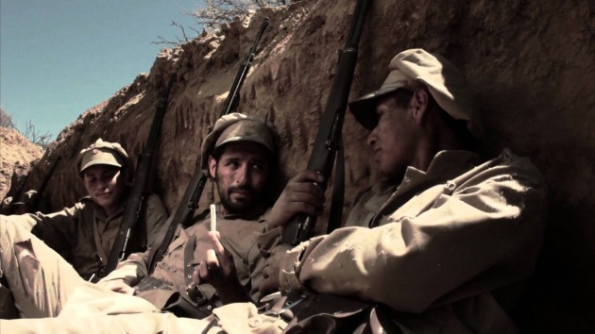
The soldier is also set apart and isolated: “Blindfolded...He stood there in a place apart” from the impersonal “They” who are doing this to him.
The repetition of “An English bullet in his heart” (lines 24 and 25) highlight how this man’s death was caused by his own people; this is what we did to men who were too young to cope with the horrors of war.
This Photo by Unknown Author is licensed under CC BY-SA-NC

Slide 6
It is clear from earlier in the poem that this is not a snap decision he has made to run away, but that he has lived through quite a lot already: “Fear had dogged by night and day” – personification making Fear sound as though it is hunting him down all the time (and later his eyes are compared to a hare’s – a hunted animal).
This Photo by Unknown Author is licensed under CC BY-SA

Slide 7
Irony
The irony lies in the fact that the mother back at home is told her son died nobly in the war and is proud – perhaps a positive effect of the lies told?
The final rhyme of the poem (“gave”/”grave”) suggests that these men have been willingly sent to their deaths.

