Slide 1
The Thickness of Ice
By Liz Loxley

Slide 2
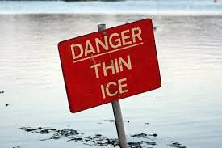
Starter
•Write down what you think the phrase “Skating on thin ice” means. What sort of phrase is this?

Slide 3
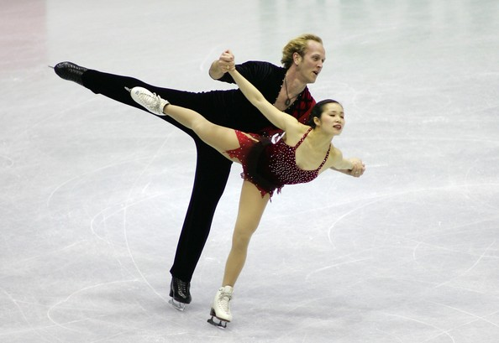
Starter
What is it like learning something for the first time? Are you amazing at it straight away?

Slide 4
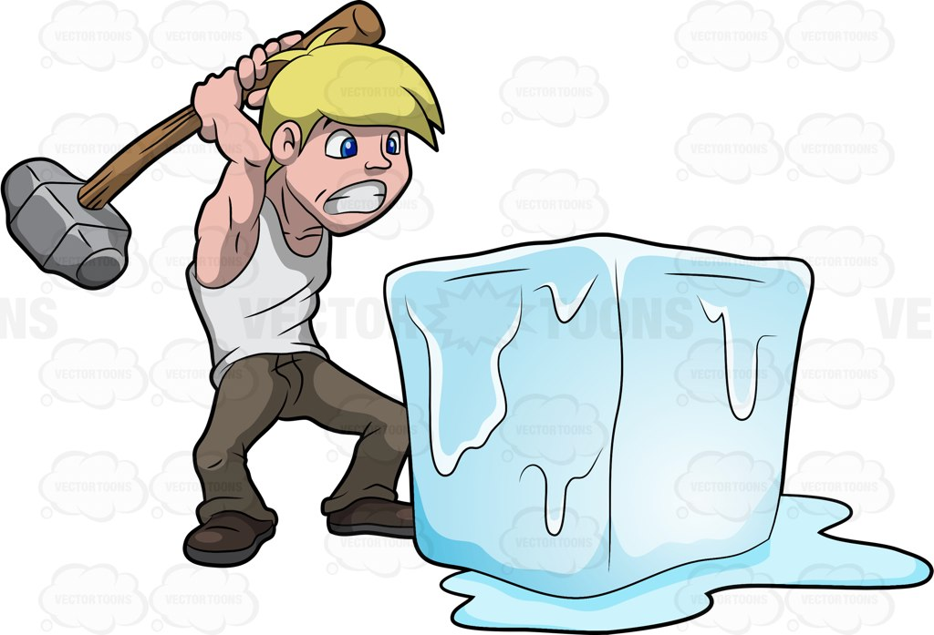
What do you think ‘breaking the ice’ means?

Slide 5
Relationships
Describe the different stages in a relationship. (Think of films that you’ve seen)
What is it like in the beginning, middle and end

Slide 6
Learning Objectives
Understand the ‘story’ of the poem.
Be familiar with the imagery in the poem.
Analyse the metaphor(s) and simile(s) used in the poem.
Be able to answer questions based on the poem

Slide 7
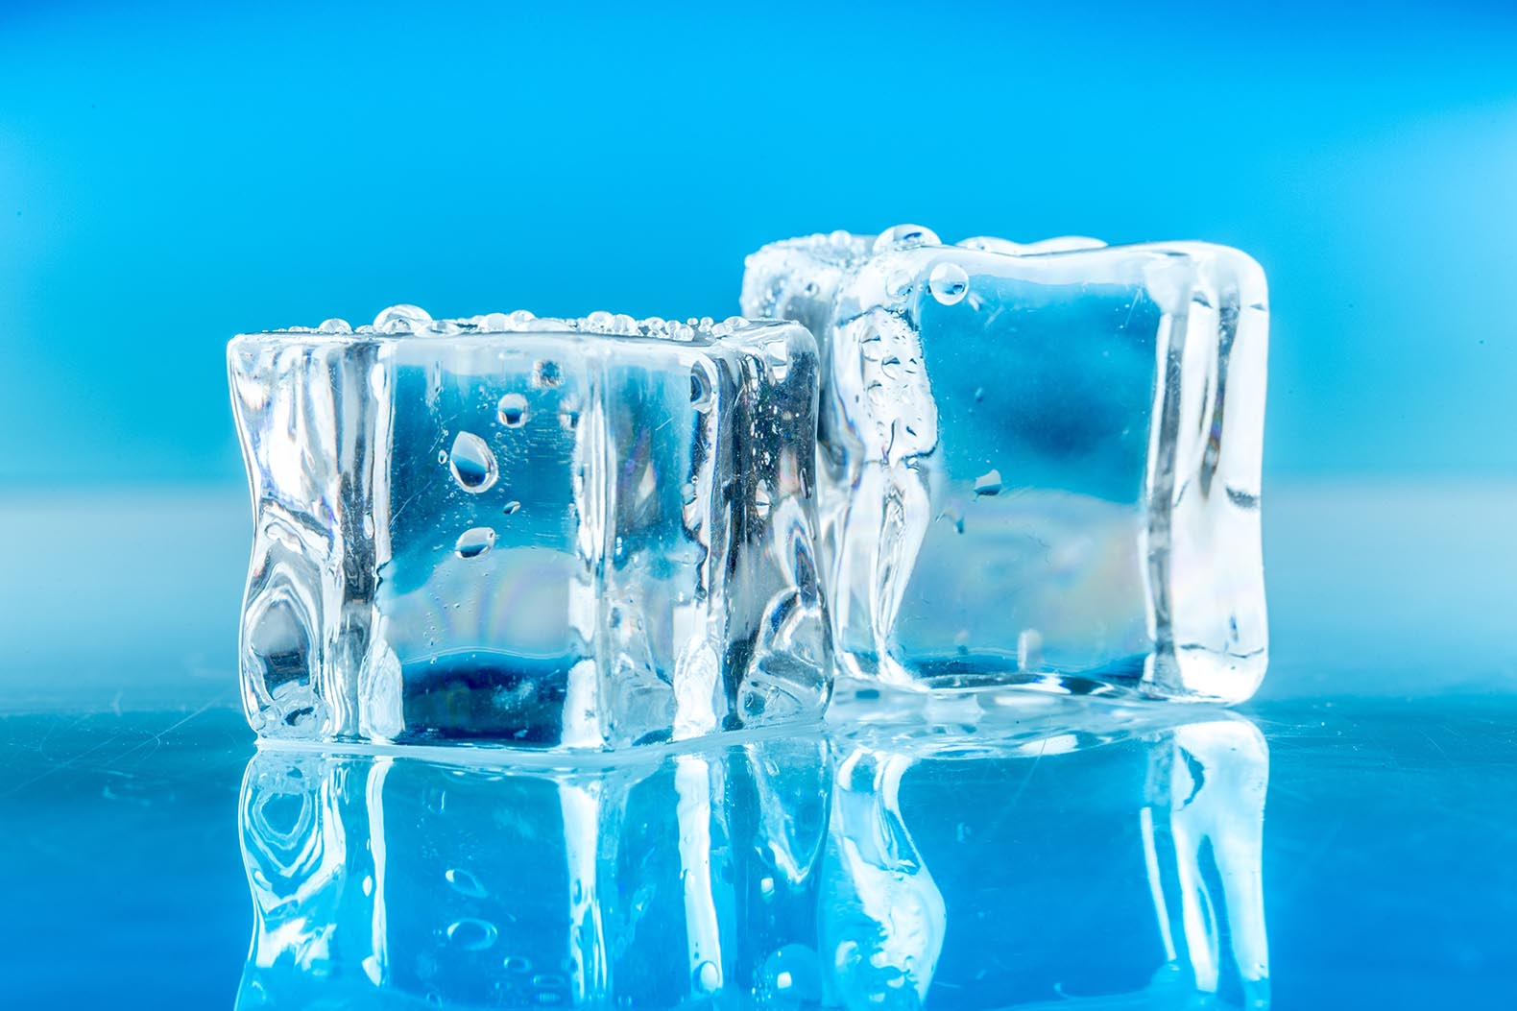
Ice
Briefly describe what ice is like. How it feels/looks.

Slide 8
New Vocabulary
Thaw - Become liquid or soft as a result of warming up.
Acquaintances - a person one knows slightly, but who is not a close friend.
Enemies - a person(s) who is actively opposed or hostile to someone or something.

Slide 9
The Thickness of Ice is . . .
A poem about relationships...
The theme of this poem is relationships and the poet depicts the fragile(breakable) and transient (temporary) nature of relationships.
The poet traces the beginning, development and ending of this relationship through the use of an effective simile: ice skaters represent the individuals.

Slide 10
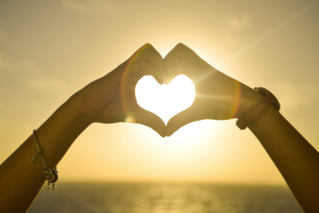
Theme(s)
Love
Relationships

Slide 11
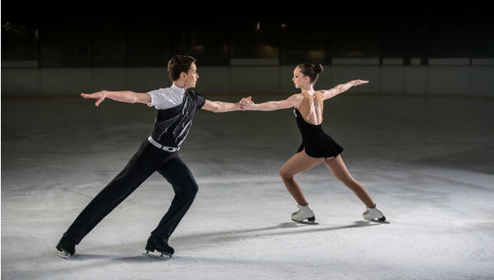
Simile
At first we’ll be like skaters testing the thickness of ice.
The skaters represent the individuals (the couple).
Can you spot another simile in the poem?

Slide 12
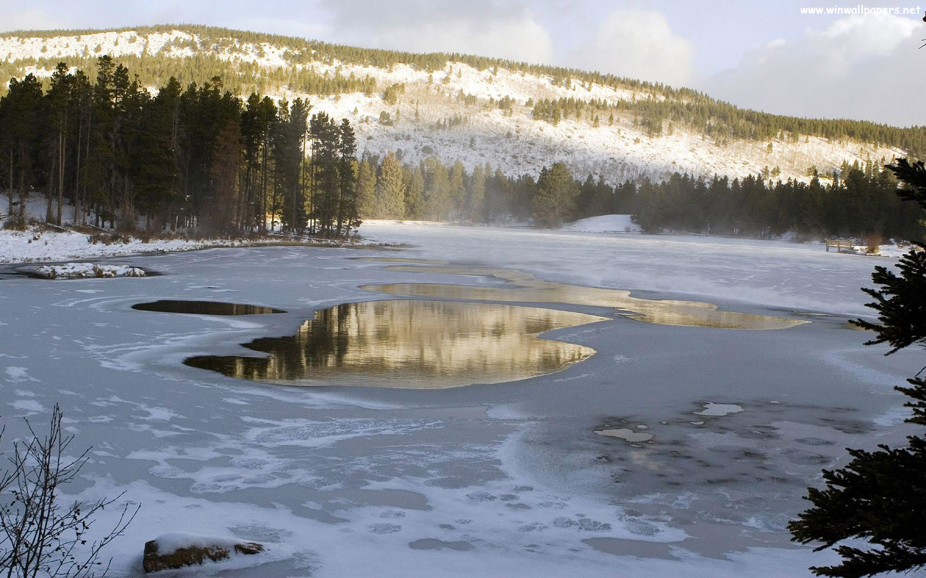
Metaphor
The “ice” acts as a metaphor for relationships while the “thinness” of ice suggests the fragile and delicate nature of relationships.

Slide 13
Mood and Tone
The mood is quite high-spirited and exciting at the beginning of the poem but changes to become quite low-spirited and sad towards the end.
The tone is sometimes quite scheming in nature, hence the poet’s deliberate use of brackets to indicate private thoughts: “(Though secretly I’ll be hoping…)”, “(Though secretly perhaps we may be hoping…)”

