Slide 1
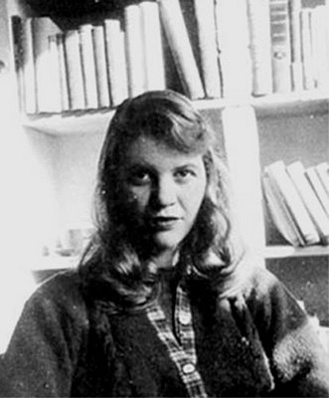
Sylvia Plath

Slide 2
Social and Cultural Context
Plath attended a college for girls, where she wanted to achieve and become a perfect American girl
Magazines etc. defined this ideal
Not to marry was to risk being labelled “unfeminine”
Plath struggled to escape this ideal of perfection throughout her life. Her letters home to her mother are full of references to her attempts to make a home for herself and Ted Hughes and to win her mother’s approval.

Slide 3
Plath’s Struggle for Identity
Much of Plath’s poetry can be seen as a struggle to create a new identity for herself that transcended the cultural limitations imposed upon women
Given society’s view of women, Plath found it difficult to find acceptance as a writer outside of women’s books and magazines
In her lifetime, her work won serious admiration from only a small number of people. She was more famous for being the wife if the poet Ted Hughes than for being a poet, novelist and short story writer in her own right

Slide 4
Plath as Expatriate (immigrant)
For Plath, the opportunity to live and study in England was a partly liberating experience. From England she could view the consumerism and militarism of American culture with clarity.
However, she did not always feel at home in England and disliked the shabby inefficiency that she saw in English life.
Her feelings of displacement are important in shaping the poetry she wrote.

Slide 5
Five Key Points to Remember
In Plath’s time, a woman should be a wife, a homemaker and a mother – she was not expected to be a professional or to have her own career. Plath struggled to escape this ideal of perfection throughout her life.
2. Much of Plath’s poetry can be seen as a struggle to create a new identity for herself that transcended the cultural limitations imposed upon women.

Slide 6
3. In her lifetime, Plath’s work won serious admiration from only a small number of people. She was more famous for being the wife of the poet Ted Hughes than for being a poet, novelist and short story writer in her own right
4. Plath was attuned to the major historical issues of her time, such as the Cold War and the threat of nuclear warfare between America and Russia and her own German ancestry
5. From England, Plath could view the consumerism and militarism of American culture with clarity, but she did not always feel at home in England and disliked the shabby inefficiency that she saw in English life

Slide 7
Themes
1. Plath struggles against herself and the world.
2. Her poetry depicts her quest for poetic inspiration and vision.
3. She explores her own depression.
4. Plath explores aspects of childhood and childhood imagination.
5. She depicts nature
6. Plath conveys her negative views of heroism, war and shooting.

Slide 8
She was a bright, intelligent, and determined young woman with a need to succeed; she had a burning desire to write.
She dreamed of the comfort of a home of her own where she could belong and be loved for herself.
She worked very hard, pushing herself relentlessly, whether in her studies, her teaching, in her relationships or her writing.
In its blend of amusing self-criticism and potent rage, her work anticipated the feminist writing that appeared in the later 1960s and the 1970s. But her work also transcended feminism.
Her work often reveals a harsh, demonic, devastating inner-self.
Plath was a self-revealing poet, but do not ignore her craft. Don’t pay too much attention to her personal history or legend while you ignore her art.

