Slide 1
Street
By Eiléan Ní Chuillenáin

Slide 2
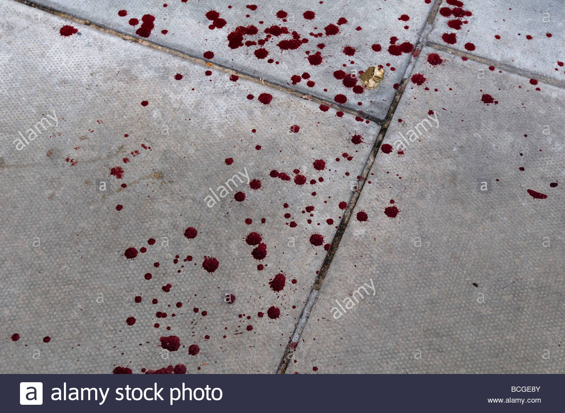
The poem tells of a person who “fell in love with the butchers daughter” when he saw her passing in the street. On one occasion he followed her home.
The girl worked in the butchers and wore a knife on her belt.
The knife was bloodied and drops of blood fell on the pavement as she walked along the street.
The man who followed her was fascinated by these drops.

Slide 3
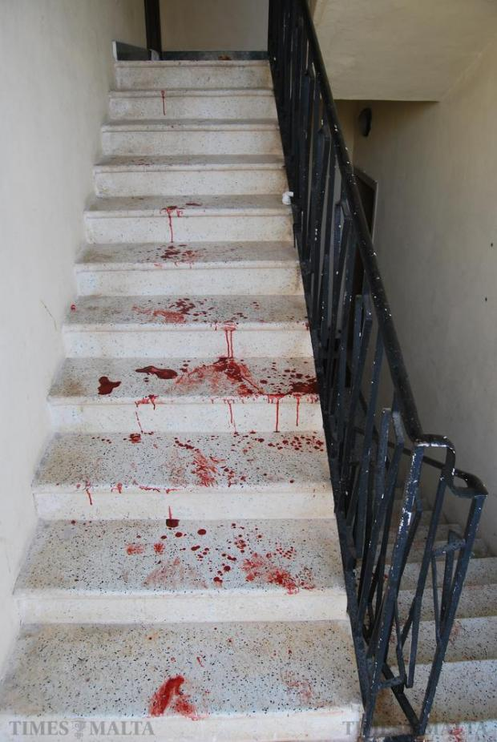
One day he decided to follow her down the lane behind the “shambles” or slaughterhouse.
In her house her shoes were placed neatly together on the bottom step.
Red moon shapes were visible on each of the steps.
Her feet were bloodied as she climbed the stairs.
Every step she took left an outline of blood on the stairs.

Slide 4
Imagery
Imagery is prevalent throughout the entire poem. The speaker focuses on the butcher’s daughter, her trousers and her belt and then focuses on the drops of blood.
We then see more blood on the shoes and on the stairs.
Although this is a short poem, it contains a number of very memorable images, such as the drops of blood on the “paving stones” and the “red crescent” marks left on the steps.

Slide 5
Alliteration
The poet uses repeated “a” sounds in line 4, which adds to the ominous atmosphere of the poem:
“He stared at the dark shining drops on the paving stones.”

Slide 6
Assonance
Assonance is a feature of the sixth line where the poet again uses repeated “a” sounds:
“Slanting lane at the back of the shambles.”

Slide 7
The last line of the poem features alliteration in the repeated “f”’s and assonance in the repeated “a” sounds:
“bare heels left, fading to faintest”

Slide 8
Atmosphere
The poem creates a tense and uncertain atmosphere.
This is partly due to the limited information that the poet offers us.
She gives us a quick sketch of the butcher’s daughter and describes her walking home.

Slide 9
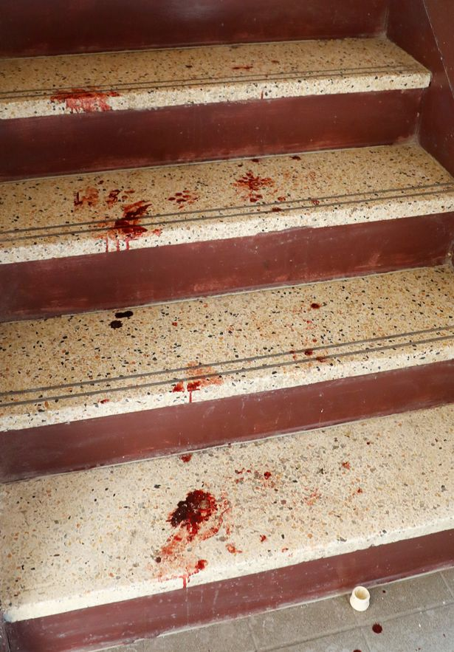
We are told that someone follows her to her door but are left uncertain as to what happens next.
The description of the knife and blood, both on the street and the stairs, also adds to the disturbing atmosphere.

Slide 10
Love
The poem suggests that love is something that often happens locally.
We fall in love with people we see in our daily lives, those who pass us regularly in the street.
We can imagine the male figure has watched the butcher’s daughter passing by on many occasions.

Slide 11
To him she is a fascinating character – the knife hanging by her waist, the blood from her work dripping on the pavement stones.
Perhaps he is too shy to speak to her and is intimidated by the power she displays as she strides past in her butchers gear.

Slide 12
The poem also hints at the dark side of attraction.
The images of the knife and blood in the poem hint at violence, and the fact that the male figure follows the butcher’s daughter back home down a winding path behind the slaughterhouse is somewhat unsettling.
We never know quite what his intentions are, and we are not told if he followed her inside the house or just left the scene.

