Slide 1
Sport
Paul Durcan

Slide 2
Sport: background
In this poem the poet addresses his father, with whom he had a very difficult relationship.
As Durcan himself describes it: “When I was ten, he began to be somewhat problematic. When I think about it there were gratuitous beatings and he was incredibly severe about things like examinations. If I hadn’t got second or third place it was bad news, and sometimes he would take the strap off his trousers and beat me. A man has to be so very complicated if he takes a school report for a ten-year-old that seriously.”

Slide 3
Sport: background
Durcan’s father was a high-ranking judge, and in the poet’s account emerges as nearly a stereotype of that profession – stern, severe and uncompromising. A man to whom discipline was everything.
He could make no sense of his son’s sensitive personality and artistic tendencies. To him these seemed like signs of mental disorder or insanity.
Over the poet’s teenage years the relationship between father and son became increasingly tense and then broke down completely. Finally, when Durcan was nineteen, his father had him committed to a psychiatric hospital.

Slide 4
‘Sport’ recalls a memory from this difficult period spent inside institutions. As he turned twenty-one, the poet was being held in Grangegorman Mental Hospital: “I was a patient / In B Wing”.
He’s selected to play in goal for the hospital’s Gaelic-football team in a match against Mullingar Mental Hospital – both teams it seems are made up of inmates rather than of staff members.
The poet provides a vivid portrait of the opposing team. He emphasises the great size and bizarre appearance of the Mullingar players, describing them as “big country men” who had “gapped teeth, red faces / Oily, frizzy hair, bushy eyebrows”.

Slide 5
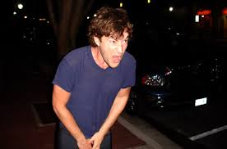
The poet stresses the enormity of the Mullingar full-forward line, which was “over six foot tall / Fifteen stone in weight”. The three full-forwards were all schizophrenics, while the centre half-forward was rumoured to be an alcoholic solicitor locked up for castrating his best friend.
Yet the poet held his nerve and bravely defended his goal against the intimidatingly crazy Mullingar attack: “To my surprise / I did not flinch in the goals” He plays far better than he expected, “leaping high” and “diving full stretch” to deny the Mullingar team.

Slide 6
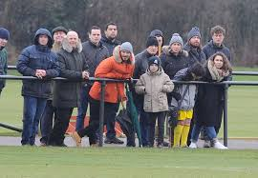
The poet credits his impressive display to the fact that his father was present at the game. So keen was he to “observe” his son’s performance that he drive all the way from Dublin to Mullingar.
The poet was determined not to disappoint his watching father: “I was fearful I would let down / Not only my team but you”. In fact, he wanted to captivate or “mesmerise” him with the quality of his performance.
His father’s presence gave him the “will to die”, the motivation to ignore pain, risk and potential injury that are “essential” to all sportsmen and artists, according the poet.

Slide 7
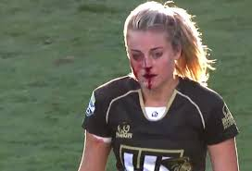
Sport
The poet suggests that both artists and sportspeople share a particular mentality. According to the poet, both require a “will to die”, a willingness to do whatever it takes to achieve their goals.
Athletes train long after they have passed through the pain barrier, throw themselves heedlessly into tackles and keep fighting long after their bodies start aching.
The artist also needs to take risks but they are with their mental health rather than physically. The artist must expose themselves to mental suffering, probe the darkest corners of their minds, explore all kinds of painful memories and memories in the creation of art.

Slide 8
THEME: family
This may seem like a funny and light-hearted poem but it provides a moving portrait of a complicated father-son relationship.
The father comes across not as loving and supportive but as severe, critical and judgemental. He seems to have a low opinion of his son and is dismissive of his talents and abilities: “There were not many fields / In which you had hopes for me”.
The use of the word “observe” in the first stanza indicates the father’s cold and critical manner.

Slide 9
THEME: family
The poem also highlights the personality clash between father and son. The young poet was a sensitive, talented and artistic individual. But to his father they meant nothing. The father regarded his son’s only success as playing on a “winning team” for Grangegorman Mental Hospital: “In your eyes I had achieved something at last”
The poet would go on to be come a famous and successful poet (a feat remarkably difficult to achieve) but these achievements would mean little compared to his performance in goal on his twenty-first birthday: “Seldom if ever again in your eyes / Was I to rise these heights”

Slide 10
THEME: family
This is a highly dysfunctional family relationship. However, we also sense that some affection or love exists between the two.
The father turns up to support his son, travelling fifty miles to watch an obscure football match between two mental institutions. At the end of the game he seems to take genuine pride in his son’s performance: “Sniffing your approval, you shook hands with me. / Well played, son”
Perhaps he felt that at last his son was doing something he could understand, something manly and physical.

Slide 11
THEME: family
The poet’s twenty-first birthday should have been an occasion of family celebration, yet it turns out to be a grim parody of togetherness, the father shaking hands with the son he’s had incarcerated.
However, the poet too displays a kind of affection towards the father who had him locked up. He is desperate to impress or “mesmerise” him, and terrified of letting him down.
We are left then with the agonising sense of what might have been, that this father-son pair could, under different circumstances, have had a healthy and happy relationship.

Slide 12
THEME: family
We sense the poet’s anger at being locked up, at being misunderstood, dismissed and disregarded by his father.
There is perhaps also a sense of anger at his younger self for trying so hard to impress the man who had him incarcerated.
Yet there is a real sense of sorrow here, as if the poet acknowledges the residual love that continues to exist between them even after he had been committed. We sense him lamenting his father’s own mental and emotional issues, and the terrible impact they had on their relationship.

Slide 13
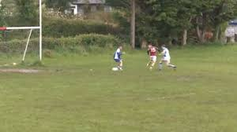
Style: Language, tone, structure etc.
Tone:
In this poem we get a real sense of the young poet’s state of mind and personality. We sense his vulnerability as he stands between the goalposts but also his hope and determination to impress his watching father.

Slide 14
Style: Language, tone, structure etc.
Imagery:
Like much of Durcan’s poetry ‘Sport’ features imagery that is memorable strange and surreal. In particular the depiction of the Mullingar players with their “gapped teeth” and “bushy eyebrows”, of their centre half-forward who was rumoured to be an alcoholic solicitor locked up for castrating his best friend

Slide 15
Style: Language, tone, structure etc.
Humour:
This poem is filled with the zany humour for which Durcan’s poetry is so often celebrated: the bizarre set-up of the match between two mental hospitals, the almost cartoonish depiction of the Mullingar team, the farcical final scoreline: “Having defeated Mullingar Mental Hospital / By 14 goals and 38 points to 3 goals and 10 points”. There is also the fact that one of the players allegedly castrated his best friend but “meant well” in doing so.

