Slide 1
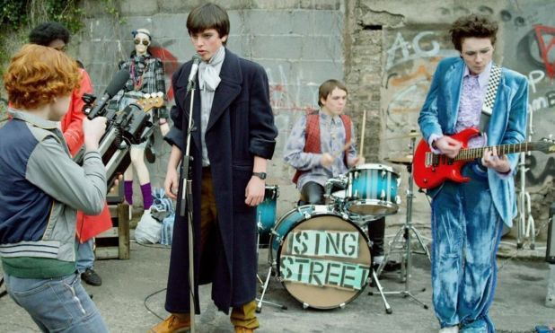
Sing Street
Tasks
This Photo by Unknown Author is licensed under CC BY-NC-ND

Slide 2
Task
Opening
Based on the opening scenes of a film you have studied. Describe your initial impressions of: the main character(s) and setting.
Use evidence from the film to support your points. (2 paragraphs)
This Photo by Unknown Author is licensed under CC BY

Slide 3
Characters
Task
Pick one character from your studied film that you personally identified with. Give reasons for your answer.

Slide 4
Characters
Task
Based on your studied film, identify a relationship between two characters that you found gave you a positive or negative impression of the word in which it is set.

Slide 5
Task
Key Moment
Key Moment
Pick one key moment from your studied film that you believe best conveys a theme present in the film. Explain your answer with reference to the film to support your point.
Pick one key moment from your studied film that you believe best conveys a theme present in the film. Explain your answer with reference to the film to support your point.

Slide 6
Character
Task
Choose a character you liked or disliked and give a detailed account of how that character treated others.

Slide 7
Sentence Starters
A relationship developed…..
It made me laugh because…..
It dealt with an important issue….
It made me think and reflect….

