Slide 1
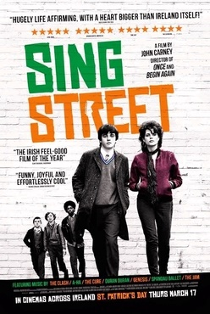
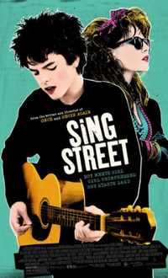
Sing Street
Directed by John Carney
This Photo by Unknown Author is licensed under CC BY-SA
This Photo by Unknown Author is licensed under CC BY-SA

Slide 2
What do you think the movie is going to be about? What are your expectations?

Slide 3
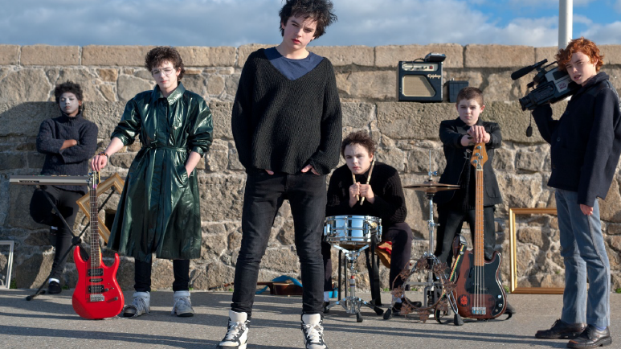

Slide 4
Before we watch it take down some notes:
Who directed the film? John Carney
Who produced the film? Irish Film Board
What year is the film set in? 1985
What was life like in this era? High unemployment rates due to a recession, a lot of young Irish people were emigrating, ongoing troubles in the North.
What were some of the main struggles for people? Financial struggles, social problems.
What town is the film set in? Dublin city.

Slide 5
Studied Film Checklist
Characters
Setting
Plot
Theme
Images
Cinematography
Personal response

Slide 6
Watch up to 20:30
What’s the name of the main character?
Conor Lawlor
What instrument is he playing in the opening scene?
Guitar
What problems are Conor’s parents experiencing?
They are struggling financially
What is Conor forced to do?
To move schools
What is your initial impression of Conor’s new school?
Full of loud, intimidating, boisterous young boys.

Slide 7
How do the other students treat him?
They exclude him and they judge him.
What are some of the social problems mentioned in the film?
Unemployment, drug addiction
What’s the name of the student who befriends Conor?
Darren
Who’s house does he bring him to?
Eamon’s house
What’s a futurist?
Someone who looks to the future
Who do the boys ask to join the band?
Ngig
What is the name of the band?
Sing Street

Slide 8
Section1 – What have we learned so far?
This Photo by Unknown Author is licensed under CC BY-SA-NC

Slide 9
Characters
Conor
Raphina
Conor’s mum and dad
Conor’s brother
Eamonn
Barry
Brother Baxter

Slide 10
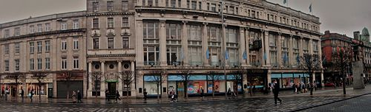
Setting
The film is set in Dublin in the 1980s. Socially, it is a difficult time with lots of unemployment due to a harsh recession. This goes hand in hand with a lot of new pop music being released in the charts. The plot of the film switches between the difficult reality of the recession in Dublin and the happy escape that music provides.
This Photo by Unknown Author is licensed under CC BY-SA

Slide 11
(Plot) Opening
The opening of the film introduces us to the main character of Conor Lawlor.
He is a fifteen year old boy who lives with his brother and parents.
Very quickly audiences realise that Conor’s home is not a happy place to be.
Because of the recession, Conor’s dad has been fired from his job while his mother has had her job reduced. Conor’s older brother has also dropped out of college.

Slide 12
To go along with this, Conor’s parents are also unhappy in their marriage.
The family have very little money and Conor is forced to go to a new school, Synge Street CBS in the inner city of Dublin.
This school is very different from what Conor has been used to and immediately he feels like an outsider, with all of the other boys in the school looking at Conor.

Slide 13
Task
Based on the opening scenes of a film you have studied. Describe your initial impressions of: the main character(s) and setting.
Use evidence from the film to support your points. (2 paragraphs)
This Photo by Unknown Author is licensed under CC BY

Slide 14
Section 2 20mins 30 secs – 49mins 40secs
How does Conor’s brother react to the band’s recording?
He wants the band to be original and creative, he’s not impressed that they’re singing covers of songs.
What is Conor’s song called?
Dangerous Eyes.
Who is the manager of the band?
Darren is the manager
How many members are in the band?
There are 5 members in the band.
What is the name of the girl who features in the video?
Raphina
Describe Barry’s relationship with his father?
His father is abusive and violent towards him.
Where does Raphina live?
She lives in an orphanage, home for girls.

Slide 15
What revelation does Brendan make about his mother?
Brendan thinks his mother is having an affair.
What are Brother Baxter’s stereotypical views?
He thinks he is superior, he’s old fashioned and believes only women should wear make-up.
Describe Brother Baxter’s treatment towards Conor?
He’s violent, physically abuses Conor for wearing make-up.
What does Raphina nickname Conor?
Cosmo
How does she describe love?
As happy sad
How does Conor describe Raphina?
As an amazing, unique person.
What life motto does Conor adapt?
To be happy / sad.

Slide 16
Conor’s first meeting with Raphena
Conor’s first meeting with Raphena is important because it introduces us to a major theme in the novel, young love. It is clear from the scene where she is standing on the steps across from his school that he likes her. The camera angle at this time also pans up to Raphena, giving audiences the impression that she is important as a character and to Conor.
This Photo by Unknown Author is licensed under CC BY-NC-ND

Slide 17
Music also plays an important part in this scene. Later, as we see the band formed fully for the first time performing the video for their song ‘The Riddle of the Model’ we can see the connection between Conor and Raphena, she is the complete centre of everything that is going on. We also witness the escapism that music gives the characters – even though they are in the bleak setting of a recession, they are still able to create music and entertainment. It is also one of the first times we see Conor enjoying himself. There is a large amount of colour and movement on screen to show a contrast to the grey, dull reality.

Slide 18
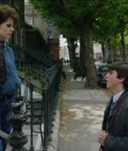
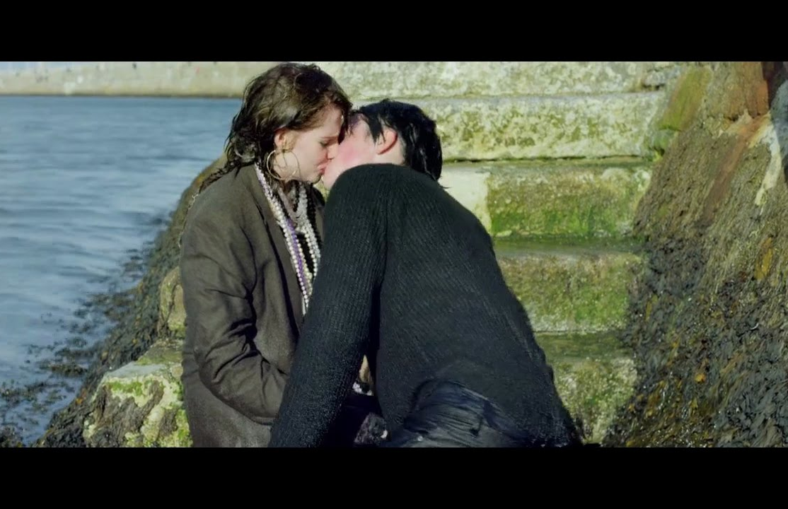
Conor and Raphena’s first kiss.
The relationship between Conor and Raphena begins to develop. Even though Raphena has a boyfriend, it is clear to us that she has feelings for Conor. Camera angles show many close up shots of each of the characters looking affectionately at each other.

Slide 19
Along with the blossoming relationship between Conor and Raphena, the band are also starting to develop their skills and talent with music. The setting of this scene again contrasts against the bleak reality of life in school or at home. Characters are enjoying a sunny day at the beach and there is also positive music playing on the soundtrack.
The most significant moment for audiences in this scene is the moment when Raphena jumps into the sea, and Conor goes to rescue her. This moment allows Conor to have his first kiss. Along with also showing the importance of art and creativity as Raphena tells Conor ‘I did it for our art, you must never do things by halves.’

Slide 20
This scene also further develops the theme of escapism is the film. Conor tells Raphena the story of his grandad’s boat and we see the main lands of the UK in the distance, while each character imagine what it would be like to leave Ireland.

Slide 21
Section 3 Watch 49mins - 57mins
How are the characters image and appearance changing?
As a form of expression the boys are becoming more creative and original with their appearance. They wear long black coats, ankle boots and hats to explore the image they want their band to convey.
Describe Conor and Brendan’s relationship.
Their love of music is bringing the brothers closer together. Brendan supports and guides Conor in his dream of creating a band. Brendan gives Conor advice on being original and on winning Raphina’s heart.
How does Cosmo’s interaction with Barry differ from their first encounter?
Cosmo stands up to Barry and no longer accepts his ridicule or intimidation. He no longer will be treated as victim of bullying. He’s not afraid to be himself and express himself.
‘You only have the power to stop things but not create’ – Explain how this quote conveys the main message of the film.
The main message of the film is about following your dreams and creating your own path in life not stopping other people from achieving their goals.

Slide 22
Section 4 Watch 57 mins – 1 hr 19mins
Who do you think Cosmo is writing his song about?
Brother Baxter
How does music help Conor and Brendan escape from reality?
They are escaping from their parents fragile relationship as they argue all the time. They find music uplifting and are passionate about it. Escape mechanism.
How does Conor compare the boat to a musical instrument?
You have to use both of them regularly.
What do Conor’s parents tell their children during the family meeting?
Their splitting up and selling the house.
What does Brendan refuse to do?
He refuses to stay with his mother’s love affair, Tony.

Slide 23
What names do people call Brendan?
A stoner and a college drop out. He feels like a failure.
Why does the camera zoom into the gym doors during the music video?
Conor is waiting for Raphina to walk in. The camera zooming into the doors creates a sense of anticipation and suspense as the viewer wait to see will she walk through the doors.
What does Conor imagine happening at the school disco? (Include 5 points)
The school hall is full of people dressed up in 50’s style.
Conor’s parents are there and they are dancing happily together.
Raphina is dancing in the crowd.
Brendan arrives on a motorbike and fights with Raphina’s boyfriend to protect her.
Brother Baxter cartwheels through the doors and shows support for Conor and the band.

Slide 24
What news does Conor find out when he goes looking for Raphina?
She has moved to London with her boyfriend.
Describe how Conor is feeling at this point in the film?
He feels disheartened, fed up, sad, let down – he’s parents are splitting up and Raphina has left without saying goodbye.

Slide 25
How does Raphina convey that she feels worthless?
She says that she deserved to be hit by her boyfriend.
What does Conor say is the most important thing in life?
Happiness
Why does Conor leave the park quickly without telling Raphina about his gig?
She insulted him and he feels hurt that she said she was mad for hanging around with a 15 year old school boy.

Slide 26
Section 5 Watch 1hr 19mins – 1hr 45mins
Why does Conor invite Brendan to play a solo at his gig?
To help build Brendan’s confidence and give him a purpose in life.
Why do Conor and Darren visit Barry?
To ask him to be involved in the security of the band
What does Darren say they all have in common?
That they don’t have any academic prospects in life. They’re no good in school.
How would you describe Barry’s homelife?
Dysfunctional family life where he is subjected to violent outbursts from his parents.

Slide 27
How could joining the band help Barry?
Give him a focus and ambition in life. Allow him to feel apart of something.
How does Cosmo convey his dream and ambitions for the bands future at the school disco?
He says ‘Hello Dublin’ which conveys his dream the band will be successful and play live concerts at huge venues.
What bold move do the band make at the gig?
They choose to play an original slow song.
Who does Cosmo dedicate the final song to?
Brother Baxter and all the Christian brothers.

Slide 28
Describe Cosmo’s behaviour at the gig?
Brave, rebellious, confident, determined and passionate to sing about what he believes in.
Describe the atmosphere in the school hall?
Lively, excitement, joy, empowerment
How does Brendan support his brother?
Driving Conor and Raphina to the port so they can sail to London.
Describe how Brendan feels as he says goodbye to his brother.
Emotional, sadness, regret that he didn’t pursue his dreams and a sense of joy to see his brother follow his dreams.
Describe the final scene of the film?
Dramatic, uplifting, inspiring, - Conor and Raphina are oblivious to the danger surrounding them at sea. They are so empowered to be following their dreams and ambitions that nothing can stop them.

Slide 29
Who is the film dedicated to?
For brothers everywhere.
What important life lessons does this film teach viewers?
To follow your dreams.
To work hard and your dreams will come through.
Stand up to the bullies.
Don’t be afraid to stand out from the crowd.
Live life to the fullest even when challenges are presented.

Slide 30
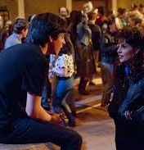
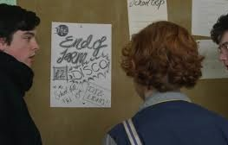
The Ending
The ending presents audiences once again with the main themes of the film; young love and escapism. Conor has performed at the end of year disco with his band and is celebrating its success. This is happening at the same time that his life at home continues to be difficult for him. The concert and his music continues to offer him an escape from his sad reality.
Raphena comes to his concert and it is clear to audiences that she has fallen in love with Conor.

Slide 31
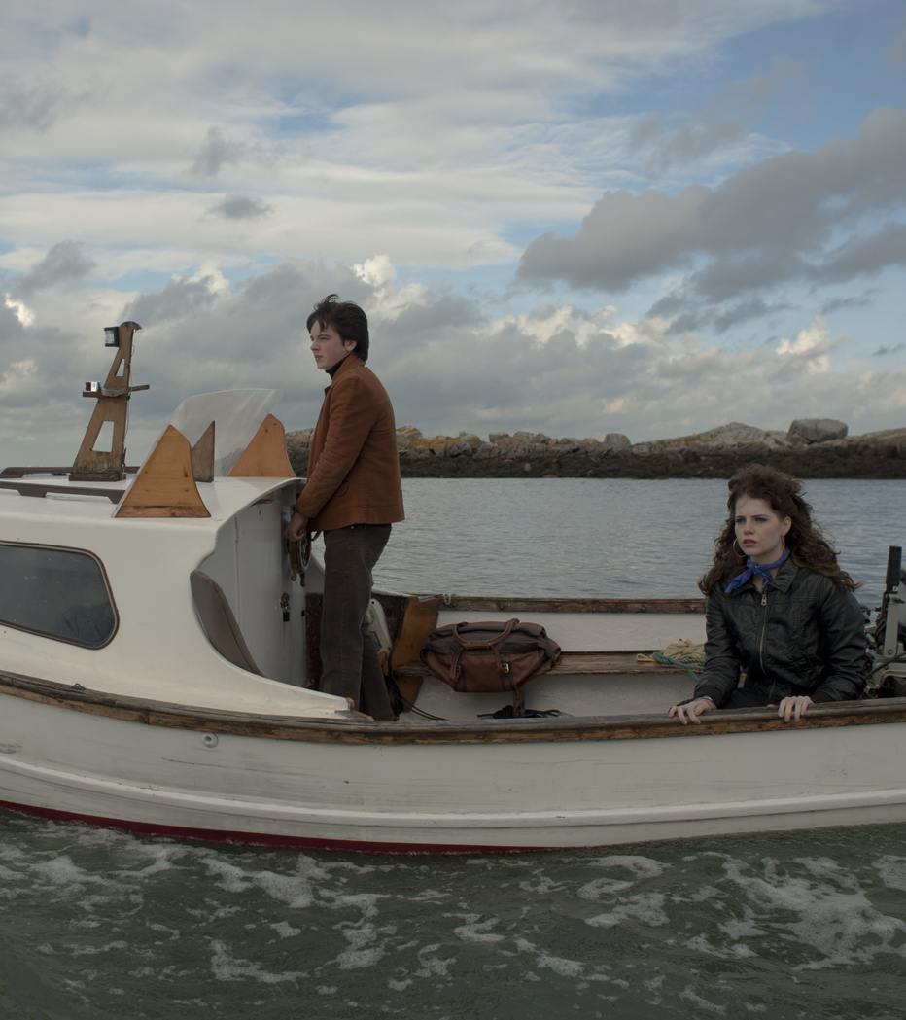
The young couple decide that there is nothing left for them in Ireland. They are going to run away together to London and try and forge a career as a model and a musician.
This idea presents audiences with a very romantic, almost fairy-tale version of young love. The music used in the soundtrack at this point in the film is upbeat and exciting to match the action of the characters on screen.

Slide 32
Conor returns home to collect his stuff and say one final goodbye to his mum, as he gets set to leave his old life behind. Conor’s older brother, Brendan gives them a lift to the harbour.
This part of the film is emotional, as Conor must say goodbye to his brother, whom he loves dearly.
The closing scene of the movie is symbolic of Brendan’s comment of being a ‘jet stream’ – Conor and Raphena have decided to follow their dream, they are unsure what their future holds, but are happy to be together, against all odds.

