Slide 1
September 1913
WB Yeats

Slide 2
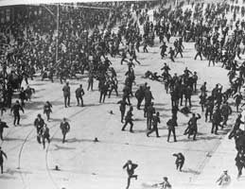
Background…
The Dublin Lock-out:
This was a major industrial dispute between approximately 20,000 workers and 300 employers which took place in Ireland's capital city of Dublin. The dispute lasted from 26 August 1913 to 18 January 1914, and is often viewed as the most severe and significant industrial dispute in Irish history. Central to the dispute was the workers' right to unionise.

Slide 3
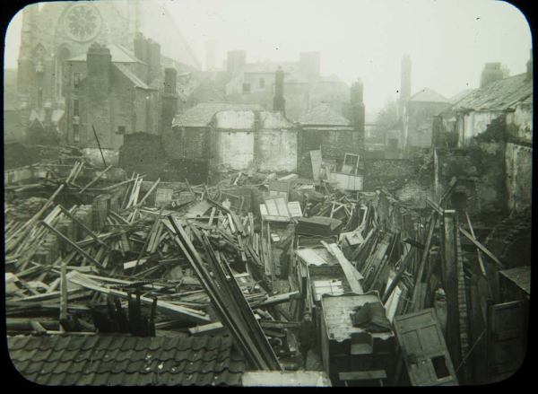
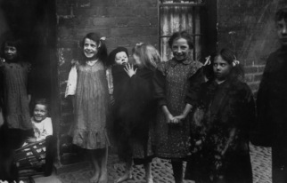
Poverty was perpetuated in Dublin by the lack of occupational opportunities for unskilled workers. Prior to the advent of trade unionism in Ireland, unskilled workers lacked any form of representation. Furthermore, there were many more unskilled labourers in Dublin than there were jobs for them. Thus unskilled workers often had to compete with one another for work on a daily basis, the job generally going to whoever agreed to work for the lowest wages.

Slide 4
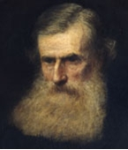
John O’Leary
Born 23 July 1830
Died 16 March 1907
Was an Irish separatist and a leading Fenian.
Both the Fenian Brotherhood and Irish Republican Brotherhood (IRB), were fraternal organisations dedicated to the establishment of an independent Irish Republic in the 19th and early 20th century.
He studied both law and medicine but did not take a degree and for his involvement in the Irish Republican Brotherhood he was imprisoned in England during the nineteenth century.

Slide 5
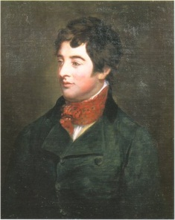
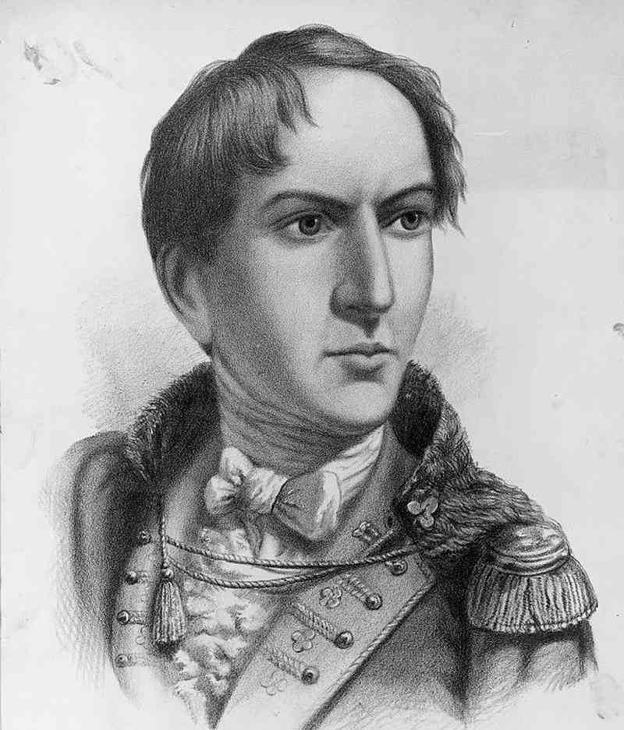
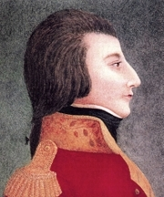
Other names in the poem…
Edward Fitzgerald
Born Oct. 15, 1763, County Kildare, Ire.—died June 4, 1798, London, Eng.), Irish rebel who was renowned for his gallantry and courage, who was a leading conspirator behind the uprising of 1798 against British rule in Ireland.
Robert Emmet
Born 4 March 1778 – 20 September 1803) was an Irish nationalist, orator and rebel leader born in Dublin, Ireland. He led an abortive rebellion against British rule in 1803 and was captured, tried and executed for high treason.
Wolfe Tone
Born 20 June 1763 – 19 November 1798) was a leading figure in the United Irishmen Irish independence movement and is regarded as the father of Irish republicanism. Wolfe Tone died from his wounds eight days after he attempted suicide by using a penknife to open an artery in his neck.

Slide 6
About the Poem
The poem is a response to the ruthless mercenary employers who locked out their workers in the General Strike in 1913.
The poem is also a comment on the refusal of commercial interests to support Yeats’ appeal for money to build an Art Gallery to house the Lane collection.
The poem is a scathing criticism of the mercenary materialism he felt was rampant in the Ireland of 1913.

Slide 7
Themes
The theme of death or old age and what it leaves behind.
Death of Patriotism, leaving selfishness as the norm: “Romantic Ireland's dead and gone…”
(as in Wild Swans)

Slide 8
2. The theme of disintegration, chaos, sudden change:
‘They have gone about the world like wind’
‘scatter wheeling in great broken rings Upon their clamorous wings’ [Wild Swans]
‘this tumult in the clouds’ [Airman]

Slide 9
3. The quest for truth is fundamental
The pursuit of national ideals at the cost of public ridicule: ‘“Some woman's yellow hair Has maddened every mother's son”: They weighed so lightly what they gave’

Slide 10
4. Model Irish society
Romantic, patriotic and heroic: ‘Yet they were of a different kind, The names that stilled your childish play, They have gone about the world like wind’

Slide 11
Tone
Scornful and sarcastic: ‘What need you, being come to sense, But fumble in a greasy till’
Ironic: ‘For men were born to pray and save’ [September 1913]

Slide 12
Metaphor: ‘delirium of the brave’ [September 1916]
Symbol: ‘a greasy till’ in ‘September 1913’ represents the mean policies of the merchant classes and portrays them as misers.
Simile:
‘They have gone about the world like wind’

Slide 13
Direct Address:
‘What need you, being come to sense’

Slide 14
The key theme is Yeats’ disillusionment with the materialisation and cynicism of middle-class Ireland
The contrast between the inspiring heroic past and the dispiriting, mean spirited present is sharply drawn by Yeats
Yeats juxtaposes the materialistic, cynical merchants with the selfless idealistic heroes of the past

Slide 15
There is vivid concrete imagery “fumble in a greasy till”
Yeats uses irony to underscore his contempt for the merchants’ values
Use of repetition “for this” underlines the depth of the poet’s disappointment and anger

Slide 16
Use of colloquial language suggests the merchants’ uncomprehending response to the patriotism of previous generations “And what, god help us, could they save?”
The repeated refrain “Romantic Ireland’s…” gives further emphasis to the poet’s profound disillusionment with the values of middle – class Ireland

Slide 17
Language, Imagery and Form
Comment on the use of pronouns in the poem.
Consider the use of consonance in stanza three.
What images are created and what is the effect?
What is the effect of the repetition of the last two lines of each stanza?
How is an confrontational tone created?
Comment on the use of rhyme and rhythm.

