Slide 1
Seamus Heaney
The Underground

Slide 2
"Marie and I were then on our honeymoon and as well as calling with my editor in Russell Square, we went to a Promenade concert in the Albert Hall, by the underground, of course, Marie in her white going away coat that had received a beetroot stain in the Museum Tavern the night before, both of us late and running down the corridor," Seamus Heaney in ‘The Guardian’, 2009.

Slide 3
Although it is a love poem, Heaney does not use the word ‘love’ in the poem.
The poem ends with a male persona waiting for his beloved who is following behind, but ‘damned if I look back’.
The love described in the poem is composed of many elements: desire, pursuit, excitement, escape, silence, complication, perseverance.

Slide 4
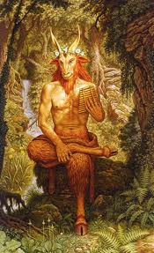
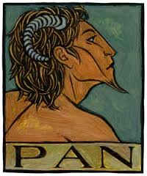
Allusions
Classical mythology and folktales.
Pan and Syrinx

Slide 5
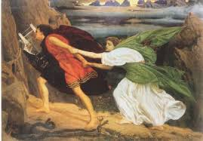
Orpheus and Eurydice

Slide 6
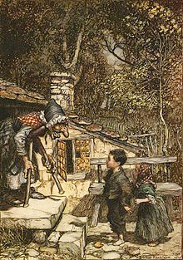
Hansel and Gretel

Slide 7
http://www.youtube.com/watch?v=30LR0tIDb3g

Slide 8
Heaney is reminded of the myth of the god Pan who chased a beautiful nymph, Syrinx. His designs on her were thwarted when she transformed herself into a bed of reeds in order to hide from him and preserve her virginity. Heaney rather playfully compares his running after his new wife to this mythological scenario. Perhaps, he thinks, she might turn into a white flower, splashed with red. This is a reference to her white coat stained with a little spilled beetroot juice, but could also refer to virginal innocence stained with the blood of a first sexual experience.

Slide 9
Imagery
There are several references to the moon in this poem. The moon is associated with change, with the tides and with the passing of time.

Slide 10
As they run, the poet’s wife’s coat flaps and buttons fly off. This reinforces the idea of the speed and the energy of the chase. There is also a reference to Hansel and Gretel who, in the fairy-tale, found their way by following a line of dropped pebbles.

Slide 11
Change in Tone
The tone of the poem changes now from one of excitement and energy to one of darkness.
He sees himself and his wife returning to that tube station, following the trail of dropped buttons. The station is dark and eerie.
The poet is agitated and tense, something he compared to the dangerous tension in the electrified train tracks.

Slide 12
Theme
Marriage:
The poem could be seen to say that the early excitement of marriage dwindles and that the pursuer can become the pursued.
It can also be seen to say that while the husband’s role in the early days of the marriage may be that of the lustful pursuer, he moves to becoming the protector and the one who must ensure his family’s safety and security.

