Slide 1
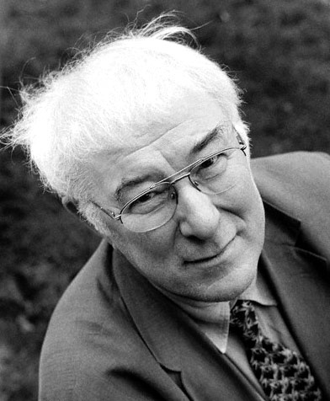
Seamus Heaney 1939

Slide 2
Background
Born in 1939 on a farm called Mossbawn in Co. Derry
Degree in English Language and Literature from Queen's University, Belfast. Became an English teacher.
He received the Nobel Prize for Literature in 1995, reinforcing his reputation as one of Ireland's finest and best-loved poets.

Slide 3
Social and Cultural Context
Born into a divided world
Sectarian assassinations in 1920s
Murder of his cousin in the 1970s
Death of his neighbour on hunger strike
Civil rights marches of 1960s
Bloody Sunday shootings and Hunger strikes of 1980s

Slide 4
One of Heaney’s major achievements is that while he has sought to face up to his responsibilities as a writer, his work is not overwhelmed by the enormity of the events to which it responds.

Slide 5
Themes
His writing is very much rooted in his Irishness, celebrating native, traditional skills, exploring Ireland's past and identity and trying to find language and imagery with which to speak of Northern Ireland's troubled past and ambiguous present.

Slide 6
Many of his themes, however, are more universal and deal with
the development of self,
the nature of love and death,
the creative process
the importance of the poetic imagination.

Slide 7
Five Key Points to Remember:
The social and political dimensions of life in Northern Ireland are part and parcel of Seamus Heaney’s inheritance and his poetry.
A theme that runs through Heaney’s work is the question of response: how should the poet respond to the circumstances in which he finds himself?

Slide 8
3. Heaney is open to the idea of learning from others and his poems borrow and refer to a wide range of writers and sources.
4. The example of Patrick Kavanagh’s poetry gave Heaney the permission to write about his own place and culture. The manner in which Kavanagh bridged the gap between the ordinary and the sacred has been taken up by Heaney in his later work.

Slide 9
Part of the excitement of reading Seamus Heaney id the way in which he leads you from the parish of Anahorish in County Derry outwards in space and time, making connections with kindred spirits, both living and dead.

