Slide 1
‘Romeo and Juliet’ William Shakespeare
Basic plot/ Summary:

Slide 2
You have arrived at your destination…
Verona, Italy c. 1300s

Slide 3
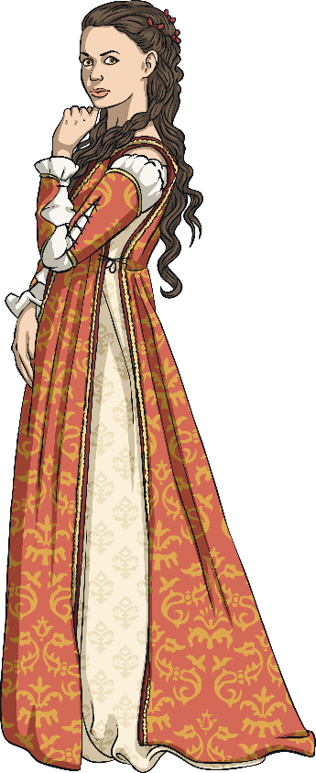
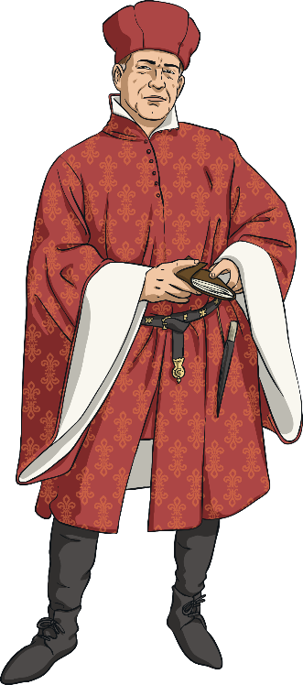
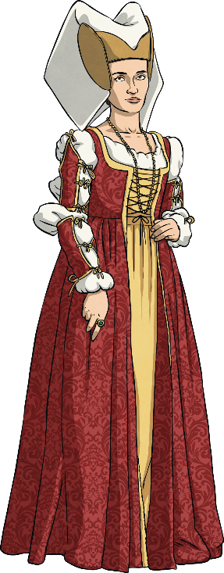
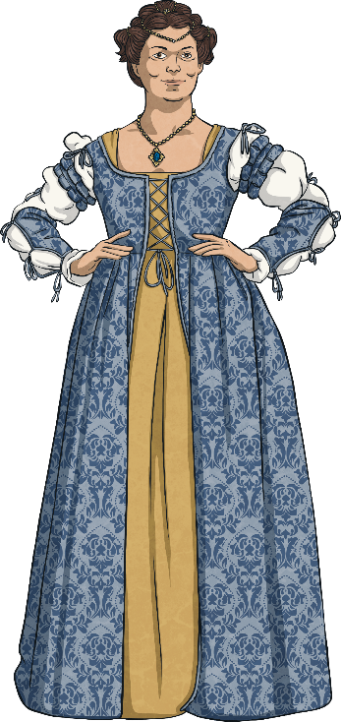
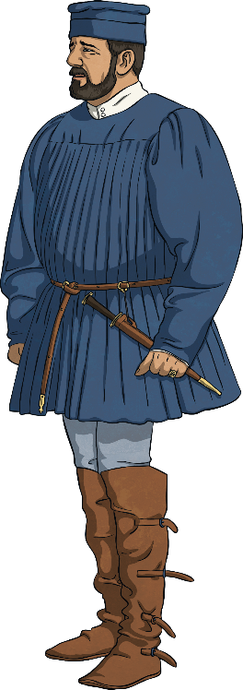
Who Are the Characters we Meet?
Capulet Family
Montague Family
Romeo
Juliet

Slide 4
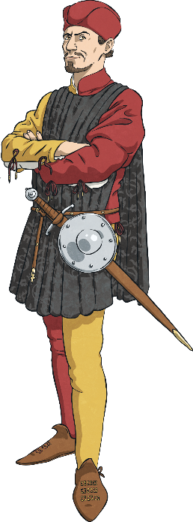
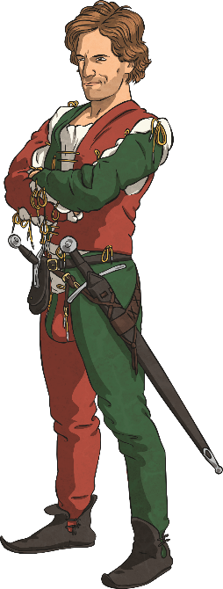
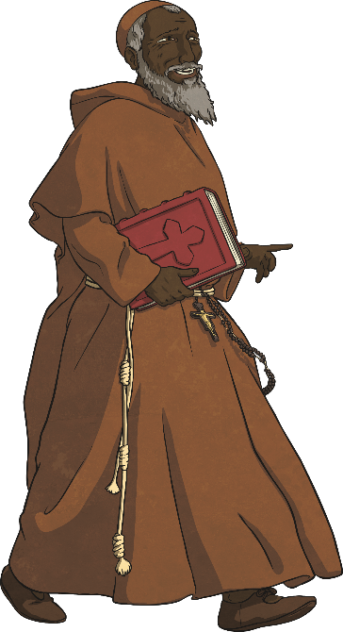
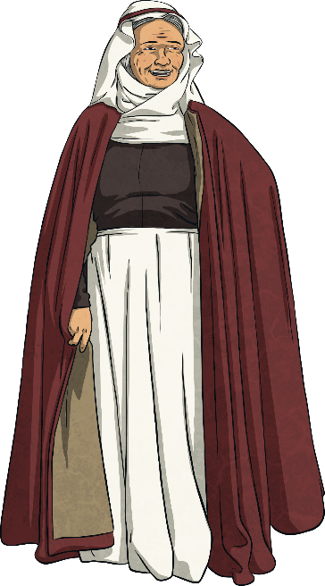
Who Are the Characters we Meet?
Tybalt
Mercutio
Juliet’s Nurse
Friar Lawrence

Slide 5
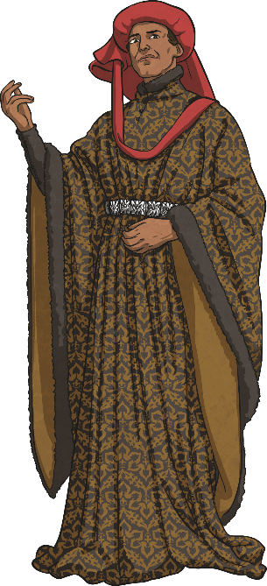
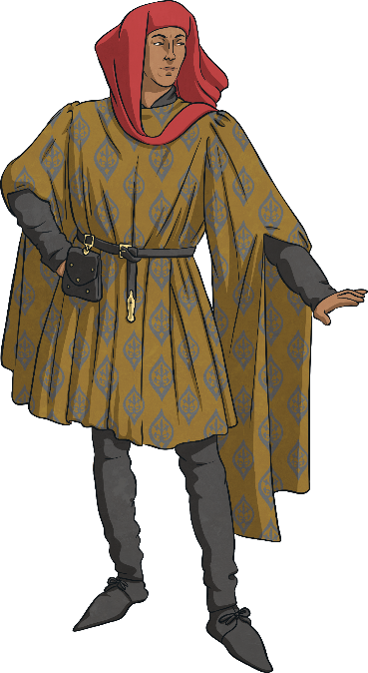
Who Are the Characters we Meet?
Prince Escalus
Benvolio
Paris

Slide 6
There is a terrible feud between the families of the Capulets and the Montagues. After yet another fight, Prince Escalus says the next person to fight will be put to death.

Slide 7
Romeo is a Montague and he is with his cousin Benvolio. Romeo’s a bit miserable because he likes a girl, Rosaline, but she doesn’t like him.

Slide 8
Now we meet Juliet who is a Capulet. A man called Paris wants to marry her. She is only fourteen so her father asks Paris to wait two years. Juliet’s father arranges a masked ball, inviting lots of people whilst hoping that Paris will win Juliet’s heart.

Slide 9
Romeo and Benvolio see the Capulet servant handing out party invitations. Benvolio thinks they should both go. Romeo agrees as he sees Rosaline’s name on the list. Meanwhile, Juliet also agrees to go and whilst at the masked ball, she will try to see if she might be able to fall in love with Paris.

Slide 10
The party begins at the Capulets’ house. Romeo arrives with Benvolio and their witty friend Mercutio. When they are inside, Romeo sees Juliet for the first time and instantly falls in love with her, forgetting about Rosaline. Tybalt (a Capulet at the party), recognizes Romeo and is angry Montagues have gate-crashed a Capulet party. Tybalt nearly starts a fight but Juliet’s father stops him.

Slide 11
Soon, Romeo speaks to Juliet and they both feel the chemistry. They kiss, not knowing they are from rival families. When they find out their families are enemies they are both distraught.

Slide 12
As Mercutio, Benvolio and Romeo leave the party, Romeo sneaks over the hedge to speak to Juliet who is on her balcony. This is where Juliet says the famous line: “O Romeo, Romeo, wherefore art thou Romeo?”

Slide 13
Romeo rushes to see Friar Lawrence, who, a little surprised to hear he loves Juliet when two minutes ago he loved Rosaline, agrees to marry them in secret. Friar Lawrence sees the possibility of ending the feud between The Capulets and The Montagues. The following day, Romeo and Juliet are married. (Only The Friar and Juliet’s Nurse knew about it).

Slide 14
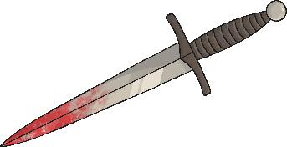
The next day, Romeo, Benvolio and Mercutio bump into Tybalt—Juliet’s cousin—who is still angry that they gate-crashed the feast and challenges Romeo to a duel. Remember, Romeo is now also a Capulet by marriage, so doesn’t want to fight a Capulet, but the others don’t understand why. Annoyed, Mercutio says that he will fight Tybalt himself. The two begin to duel. Romeo tries to stop them, but Tybalt stabs Mercutio and he dies. This gets Romeo really angry and he kills Tybalt.

Slide 15
Romeo panics and runs away as he has just killed a man. Soon after, Prince Escalus says Romeo is forever banished from Verona for his crime. Friar Lawrence arranges for Romeo to spend the night with Juliet before he has to leave for Mantua the following morning. While Juliet waits for Romeo, The Nurse tells her that Romeo has killed Tybalt. She is distraught that he has killed a Capulet but calms down and realises that Romeo is her love.

Slide 16
After his night with Juliet, Romeo leaves Verona. Juliet’s father is now keen for Juliet to marry Paris and arranges the wedding for three days’ time. Juliet can’t tell her family that she is already married. Her nurse tells her to just pretend Romeo is dead and marry Paris. Juliet is not happy about this and goes to see Friar Lawrence.

Slide 17
When Juliet sees Friar Lawrence, he has a cunning plan… Juliet can drink a potion that makes her look dead, then the Friar and Romeo will collect her and Romeo and Juliet can run away together and be happy.

Slide 18
The night before the wedding to Paris, Juliet drinks the ‘pretend-to-be-dead’ potion. The Nurse and her family find her, they are very sad and she is taken to the family crypt.

Slide 19
Something goes wrong with the cunning plan message getting to Romeo from Friar Lawrence, so he only hears that Juliet is actually dead. He arrives back, distraught and decides to drink some poison to kill himself as he thinks life is not worth living without Juliet. When he arrives at the tomb, he sees Paris scattering flowers and in a rage kills him.

Slide 20
Romeo now takes the poison and lays dead next to Juliet. Not long after, Juliet awakes from her sleep and is distraught to find Romeo dead next to her. The Friar arrives too late and tells Juliet what has happened. She is so distraught that she stabs herself with Romeo’s dagger and dies next to him.

Slide 21
Finally, Friar Lawrence comes back to the tomb after bringing back the Prince, the Capulets and Romeo’s father. The deaths of their children make the families realise that they need to make peace and they put up a monument in their memory.

Slide 22
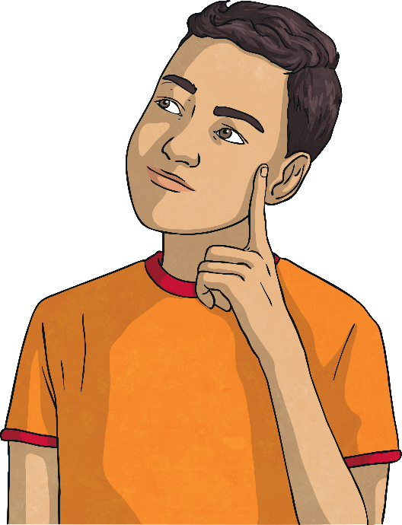
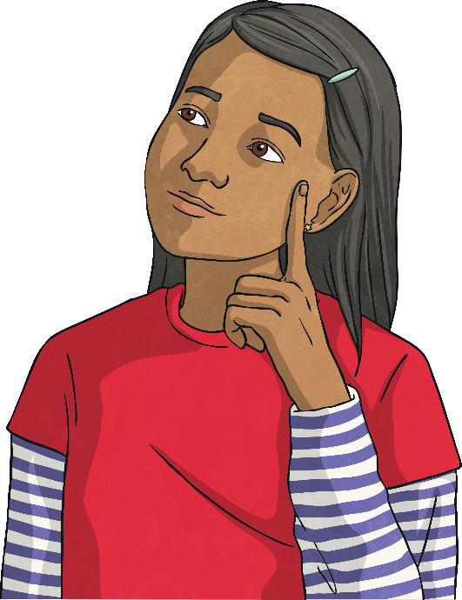
What can you remember?

