Slide 1
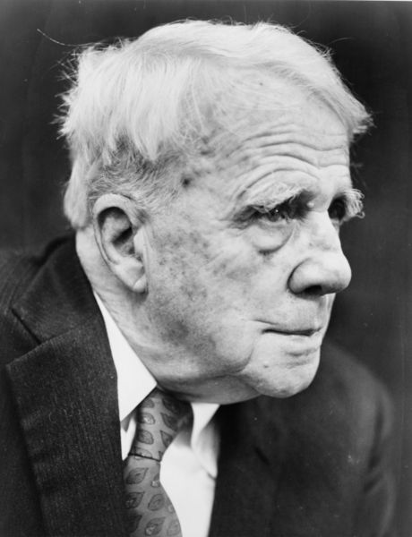
Robert Frost
1874-1963

Slide 2
Frost and Modernism:
Poets of the Modernist movement were influenced by the great developments in human thought and philosophy and science that had taken place at the end of the nineteenth century, notably the work of Sigmund Freud in psychoanalysis and Charles Darwin in science.
The experience of the First World War altered social attitudes and structures immeasurably. As it no longer seemed artistically credible to write the poems in the traditional metres and forms, the central tenet of the Modernist movement was ‘make it new’.

Slide 3
…
Frost was part of a literary circle in London. Unlike his contemporaries, however, whose quest for newness sometimes went to the absurd, Frost set out to be understood. He said “I could never make a merit of being caviar to the crowd the way my quasi-friend Pound does”.
From the beginning, he was traditionalist in form and metre. He avoided writing in free verse, for example, which he once famously described as playing tennis with the net down.

Slide 4
The settings of his poems are for the most part rural, whereas the Modernists saw themselves as poets of the metropolis. Their works constantly allude to classical literature, while Frost’s poems have often been praised for their lack of obscure references and their accessibility.

Slide 5
A Typical ‘Yankee’
The story of Frost’s subsequent career as a poet is interesting in the light it throws upon cultural attitudes in America.
His success can be partly explained by the fact that he persistently built up a public persona of himself as a typical Yankee – a plain man living in rural New England, a man for whom the hard work of farming was a source of real inspiration.
Biographers and critics of the poet have discussed the extent to which this persona was real or invented. They point to the fact that he was a distinguished teacher with a genuine interest in education and a deep thinker who was interested in philosophy and fascinated by the scientific developments of his time.

Slide 6
…
His poems, although immediately accessible, are never merely the simple ‘nature’ poems that they seem to be on the surface. As he said himself “I am not a nature poet. There’s always something else in my poetry.”
But he continued to play a role that appealed to the American view of what a wise poet should be.
Culturally, his life and his work are central to depiction of an ideal way of life that is essentially American: hard working, independent, full of down-to-earth common sense.
Social historians would point out that in the twentieth century, the American way of life became increasingly urbanised and remote from the rustic idylls Frost’s nature lyrics seem to offer.

Slide 7
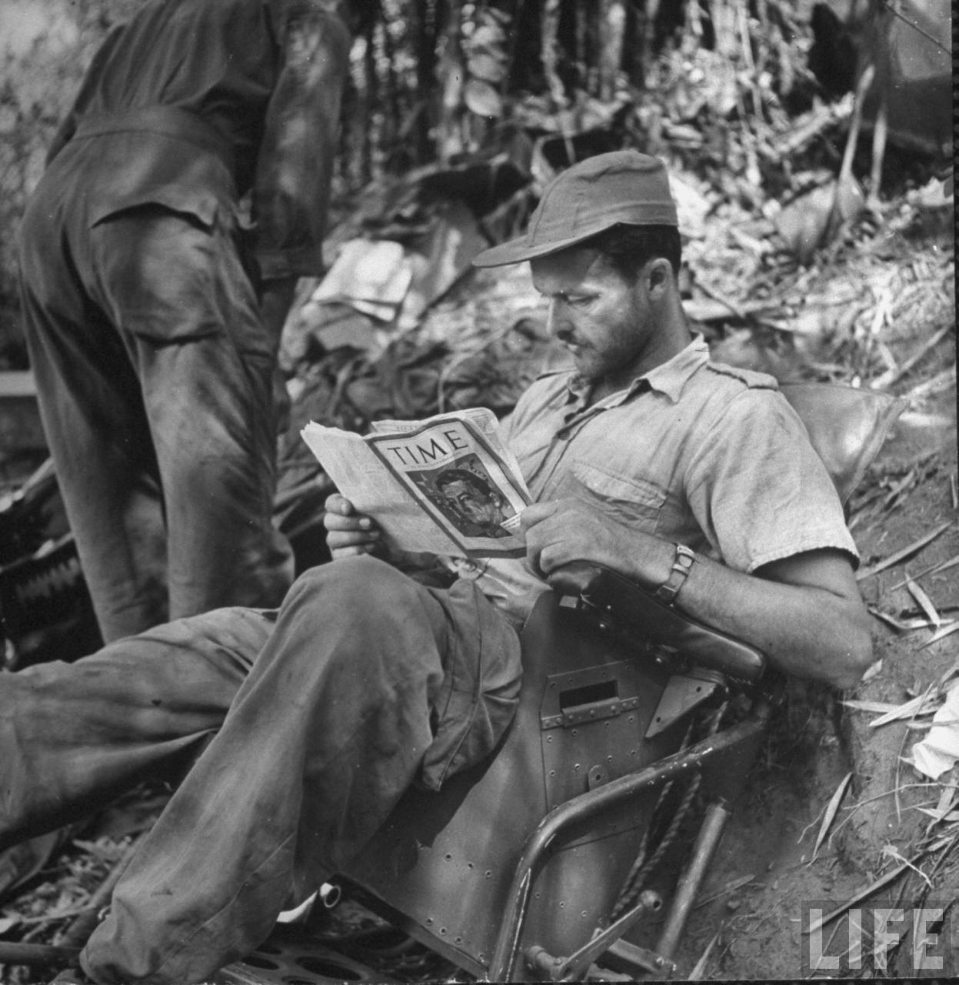
It may be that nostalgia played a part on the public acclaim of Robert Frost. Certainly in social and cultural terms he had a prominent role in American public life. During the Second World War, 50,000 copies of one of his poems were distributed to US troops stationed overseas to boost morale.

Slide 8
5 Key Points to Remember
1. Robert Frost was a contemporary of many of the great poets of the twentieth century, but his work differs from theirs in certain important respects.
2. Frost developed a theory of poetic language which he called the ‘sound of sense’. By this he meant that language in poetry should reproduce the exact tone of meaning in human speech.
3. Frost built up a public persona of himself as a typical Yankee – a plain man living in rural New England, a man for whom the hard work of farming was a source of real inspiration.
4. Culturally, Frost’s life and his work are central to the depiction of an ideal way of life that is essentially American: hard working, independent, full of down-to-earth common sense.
5. it may be that nostalgia played a part in the public acclaim of Robert Frost. Certainly in social and cultural terms he had a prominent role in American public life.

Slide 9
Concluding Paragraph:
In his work, Frost found greatest meaning in the natural world. Shunning the modern world of the city, and all the existential angst that the poets after the First World War sought to articulate, Frost relied for the most part upon the natural surroundings of his various farms to provide him with inspirations and symbols. But he always refused classification as a ‘nature poet’, insisting that his poems contained so much more. However, the appeal of Robert Frost to so many Americans during his lifetime, and subsequently, was the connection he allowed them to an almost forgotten world of nature in a modern world of urbanisation and industry - an issue which I can wholeheartedly relate to today.

