Slide 1
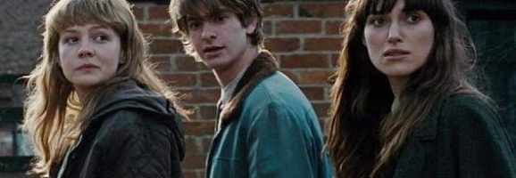
Mode: Relationships ‘Never Let Me Go’
By Kazuo Ishiguro

Slide 2
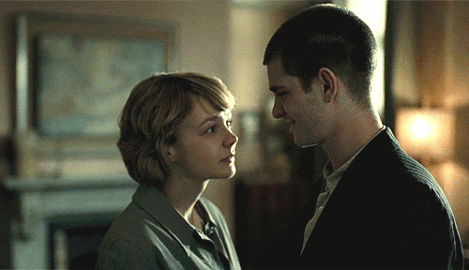
Key Relationship: Kathy and Tommy

Slide 3
From childhood, Kathy cares for Tommy and understands him in a way the other students do not. Tommy is prone to temper tantrums and his outbursts make him the butt of jokes in the school, but Kathy does her best to help him through these difficult moments.
One summer’s day, when Kathy is 13, the students deliberately goad Tommy into losing his temper by not choosing him for a team game. His predictable performance amuses the children, but Kathy knows Tommy is wearing his favourite shirt and she worries his frantic stamping in the mud will dirty it.

Slide 4
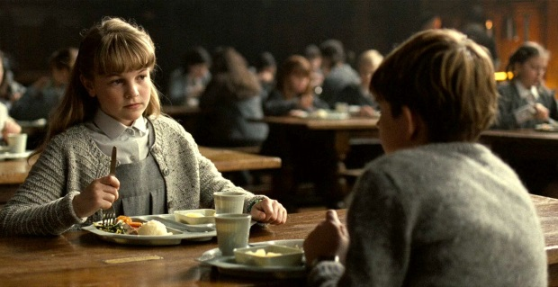
She leaves the group and approaches Tommy, warning him about his shirt. Although Tommy lashes out in his blind rage and strikes Kathy, her focus is still on helping him. She calms him down and advises him to go inside and get changed because he has mud all over his favourite shirt.
This little detail – knowing how Tommy feels about his polo shirt – surprises Tommy and demonstrates Kathy’s affection for him.

Slide 5
Tommy apologises to Kathy a few days later when they meet on the stairs, and this brief encounter strengthens the growing bond between them. Kathy takes an interest in Tommy and she summons up the courage to ask her fellow students to stop bullying them.
Kathy’s words fall on deaf ears but her attempt to spare Tommy further humiliation and pain shoes that she cares for Tommy in a way none of the others do.

Slide 6
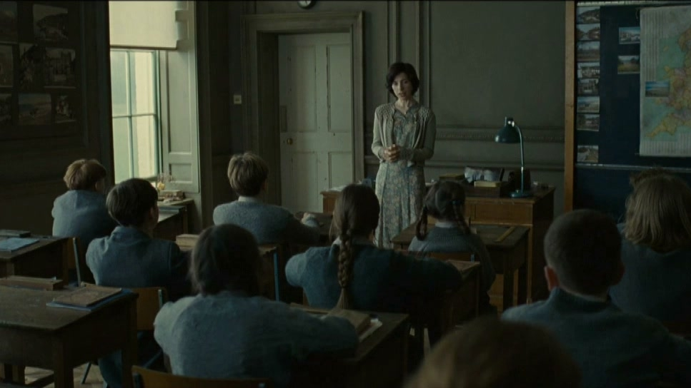
Tommy is understandably cautious about confiding in his fellow students, but after the incident on the playing field, he realises that Kathy is on his side.
Sometime later, when Kathy comments on his improved mood, Tommy tells her about his private conversation with Miss Lucy regarding the fate of the students.

Slide 7
Kathy suspects Tommy is lying and feels angry and betrayed after the months she has spent worrying about him. She walks off but notices that Tommy looks “bewildered and crestfallen” by her treatment of him. Later that day she repents and manages to find a time and place to have a private conversation with Tommy about his encounter with Miss Lucy. This is an important step in their relationship because it shows the growing trust between them.

Slide 8
The course of true love does not run smoothly in the story, however. Kathy and Tommy’s relationship is very complicated. By the time they are 16, they are not “talking so freely” any more for a variety of reasons.
Tommy’s temper tantrums seem to be on the verge of surfacing again and Kathy does not know why. After one of the ‘Exchanges’ she shows him a calendar drawn by another student. As Tommy looks at the illustrations, Kathy sees “something closing off inside him”.
He hands it back without a word and walks off. At the time she does not realise why he is so upset, but later Kathy realises that the drawings in the calendar reminded Tommy of his lack of creativity.

Slide 9
Part of the reason for Kathy’s inability to talk to Tommy and find out what was wrong during their final days at Hailsham stems from his relationship with Ruth. Ruth poses the most serious challenge to Tommy and Kathy’s relationship.
Ruth’s interest in Tommy is not real love, rather it is based on her desire to fit in and have what she believes everybody wants. At the time, however, Kathy does not realise this and she believes they are in love.

Slide 10
Kathy decides that if she is to have a sexual relationship with anyone, she will have to look elsewhere, and settles on another boy, Harry, to be her first lover.
Before anything can happen between Kathy and Harry, Tommy and Ruth break up and it is generally assumed that Kathy will be Ruth’s “natural successor”. Kathy backs off from her intention to sleep with Harry and harbours a secret hope that she and Tommy will get together.

Slide 11
That plan is swiftly brought to an end by Ruth’s manipulative ways. She decides she wants to go out with Tommy again and asks Kathy to speak to him about it. Kathy is doubtful, asking, “Ruth, are you serious about Tommy? I mean, if I do persuade him, and you get back together, you won’t hurt him again?”
Ruth assures Kathy she is very serious about Tommy and that relationships are not a game anymore, not when the students are on the brink of leaving Hailsham for the Cottages. Kathy does as Ruth asks and speaks to Tommy.

Slide 12
Although he does not commit to an answer straight away, he says he will think about it. Tommy is more concerned with what Miss Lucy told him about needing artwork as “evidence”, and he wants to focus on learning as much as he can about the future in store for the clones.
However, Miss Lucy leaves the school abruptly and that seems to break Tommy’s spirit. Almost immediately, he begins going out with Ruth again. Kathy’s hesitation to take this chance to strike up a romantic relationship with Tommy springs from her natural reserve. She is not as outgoing or determined to get her way as Ruth, and is therefore forced to watch as her two friends become an established couple.

Slide 13
It is difficult for Kathy to see Tommy and Ruth together, particularly as there seems to be something artificial about their relationship. When they move to the Cottages, Ruth copies the behaviour of the other couples who, in turn, model their behaviour on what they see on television. Kathy spots this and realises that Ruth does not truly love Tommy but is simply using him.

Slide 14
Kathy’s suspicions about Ruth appear to be confirmed when they, along with Tommy, Chrissie and Rodney, take a trip to Norfolk. Chrissie and Rodney are in love and ask if it is true that Hailsham students could postpone their donations if they could prove they were in love. Ruth pretends that she heard such rumours at Hailsham, which is a lie. Kathy loyally backs her up, but Tommy says “I don’t remember anything like that.” Ruth turns on him, telling the others that Tommy was never a “real Hailsham student” and that he was isolated and laughed at. Tommy is furious and upset but says nothing.

Slide 15
Later that same day, Tommy shows great sensitivity and thoughtfulness when he reveals to Kathy that he spent years looking for a treasured music tape she lost as a child. He did not succeed then, but now he takes Kathy around the second-hand shops of Norfolk, looking for a copy. Kathy eventually finds a copy and the discovery leads to mixed emotions for the young couple.
Kathy is sorry that their search, which had been the “perfect excuse for all this fun” is over. Tommy wishes he had been the one who found the tape, saying that he used to imagine what Kathy would say and do if he handed it to her.

Slide 16
It is little moments like the one in the second-hand shop that show that Kathy and Tommy share a far more meaningful bond than Ruth and Tommy do. Tommy also confides in Kathy that he is building up a collection of artwork in case he is ever asked to prove that he is a creative person capable of love and worthy of a deferral.
Further evidence of the deep understanding between Kathy and Tommy is shown by his realisation that when he once found her reading pornographic magazines, she was doing it to see if she could find the person from whom she was cloned.

Slide 17
He asks why Kathy might think she was modelled on a person like this. She explains that she sometimes has strong sexual desires and fears that they may be because of her background.
This topic upsets Kathy, and Tommy puts his arm around her when she begins to cry.
All the time, however, Kathy is conscious that Tommy is Ruth’s boyfriend and she is unwilling to jeopardise her friendship with Ruth by expressing her feelings for Tommy. The love triangle makes the situation extremely complicated.

Slide 18
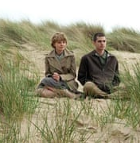
Ruth is upset when she discovers that Tommy and Kathy went searching for the tape and that she knew nothing about it. In typical manipulative fashion, she lures Kathy into laughing along with her when she says she does not think much of Tommy’s drawings.
Ruth uses this incident to drive a wedge between Kathy and Tommy, cruelly telling Tommy that Kathy agrees his art is no good. Once again, Kathy is unable to stand up to Ruth and merely walks away. She says “Something in me just gave up. A voice went: “All right, let him think the absolute worst”.”

Slide 19
The fight between Tommy, Ruth and Kathy is the beginning of the end of their time together. They pretend to get on well in the days that follow but there is a growing distance between them all. Kathy cannot mend the rift with Tommy because she does not find it easy to talk to him any more. They have drifted apart, mainly because of Ruth’s manipulative ways.

Slide 20
Ruth decides that the time has come to destroy any hopes Kathy might have had of getting together with Tommy. She says that even if she and Tommy were to break up, there would be no hope for Kathy because he could never see her as a “proper girlfriend”.
Cruelly, Ruth claims this is because Tommy is “fussy” and “doesn’t like girls who’ve been with … well, you know, with this person and that.”
On foot of Ruth’s devastating comment, Kathy decides to leave the Cottages and begin her training to become a carer. She keeps a distance from both Ruth and Tommy and very soon she leaves to start the next part of her life.

Slide 21
Seven years later, Kathy reunites with Ruth and Tommy. She has become Ruth’s carer and she and Ruth pick Tommy up on a road trip to the countryside to see a stranded boat. Ruth has kept Tommy and Kathy apart, but on this trip she openly repents, saying “it should have been you two.”
She urges them to find some sort of future together. Ruth believes that Tommy and Kathy’s love for one another is so strong that they have a good chance of being granted a “deferral”, and she gives them Madame’s address.

Slide 22
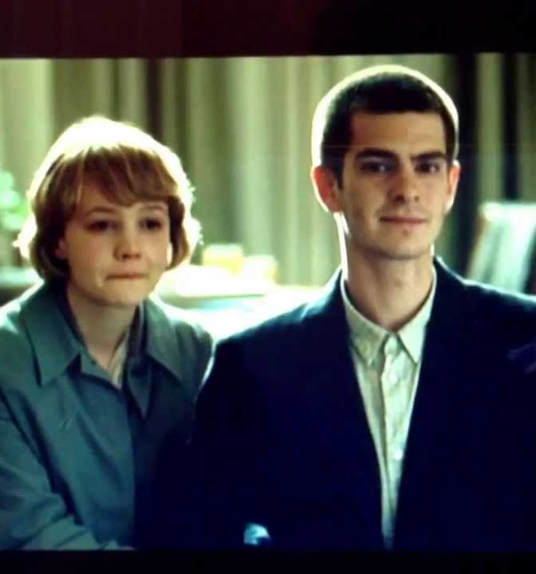
When Ruth dies, Kathy becomes Tommy’s carer. He has given his third donation and is very weak. However, they manage to have a physical relationship, which is marred by the awareness of all the time they have lost.
Eventually, Tommy and Kathy visit Madame and Miss Emily and learn the terrible truth: there are no deferrals, despite all the rumours. It is merely a desperate hope that the young people cling to before they resign themselves to their fate and accept that they can never have a normal life together.
Ultimately, Kathy and Tommy accept that all they can do is spend as much of their remaining time together as possible.

Slide 23
At the end of the novel, Kathy is alone. Ruth and Tommy have “completed” and she is about to begin her own donation journey. However, love has given her short life a great deal of meaning.
She says “I lost Ruth, then I lost Tommy, but I won’t lose my memories of them.”
These precious memories of love are both uplifting and heart-breaking.

Slide 24
