Slide 1
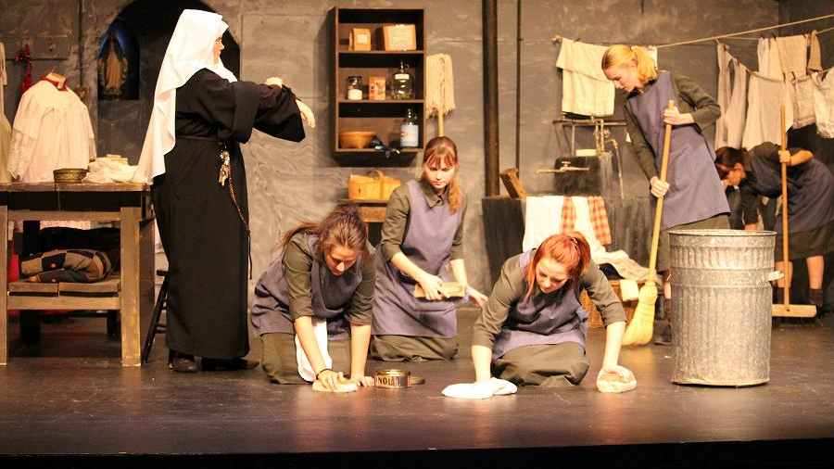
Mode: Relationships ‘Eclipsed’
By Patricia Burke Brogan

Slide 2
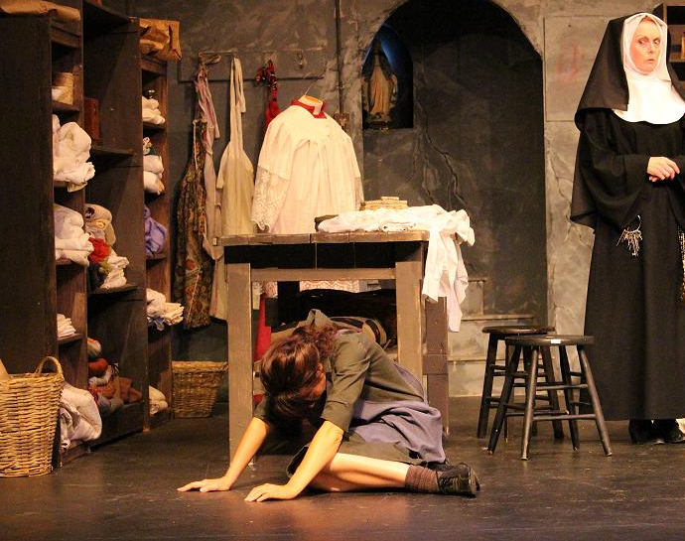
Key Relationship: Sister Virginia and the Women in the Laundry

Slide 3
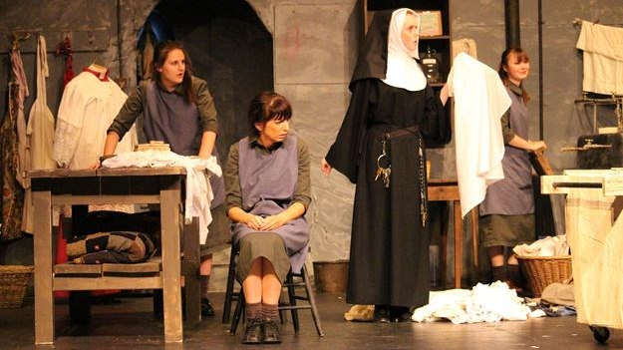
Sister Virginia’s relationship with the women in the laundry is complex. She sympathises with their situation and wants to do all she can to help them. However, she is relatively powerless and, in the end, can do nothing meaningful to improve their lives or even show them how much she cares.

Slide 4
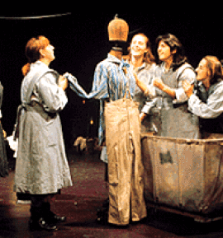
Our first indication that Sister Virginia is on the women’s side comes when she enters the laundry and sees Brigit imitating the Bishop and placing underpants on Mandy’s head while Nellie-Nora smokes, something that is forbidden by Mother Victoria.
Sister Virginia does nothing beyond telling Brigit and Mandy to stop fooling around and advising Nellie-Nora to be careful with the cigarette in case she burns the “precious Carrickmacross lace” on the Bishop’s clothes.

Slide 5
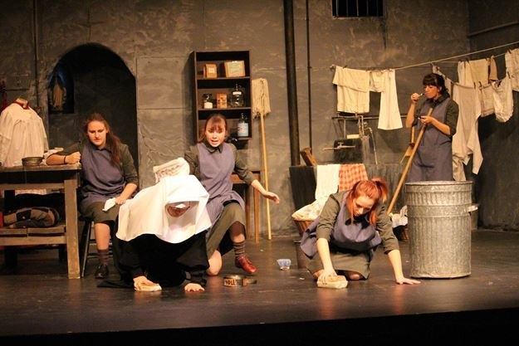
The women smile because they know Sister Virginia has heard them mocking the Bishop and the fuss made over the fancy lace.
Although she cannot openly agree with them or join in the fun, Sister Virginia’s tolerance and her comment on the lace show that she understands and likes the women in the laundry. Her kindness towards the women is apparent from the beginning.

Slide 6
Sister Virginia is deeply distressed by the institutionalisation of the women in her care. She gently encourages Juliet to consider leaving the laundry: “You mustn’t stay here! Take a job outside! Go away and see new places! Read the great books! Earn your own money.”
Unfortunately, Sister Virginia is fighting a losing battle. Her kindness is but a drop in the ocean compared to the cruelty these women have had to live with most of their lives. Eventually, Sister Virginia realises that her ability to connect with Juliet is not as strong as the young girl’s fear of the outside world, and she is left saying weekly, “I’ll – We’ll pray for you.”

Slide 7
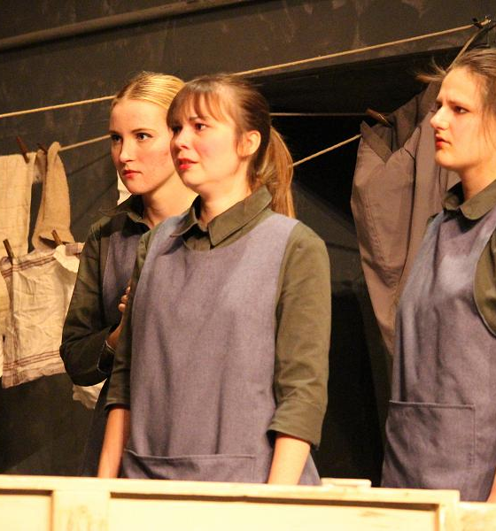
Sister Virginia’s attempt to form a relationship with the women is doomed to failure because no mater what she does, she is a member of the Catholic Church: the institution that runs the laundry and therefore imprisons the women.
At one stage, when Brigit learns that her boyfriend, John-Joe, is getting married the following week, she begs Sister Virginia for the keys so she can escape and tell him that they have a daughter together.

Slide 8
Clearly, he doesn’t know about the baby and Brigit believes that if she tells him, he will want the three of them to be a family.
Although Brigit’s dream is unrealistic, she needs to learn the truth for herself and she must leave the laundry in order to do so.
Sister Virginia says she cannot do anything because she is “not in charge”. When she leaves, Brigit expresses her disgust with her saying, “Bloody nuns! They don’t give a damn!”
This key moment shows that Sister Virginia is not able to be on the women’s side in a practical way as long as she is a member of the religious order running the laundry.

Slide 9
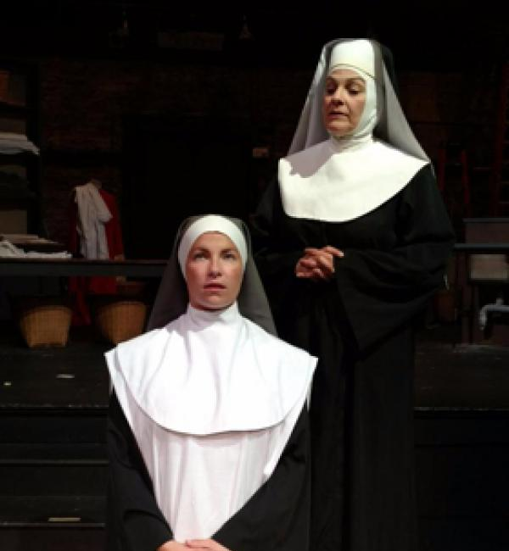
Sister Virginia comes to realise that she cannot reconcile her affection and sympathy for the women in her care with her role as jailor. She approaches Mother Victoria to ask if it is really necessary “to keep them locked away”.
She makes a spirited defence of the women, showing her understanding of their individual situations: “they need medicines – vitamins, fresh air, sunshine! – Cathy’s asthma! The attacks are more frequent! Brigit mourns the baby she gave up for adoption! She’s a bitter woman!”

Slide 10
Mother Victoria does her best to persuade sister Virginia what that her loyalties should be to the church not to the women in the laundry.
She tells the young nun that “Those women can be treacherous”, and points to an incident in which Brigit threw bleach at Sister Luke who now has “permanent scars on her face and hands.” To sister Virginia's credit, she is not put off by this story and remains loyal to Brigit and the others. she understands how the women were driven to acts of violence And it says that if her baby had been taken from her, she would “tear down the walls with my nails”.
Sister Virginia's empathy set her apart from Mother Victoria and the hierarchy of the Catholic Church.

Slide 11
Sister Virginia maybe powerless to do much to help the women, but she repeatedly tries to show them she is on their side. At the beginning of Act 2, Scene 2, Cathy struggles to polish the floor And says that the women need “machine for polishing instead of these old wooden blocks”.
When Brigit responds, “We're the machines, Cathy”, sister Virginia promptly says she will speak to mother Victoria about it, and when Cathy coughs asthmatically as she works, sister Virginia takes the heavy polishing block from her and continues the work herself.
The prayer Bell rings and Bridget reminds sister Virginia that she should be in the Chapel with the other nuns, but Sister Virginia stays where she is and continues polishing.

Slide 12
The women's reactions to Sister Virginia's attempts to befriend them vary.
Brigit thinks Sister Virginia is like all other nuns and that she joined the religious order because she is “afraid of men”. She believes that Sister Virginia will eventually become like all the older nuns, “waving her leather belt and treating us like dirt”.
Nellie-Nora and Cathy believe Brigit is too hard on Sister Virginia, but their arguments are not strong enough to influence Brigit who is the most strong-willed and vocal of the women in the laundry.

Slide 13
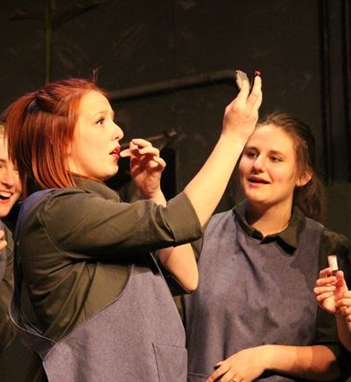
A crisis in Sister Virginia's relationship with the women occurs when Brigit’s offer of lipstick reminds Nellie-Nora of Mr Persse, Her former employer who raped her and made her pregnant. He had forced her to wear lipstick and perfume before the attack, and the memory causes Nellie-Nora to breakdown completely.
Sister Virginia enters with a box of chocolates to share with the women, and asks Brigit what she did to cause Nelly-Nora such distress. She tries to cheer Nelly Nora and the other women up by offering them some chocolates, but Brigit turns on her savagely, calling her “Pasty Face” and demanding the keys instead of “bloody chocolates”.

Slide 14
Brigit views Sister Virginia's repeated refusals to give her the keys as proof that she is only “Think to help” and is “just like the rest o’ them’ who think that if they stay locked up, they will “forget about living! About being alive!”
Brigit pushes Sister Virginia against a wall and asks her aggressively why she hasn’t ever had a lover. She questions Sister Virginia about her loyalties, calling her a scab, a spy and an informer, and she rips off her veil before throwing the nun on to the floor.

Slide 15
She scornfully rejects Sister Virginia’s claim that she wants to help and is on the women's side: “No! You’re not! I’d kill you, but you’re not worth it.”
Brigit throws the lipstick and the chocolates at Sister Virginia in disgust. The nun gathers herself together and leaves the room quietly.

Slide 16
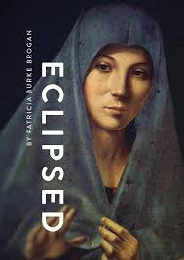
It would be reasonable to assume that bridge its treatment of sister Virginia would irreparably damage the nun’s affection for the women in her care, but it does not.
She continues to champion their cause, even writing a letter to the Bishop, begging him to come to the laundry and see how badly the women are treated.

Slide 17
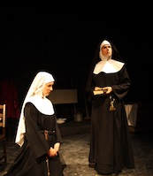
However, this letter is never sent because Mother Victoria intercepts it. She berates sister Virginia and reminds her that she warned her to “keep aloof from those women”. Sister Virginia protests that the women are “Sisters in Christ”, but Mother Victoria will have none of this. She is equally unsympathetic to Sister Virginia’s claim that she and the other nuns are “scarred for life” because they have been “jailers” to these women.

Slide 18
Sister Virginia's relationship with the women has no happy ending. She cares for them and wants to do her best to help them, but faces opposition from both sides. The women are distrustful because they see Sister Virginia as a representative of a hated authority, of their captors, and mother Victoria insists that sister Virginia view the women as “fallen” and “sinful”.
Sister Virginia wants to have a constructive and nurturing relationship with the women in the laundry, but she comes to see that she is powerless in the face of the Catholic Church, and the hostile feelings of the women, epitomised by Brigit.

Slide 19
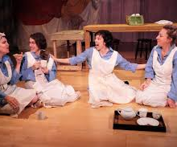
Ultimately, all sister Virginia's good intentions and genuinely warm feelings for Brigit, Nellie-Nora, Cathy, Mandy and Juliet Come to nothing because she is faced with such powerful antagonistic forces on both sides.

