Slide 1
Mode: Relationships ‘Brooklyn’
Directed by John Crowley
This Photo by Unknown Author is licensed under CC BY-SA

Slide 2
Key Relationship: Eilis and Tony
This Photo by Unknown Author is licensed under CC BY-ND

Slide 3
Eilis is lonely during her first few weeks in New York, but as soon as she meets Tony, things begin to look up. They meet for the first time at an Irish dance. Tony watches Eilis from a distance, and it is obvious he is attracted to her.
He looks on with quite amusement as a rather bored and frustrated young man tries to tell Eilis how to dance. The young man makes his excuses and leaves Eilis mid-dance so he can pair up with her more sophisticated and worldly housemate, Patty.

Slide 4
Tony makes his move, asking Eilis if she wants to dance and assuring her that inexperience is unimportant. Within a few minutes, they are slow-dancing together, much to Eilis’s housemates’ surprise. After all, despite not being as well-dressed or flirtatious as they are, Eilis managed to catch Tony’s eye.

Slide 5
Tony asks if he can walk her home and Eilis agrees, partly because she wants to get away from her awful housemate Dolores, and partly because Tony is attractive and mannerly.
Tony is not put off by the fact that Eilis is using him as an excuse to get away from Dolores and seems charmed by her openness.
Tony is straightforward and honest from the moment they meet. He tells Eilis that he is Italian but goes to Irish dances because he really like Irish girls. He is keen to have “everything out in the open”.
Eilis is more reserved, accepting Tony’s invitations but not making it clear how she feels about him.

Slide 6
There is inequality in the relationship because Eilis is better educated and a faster thinker than Tony. When she wants to, Eilis can run verbal rings around her boyfriend.
This is evident on their walk home that first night when he tells her that he really likes Irish girls and Eilis asks if she was the only one willing to dance with him.
Tony is flustered and replies, “Oh, no … it wasn’t …” and Eilis instantly responds with “Oh, so you danced with loads of others?”
This inequality is not a problem because Tony admires Eilis’s quick wit and intelligence. For her part, Eilis appreciates Tony’s kindness and decency.

Slide 7
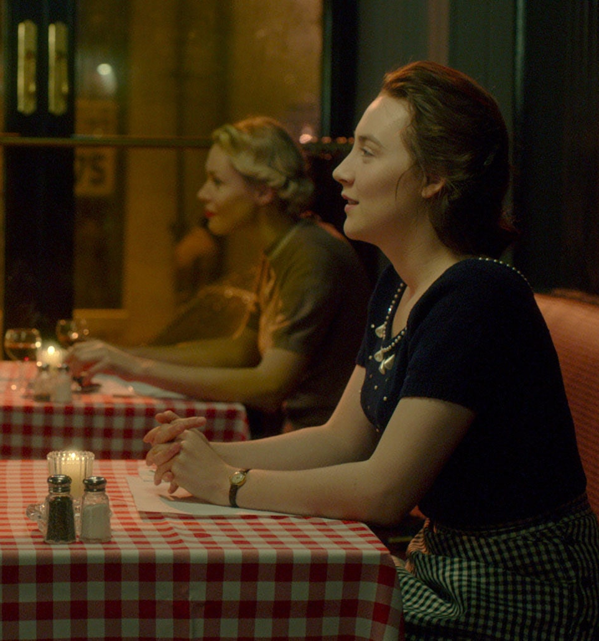
On their first proper date, Eilis tells Tony that she is studying bookkeeping because she wants to be an accountant. He is impressed and encourages her to tell him all about her classes.
Soon, Eilis is telling Tony all about her family and is so busy talking that she doesn’t eat her food.

Slide 8
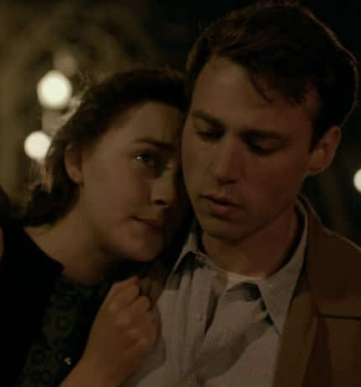
Having Tony as a boyfriend gives Eilis a sense of purpose. For the first time, she is happy in New York. Her supervisor notices the change in her and asks what the secret is, and Eilis replies, “I … I met somebody. An Italian fella.”
Eilis’s letters home also reflect this new-found happiness. She confides in Rose: “Tony has helped me to feel that I have a life here. I didn’t have, before I met him. My body was here, but my life was back in Ireland, with you. Now it is halfway across the sea.”

Slide 9
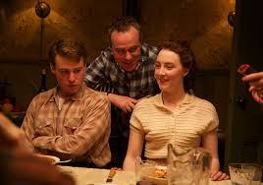
A slight difficulty in the relationship is Tony’s ready assumption that they will get married and start a family. He invites Eilis to dinner with his family and during a conversation around the table, he expresses his hope that he and Eilis’s children will be Dodgers fans.
Eilis is uncomfortable with this leap into an imagined future and thinks Tony is moving too fast.
On the walk home, Tony tells Eilis he loves her. He has no idea that he has made her feel uneasy, and he is clearly crushed when Eilis does not respond that she loves him too.

Slide 10
However, Eilis quickly comes to realise that she does indeed love Tony and tells him as much when he walks her home from her next night class.
Tony is delighted because he worried that Eilis was going to break up with him.
Happily, he agrees not to push her to commit to any future together just yet.

Slide 11
The relationship faces a crisis when Eilis returns to Ireland for a while after the sudden death of her sister, Rose. Tony is anxious and fears that Eilis will not return, telling her honestly “I’d be afraid every single day”.
In an effort to ensure that she does come back, he shows her a plot of land on Long Island where he and his brothers plan to build five houses, one of which he will keep as a family home for himself and Eilis if she is willing.
He is concerned when Eilis doesn’t respond immediately, and he asks her to think about it at least. She smiles and says “I don’t need to think about it”.

Slide 12
Although Eilis’s acceptance of Tony’s house plans is a good sign, it is not quite enough for him, so he also begs her to marry him in secret before leaving for home.
Eilis asks if a promise of marriage will do, but Tony replies “If you can promise, then you can easily do this.” Yet again, it is Tony who is pushing the relationship forward while Eilis seems a little more hesitant.
However, once Eilis has accepted Tony’s proposal, she takes the lead for a change, inviting Tony into her room so they can make love. He is surprised but delighted, and they spend their first and only night together before Eilis returns home.

Slide 13
Once home, Eilis finds herself drawn into life in Enniscorthy. Her friend Nancy is keen to set her up with the eligible, well off Jim Farrell, and Eilis begins to fall for him.
She stops opening Tony’s letters. Tony is deeply worried and asks his little brother to help him write to Eilis, admitting to the boy that she has only written back once.

Slide 14
The letter he writes with his brother’s help is read-out as a voice-over to Jim and Eilis’s trip to the beach. The language is childish and unsophisticated: “Dear Eilis, I hope that you are doing well in Ireland. I hope that your mother is feeling less sad. It will not be long before your friend gets married and you can come home.”
Far from improving the situation, this heartfelt attempt to communicate seems to make the gap between Eilis and Tony’s relationship more obvious than ever.
His simplistic, rather awkward expression contrasts sharply with what Eilis calls Jim Farrell’s calm, civilised and charming manner.

Slide 15
At this stage, the relationship seems to be in deep trouble, and when Jim asks her to stay with him and makes it clear that he would like to marry her, Eilis is tempted. For the first time, she sees the possibility of a happy and fulfilling life in Ireland.

Slide 16
Surprisingly, it is the spiteful and vindictive Miss Kelly – Eilis’s former employer – who brings Tony and Eilis back together again. In a private conversation, she gleefully tells Eilis that a rumour is going around about her marriage to Tony.
As Eilis observes the small-minded, spiteful, gossipy old lady, she remembers what life is really like in her hometown, and what she has left behind in New York.

Slide 17
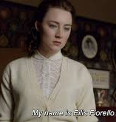
Forced to make a choice and decide on her priorities, Eilis instantly decides to go back to Tony.
She tells Miss Kelly, with pride and confidence, that her name is “Eilis Fiorello” before walking straight to the Post Office to book a sailing back to America.
Although Eilis knows she is doing the right thing, it is nonetheless incredibly difficult to admit the truth to her mother. She cries as she tells her heartbroken but understanding mother, “I want to be with him. I want to be with my husband.”

Slide 18
On the ship, Eilis gives advice to a young girl and her words become the voice-over for her reunion with Tony. She tells the girl that although she will be lonely, she will meet someone who will make her feel that the sun is coming out at last, someone who has no connection with the past and is hers alone.
The film ends with Tony catching sight of Eilis leaning against a wall waiting for him as he comes out of a shop. He smiles broadly, runs over to her and they embrace lovingly as Eilis’s voice over says “and you’ll realise, this is where your life is.”
This uplifting, positive ending to the film cements Eilis and Tony’s relationship and leaves us with the belief that they will lead a wonderfully happy life together.

