Slide 1
Comprehension Question B & Composition Overview
Aoife O’Driscoll
www.aoifesnotes.com

Slide 2
Theme
The theme is written in block capitals on the cover page of the exam.
The theme will reflect an aspect of life that is relevant to young people.
There is no obligation to stick to that theme in the Comp B or composition, but it can be an aid to your planning and can guide your reading of the texts.
Don’t waste time trying to predict the theme!
The theme will never be controversial or specific. So, for example, ‘Covid 19’ will never appear, but you might see something like ‘Challenges’ or ‘Uncertainty’.

Slide 3
Themes – on the cover page of the exam Will reflect an aspect of life that is relevant to young people There is no obligation to stick to that theme in the comp B or composition, but it can be an aid to your planning and can guide your reading of the texts.
2015 - 2020
2009 - 2014
2003 - 2008
2020 – Exploring Genre
2019 – Feeding Our Imaginations
2018 – Young Writers
2017 – Different Worlds
2016 – Journeys
2015 – Challenges
2014 – Influence
2013- Story-telling
2012 – Memory
2011 – Mystery
2010 – The Future
2009 - Decisions
2008 – Identity
2007 – Change
2006 – Pretence
2005 – Ordinary lives
2004 – Work and Play
2003 – Journeys

Slide 4
Two writing tasks – short and extended
Comprehension Question B
50 marks – 12.5% of overall exam
Forty-five minutes
Equivalent to marks for prescribed poetry
Short, focused writing task
Composition
100 marks – 25% of overall exam
An hour and twenty minutes
Choice of seven titles
Four main areas: opinion pieces, personal essays, short stories, descriptive essays

Slide 5
Tip
You can prepare for both the long and the short composition tasks at the same time.
Speech writing and feature articles, for example, could be a Comp B or a Composition task.

Slide 6
Comprehension Question B
Choose
Choose your Comp B question first.
Have
Have an idea which type of task suits you best.
Do
Do you know what type of task this is? If not, maybe choose again…
Cross out
When you have chosen your Comp B, cross out the Comp A questions from that text.
Read
Read the text which accompanies the Comp B question. Sometimes this is essential (diary entry based on events in the text) but in all cases the text can give you ideas and tips.

Slide 7
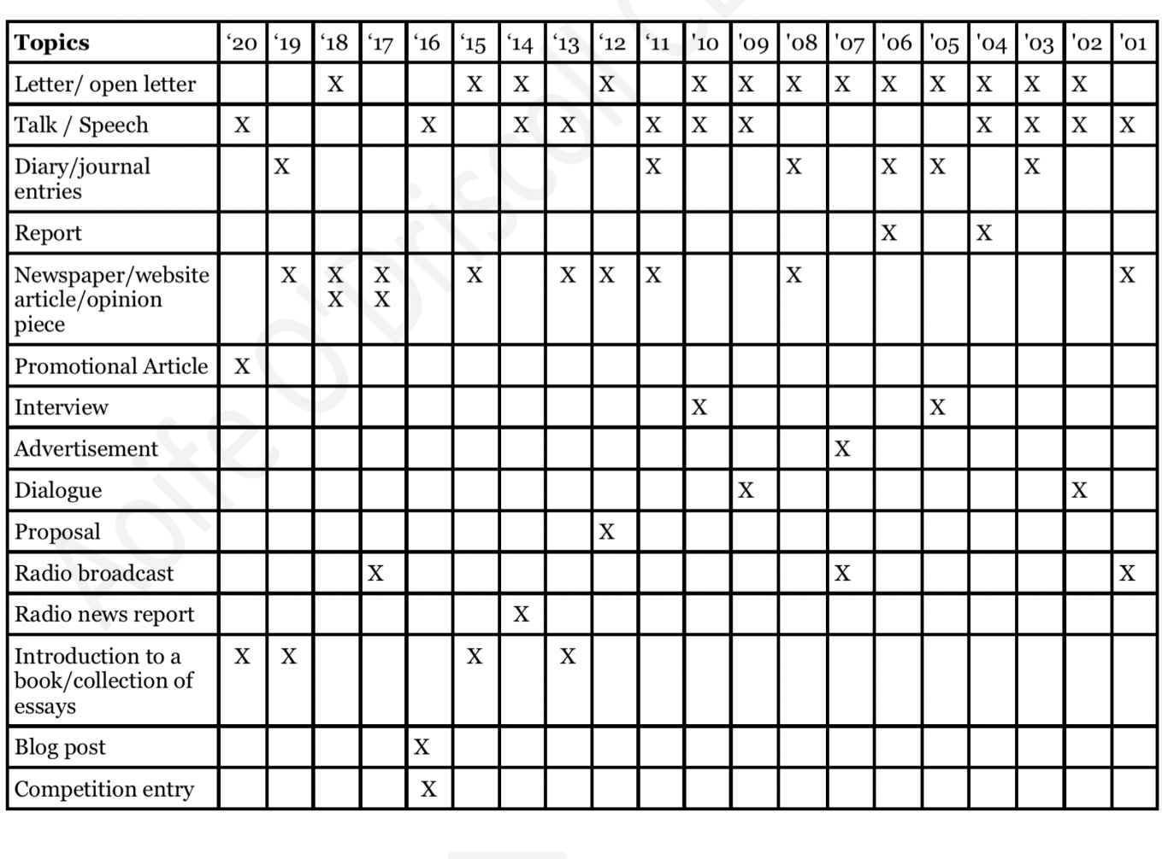
Types of task – Comp B

Slide 8
Planning your answer – Four questions
What is the task? Be clear on this. Is it a letter, blog post, article? If you are not sure, think again.
What should the content be?
Who is my audience? This will determine the level of formality and will affect the content.
What language genre/genres should I use?
NB
In recent years, candidates have been asked to address THREE things in the Comp B task. You do not need to give them all equal treatment, but if you leave one out, you will be penalised.

Slide 9
Don’t trust your memory!
Number each thing you are asked to do.
Write a very brief summary of each aspect of the question to ensure you remain focused.

