Slide 2
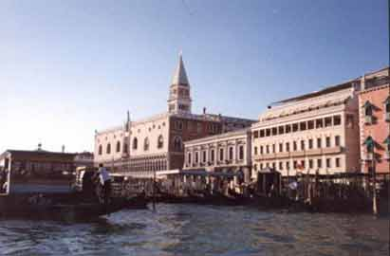
Venice

Slide 3
Venice was famous as an important Mediterranean trading centre for goods from the Far East. Silks, spices, jewels and other expensive items were bought and sold there - including slaves. It had the reputation of being full of fashion, culture and sophistication. It would have been a very exotic location for an Elizabethan audience.

Slide 4
Venice was run by a Duke, or Doge, and a Council of Ten, who ruled with an iron fist. All Venetians were encouraged to do whatever they had to for the security of the state, even spying on other ports. People who were seen to have committed a crime against the state were often killed without trial and their bodies were left in the street to serve as a warning to others.

Slide 5
Because of Venice's position as a centre for trade, it was full of people of many different nationalities, religions and races. The Christian leaders were keen to quell the activities of the Jews, and so created one of the first Jewish ghettos, forcing the Jews to live in a particular area. Yet the Jewish community continued to flourish in spite of the prejudice shown against them.

Slide 6
Belmont, Portia's home, is an imaginary setting. All we know about it is that it is two days' sail away from Venice. It seems to be a beautiful, rich country estate.

Slide 7
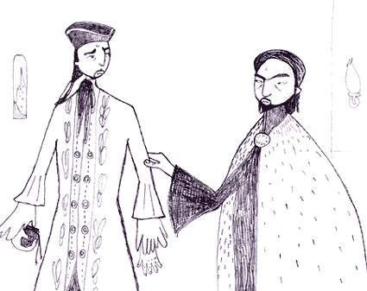
Christians & Jews

Slide 8
Although Jesus Christ himself was born a Jew, there have been battles between Jews and Christians for 2000 years. This is because the Romans who then ruled the area where they lived - now known as Israel - tried to crush the Jewish faith. Many Jews moved away to escape persecution, taking their customs and cultures with them. Through their hard work and consequent success in business, Jews were often resented in their new homes, especially in Christian countries. Terrible crimes were committed against them.

Slide 9
In England, when Shakespeare was writing, Jews had been banished for the past 300 years. Shakespeare's audience would not have known any Jews; their knowledge of Jews would have been based solely on rumour and prejudice. They would have enjoyed the verbal insults and racist jokes against Shylock, and would probably not have questioned the treatment Shylock receives as we do today.

Slide 10
The worst ever persecution of Jewish people occurred comparatively recently, before and during World War II (1939 - 45). The Nazi party convinced the Germans that the Jews were responsible for the country's economic problems and so began the Holocaust: 6 million Jews were killed in Germany and other European countries, many in gas chambers at concentration camps. The Diary of Anne Frank will give you some idea of the horrors of that time.
And, unfortunately, Jews are still being persecuted in different countries around the world today.

Slide 11
The plot breakdown
The deal between Antonio, a merchant of Venice who makes his money from trading fine goods carried to and fro in his sailing ships, and Shylock a Jewish moneylender. The deal goes wrong when a number of Antonio's ships perish at sea and threaten him with ruin. Shylock is determined to earn the pound of Antonio's flesh that was promised him instead of interest when the loan was made. Can Antonio escape death?

Slide 12
The love between Portia and Bassanio

Slide 13
The elopement of Shylock's Jewish daughter, Jessica, with the Christian Lorenzo

Slide 14
A trick Portia plays on Bassanio to test his love of her

Slide 15
Act 1
Antonio - The Merchant of Venice - is sad, but his friends cannot discover why. All the ships in which his money is invested are at sea, but he claims this is not what is worrying him - he has many ships, which makes good business sense. (In other words, he is not risking all his eggs in one basket.) His best friend, Bassanio, asks Antonio to lend him even more money than he already owes him, to help him win the hand of a rich and beautiful heiress, Portia. Antonio has not got any spare cash, but agrees to borrow money to help him.
Portia complains about the restrictive terms of her father's will to her maid, Nerissa. She can only marry the man who correctly guesses whether her portrait lies within a gold, silver or lead casket. She wittily attacks the most recent batch of suitors, none of whom she would have dreamed of marrying. The only man she has ever met whom she thinks worthy of praise is Bassanio.

Slide 16
Antonio and Shylock, a Jewish moneylender, arrange the details of the loan: Shylock will provide Bassanio with 3000 ducats, but instead of charging interest, Antonio will owe Shylock a pound of his own flesh if the money is not repaid within 3 months. Although Bassanio is not happy with the terms, Antonio is confidant that his ships will return in profit in plenty of time.

Slide 17
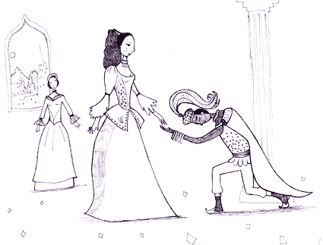
Act 2

Slide 18
The Prince of Morocco arrives in Belmont to woo Portia and try his luck with the caskets.
Lancelot, one of Shylock's servants, plans to leave Shylock and work for Bassanio instead.
Gratiano, Bassanio's trusted servant, gets permission from his master to travel to Belmont too - on condition that he improves his manners!
Shylock's daughter, Jessica, tells Lancelot that she will miss him when he has gone, but then discloses she is planning her own departure - she is going to elope with the Christian Lorenzo.

Slide 19
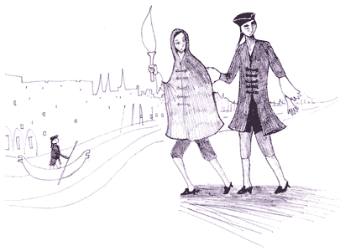

Slide 20
Shylock has been invited to dinner by Bassanio, but is nervous about the evening and feels that something is about to go wrong. He tells Jessica to take special care to lock up the house carefully while he is away - yet while he is gone, she elopes with Lorenzo, dressed as a young male torchbearer - carrying a large amount of Shylock's wealth with her!
The Prince of Morocco chooses the gold casket and so loses his chance to marry Portia.
Back in Venice, there is news of Shylock's rage on the discovery of his missing treasure and his missing daughter. There is also news that a galleon has been wrecked - could it be Antonio's? - and we hear that Bassanio had an emotional parting with Antonio before leaving for Belmont.
The Prince of Arragon, another suitor for Portia's hand in marriage, chooses the silver casket and is also proved wrong. News reaches Portia that Bassanio has arrived.

Slide 21
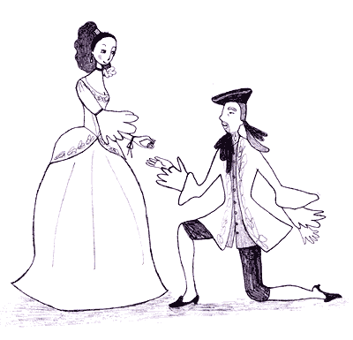
Act 3

Slide 22
Antonio's friends mock Shylock over the loss of his daughter.
After news reaches Venice of the loss of another ship, Shylock, argues forcefully that he is just as much a man as a Christian and therefore will follow that the example the Christians set and seek revenge. When he hears that yet another of Antonio's ships has been lost, Shylock gleefully orders the arrest of Antonio.

Slide 23
Although Portia urges Bassanio to take his time in choosing a casket (not wanting to lose him if he chose the wrong one), Bassanio goes ahead. He chooses the lead casket that contains Portia's portrait, to much rejoicing. Portia hands Bassanio a ring as a symbol of their love. Gratiano and Nerissa become engaged too.
Jessica and Lorenzo arrive in Belmont - so all the lovers are together. Yet then news comes that disturbs their happiness.
Antonio has sent Bassanio a letter telling him that all his ships have been lost. Portia sends Bassanio to Antonio straight away, with enough money to settle the debt to Shylock several times over.
Antonio is in prison, longing to see Bassanio once more before he dies. Shylock is keen to have his pound of flesh.
Portia and Nerissa leave Lorenzo and Jessica in charge of Belmont, saying that they are going to a convent during their husbands' absence. Yet Portia sends a letter to her cousin, asking for men's costumes and tells Nerissa that they will see their husbands again soon, disguised as men...
Jessica tells Lancelot that Lorenzo has converted her to Christianity. She talks of how much she admires Portia.

Slide 24
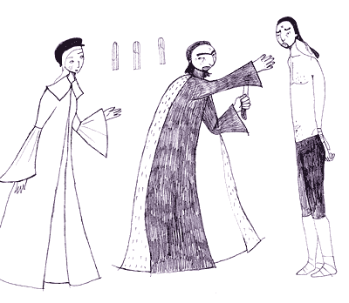
Act 4

Slide 25
The trial
The Duke hears the details of the case between Antonio and Shylock. He expects Shylock to be merciful, but Shylock refuses: he is determined to have his bond. He also refuses Bassanio's offer of 6000 ducats (double the amount owed), claiming his right to justice. He sharpens his knife, preparing to cut away the pound of flesh.
Portia enters, disguised as a lawyer, Balthazar. Shylock is not swayed by Portia/Balthazar's arguments to be merciful either, nor by an increased offer of money, so Portia/Balthazar grants him his wish: the bond must be honoured. Shylock prepares to cut out a pound of Antonio's flesh from near his heart. Antonio prepares to die.
At the last minute, Portia/Balthazar points out that the bond makes no mention of blood - so that if Shylock spills the smallest drop of Antonio's blood, his act is illegal. Shylock, realising he has been defeated, says he will simply take the 3000 ducats owed him, but Portia/Balthazar insists (as Shylock had himself insisted) that he must take the bond only. So, Shylock is left with nothing.
Things then become even worse for Shylock, because Portia/Balthazar cites an ancient rule that says anyone who has attempted to kill a Venetian should be condemned to death and have their wealth confiscated. The Duke grants Shylock his life, but rules that his wealth should be split between Antonio and the state. Antonio requests that part of the money should go to Jessica. However, in a final humiliation, Antonio says that Shylock has to become a Christian.

Slide 26
Antonio and Bassanio thank Portia/Balthazar for having saved Antonio's life, offering him money as a reward, but Portia/Balthazar will accept nothing but Bassanio's ring. He gives it away, reluctantly, at Antonio's request.
Nerissa (acting as Balthazar's clerk) collects the ring and tells Portia that she will try to obtain Gratiano's ring in the same way.

Slide 27
Act 5
Jessica and Lorenzo talk of love, comparing their own love to famous lovers in history.
Portia and Nerissa arrive back in Belmont shortly before Bassanio and Gratiano, so that their husbands do not know that they have been away. The women mock the men about the loss of their rings, saying that they will not sleep with their new husbands until the rings are returned. Only when Bassanio has sworn eternal fidelity does Portia reveal the joke.

Slide 28
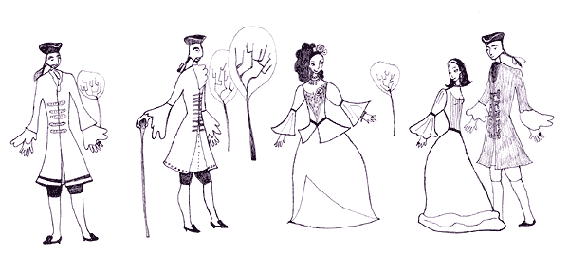

Slide 29
Portia tells Antonio that three of his ships have been saved (so he is not ruined, as he had thought).
Portia tells Jessica and Lorenzo that Shylock has given everything he has to them.

