Slide 1
Poetic Techniques
Hello!
Ms. Deasy
Hi!

Slide 2
What is Poetry?
Poetry is a type of literature based on words and rhythm.
In poetry, words are put together to make different sounds, images and ideas.
N.B! Not all poems rhyme.
Poems can vary in length, style, techniques and themes.

Slide 3
Poetic Techniques
There are many different types of poetic techniques.
Poets use these techniques to emphasize a point.
Poets also use these techniques to highlight a certain theme.
Poets may also use these techniques to provoke an emotional reaction from the reader.

Slide 4
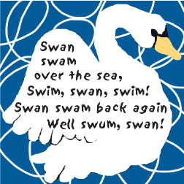
Alliteration
Alliteration is the repetition of the same letter or sound at the beginning of closely connected words.
Examples;
● Peter Piper picked a peck of pickled peppers.
● Sheep should sleep in a shed
● Coca-cola
● Krispy Kreme

Slide 5
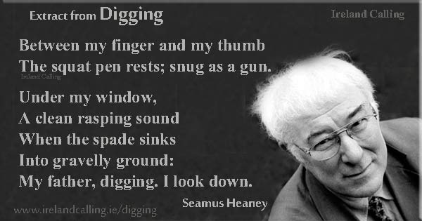
Seamus Heaney using Alliteration

Slide 6
Can you think of any examples of Alliteration?

Slide 7
Assonance
Assonance is the repetition of the vowel sound in a sentence.
Assonance is mainly used to make the words more memorable to the reader.
Goodnight, sleep tight, don’t let the bedbugs bite.

Slide 8
Difference between Alliteration and Assonance
Try not to mix the two up!
Alliteration and Assonance are similar as both rely on the repetition of words that are beside or close to one another.
BUT..
Alliteration is the repetition of the same letter or sound at the beginning of words and Assonance is the is the repetition of vowel sounds.

Slide 9
Allusion
“He was a real Romeo with the ladies.”
Romeo was a character in Shakespeare’s play, Romeo and Juliet, and was very romantic in expressing his love for Juliet.
A reference to another writer or to something else which is not really part of the main body of the poem.

Slide 10
Couplet
Two successive lines of poetry which have the same rhythm and rhyme.
These two lines often contain a complete thought.
''So long as men can breathe, or eyes can see,
So long lives this, and this gives life to thee.''

Slide 11
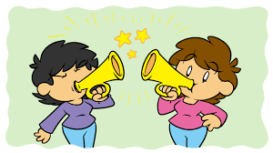
Cacophony
Harsh or discordant sounds, often the result of repetition and combination of consonants within a group of words.

Slide 12
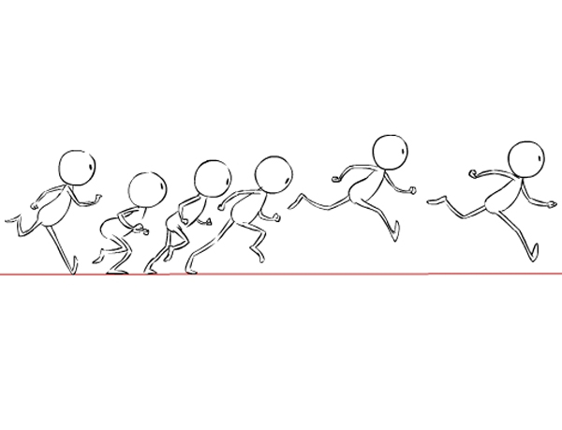
Enjambment / Run on Lines
When a sentence continues into the next line of the poem without any punctuation mark. Enjambment is often used to suggest fast action or movement.
Enjambment is sometimes called a ''run-on line”.

Slide 13
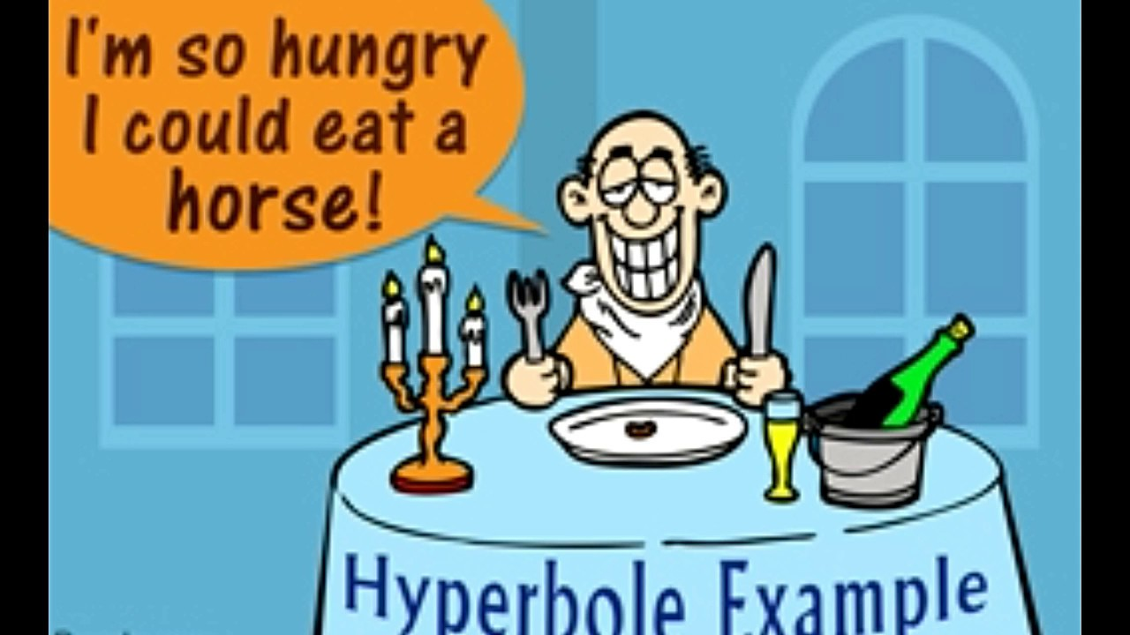
Hyperbole
A hyperbole is exaggeration used to emphasize something.
It is not always literal/true.
Examples:
She was dying with laughter!
I’m so hungry I could eat a horse!

Slide 14
Hyperbole in Poetry
Where is the hyperbole in this poem?
‘As I Walked Out One Evening’ – W.H Auden
“I’ll love you, dear, I’ll love you
Till China and Africa meet,
And the river jumps over the mountain
And the salmon sing in the street”

Slide 15
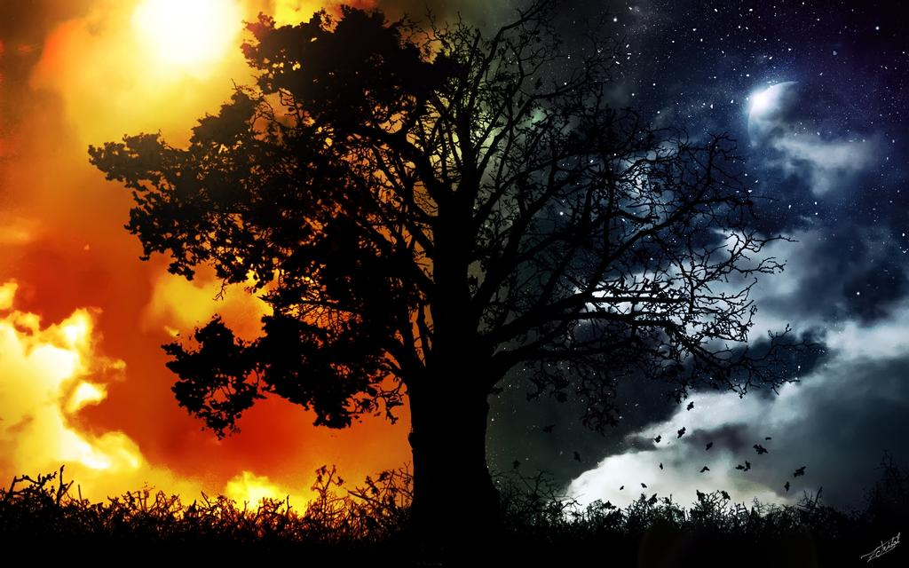
Imagery
Poets use vivid imagery to describe objects, actions, and ideas in their poems.
Imagery engages readers senses such as taste, touch, sight and hearing.
“It was dark and dim, children were shouting and screaming”

Slide 16
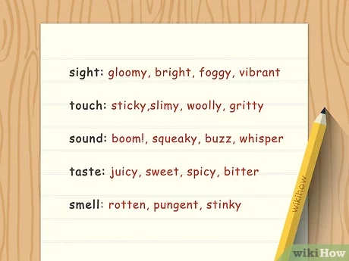

Slide 17
Examples:
The assignment was a breeze.
He is a shining star.
Your room is a pigsty.
Mary has a heart of gold!
The students of that school are all brains!

Slide 18
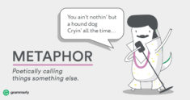
Can you come up with any of your own?

Slide 19
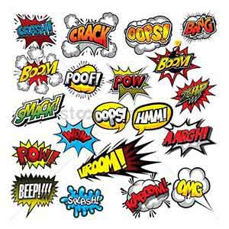
Onomatopoeia
Onomatopoeia is when a poet uses words that imitate the sound they make.
Onomatopoeia is when a word sounds like what it means.
(The buzzing bee flew away)
This Photo by Unknown Author is licensed under CC BY-NC-ND

Slide 20
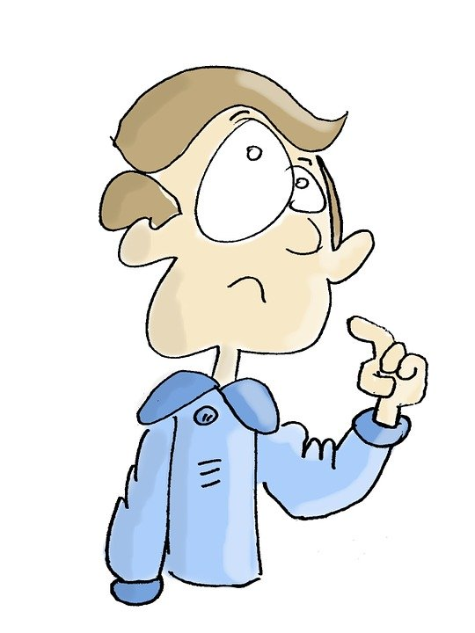
Onomatopoeia
‘Thud’, ‘crash’, ‘bang’ and ‘buzz’ are all examples. Can you think of any more?

Slide 21
Personification
This poetic device refers to the use of human characteristics or abilities to describe a non-human thing or object.
Example: The rain pounded on the window.

Slide 22
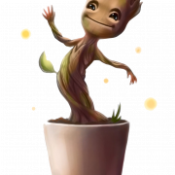
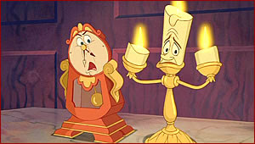
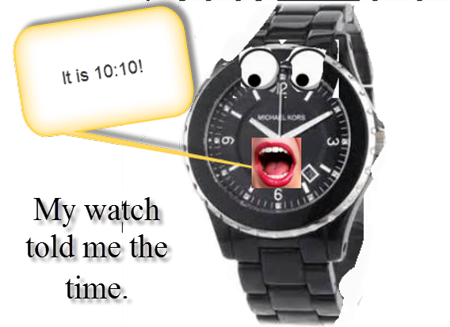
Your turn!

Slide 23
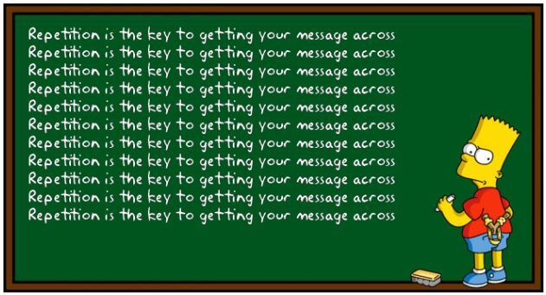
Repetition
Repetition refers to the repeating of a word, within a short space of words.
Poets use repetition to emphasize a feeling, idea or to create a sense of urgency.

Slide 24
Simile
A simile is a figure of speech that compares two things, using the words ‘like’ or ‘as’.
As brave as a lion.
They fought like cats and dogs.
He is as strong as an ox.
As light as a feather.
As cold as ice.
As black as coal.
Last night, I slept like a log.

Slide 25
Simile

Slide 26
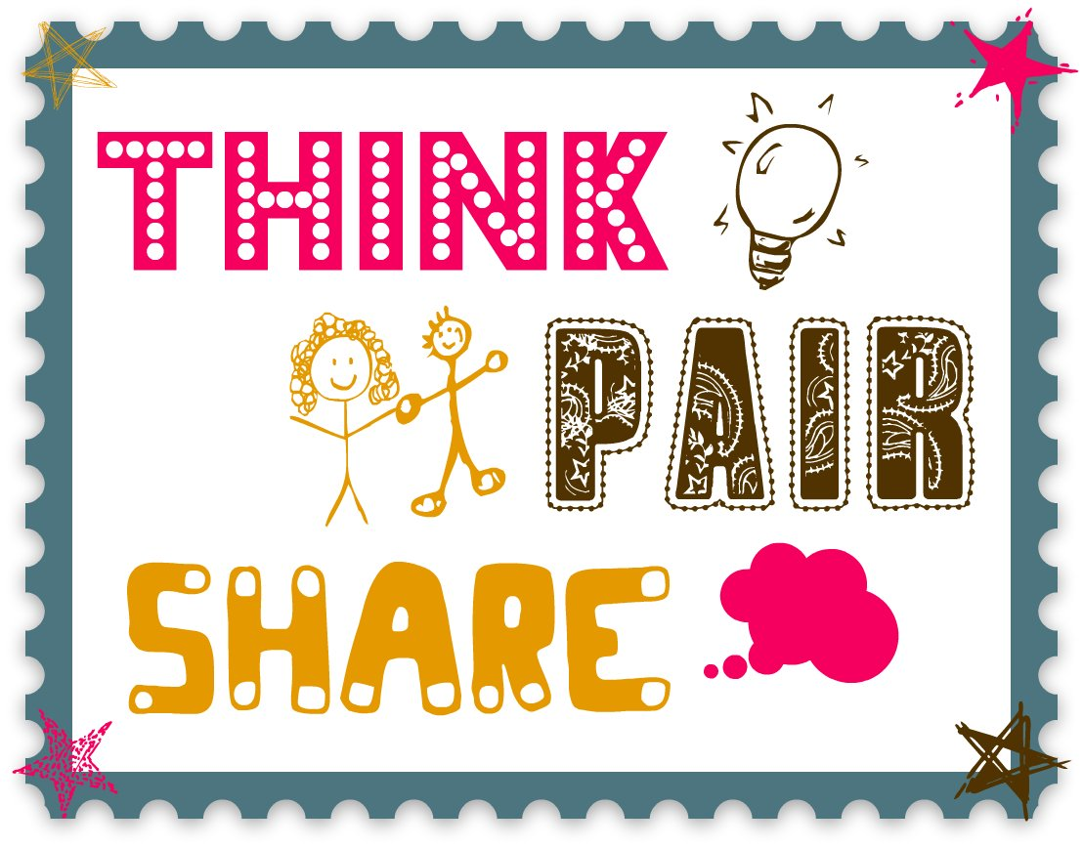
Your turn to come up with some similes
This Photo by Unknown Author is licensed under CC BY-SA-NC

Slide 27
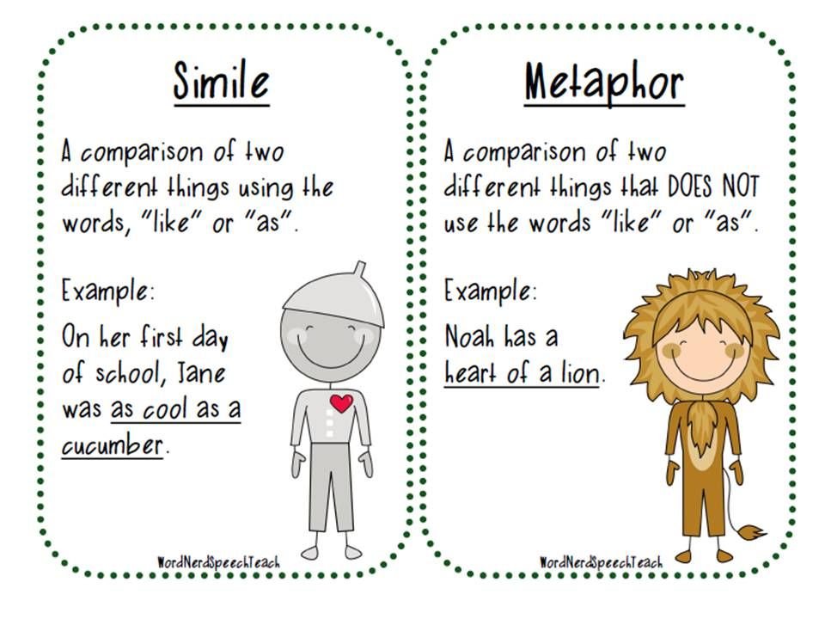

Slide 28
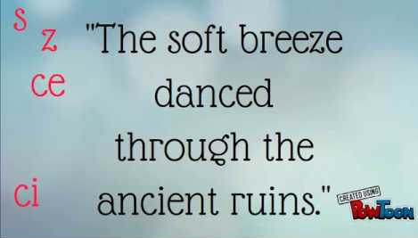
Sibilance
Sibilance is a figure of speech in which a hissing sound is created within a group of words through the repetition of "s" sounds.

Slide 29
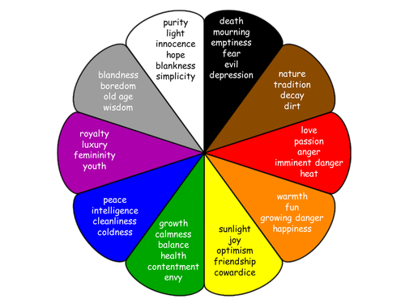
Symbolism
Symbolism is the use of a symbol a meaning or idea.
Symbolism can be used to express the poets emotions.
Sometimes, symbols can mean different things to different readers.

Slide 30
Symbolism
‘A Red, Red Rose’ by Robert Burns
Oh my Luve is like a red, red rose
That’s newly sprung in June
O my Luve is like the melody
That’s sweetly played in tune.
What is the rose a symbol of?
-
-
-
-
-
-
-

Slide 31
Theme
The main message of the poem – what the poem is about. It is not the story of the poem.

Slide 32
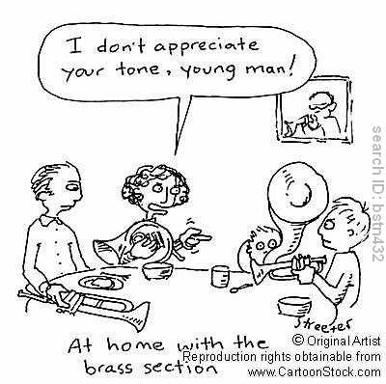
Tone
The poet's mood or attitude towards the subject of the poem

Slide 33
Let’s Recap!
Alliteration
Assonance
Imagery
Repetition
Is when words start with the same sound.
Repeated vowel sounds (AEIOU)
Vivid language to represent ideas.
When a word/words are repeated for effect.
Symbolism
Simile
Onomatopoeia
Personification
The use of symbols to represent deeper meanings.
Comparing two things using ‘like’ or ‘as’.
Describing objects as if they are people.
A word which sounds like what it means.

Slide 34
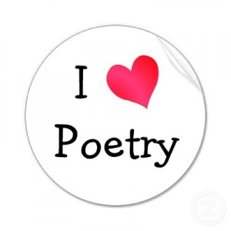
Let’s Recap!
Allusion
Cacophony
Theme
Tone
Referring another writer’s work.
Harsh sounds
Main message/ Idea of the poem
The writer’s attitude towards the subject of the poem
Sibilance
Couplet
Repeated ‘S’ sounds
Two lines with the same rhythm and rhyme

