Slide 1
Paul Durcan

Slide 2
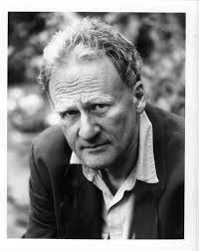
Paul durcan: Biography
Born in 1944 in Dublin. His childhood was divided between Dublin and Mayo where his father worked as a circuit court judge and his mother was trained as a solicitor.
His childhood was characterised by a turbulent relationship with his father who subjected Durcan to regular beatings for trivial things, in particular his academic performance.
His relationship with his mother was much more gentle and though he believes he was a disappointment to her, she always supported him.
Durcan was an extremely talented young sportsman but at the age of thirteen his sports career was over when he contracted a bone disease

Slide 3
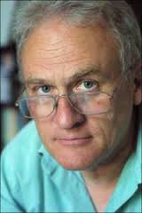
Paul Durcan: Biography
Durcan maintains that he did not suffer from mental illness as his family alleged. However he says he has suffered from depression and insomnia ever since the ECT treatments. He said "Here were these authoritarian, cocky middle-aged men telling me they knew everything about me. "They could inject electricity and gas into you so as to make you conform."
In 1965 Durcan fled hospital and made his way to London where he became friendly with the poet Patrick Kavanagh. Kavanagh became a surrogate father for Durcan and he saw him almost every day.

Slide 4
Paul durcan: Biography
His first collection of poetry Endsville, which he co-authored with Brian Lynch, was published in 1967. Soon after, Durcan met Nessa O’Neill at a wedding Kavanagh had invited him to. They were later married and had two daughters before returning to Ireland in 1970.
Durcan went back to education, studying archaeology and medieval history at UCC after reportedly being informed by the English department he did not understand English or poetry and “had no future in it”. Durcan describes this as “one of the most traumatic moments” of his life.

Slide 5
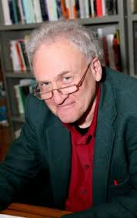
Paul durcan: Biography
He carried on writing, despite the lack of encouragement, and received first class honours in his degree as well as the Patrick Kavanagh Poetry Award in 1974.
In 1984 Durcan and Nessa decided to end their marriage after sixteen years. This painful and traumatic event is captured in his poetry as his response to his father’s death in 1988. Durcan’s poetry deals with themes of love, marriage, family and Ireland and its history.

