Slide 1
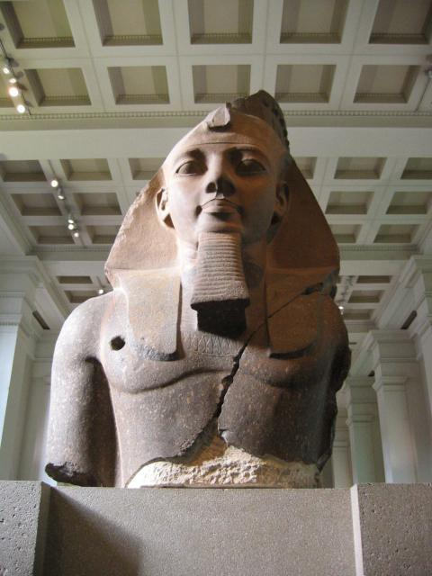
Who is this statue of?

Slide 2
Ramses II, Pharaoh, Ozymandias

Slide 3
What happened to the statue?

Slide 4
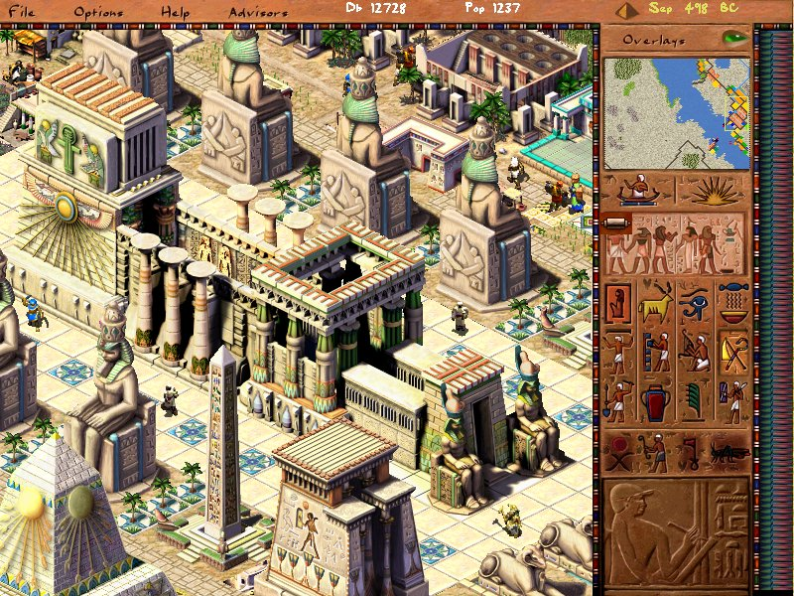
Ramses was known for building a lot

Slide 5
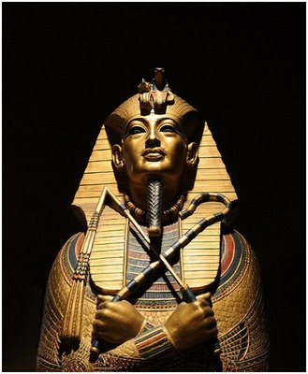
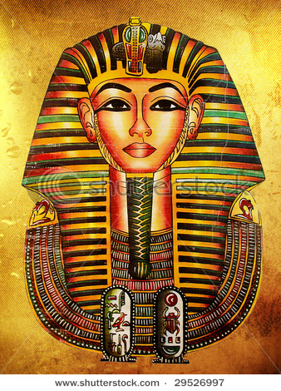
Known for the many “works” he created of himself

Slide 6
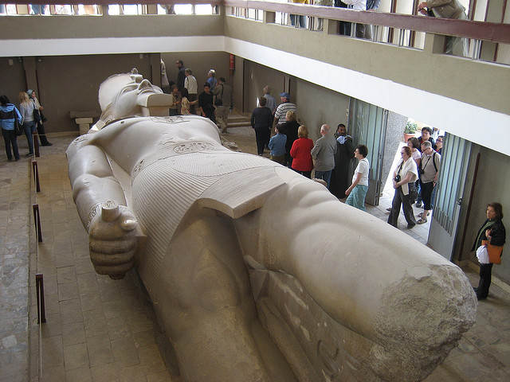
And there are many more…

Slide 7
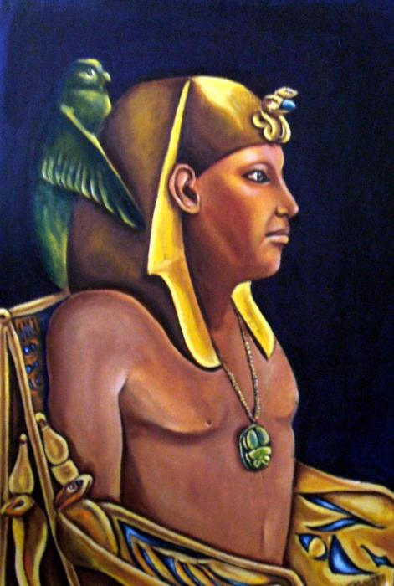
What Kind of a leader was Ramses the Great?
Distinguishing different perspectives:
From our perspective, he
was probably very charismatic.
took every possible advantage of
reign.
exercised total control.
was megalomaniac.
was ruthless in wars.
was cruel to his subjects and to strangers.

Slide 8
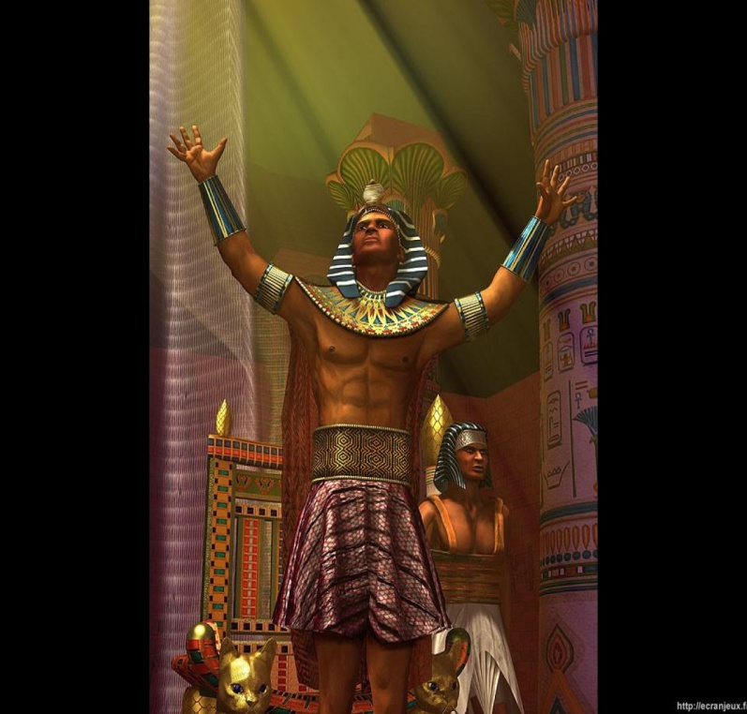
What kind of a leader was Ramses the Great?-Continuation
Distinguishing different perspectives:
In ancient times, he was probably considered
neither better nor worse than any other Egyptian king.
did what Egyptian pharaohs were suppose to do.

Slide 9
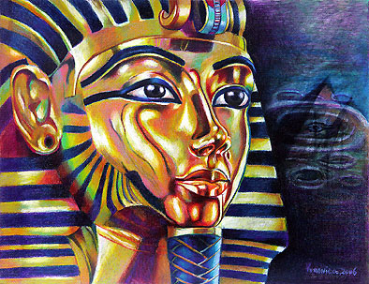
Conclusion
We can’t really judge him by our norms.
We must judge him by norms and ideas of his culture, not ours!

Slide 10
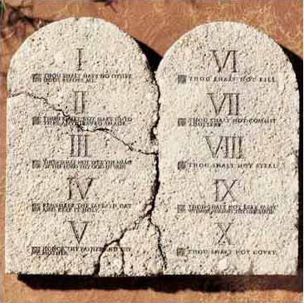
On the other hand, a different culture warned against the use of statues and pictures for worship
The Second Commandment:
"You shall not make for
yourself a graven image,
or any likeness of anything
that is in heaven above, or
that is in the earth beneath,
or that is in the water under the earth;
you shall not bow down to them or serve them…”
Exodus:20:3 or Deuteronomy:5:7

Slide 11
The value of MODESTY
Goes back in our culture to biblical times.
It’s mentioned several times in the Bible.
Maybe, to prevent cases of such power-hungry rulers, like Ozymandias…?

Slide 12
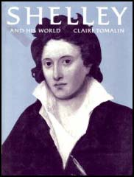
Ozymandias/Percy Bysshe Shelley (1792-1822)
A British Romantic poet.
Like other romantic poets, he wrote about the return to nature, freedom, democracy and human rights.
Many of the poems often use ancient stories as sources of inspiration.
Ozymandias is his most famous poem.

Slide 13
The Poem: Ozymandias
The name: a combination of two Greek words: ozium= breath, air; mandate= to rule
A sonnet- little song (Italian)
Sonnets usually contain 14 lines.
the octave- the first 8 lines: the question/the problem
the sestet- answers the question/ resolves the problem

Slide 14
Reading the poem-page 82
The Octave- the problem
I met a traveller from an antique land
Who said: "Two vast and trunkless legs of stone
Stand in the desert. Near them on the sand,
Half sunk, a shattered visage lies, whose frown
And wrinkled lip and sneer of cold command
Tell that its sculptor well those passions read
Which yet survive, stamped on these lifeless things,
The hand that mocked them and the heart that fed.

Slide 15
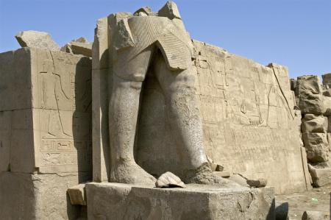
Let’s see again what the traveller saw

Slide 16
And the other part

Slide 17
Reading the poem- continuation
The Sestet- the resolution
And on the pedestal these words appear:
`My name is Ozymandias, King of Kings:
Look on my works, ye mighty, and despair!‘
Nothing beside remains. Round the decay
Of that colossal wreck, boundless and bare,
The lone and level sands stretch far away".

Slide 18
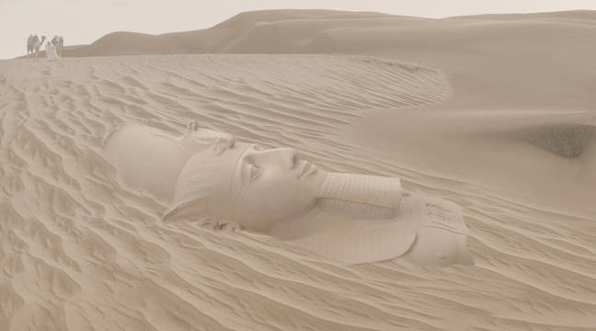
Let’s finish this presentation together:
If YOU could, what would YOU say to Ozymandias?

