Slide 1
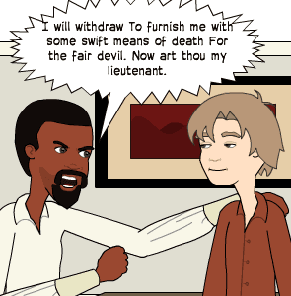
‘Othello’ by William Shakespeare - Characterisation
The Character of Othello
Ms Deasy
This Photo by Unknown Author is licensed under CC BY-SA-NC

Slide 2
Key adjectives
When we first meet him he is:
Noble, honourable, dignified
Capable, accomplished, masterly (as a general)
Composed, calm, self-possessed, unflappable, imperturbable
Affectionate (towards Desdemona)
Kind, considerate, thoughtful
However, transformed by Iago’s evil scheming, he becomes:
Coarse, vulgar
Cruel, heartless
Degraded, bebased

Slide 3
Before he appears on stage we are led to believe that the Moor is professionally bombastic and proud and personally lascivious (Iago dwells on the general's abhorrent black sexuality in the opening scene). But Othello's appearance in Act I Scene 2 immediately contradicts this reductive assessment. Instead we see an impressive figure who displays a number of fine qualities; openness, sincerity, a natural authority, cool-headedness.
Shakespeare stresses the paid mercenary's nobility. The Moor is the descendant of a royal line of kings (Othello refers to his birthright when he defends his right to marry Desdemona) and has been an impressive military commander.
In the early scenes of the play we come to understand that Othello is self-confident but modest, just and generous. His attributes indicate that we should view him as a hero, as does his customary mode of speech (Othello almost always speaks in verse and is a fine rhetorician, despite his protestations to the contrary).
This Photo by Unknown Author is licensed under CC BY-SA

Slide 4
Noble and Composed
At the beginning of the play Othello is a highly esteemed figure. Lodovico describes him as having been the complete man, ‘all-in-all sufficient’.
Othello is admired for his military prowess and leadership, ‘valiant Othello’ (Duke). He is the man the Venetian Senate turn to when the Turkish fleet threatens Cyprus, ‘Another of his fathom they have none to lead their business’ (Iago).
The audience see him as being noble and composed. Othello remains calm and reasonable in the face of Brabantio’s racist insults and threatening behaviour, defusing a potentially explosive situation with his quiet authority, ‘Keep up your bright swords for the dew will rust them. Good signior, you shall more command with years than with your weapons’.

Slide 5
A man of fine personal qualities
Othello speaks of Desdemona with obvious affection, ‘O my soul’s joy!’ He is concerned that she might be disturbed by the drunken brawl, ‘See if my gentle love be not raised up’. He is considerate and courteous towards the wounded Montano, ‘Sir, for your hurts, myself will be your surgeon’. Various characters testify to Othello’s admirable character: ‘my noble Moor is true of mind’ (Desdemona); ‘He was great of heart’ (Cassio); ‘The Moor . . . is of a constant, loving, noble nature’ (Iago).

Slide 6
Othello’s open and trusting nature
While this is an admirable trait, Iago sees it as a weakness that he can exploit. Othello, naively assumes that everyone else is as sincere as he himself is (‘Certain, men should be what they seem’) and never doubts Iago’s trustworthiness.
In the second half of the play, Othello’s noble mind is debased and corrupted by Iago’s insinuations and lies. From the moment Othello asks Iago to have Emilia spy on Desdemona, we see the poisonous effects of Iago’s venomous scheming. At the end of the temptation scene, it is apparent that Othello craves revenge – not justice, ‘Arise black vengeance from the hollow of hell!’

Slide 7
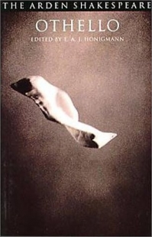
Othello’s degradation is reflected in the coarsening of his language. As well as diabolic imagery (‘O devil!’) he uses the animal imagery generally associated with Iago, ‘Goats and monkeys!’ Having addressed Desdemona as ‘my soul’s joy’ when he first arrives in Cyprus, he now calls her ‘a subtle whore’ and ‘impudent strumpet’. The once noble Othello publicly insults and strikes his wife, prompting Lodovico to wonder aloud about the Moor’s sanity.
This Photo by Unknown Author is licensed under CC BY-SA

Slide 8
Transformed into a Cruel Monster
As a consequence of Iago’s evil scheming, the Othello that we see towards the close of the play is very far removed from the ‘all-in-all sufficient’ Moor so admired by the Venetian senate. In the dramatic final scene Othello pictures himself as the agent of justice and declares, ‘Yet she must die, else she’ll betray more men’. However, this is no more than self-delusion as Othello struggles to justify to himself the murder of the woman he still loves. In reality he has become a bloody avenger bent on achieving ‘a capable and wide revenge’. Desdemona does not die because justice demands it, but dies because Othello is intent on vengeance, ‘O blood, Iago, blood!’

Slide 9
Regains some Nobility
At the close of the play Othello regains some of his former nobility as he calmly assesses both his military career (‘I have done the state some service’) and his own tragic flaw, (‘one not easily jealous but, being wrought, perplexed in the extreme’). He acquires a degree of self-knowledge and redeems his honour by taking his own life.

