Slide 1
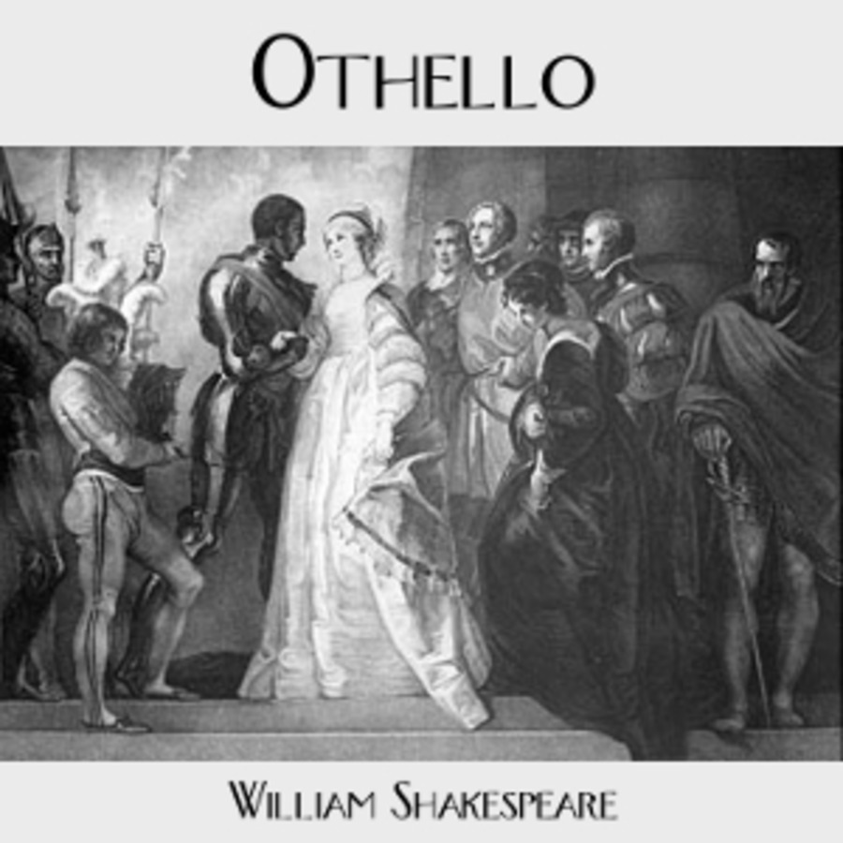
‘Othello’ by William Shakespeare Background
Ms Deasy

Slide 2
The Source of ‘Othello’
Shakespeare delighted in taking old stories, adding his own particular brand of genius, and creating something new and better. He based Othello on a story in a collection of tales, called Hecatonimithi, written in 1565 by Giraldi Cinthio, an Italian. A short synopsis of the original story gives some indication of how Shakespeare merely borrowed stories and made them his own.

Slide 3
The heroine, called Disdemona, falls in love with a Moor. Her family agrees reluctantly to her marriage with him, and the couple lives together in Venice for awhile.
• The Moor (given no name) is sent to command the troops in Cyprus. The Moor and Disdemona travel there together, and it's in Cyprus that the ensign (Shakespeare's lago) plots against them.
• The ensign is in love with Disdemona. He feels that her rejection of him comes from her love of the captain (Shakespeare's Cassio). Therefore, the ensign's plot is against Disdemona, not the Moor.
• The captain loses his job when he attempts a fight with another soldier; he isn't drunk, and the character of Roderigo has no counterpart.
• The ensign steals Disdemona's handkerchief (while she is holding his child) and places it in the captain's house. The captain finds it and tries to return it to Desdemona, but he leaves quickly when he hears the Moor's voice.
• Together, the Moor and the ensign kill Disdemona by hitting her on the head with a sandbag, and then making the roof collapse to make it look like an accident, The Moor is eventually killed by a relative of Disdemona, and the ensign is tortured to death for another crime. The ensign's wife has known the story all along.

Slide 4
By making the Moor the center of his tragedy, Shakespeare created a character of nobility and sympathy. (The Moor in the Cinthio tale is unsympathetic.) He transformed an ugly little tale of sexual jealousy into a character study of a good man who, for all his virtue, is caught in a trap of evil and can't escape. It was Shakespeare's genius to take the stuff of melodrama and transform it into tragedy of the highest.

Slide 5
Racism
In the 17th century, racism was an accepted part of public life; people of color were often thought of as "savage." Shakespeare would have encountered no societal pressures against presenting such ideas. Yet he doesn't actually portray Othello as inferior.
Although Iago and Roderigo make him sound despicable in their disparaging first-act conversation, Shakespeare then shows Othello as a well-spoken and highly regarded military leader who has won the hand of an aristocratic woman. Iago's treachery is what ultimately tears him apart.
Does Shakespeare mean to portray Othello as inferior? Or does he show Othello's internalization of the harsh prejudice against him, ultimately believing himself incapable of winning Desdemona's love?

Slide 6
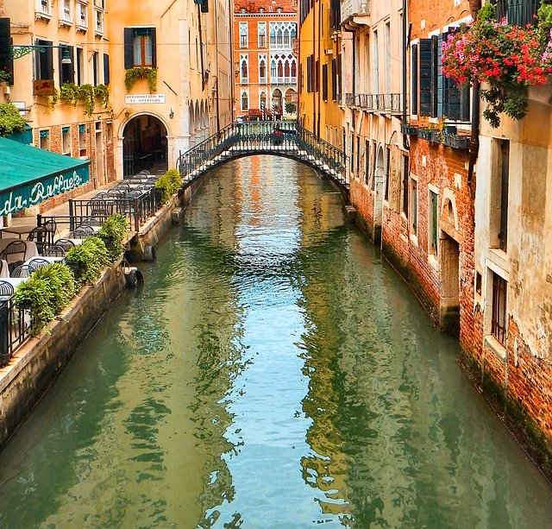
Setting
It's not surprising that Shakespeare chose Venice as the setting of a story filled with passion, jealousy, and sexual tension. For the Elizabethans, the Italians were wicked, murderous, and of loose morals. When playwrights of the day wanted to portray wickedness, they often created Italian characters causing problems in England, or set the plays in Italy.

Slide 7
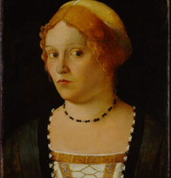
Venice was particularly exciting to the English. The women there were rumored to be very beautiful, and very interested in making love. Venetian men were considered hot-tempered, aggressive, and easily jealous. An Elizabethan audience watching Othello would have been highly suspicious of Desdemona and her behavior. Running off to get married behind your father's back was simply not done. Because Desdemona was Venetian, however, audiences wouldn't have been too surprised. As for Iago, he probably represented the kind of villain Elizabethans thought ran rampant throughout Italy!
This Photo by Unknown Author is licensed under CC BY-SA

Slide 8
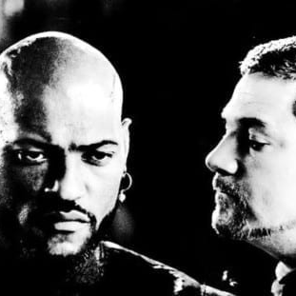
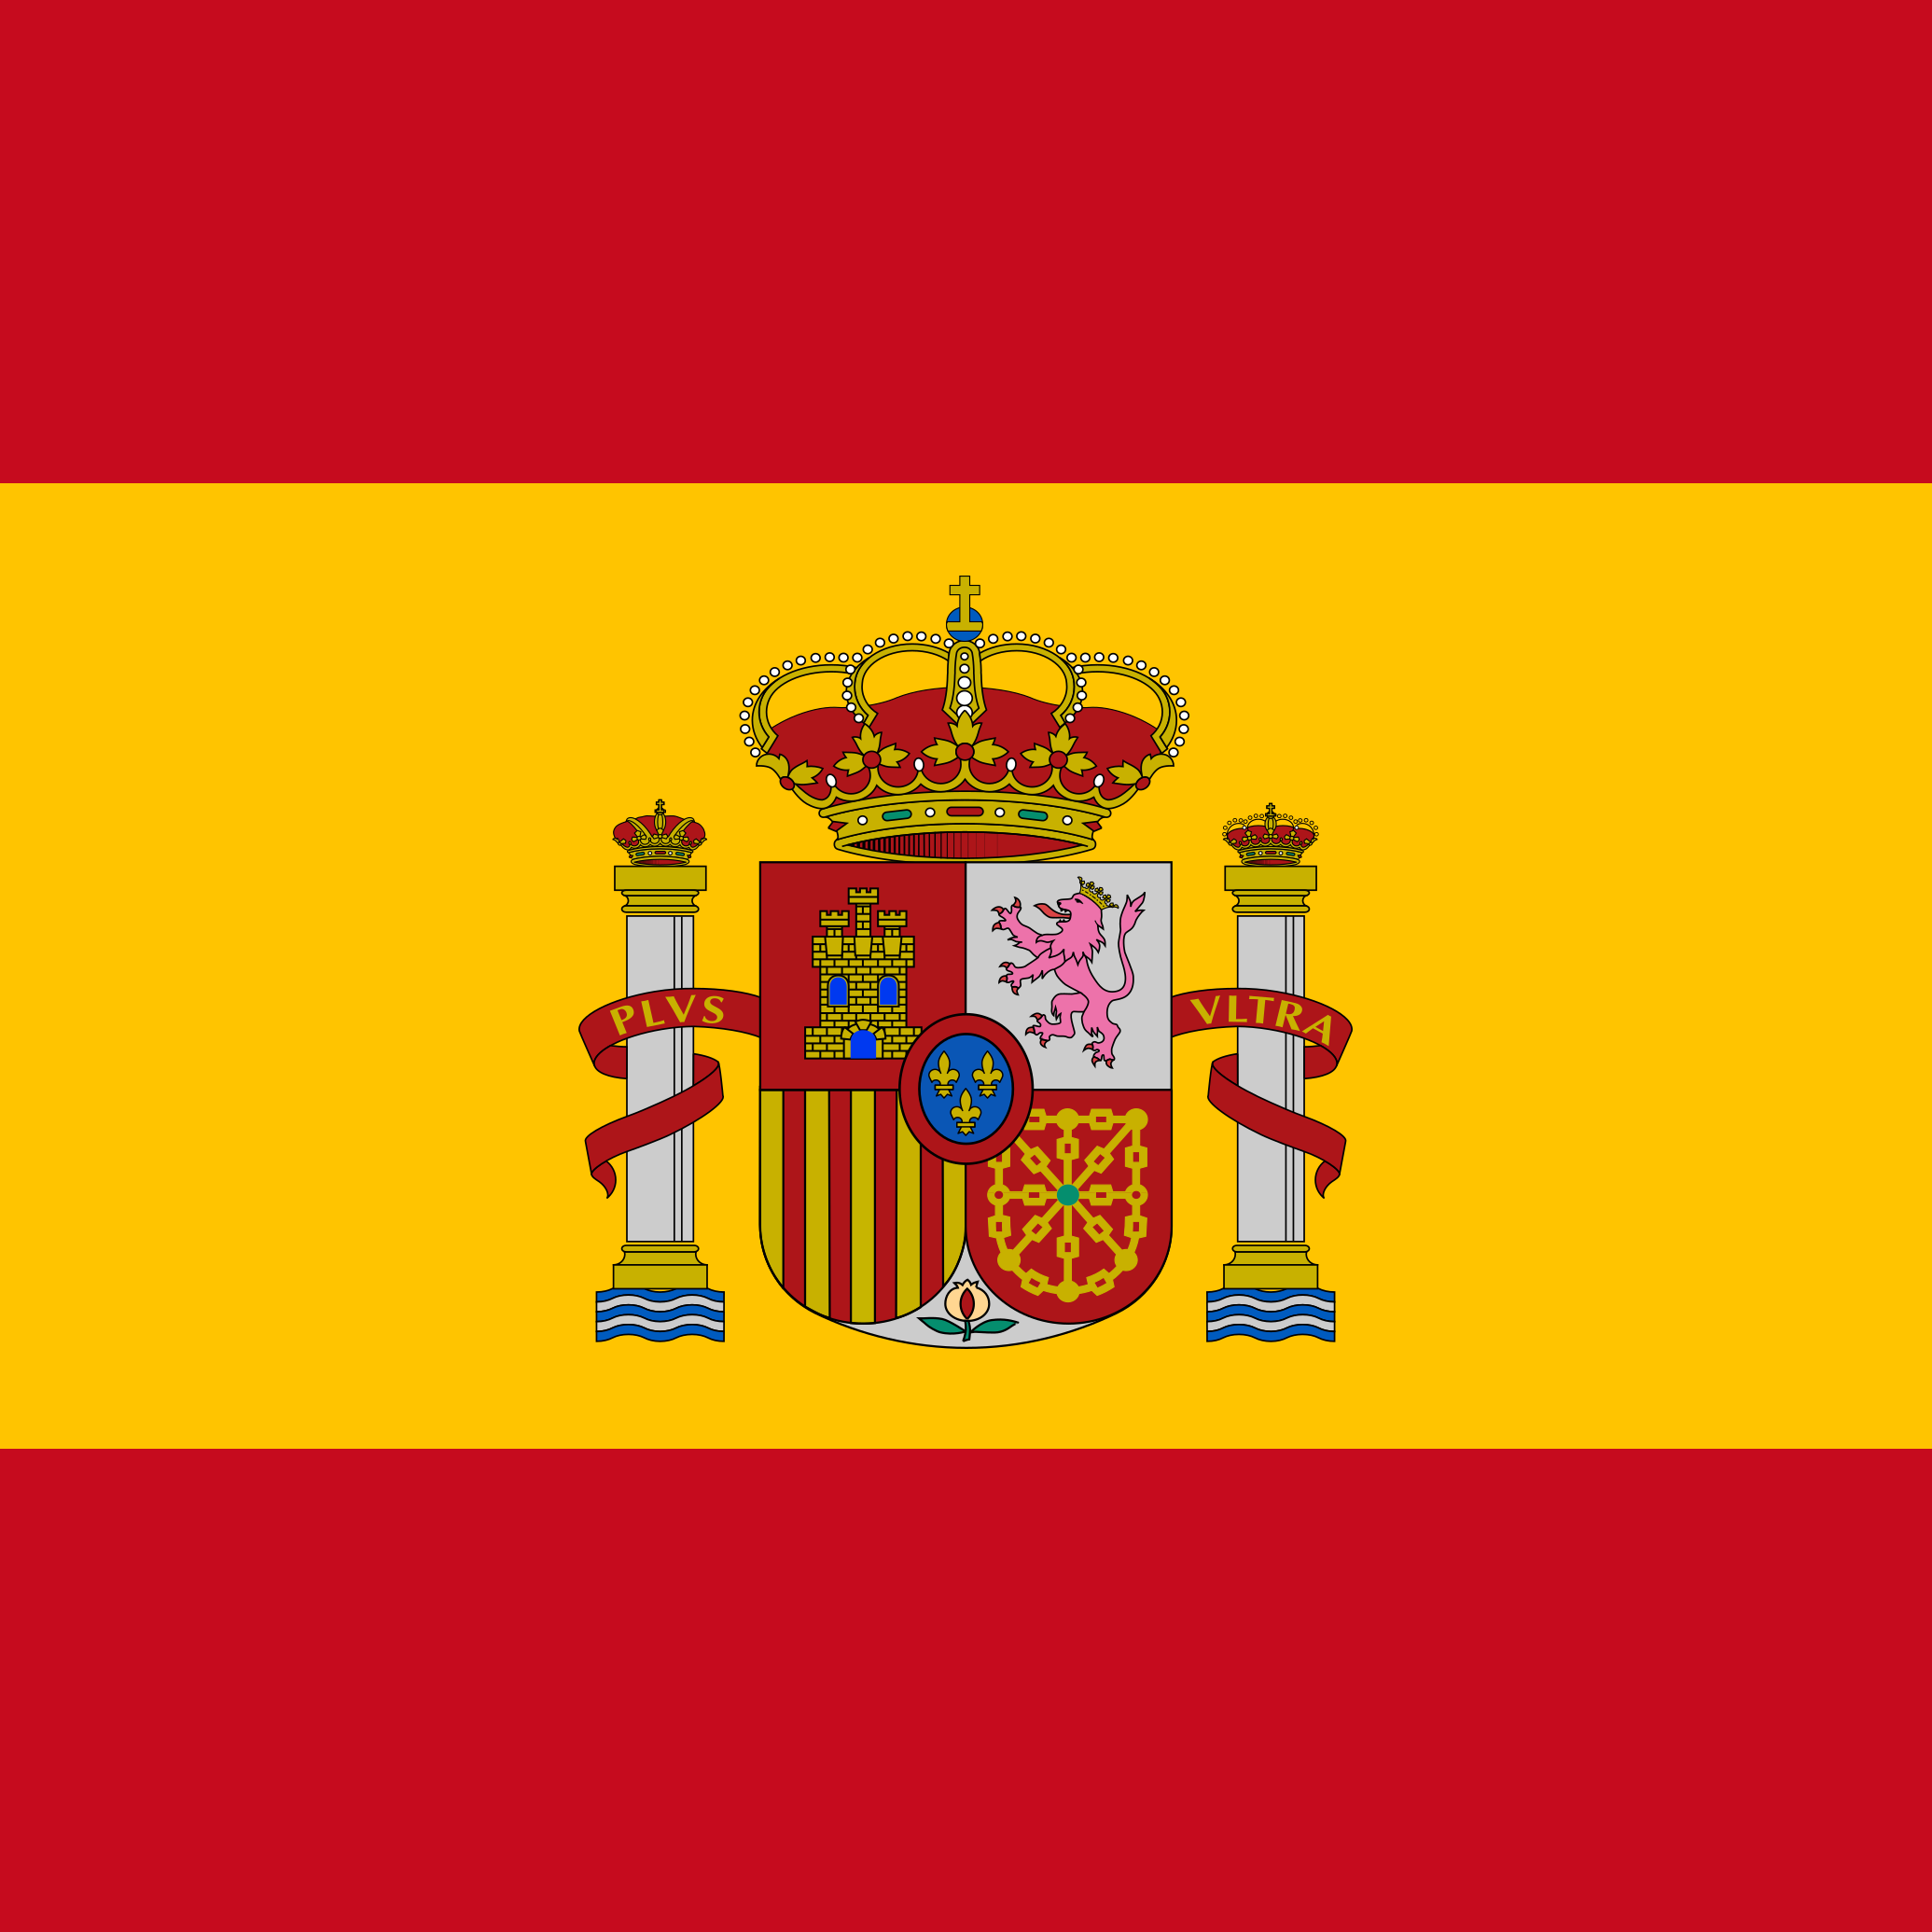
One interesting note is that the name Iago is Spanish. (The Italian form is Giacomo.) Shakespeare gave his most evil character a Spanish name, probably because Spain was England's worst enemy. Italy may have been the home of romantic, exotic sin, but true evil, according to the Elizabethans, came from Spain!
This Photo by Unknown Author is licensed under CC BY
This Photo by Unknown Author is licensed under CC BY-SA
This Photo by Unknown Author is licensed under CC BY-SA

Slide 9
Othello’s tragic flaw
What is it that causes Othello's downfall? Some have said that he's simply a jealous person whose jealousy of his wife gets out of hand. Others insist that jealousy is not part of his natural make-up that the emotion takes over only when Iago pushes him to the brink of insanity.
Most of the evidence in the play tends to support the latter interpretation. Othello doesn't show himself to be jealous early in the play. Manipulated by Iago's skillful lies, Othello must confront emotions he can't handle. His jealousy literally drives \him mad. Anger and hate replace his wisdom and judgment, and the power of these destructive emotions leads to this sorry end.

Slide 10
Themes
The “Outsider”
Jealousy
Hatred
Appearance vs Reality
Race

Slide 11
The Turks
Who Were They?
They were people of the vast Ottoman Empire, in what would eventually become Turkey and other regions.
In the 16th and 17th centuries it included parts of Europe, Asia and Africa.
Its capital was once Istanbul, formerly known as Constantinople. It collapsed after WWI.

Slide 12
The Turks
Where did they come from?
Parts of Europe, Western Asia, and North Africa
How did Elizabethan people view foreigners such as Turks and other non-Christians?
Elizabethan people were very suspicious of them. They often felt superior to them as well.
What does the term “Ottoman” refer to?
It refers to native people of the Ottoman Empire territories.

Slide 13
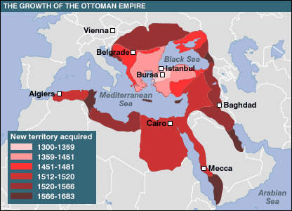
Map of the Ottoman Empire
In the 16th and 17th centuries The Ottoman Empire included parts of Europe, Asia and Africa.

Slide 14
The Moors
Who were they?
The term "Moor" was once used in Europe to refer to Muslims, especially those of Arab or Berber descent, whether living in Spain or North Africa, or elsewhere.
Where did they come from?
Most came originally from North Africa and settled in Spain, Portugal, parts of Southern Italy and Southern France.

Slide 15
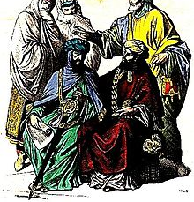
The Moors
What did they do in Europe in the 1500s?
They settled in various parts of Europe and spread their religion and culture.
What do we know about their religious and cultural practices?
They were Muslims who practiced the religion of Islam. Their cultural practices stemmed from Africa and their religion.

Slide 16
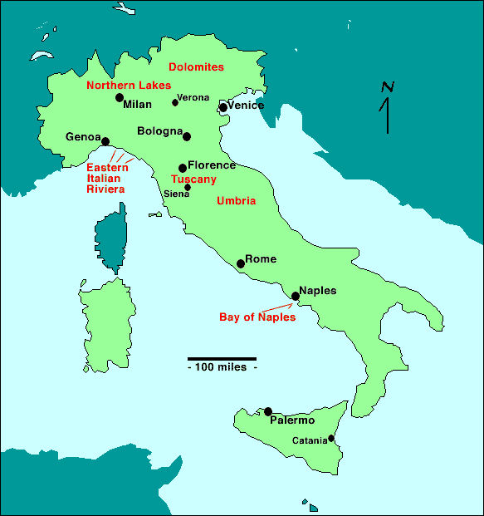
Venice
Where is Venice?
In the Veneto region of Northern Italy.
Venice

Slide 17
Venice
What was the relationship between the Venetians and the Turks at that time?
The large and wealthy island of Cyprus had been under Venetian rule since 1489. Together with Crete, it was one of the major overseas possessions of the Republic.
The war, began with the Ottoman invasion of the Venetian-held island of Cyprus. The capital Nicosia and several other towns fell quickly to the considerably superior Ottoman army, leaving only Famagusta in Venetian hands.
Christian reinforcements were delayed, and Famagusta eventually fell in August 1571 after a siege of 11 months. Two months later, at the Battle of Lepanto, the united Christian fleet destroyed the Ottoman fleet, but was unable to take advantage of this victory. The Ottomans quickly rebuilt their naval forces, and Venice was forced to negotiate a separate peace, ceding Cyprus to the Ottomans and paying a tribute of 300,000 ducats.

Slide 18
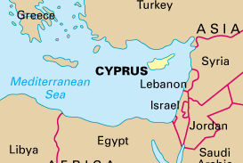
Cyprus
Where is Cyprus?
Cyprus is the third largest
and third most populous
island in the Mediterranean,
and a member state of the
European Union. It is located south of Turkey,
west of Syria and Lebanon, northwest of Israel,
north of Egypt and east of Greece.

Slide 19
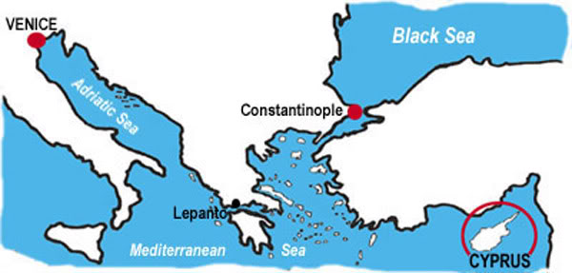
How Far is Cyprus from Venice?
Venice is 1,315.6 miles from Cyprus

Slide 20
Cyprus
In what way was Cyprus important in the 16thcentury?
The Island of Cyprus, has been a land of many conquests due to its proximity to the Middle Eastern countries and its strategic location at the cross-road of East and West. Aside from its location, which allowed the control of the Levantine trade, the island possessed a profitable production of cotton and sugar.
Cyprus has seen a succession of rulers, namely Assyrians, Egyptians, Persians, Romans, Arabs, Crusaders and Turks who ruled the Island as part of the Ottoman Empire, from 1571 until 1878. Cyprus has never been a Greek Island.

Slide 21
Cyprus
What was happening in the countries close to Cyprus at that time?
Throughout this period there was a series of armed tax-revolts which often united both Greek and Turk against an especially greedy governor or an over-mighty community leader.

