Slide 1
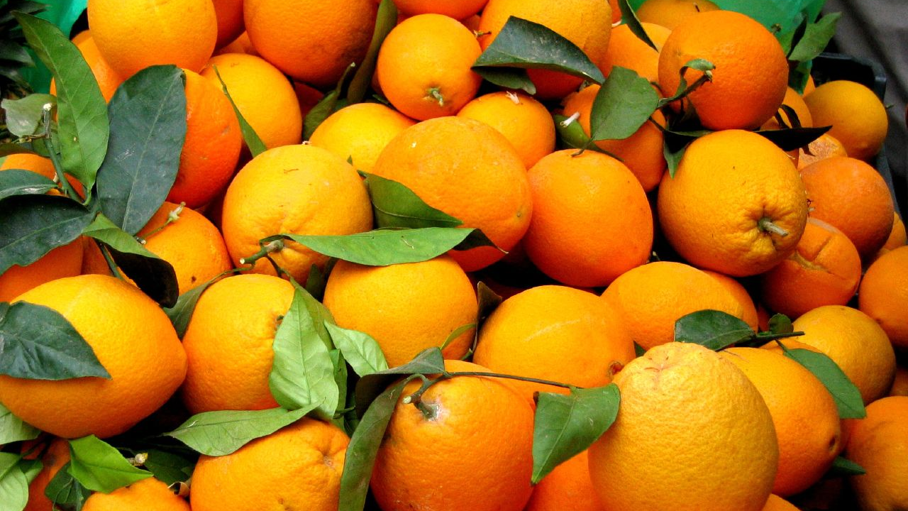
Oranges
Gary Soto
This Photo by Unknown Author is licensed under CC BY-SA

Slide 2
Summary
The poem "Oranges" by Gary Soto tells the story of a twelve-year-old boy who goes over to a girl's house on a cold December morning, bringing two oranges in his pocket.
They go out walking and end up at a drugstore candy counter, where he offers to buy her any candy she wants. When the chocolate bar she chooses costs more than he has in his pocket, the boy finds himself in a potentially embarrassing situation.
He quickly manages to appeal to the store's cashier, subtly, without the girl noticing, and is given the candy. As they walk back to her house, he basks in both the gratitude of the girl and the charity of the store clerk, feeling warmth and heat emanate from himself, as if he were able to hold not just the orange he is peeling but fire itself.

Slide 3
A Closer Look: Stanza 1
"Oranges" begins with a narrator looking back at his childhood. He remembers a particular experience of walking side by side with a girl. All that readers know about the two characters in this poem is that he is twelve years old at the time of its events, and that she is presumably twelve or near that. When the poem begins, the narrator is alone, having not reached the girl's house yet.

Slide 4
Lines 5 through 7 offer readers a graphic, sensory description of the cold of the day that had been referred to earlier. Soto's description of frost on the ground and breath condensing as it is exhaled indicates that it may have been an unusual cold snap, as most of his poems are autobiographical and take place in Fresno, California, where he grew up
This Photo by Unknown Author is licensed under CC BY-SA

Slide 5
The fact that this is no casual meeting, but a prearranged date, is indicated in line 13 by the fact that the girl comes to the boy when she sees him. The fact that it is a date is implied in line 15 by the fact that she has taken the time to apply makeup to her face, wanting to make herself look appealing. She has a bright, happy face, and he smiles, and in line 16 the narrator makes a point of mentioning that he touched her on the shoulder, a significant enough gesture to mention, though nothing is made of it.
This Photo by Unknown Author is licensed under CC BY

Slide 6
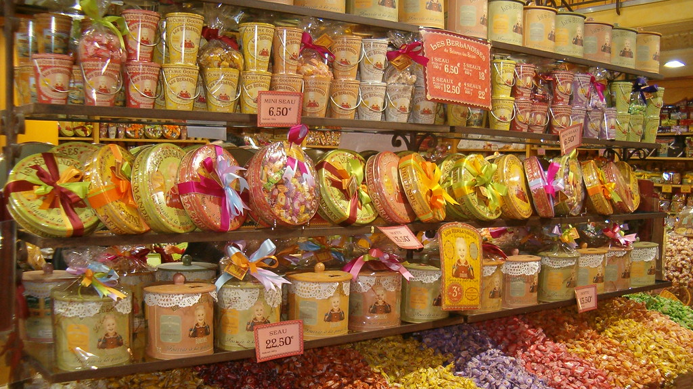
Gesture of Love
The boy's grand gesture in lines 25 through 27 is obviously the fulfillment of what he has been planning all along. He gestures to the candy display, offering to buy whichever candy she picks.
This Photo by Unknown Author is licensed under CC BY-SA-NC

Slide 7
Poverty
Though it is never explicitly addressed, readers can infer that these two young people live in poverty. For one thing, the girl reacts with glee to an offer of a candy bar in lines 28 through 30, implying that she does not have much chance to purchase any candy for herself. The most obvious indicator of their depressed situation, however, is the fact that the boy does not even have the price of a candy bar in his pocket; he only has a nickel, while the candy bar she chooses costs a dime (lines 31-33).

Slide 8
In lines 34 through 38, the boy quickly thinks of a way to deal with the embarrassing situation of having offered to buy the girl a candy bar but not having enough to pay for it. He does not object, or draw attention to his poverty. Instead, he approaches the woman who is running the store and silently offers her a deal, offering her half of the price of the candy and one of the two oranges that he brought along to share with the girl.

Slide 9
A Closer Look: Stanza 2
The second stanza starts on line 43 with one word, indented, to give readers a sense that more than the setting has changed: the mood of the poem has changed, too, as the boy and the girl have reached a new point in their relationship, with a new closeness. While the first stanza emphasized the coldness outside when the boy was walking alone, the descriptions in the second stanza, lines 44-46, show that the day has warmed a little bit: the hiss of the cars as they pass on the street shows that the frost that once crunched beneath the boy's feet has melted, and the fog that hangs in the air would not be possible if the weather were below freezing.

Slide 10
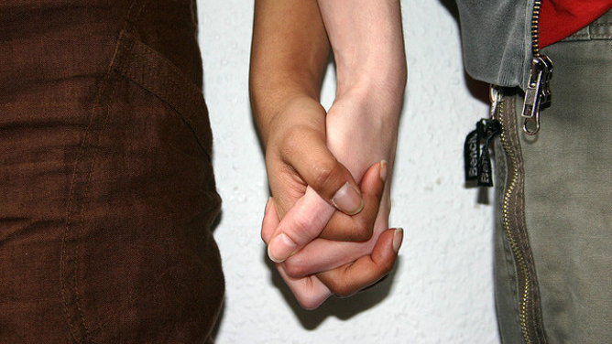
In lines 47 and 48, the boy takes hold of the girl's hand. She does not object, but still he does not hold it for long, letting go in line 49 after only two blocks. He knows that she accepts him, but that the chocolate that he has bought her is very important to her as well.
This Photo by Unknown Author is licensed under CC BY-ND

Slide 11
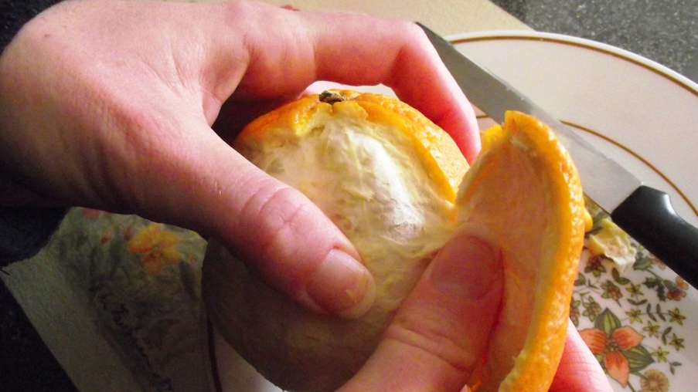
The last six lines of the poem, lines 51-56, contain an extended description of the orange that the boy peels as the girl is unwrapping her chocolate bar. Soto does not explicitly describe what makes it so special; that much is made clear through the events that preceded this moment, with the boy bringing an orange for the girl he likes and the salesclerk accepting the orange as payment.
This Photo by Unknown Author is licensed under CC BY-NC-ND

Slide 12
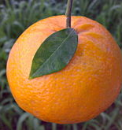
Instead, the poem leaves reader with a visual image. The brightness of the orange is contrasted with the grayness of the dark, cool day, and then it is described as looking from afar like a fire in the boy's hand.
Since the connotations of fire, in this context, are all positive, readers are left feeling that the boy's outing with the girl has warmed and enlightened him, and that the one orange left is an emblem of the special feeling that came over him that day.
This Photo by Unknown Author is licensed under CC BY-SA

Slide 13
Themes: Coming of Age
"Oranges" is the story of a twelve-year-old boy who is crossing an emotional threshold and entering into a new period of his life, facing things that he has never encountered before. This is made clear in the first few words of the poem. The fact that he has never walked with a girl until the events related here indicates to readers that they are about to witness something that will change his life. In doing something for the first time ever, especially in entering into his first adult relationship, the boy is gaining some aspect of maturity.

Slide 14
Themes: Empathy
The dramatic tension of this story derives from the fact that the boy finds his desires in conflict with his means. He wants to impress the girl by buying her whatever she wants, but the chocolate she chooses costs twice what he can afford. It is a situation that could end tragically, leaving the boy humiliated and cynical about women, but instead Soto shows the boy making a tacit agreement with the woman he is supposed to pay, offering her an orange for half the price of the candy bar. No words pass between them about this deal. He does not have to explain his situation; it is clear. She sees the young people together and she knows what the boy is trying to do when he buys the candy bar, just as she knows, from the fact that he has done what he can to make up the missing money with what he does have—an orange—that he does not want to cheat the store.

Slide 15
Soto shows that empathy, the ability to understand the emotions of another person, is one of the most important human emotions by using symbolism. The title of the poem is "Oranges"; one orange is used at the end to show that the boy has a newfound sense of warmth; the other orange is left with the woman at the drugstore, not as a substitute for cash as much as a way of giving her something truly good in thanks for her understanding.

Slide 16
Style : Narrative/ Free Verse
"Oranges" is an example of a narrative poem, or one that tells a story.

Slide 17
Style : First Person Point of View
"Oranges" is told in the first person, from the perspective of one of the participants in the poem, but in some sense the person who is telling the story is a very different person from the boy who walks with the girl.
The speaker of the poem is clearly telling the story years after the action took place. This distance in time gives the poem a feeling of calmness that would be lacking if the events were presented with more immediacy.

Slide 18
Imagery:
Soto uses the cold weather as a recurring device or image used to emphasize the mood or message of the work.
In the first segment, the boy's loneliness and foreboding about approaching a girl's house for the first time is magnified by the fact that he is cold. Mentioning the external effects of the cold, such as his visible breath and the sound of frost crunching beneath his footsteps, draws attention to his apprehension by showing just how hyper-aware he is to sensory input. When the girl comes out of her house the first thing she does is pull on her gloves which draws readers' attention to her overall defensiveness in this new and uncertain situation.

Slide 19
By contrast, the weather seems warmer after they leave drug store. The crunchy frost has melted to wetness, which makes cars on the street hiss on the pavement and moisture has risen into the air as fog.
The girl's hand is uncovered during the walk home, allowing the boy to take hold of it briefly. At the end of the poem, Soto uses the weather as a visual aid.
The gray, foggy day is invoked to contrast the brightness of the orange in his hand, making it look even more vibrant, like fire.

Slide 20
Activity
Write a short story or a poem that is a sequel to "Oranges" from the first-person point of view of the girl.

