Slide 1
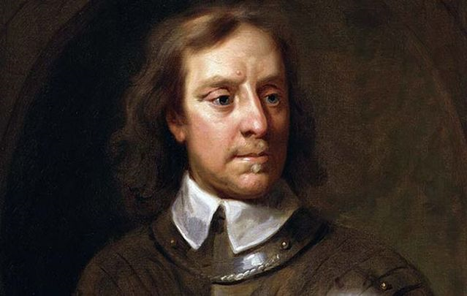
Oliver to His Brother
Brendan Kennelly

Slide 2
(No need to write down!) Cromwell in Ireland
In 1641, just before the Civil War, some Irish rebels had risen against English rule.
They had attacked the English Protestant minority in Ireland killing around 4,000 of them.
During the English Civil War nothing could be done about the problem, but after the war ended Cromwell took action.
In 1649, Cromwell took 12,000 men to Ireland.

Slide 3
Kennelly wrote any poems about the English Plantation leader Oliver Cromwell.
Here, he adopts the voice of the infamous Cromwell in the form of a hypothetical letter written to his brother.
Such an approach is unexpected – Cromwell is largely associated with the plantations of the 17th century, and the injustices of the Penal Laws.
However, Kennelly turns popular perception on its head when he writes of the British military leader as more than the sum of his possession; he was also a father and an uncle.
In turn, we arrive at a key theme of the poem; the complexity of history.

Slide 4
The poem opens with a tender tone as Cromwell addresses his sibling breezily; “loving brother” he writes.
However, feelings of affection are undermined as he continues with stuffy, cumbersome language: “I am glad to hear of your welfare…”
This contrasts glaringly with the warmth and amiability of Kennelly’s language in other poems.
We quickly conclude that this is not the poet speaking.

Slide 5
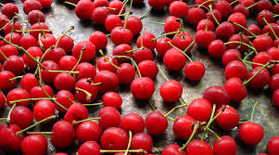
Cromwell writes to express his pleasure that “our children have so much leisure / They can travel far to eat cherries,” though the mood is distinctly joyless and the repeated ‘r’ sounds give the impression that the Englishman is being sarcastic.
There is something threatening in Kennelly’s treatment of Cromwell when he writes, using a simmering assonance, that his daughter’s love for cherries “is most excusable”.
The repeated ‘s’ sounds create an ominous atmosphere.
I see the cherries as a central motif; they symbolise leisure and indulgence, and Cromwell’s understated language suggests he does not approve of either.

Slide 6
Atypically, Kennelly continues the poem in largely unrhymed free verse. This device allows the style to echo the content: the poem feels more like a letter than a poem and its use of clipped sentences promotes the idea of Cromwell as a decisive, authoritative presence.
As the first third of the poem concludes it starts to appear more personal, though interestingly, it remains devoid of any real tenderness. “I have delivered my son up to you,” he writes, “I hope you counsel him… / I choose to believe he believes what you say. / I send my affection to all your family.”

Slide 7
The absence of names creates a frosty atmosphere, while the repetitive use of the first person pronoun feels grandiose and even threatening.
Life revolves around the author’s wishes and there is little room for any objection.
Cromwell then proclaims his desire that “sons and daughters be serious; the age requires it.”
Here his sibilance is serpentine (like a snake) and his tone is tremendously formal.

Slide 8
The ominous mood grows on the following line, its metre perfectly measures and suggestive of a man completely focussed in his mission and unapologetic in his righteousness: “I have things to do, all in my own way.”
The poet makes Cromwell the centre of authority – and the following line allows him to reassert his power.
“I take not kindly to rebels” he writes, in a tone of devastating understatement, given that we know of the harsh punishments he meted out historically.

Slide 9
Now he recounts to his brother the tale of an ambush in which Cromwell led an attach in England on a group of rebels known as The Levellers (a dissenting political faction inside the Cromwell- led New Model Army of the 1640s.)
I noticed Kennelly’s characteristic inclusion of a place name, as well as the callous tone which reduces killing to a procedure.

Slide 10
“… in Burford Churchyard, Cornet Thompson / Was led to the place of execution. / He asked for prayers, got them, did well”.
It is here too that Kennelly uses alliteration while describing killing to clinical effect; “Affect him … a Corporal … / Set his back against the wall and die. / A third chose to look death in the face”. (harsh f and t sounds)
Repetition of fatal imagery gives the poem a strong coherence and reiterates once more the lack of ambiguity in Cromwell’s thinking.

Slide 11
As we approach the conclusion of the poem, Kennelly adapts his rhythm with enjambment; “Men die their different ways / And girls eat cherries / In the Christ Blessed fields of England”.
The reappearance of the fruit after so much talk of killing has a jarring effect on me as a reader – they symbolise a kind of leisure and indulgence that eluded Cromwell.
We find it hard to reconcile the image of a caring father and uncle with such an unforgiving military leader – but that is the challenge that Kennelly sets us.

Slide 12
In addition, his invocation of Christ creates an atmosphere that is at once reverent and jingoistic (a form of extreme patriotism), a feeling which lingers in the final lines of the poem.
“Some weep. Some have cause. Let weep who will,” he writes, again without compassion and with a very questionable moral certainty.
He writes of these tears with a metaphor, calling them “Whole floods of brine”.

Slide 13
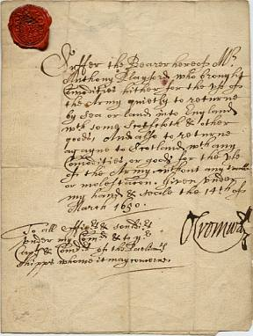
The final line should be read in the context of the opening – a letter that began with an affectionate greeting ends with a chilling affirmation: “I have work to do in Ireland”.
There is no salutation and little tenderness as Cromwell signs off to his brother and sets off to Ireland.

