Slide 1
Literary Genre

Slide 2
Literary genre deals with how a story is told. On a basic level, the texts tell their stories differently depending on whether they are a novel, play or film. For the novel, this involves the use of descriptive prose with a narrator(s) forwarding the plot. In the play the story is told through the dialogue and stage directions.
While we may study drama by reading its text, it is often easy to lose sight of the fact that playwrights intend for their work to be performed on stage and not simply read in a classroom. In this light, the performance of actors and indeed the production will be as critical as the text.
This also applies to film-although interestingly we don’t study a film by reading its screenplay. However what distinguishes film from the other media is the ability of a director to use different camera angles and more elaborate sets/locations to tell a story.

Slide 3
Example of Layout
1. Intro
2. Text type – anchor text (x)
3. Text type – (y) + anchor text (x)
4. Text type – (y)+(z)+(x)
5. Characterisation – anchor text (x)
6. Characterisation – (y) + (x)
7. Characterisation – (z) + (x) + (y)
8. Narrative Directions – (x)
9. Narrative Directions – (y) + (x)
10. Narrative Directions – (z) + (x) + (y)
11. Conclusion

Slide 4
Our Sub – Headings
Text type
Genre
Chronology
Characterisation
Dialogue
Imagery and Symbolism
Narrative Directions

Slide 5
Text Type:
The text is a novel, which means the reader has significant influence in the presentation of the narrative.
While the author will present various plot details on the page the reader can apply certain variations so as to imagine these how s/he sees fit.
This represents the influence of the reader in the narrative process of the text which is not present in the drama or film.
In drama and film the audience is shown how plot details appear and therefore cannot shape these as they see fit, an opportunity which the reader in a novel is allowed.

Slide 6
This is seen in various instances where the reader is clued into various plot details, such as character appearance.
When the narrator details how “I am thirty-three years old. I have brown hair. I stand five seven without shoes. I have trouble remembering what I used to look like. I have viable ovaries. I have one more chance” the reader is offered the opportunity to determine her exact appearance.
They can decide the shade of brown that her hair is, similar to how they can decide on the various markings on Luke’s body that the narrator describes, and whether they are extremely prevalent or fading due to the narrator’s declining memory of him near the end of the novel: “I ought to have done that with Luke, paid more attention, to the details, the moles and scars, the singular creases; I didn’t and he’s fading. Day by day, night by night he recedes, and I become more faithless.”

Slide 7
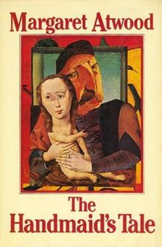
Genre
The text is depressing, detailing the confined living experience of the handmaids who are increasingly overpowered to the extent that they come to accept the demands of the ‘powers that be’ in their world.
This represents both the decline of the human spirit but also the inability to challenge more powerful and exploitative parties in one’s world.

Slide 8
Early in the novel such depressing subject matter is seen, with the description of the attempted indoctrination of the Handmaids.
Such is orchestrated in a manner that the Handmaids not only lose all sense of independence and freedom but also come to pity those that are responsible for their pitiful situation: “Aunt Lydia said it was best not to speak unless they asked you a direct question. Try not to think of it from their point of view she said, her hands clasped and wrung together, her nervous pleading smile. It isn’t easy for them.”
This section is telling as the handmaids are mentioned just once with one word, “you”, while the remainder of the sentence is focused on those controlling the Handmaids, representing the focus on such parties and a warped extended attempt to create pity for these groups.

Slide 9
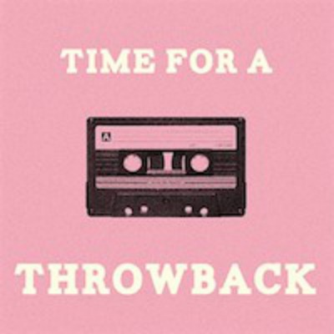
Chronology of texts:
Throughout the novel there are flashbacks included which distort the linear narrative; however, these are essential to reveal information about events that occurred prior to the present moment or drama.
Without awareness of such past episodes, the reader would not know the significance of the current plot and why it is occurring as it is.
Therefore I believe the distortion of the linear narrative is crucial.

Slide 10
The importance of such flashbacks is perhaps most evident with the narrator’s mother; she is only seen through flashbacks and without such movement back to the past would otherwise never be seen.
This allows the revelations that this woman was a hardcore feminist and protestor who was concerned primarily with women’s rights; this led to participation in demonstrative events such as the burning of born, the likes of which she eventually brought the narrator to.
Her mother is presented as a rational and independent women, which arguably is designed to contrast with the narrator’s lack of freedom; such is seen when the mother’s friends are shown to have concerns about her raising a child as a sole parent, to which the mother defiantly declares “I make a decent salary. I can afford daycare.”

Slide 11
Characterisation:
Ironically, for the leading character in a novel, there is relatively little known about the protagonist, at least compared to those in similar positions in other texts.
However, this reflects the text itself where the aim of the ‘powers that be’ in the world of the novel is to remove the Handmaids’ sense of independence, freedom and self.

Slide 12
The lack of individual characterization is epitomized by the protagonist’s self-declaration when describing herself that “I have brown hair. I stand five seven without shoes. I have trouble remembering what I used to look like. I have viable ovaries.”
The defining statement is the closing element, about her body part, as this is what has kept her from danger and death for most of the novel to date.
However, relatively little else is known about her, obvious from her general descriptions elsewhere in the comment which as said earlier allow the reader to determine the character as they see fit.

Slide 13
Indeed, Professor Pieixoto’s wonderings about the character in the “Historical Notes” sum up how little we know about her, and hence how successful the world around her is in removing her sense of self: “But what else do we know about her, apart from her age, some physical characteristics that could be anyone’s, and her place of residence? Not very much. She appears to have been an educated woman, insofar as a graduate of any North American college of the time may be said to have been educated… But the woods, as you say, were full of these, so that is no help.”

Slide 14
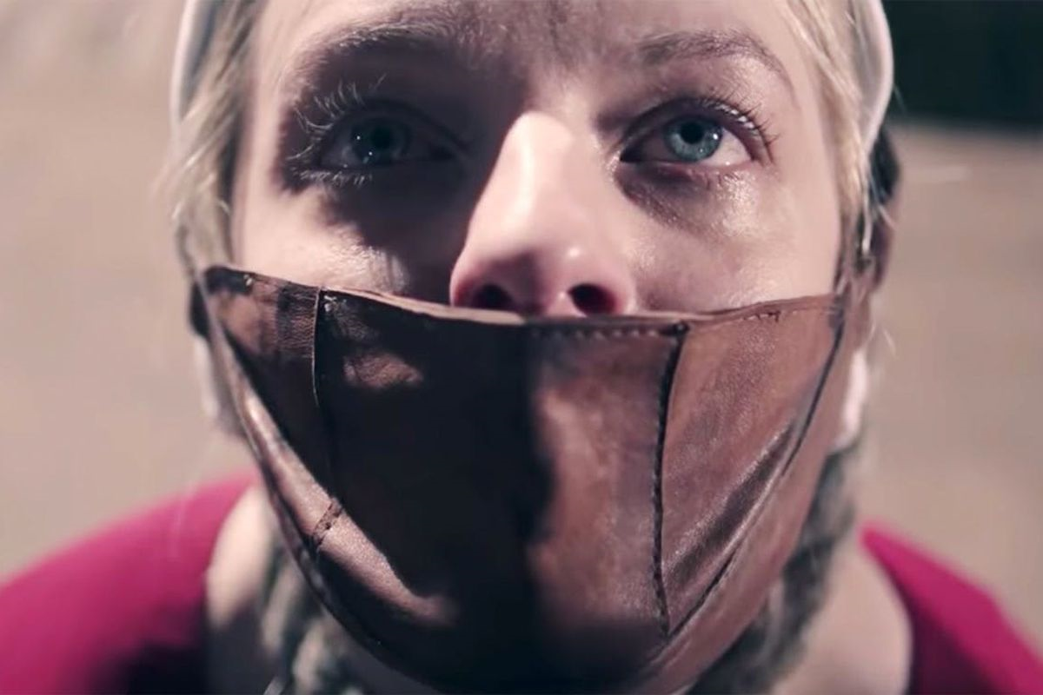
Dialogue:
The lack of dialogue evident at the start of the text represents the confinement experienced by the protagonist and the other Handmaids; they are not allowed to communicate normally and authentically, a metaphorical representation for how they are not allowed a semblance of normal life due to restrictions on various rights.

Slide 15
The narrator’s description of her silent communication with the other Handmaids immediately presents a confined living experience where they cannot do as they usually would or please: “We learned to lip-read, our heads flat on the beds, turned sideways, watching each other’s mouths. In this way we exchanged names from bed to bed: Alma. Janine. Dolores. Moira. June.”

Slide 16
The act of communicating silently without dialogue is a metaphorical representation of the Handmaids themselves and reveals how dialogue conveys their situation at present; much like they speak without sound, the Handmaids are living but without any true sense of life, as they have their experiences shaped for them in the world of the text and are disallowed various rights and freedoms.

Slide 17
Imagery and Symbolism
Throughout the text the narrator symbolically uses flowers to represent various plot elements to the reader and/ or reinforce details that have been suggested or implied previously.
One way in which this is achieved is the use of flowers to disguise terrifying or ugly plot elements, such as when the narrator symbolically compares the “red of the tulips” from Serena Joy’s garden to the bloody mouth of a hanged man.

Slide 18
Elsewhere, flowers are also symbolically associated with beauty and/or fertility, which connects with how flowers are the part of the plant containing the reproductive organs. This explains why the older Wives occupy themselves with gardening, as this is a symbolic connection to fertility which is now beyond them: “Many of the Wives have such gardens, it is something for them to order and maintain and care for.”

Slide 19
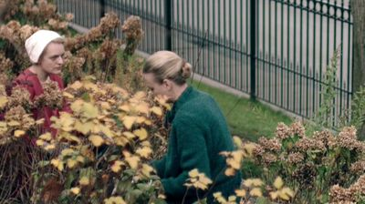
Finally, flowers allow for the symbolic presentation of Serena Joy’s desire to attack the Handmaid, as she is seen on various occasions destroying flowers; it can be argued that she wants to do similar to the Handmaid, the symbolic flower living in her house: “Was it… some kamikaze, committed on the swelling genitalia of the flowers? The fruiting body.”

Slide 20
Narrative Directions:
The narrator is limited in the information she offers to the readers; as the novel progresses we would expect for the protagonist to offer specific and increasing information that is relevant to the plot but this is not the case; rather, there is a consistent lack of detail revealed which presents her as an atypical, if not also ineffective, narrator.
The ineffective narration offered by the narrator becomes obvious as she increasingly refers to what she wishes could happen rather than providing detail about what is happening and its significance to the plot. Her language is emotional rather than informative, which while sometimes can be useful if revealing information simultaneously is not useful here as it merely focuses on the narrator’s ambiguous wishes for change.

Slide 21
What results is a somewhat muddled narrative where the reader is left wondering and searching for information, summed up when the narrator admits she has not structured an effective and clear plot: “This isn’t a story I’m telling… It’s also a story I’m telling, in my head, as I go along.” The symbolism of the reference is clear to see as the protagonist admits she is self-focused and not concerned with her audience, who rely on her for information.

