Slide 1
Literary Genre
A Dolls House – Henrik Ibsen

Slide 2
Literary genre deals with how a story is told. On a basic level, the texts tell their stories differently depending on whether they are a novel, play or film. For the novel, this involves the use of descriptive prose with a narrator(s) forwarding the plot. In the play the story is told through the dialogue and stage directions.
While we may study drama by reading its text, it is often easy to lose sight of the fact that playwrights intend for their work to be performed on stage and not simply read in a classroom. In this light, the performance of actors and indeed the production will be as critical as the text.
This also applies to film-although interestingly we don’t study a film by reading its screenplay. However what distinguishes film from the other media is the ability of a director to use different camera angles and more elaborate sets/locations to tell a story.

Slide 3
Example of Layout
1. Intro
2. Text type – anchor text (x)
3. Text type – (y) + anchor text (x)
4. Text type – (y)+(z)+(x)
5. Characterisation – anchor text (x)
6. Characterisation – (y) + (x)
7. Characterisation – (z) + (x) + (y)
8. Narrative Directions – (x)
9. Narrative Directions – (y) + (x)
10. Narrative Directions – (z) + (x) + (y)
11. Conclusion

Slide 4
Our Sub – Headings
Text type
Genre
Chronology
Characterisation
Dialogue
Imagery and Symbolism
Narrative Directions

Slide 5
Text Type
Ibsen’s work is a drama, where the emphasis is on performance rather than reading. It is unlike the novel (where the reader can imagine what occurs) as Ibsen’s play shows us events firsthand.
For example, the audience sees how characters appear, such as Nora, who often acts in an exuberant manner and is hence portrayed by a similarly youthful female actress to complement the role. In addition, the audience is shown how events occur in the play, such as the climaxing scene where Nora finally stands up to Torvald, declaring he has treated her like a doll and she needs to make sense of “self and everything”.
They are shown every detail of the scene, even how loudly she slams the door when leaving her husband and her familial obligations behind.

Slide 6
This, like all other happenings in the play, does not need to be described as they would be in the novel, as the audience sees such events as if they were happening in real life before them.
The text’s form as a drama can be located as the reason for it remaining in one room for its entirety; while in a novel or a film it would be easier to change setting this is time consuming in a drama as it would disrupt and delay the narrative experience.
As a result, it is easier to retain the one setting throughout, so as for fluid and continuous viewing.

Slide 7
Genre:
The text is told bleakly, as it focuses on characters who are selfish and not willing to openly challenge the restricted positions of females who suffer in a patriarchal society. Rather, they choose to protect themselves in a cowardly manner, when they should devote their efforts to freeing such characters from this depressing existence.
Torvald shows this in his reaction to the revelation of the secret loan, as Nora indicates her belief that her husband will take the blame for the loan, telling Mrs. Linde that “Something glorious is going to happen” at the end of the second act.
She is convinced her husband will free her from her isolated position in which she is irreconcilably placed in a position of guilt and cannot escape punishment as it is against the law for a female to take a loan without the permission of her husband.

Slide 8
Nora’s belief provides an example of overbearing demands placed on the females in the play, as they are removed from any concept of a normal and fair life due to the male dominance of the world.
Torvald does not do as his wife hopes he will, instead telling Nora “From now on, forget happiness. Now it’s just about saving the remains, the wreckage, the appearance”, which confirms that he only cares about his public reputation: he only refers to his societal appearance, and will prioritise this rather than coming to the aid of his wife.

Slide 9
Elsewhere, the man who provides the illegal loan, Krogstad, causes Nora’s difficult position due to his self-centred nature. He will not accept the consequence for the illegal nature of the loan, the loss of his job, and rather seeks to make use of the patriarchal society they inhabit to safeguard his position.
He henceforth attempts to blackmail Nora by promising to reveal all about the loan if he is fired as he is aware that its illegal nature will disgrace Nora and her husband Torvald, the man hoping to fire Krogstad.
Once more this shows the confined position facing women in the text, as the male figues around Nora can enact complete control over her.

Slide 10
Chronology:
The text is told in a simple linear fashion, with the events occurring as we would expect them to if we viewed them in our own life.
The story begins with the presentation of Nora and Torvald Helmer, and the news that Tovald is receiving a new position, managing the bank. This will give them permanent financial security, but Krogstad appears and it is revealed that Nora borrowed money from him and forged a signature to do so.
Now that Torvald wants to fire him, Krogstad plans to blackmail Nora by threatening to reveal this information if he is fired. As the narrative structure happens as we would expect it to in our world, Krogstad only appears because he is threatened; there is no reason for Ibsen to reveal this information, or for Nora to worry about this, until Torvald threatens Krogstad with his job.

Slide 11
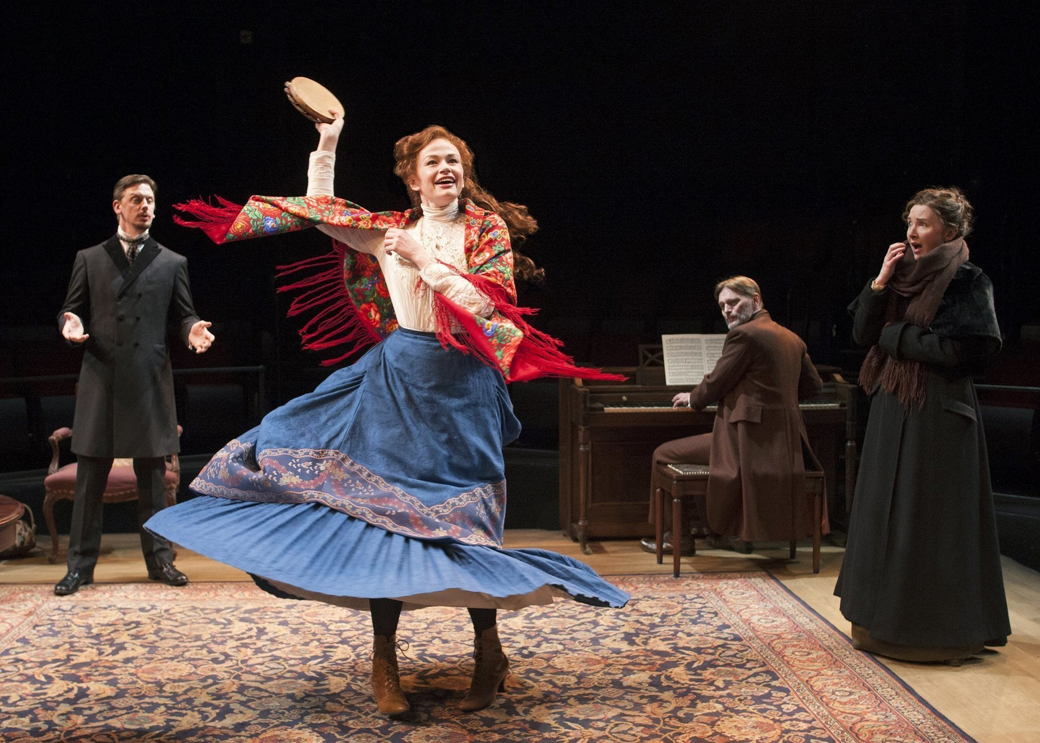
This narrative structure, where characters react to certain events, continues as Torvald fires Krogstad despite Nora begging him not to, and Krogstad resultantly telling Nora he will blackmail her and Torvald.
He places a letter revealing all in the mailbox and when Nora tells Christine of recent events she goes to Krogstad to reason with him. Nora attempts to stop Torvald opening the letter by dancing the tarantella, but this is unsuccessful and she eventually allows him to read its contents.

Slide 12
The play ends with the same narrative structure, with events occuring in reaction to others, as Torvald forgives Nora when Krogstad says he will not blackmail them.
Nora, however, is not so forgiving to her husband, realising after recent events that her life has been meaningless for years as she has only existed for the benefit of males and not for herself. She tells her husband “I have been performing tricks for you, Torvald. That’s how I’ve survived. You wanted it like that. You and Papa have done me a great wrong. It’s because of you I’ve made nothing of my life.”
Nora then decides to leave her husband, asserting that Torvald has treated her like a “doll” to be played with and admired, declaring she must “make sense of self and everything around her”. The protagonist, realising her primary duties are no longer just to her husband and her children, departs at the play’s end to devote time to identifying her wants, beliefs and desires.

Slide 13
Characterisation:
The play divides characters into heroes and villains in a conventional manner. Torvald’s villainy is due to his desire to force others, here his wife, to conform to an immoral way of life that will suit his own purposes, which echoes the mindset of many similarly evil characters.
In the opening act he demands his wife have no secrets from him so as to preserve the sanctity of their home, which translates into a desire to know all facets of her existence so as to confirm that she is wholly obedient to him: “an atmosphere of lies infects and poisons the whole life of a home. Each breath the children take in such a house is full of the germs of evil.”

Slide 14
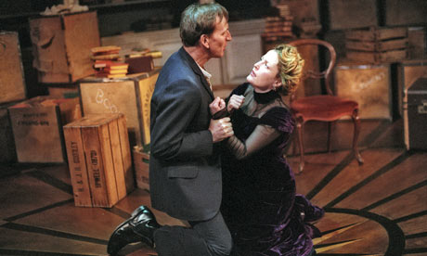
Elsewhere, his dominance is shown through other statements, such as when he asserts control of the home, implying it is a place where Nora is welcome but must obey his demands: “You will still remain in my house, that is a matter of course.”
He likens himself to a hawk protecting a dove that is his wife, a ridiculous analogy that merely emphasizes his control over her due to the aggressive mind-set of the latter animal: “How warm and cosy our home is, Nora. Here is shelter for you; here I will protect you like a hunted dove that I have saved from a hawk’s claws.”

Slide 15
Dialogue:
Various male characters speak in assertions and declarations rather than in conversational tone, representing the patriarchal society of the text where men expect women to follow their rule rather than acting independently.
Torvald introduces such early in the play as he claims that Nora cannot hide any secrets from him, which he presents as a virtue of innocence but in reality is a demand for obedience: “My little songbird must never do that again. A songbird must have a clean break to chirp with - no false notes!”

Slide 16
Elsewhere, he justifies his and the male sex’s deceptive tendencies, announcing these as a necessity. There is no apologetic tone that would be present if revealing such to another person, such as Nora here: rather he is acknowledging his actions without remorse, which influences the manner of his declaration and reminds us of the patriarchy’s desire for dominance, “A guilty man like that has to lie and… has to wear a mask in the presence of those near and dear to him, even before his own wife and children… the children - that is the most terrible part of it all, Nora.”

Slide 17
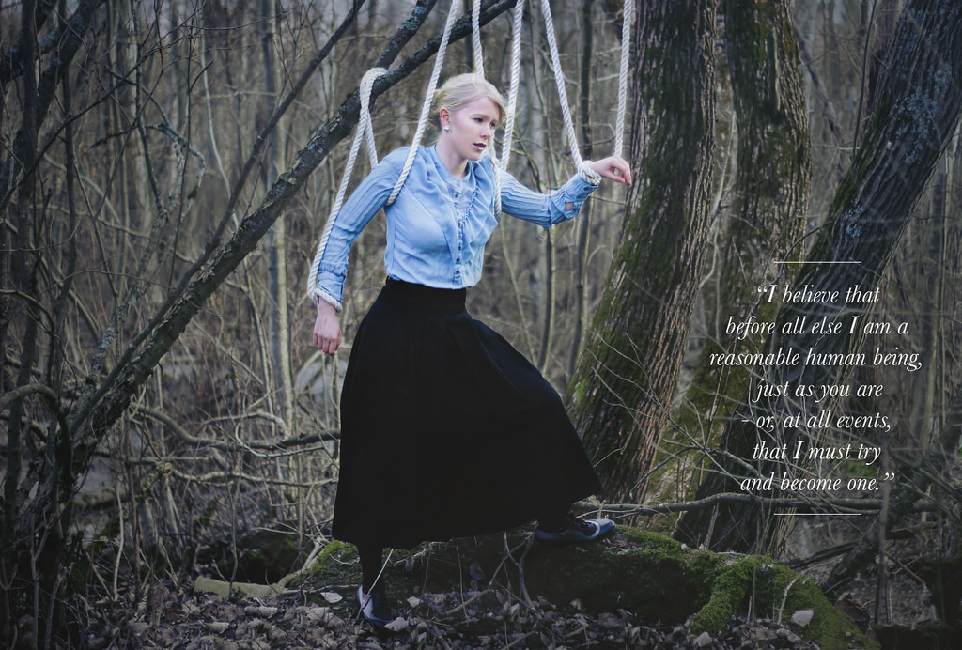
Imagery and Symbolism:
Various images are used to represent the central issue of the play, male dominance over the female characters. As the drama draws to a close Nora conjures up the image of a doll, likening herself to such an item in that it is used when required, akin to a bored child requiring some entertainment. This reinforces the idea that she is also discarded of when not deemed necessary, like when a child grows tired of the doll and longs for something else to play with.

Slide 18
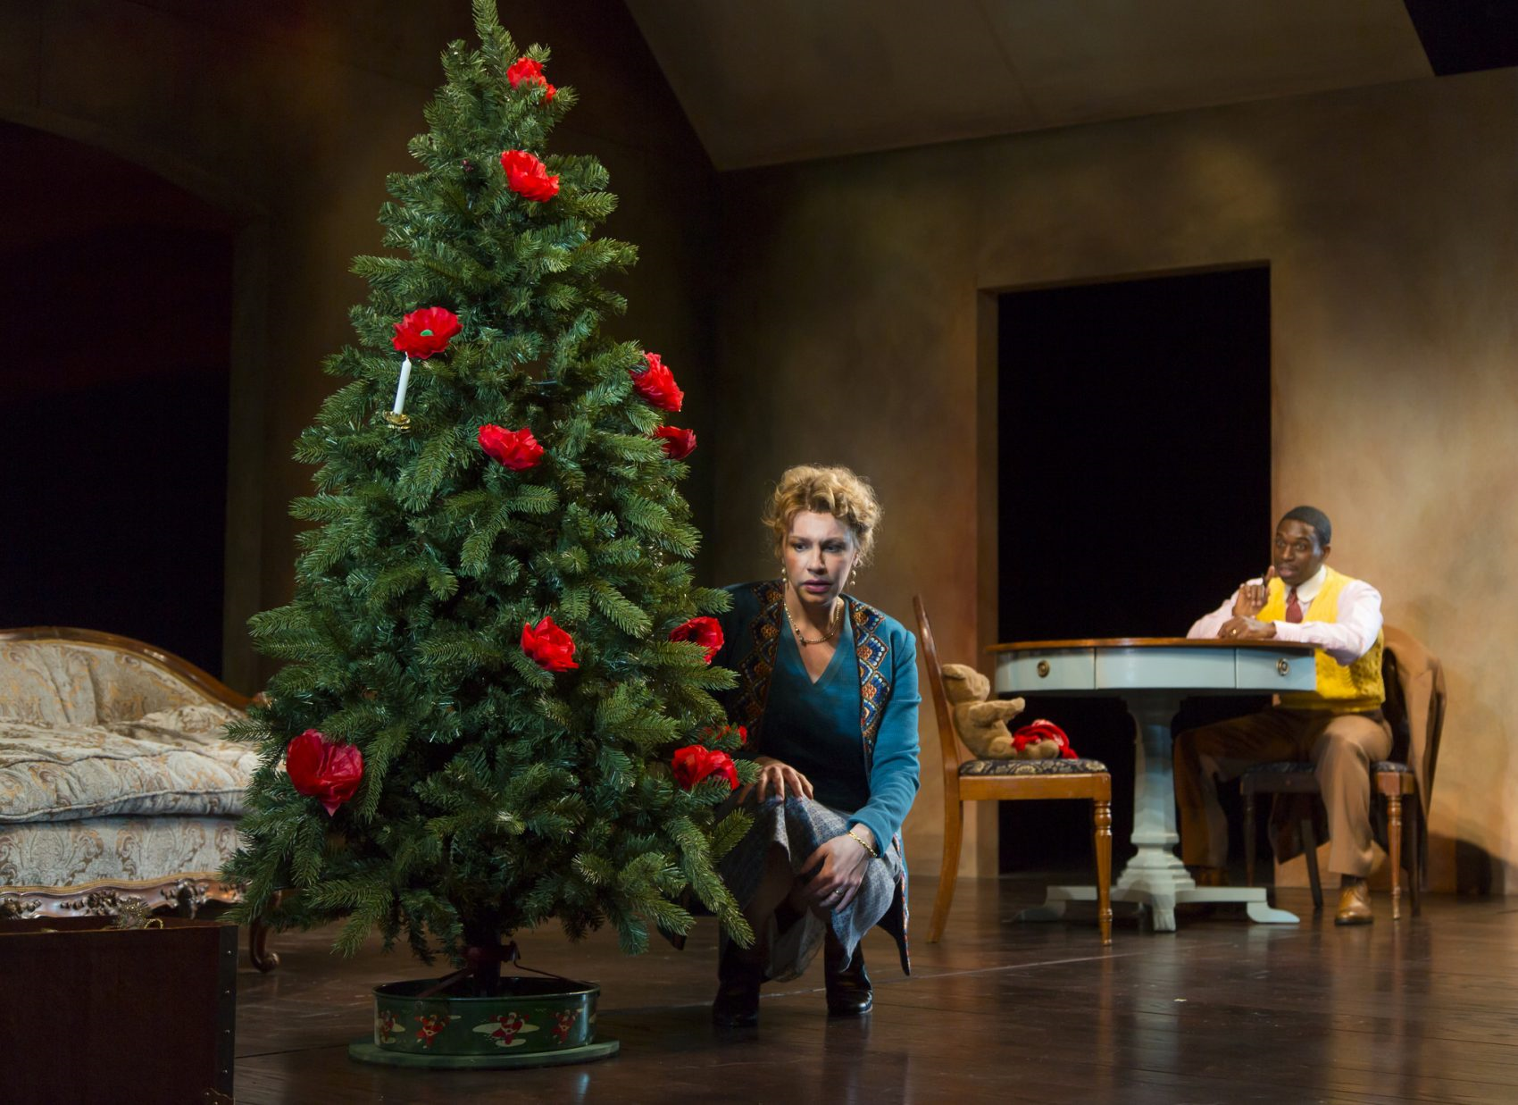
This mirrors how Torvald only focuses on his wife until societal reputation becomes a more pressing matter: “Our home has been nothing but a playroom. I have been your dollwife.”
The Christmas Tree is a similar symbol, as it represents Nora’s role in the home, a superficial element designed for appearance and nothing more, reinforced as the Christmas tree becomes “dishevelled” when Nora begins to suffer further from her husband’s attempts at dominance.

Slide 19
Narrative Directions:
The stage directions in the drama introduce key elements of the plot, such as the class level and traits of certain characters. This means that there is no need for a narrator or constant revelation of necessary details by characters, which would take up and time and disrupt the plot and thus the viewing experience of the audience.

Slide 20
For example, stage directions near the beginning of the drama note that it begins in “a comfortable room, furnished inexpensively, but with taste”. This immediately implies that Nora and Torvald are a middle class family, due to the combination of tastefulness but a lack of excessive luxury.
Elsewhere, Nora’s nervousness and obvious respect for her domineering husband is represented easily through stage directions, which note how she may eat sweets but in a hurried and secretive manner.
This implies how she may be disobedient but is unsettled by such behaviour, representing how she may be a somewhat independent character but not to the point that she will challenge the status quo yet: “She takes a packet of macaroons from her pocket and eats one or two; then goes cautiously to her husband’s door and listens.”

