Slide 2
Leaving Certificate English 2021-2023
A TWO year course
Ms Deasy

Slide 3
The Exam
The Leaving Certificate H.L. English exam consists of two papers – both worth equal marks (200 each).
Paper 1 is primarily concerned with the study of Language.
Paper 2 is primarily concerned with the study of Literature.

Slide 4
Paper 1 – 200 marks
For Paper 1, you will have to answer 2 questions.
Comprehension (Part A & Part B )
100 marks (50 marks each)
Composition (essay)
100 marks

Slide 5
Paper 1 skills
Language is integral to our everyday lives. We use it to express ourselves – our feelings, thoughts, beliefs. It is a hugely important form of communication with others.
To do well in Paper 1, you will need to become familiar with various types of language. You must be able to identify features of different types of language when reading a text. You must also be able to write in different types of language and understand the effect it has on your audience.

Slide 6
What are the types of language you will need to know?
The language of Narration – Fiction & Non-Fiction
The language of Aesthetics
The language of Argument
The language of Persuasion
The language of Information

Slide 7
Paper 1 – A sample plan
Year 1
Sept – Mid-term Elizabeth Bishop
Oct – Christmas Macbeth
Jan – Mid-term WB Yeats
Feb – Easter Emily Dickinson
Easter – Exams Revision
Year 2 Comparative Novel, Play, Film,
Patrick Kavanagh
Adrienne Rich
Paula Meehan
Revision

Slide 8
Paper 2 skills
English Paper 2 asks students to undertake meaningful study of literature and poetry.
There are 3 questions on paper 2.
The Single Text (60 marks) – ‘Othello’ by William Shakespeare
Comparative study (70 marks)
Poetry - Studied (50 marks)
- Unseen (20 marks)

Slide 9
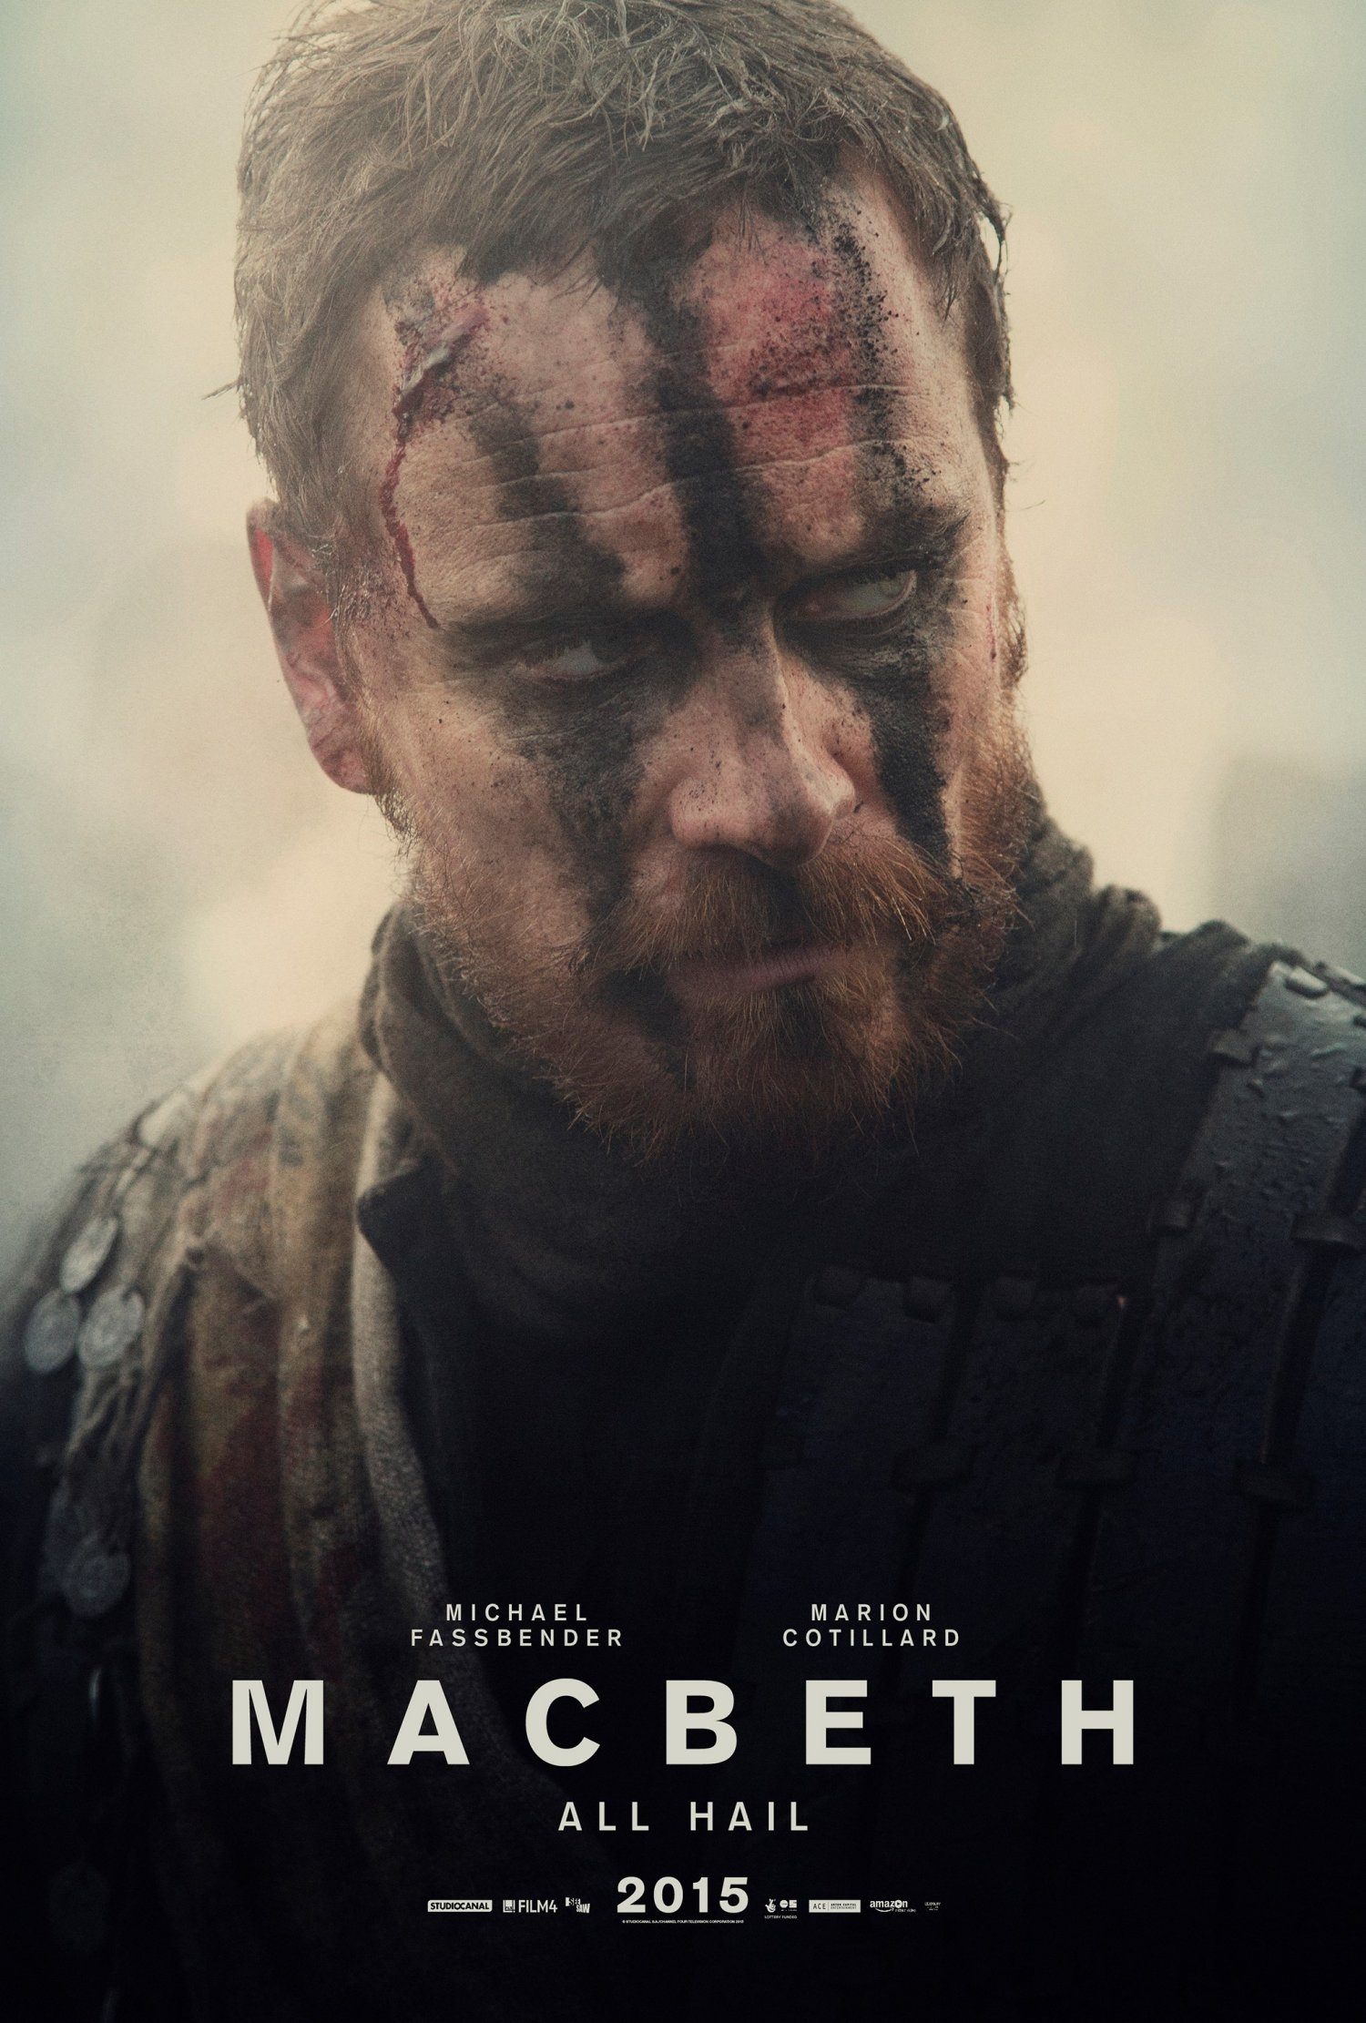
Single Text
Macbeth (2021-2022)
You will be expected to answer an essay on Macbeth. Your essay must consist of a well formed argument, each point fully supported with appropriate quotes as evidence. Evidence of extra reading is rewarded.
Topics to be studied include :
Character, themes, imagery, atmosphere, key scenes etc.
This Photo by Unknown Author is licensed under CC BY-ND

Slide 10
Comparative study
For this question, you must compare and contrast three texts. (One of which can be a film) Different texts are prescribed each year.
Texts are compared under 3 out of 4 headings.
Theme or issue
General vision and Viewpoint
Literary genre
Comparative study

Slide 11
Poetry
You are required to study the work of at least six prescribed poets. (Usually 6 poems by each poet) Again, your analysis of each poet’s work must be well structured and include relevant quotes to support points. Evidence of extra reading is rewarded.
You are also expected to write an analysis of an unseen poem, based on the skills you have learned through your study of prescribed poets.

Slide 12
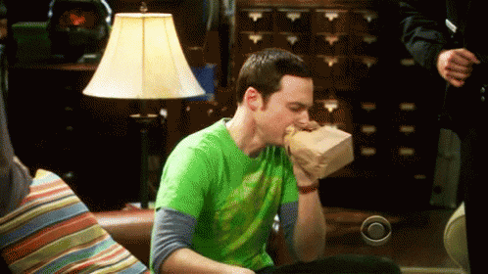
Best foot forward …
It is impossible to emphasise enough how important it is to start 5th year with the right attitude.
Do the work … put in the effort from the start …ask for help if you feel you are falling behind! This will help avoid any stressful melt-downs in 6th year.
Best of luck on your commencement of the LEAVING CERTIFICATE 2023 course!

Slide 13
Your new best friend will be…..
msdeasynotes.weebly.com

