Slide 1
Paper 1: Language Genres Language of Persuasion Ms. Deasy

Slide 2
The language of persuasion is similar in many ways to the language of argument. Both outline a case for or against a particular point of view.
The difference is that language of persuasion deliberately tries to influence the reader by appealing to his or her emotions, not reason.

Slide 3
Forms of Persuasive Writing
Advertisements
Articles
Speeches
Propaganda
Reviews
Blogs
Persuasive Essays

Slide 4
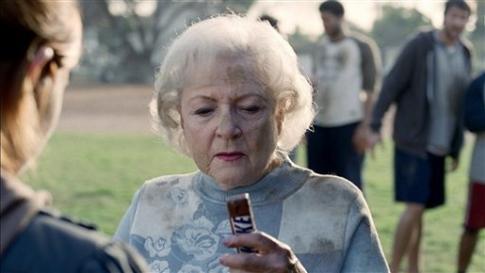
Forms of Persuasive Writing
Advertisements try to convince you to do or buy something.

Slide 5
Articles about current issues appear in newspapers and magazines, or on television, radio, and the internet.
http://topmagazines.wordpress.com/2011/06/29/recommended-magazines-for-people-who-can%E2%80%99t-get-enough/

Slide 6
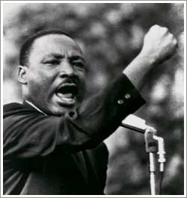
Persuasive speeches try to convince an audience to take action
http://www.pbs.org/wnet/historyofus/web14/index.html

Slide 7
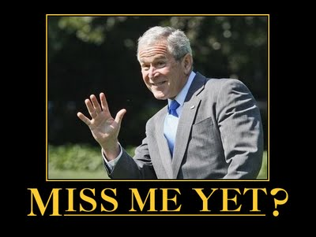
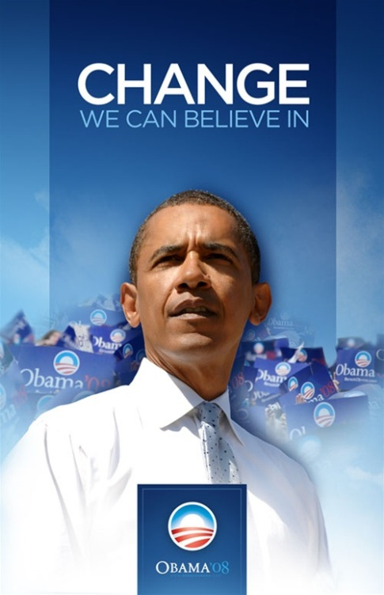
Propaganda is often about political issues, and usually includes emotionally charged appeals.
http://www.zazzle.com/change_we_can_believe_in_poster-228719897857931246 http://www.zazzle.com/miss_me_yet_george_bush_billboard_postcard-239692539098456593
Notes:
A campaign poster for Barack Obama and a billboard advertisement that was displayed on Interstate 35 between Dallas and Austin in Texas

Slide 8
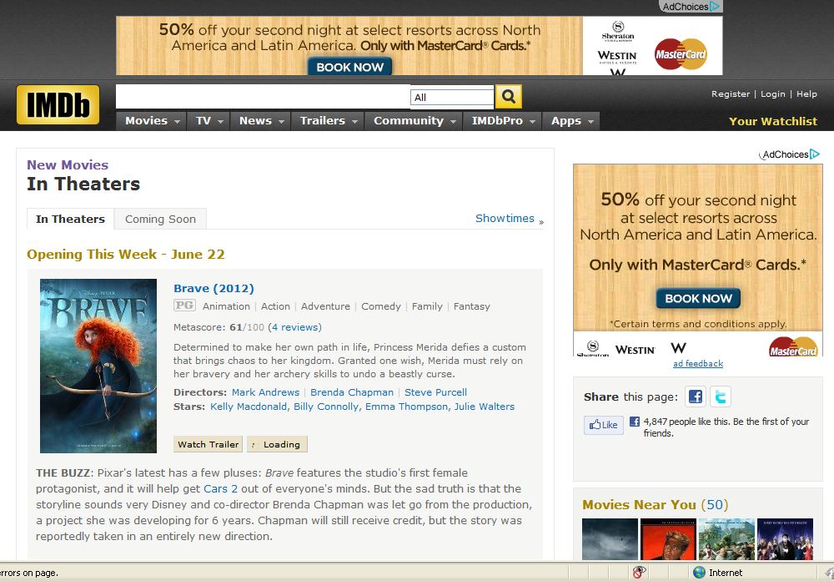
Reviews evaluate items like books or movies and state an opinion as to whether the product is worth the reader’s time and money.
http://www.imdb.com/movies-in-theaters/

Slide 9
Blogs provide commentary on a particular topic, often combining text, images, and links to other blogs, web pages, and other media related to its topic. Blogs also allow readers to respond.
http://www.ted.com/talks/marcel_dicke_why_not_eat_insects.html

Slide 10
Persuasive essays use logic, reason, and emotion to convince readers to join the writer in a certain point of view.
http://www.essay.tv/wp-content/uploads/2010/01/how-to-write-essay.jpg

Slide 11
Features of Persuasive Language
Manipulation can be a major part of the language of persuasion. It often plays on the reader's conscience, making him or her feel guilty or pressurised into agreeing with the case being made.
It can also flatter the reader into agreeing.
Question???
Have you ever manipulated
someone (a parent/ friend) to get
Your own way?

Slide 12
Strong, emotive language can be used to win the reader over.

Slide 13
The word 'We' is often used instead of 'I' to draw the reader in and make him or her feel on the same side as the writer.

Slide 14
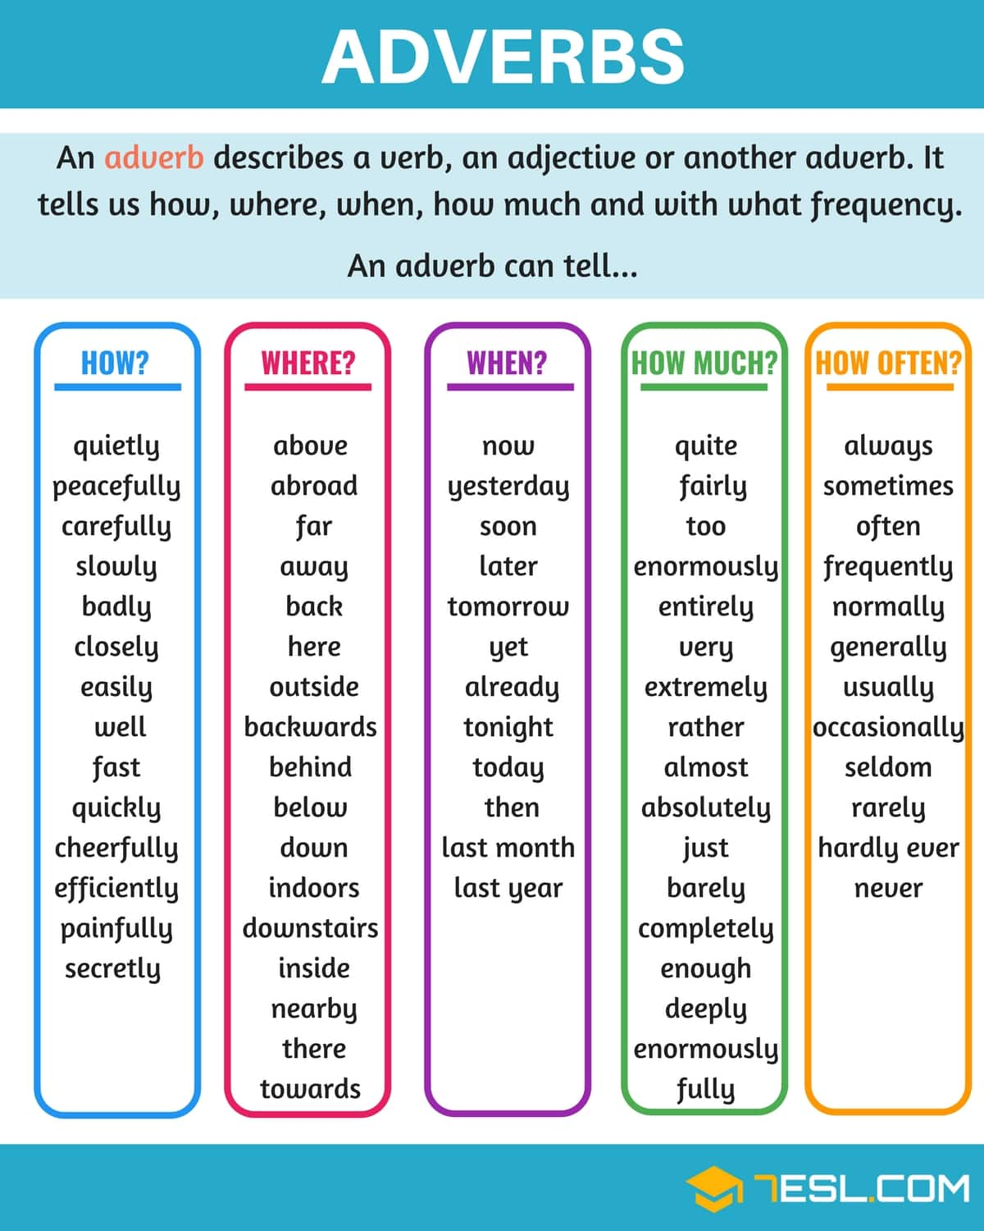
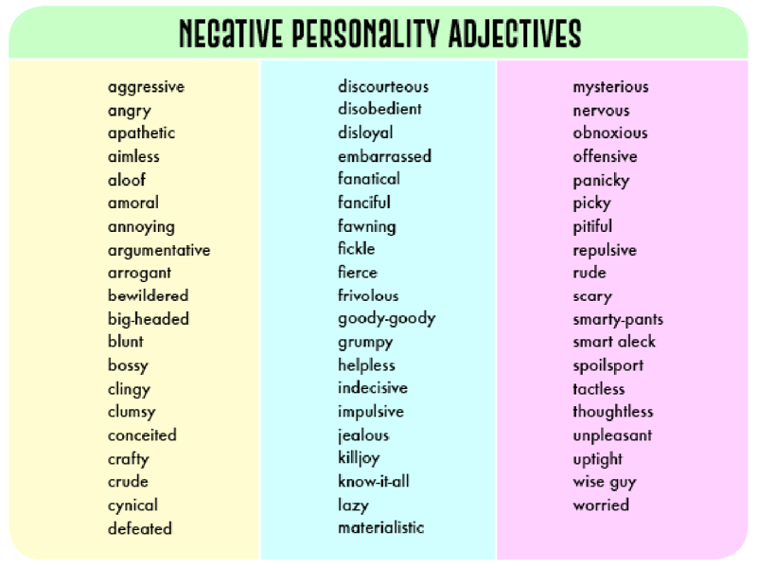
Adjectives and adverbs are used freely and they are often quite extreme.

Slide 15
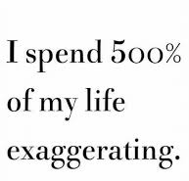
Facts and figures may be given but they may be vague or exaggerated, 'The vast majority of people', 'Almost every student in the country', etc.
This is very useful in advertising. Generalisations are used without the support of a source – watch out for 'All' or 'Every'.

Slide 16
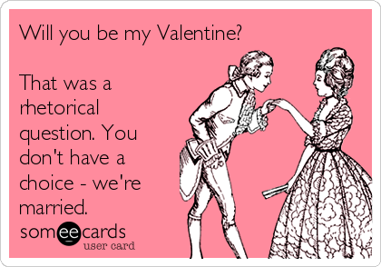
Rhetorical questions, an argument framed in the form of a question to which there can be only one possible answer, may be used.
'Why should we allow our parents to rule every aspect of our lives?' (Answer expected – we shouldn't.)

Slide 17
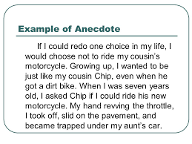
Personal opinion and anecdotes are often used.

Slide 18
'Persuader' words and phrases can be used to good effect:
Clearly
Plainly
Surely
Undoubtedly
Obviously
As we all know..
Everybody is fully aware that...

Slide 19
Banishing to Room 101:

Slide 21
Your Turn…
Write one paragraph banishing something that irritates you to Room 101
Try to use some of the persuasive techniques you have learned

