Slide 1
Language of Narration
(Fiction)

Slide 2
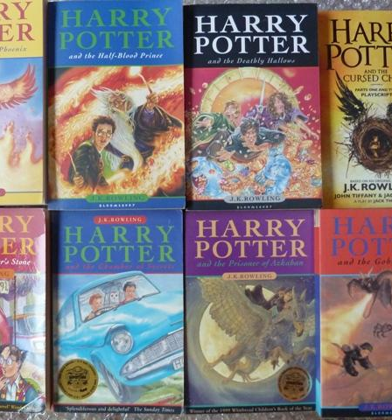
Narrative fiction tells the reader stories that have been made up.
The writer intends to describe an event, a person or a place.
They want the reader to share the emotions and experiences of the characters.
This kind of writing is aimed at all readers because it appeals to a variety of interests, memories and emotions.

Slide 3
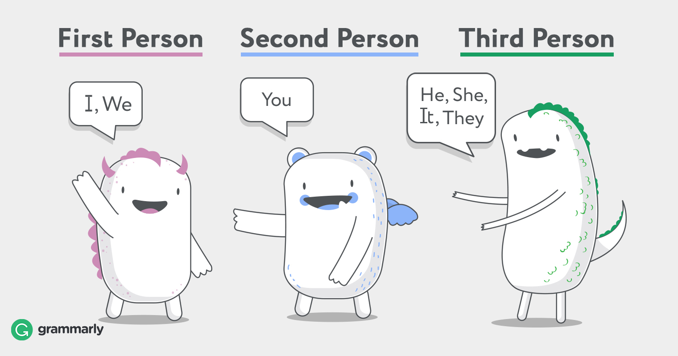
Features:
Usually first person or third person narrative.

Slide 4
Careful creation of the setting

Slide 5
Engaging characters

Slide 6
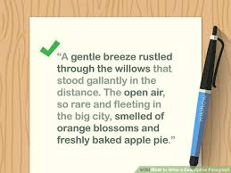
Descriptive language

Slide 7
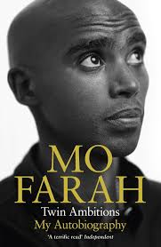
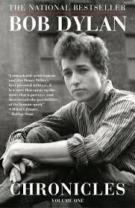
The story can be fact or fiction.
Autobiographies are written in a narrative style: they generally present us with the events of the subject's life in chronological order.

Slide 8
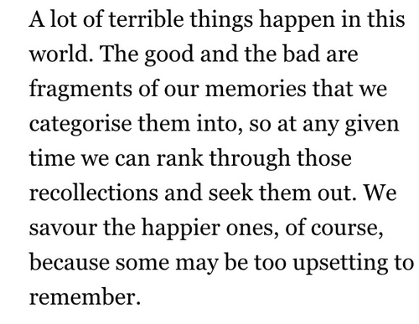
The language of narration often contains an element of aesthetic language.

