Slide 1
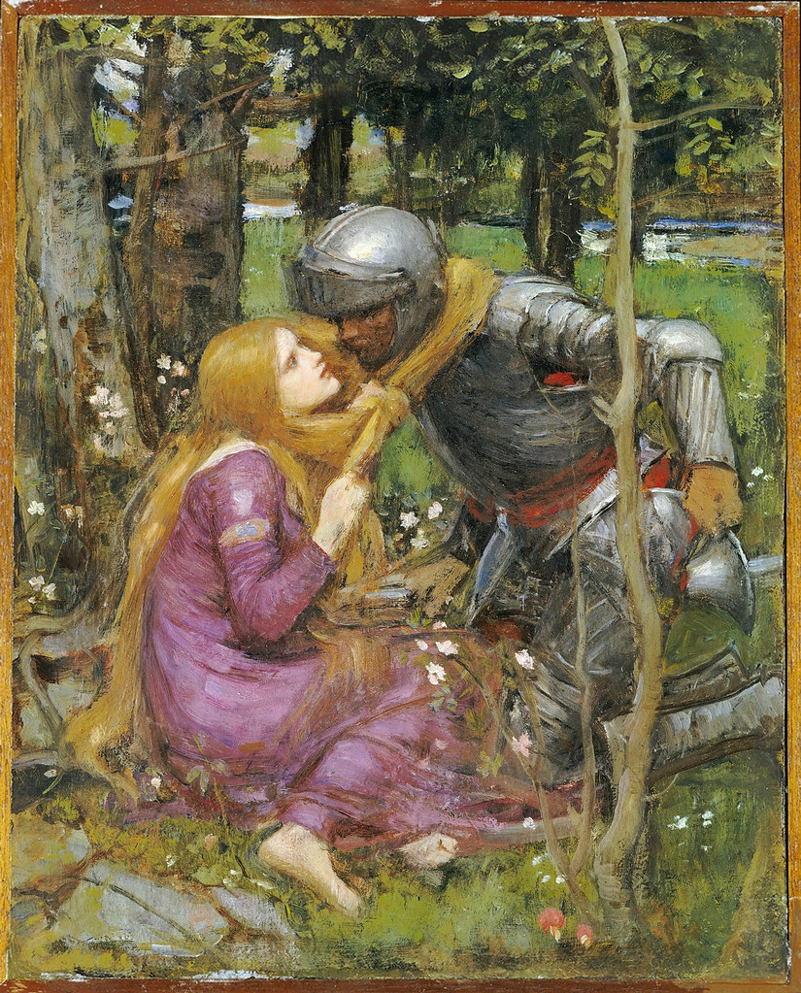
‘La Belle Dame Sans Merci’
John Keats

Slide 2
Background
In 1424, Alain Chartier, the French court poet, wrote a poem with this title. The title appealed to Keats so he used it himself but borrowed nothing else from the original. This poem may have been written in response to a dream Keats had about meeting a beautiful woman who was surrounded by ghostly lovers.

Slide 3
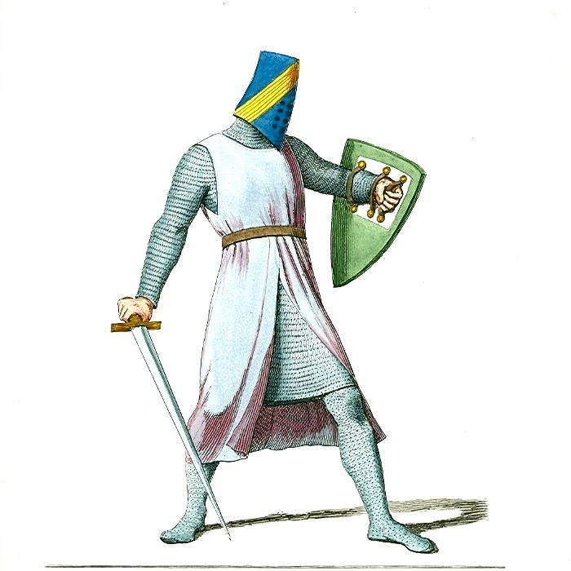
Narrator and Knight
The poem is split in two halves – in the first a narrator is speaking and in the second we hear the voice of a knight
This Photo by Unknown Author is licensed under CC BY-SA

Slide 4
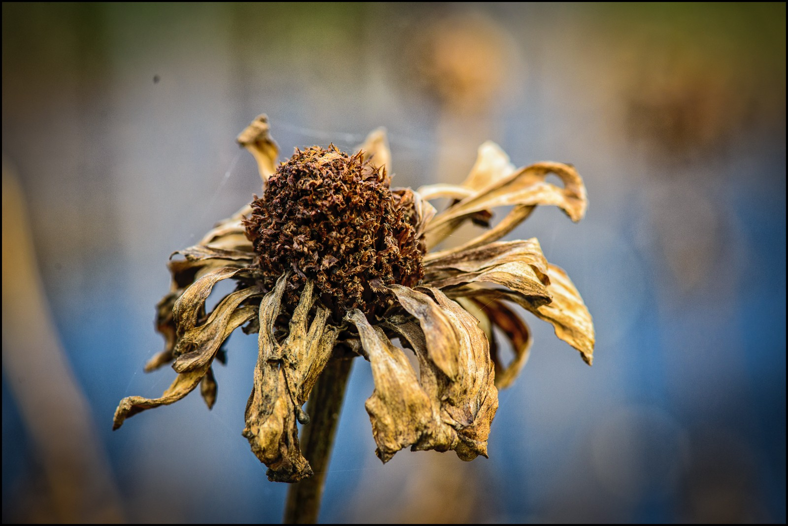
Stanza by Stanza The Narrator
This Photo by Unknown Author is licensed under CC BY-NC
Ah, what can ail thee, knight-at-arms,
Alone and palely loitering?
The sedge has withered from the lake,
And no birds sing.
What is wrong with you, brave knight,
Alone and pale and wandering without purpose?
The plants by the lake have died,
And the birds are not singing.
Note: The imagery of nature here is gloomy and depressing. The only plants mentioned are dead and there is no birdsong. It is obviously autumn but it is not a positive image of that season.

Slide 5
Ah, what can ail thee, knight-at-arms,
So haggard and so woe-begone?
The squirrel's granary is full,
And the harvest's done.
What is wrong with you, brave knight,
So careworn and so sad,
The squirrel has stored his food for the winter
And the farmers have gathered their harvest.
Note: Although the knight is in a sorry state, not everyone or everything is similarly afflicted. Even though it is autumn, others are content and prepared for the winter ahead. Why isn't he?

Slide 6
I see a lily on thy brow
With anguish moist and fever-dew,
And on thy cheek a fading rose
Fast withereth too.
I see you are sick; your forehead is as pale as a lily
And you are feverish
The colour is draining from your cheeks
Very quickly.
Note: The images of nature here are negative too; flowers are usually associated with love but here they signal sickness and death.

Slide 7
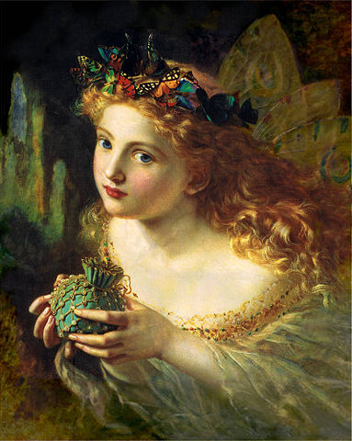
Knight:
I met a lady in the meads,
Full beautiful - a faery's child:
Her hair was long, her foot was light,
And her eyes were wild.
I met a lady in the meadows
She was so beautiful, like a fairy
She had long hair and a graceful step
Her eyes were wild.
Note: Though the description of the lady is of a beautiful creature, there are hints of trouble to come. She may not be completely human and she has wild eyes.

Slide 8
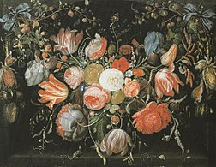
I made a garland for her head,
And bracelets too, and fragrant zone;
She looked at me as she did love,
And made sweet moan.
I made her a hair band of flowers
And floral bracelets and a floral belt
She looked at me as if she loved me
And moaned softly
This Photo by Unknown Author is licensed under CC BY-SA
Note: Although the images of nature, the references to flowers, are more traditional here, it is significant that the lady only looked at him as if she loved him. Is the knight perhaps reading too much into it? And why does she moan? This leads us to wonder if she is unhappy.

Slide 9
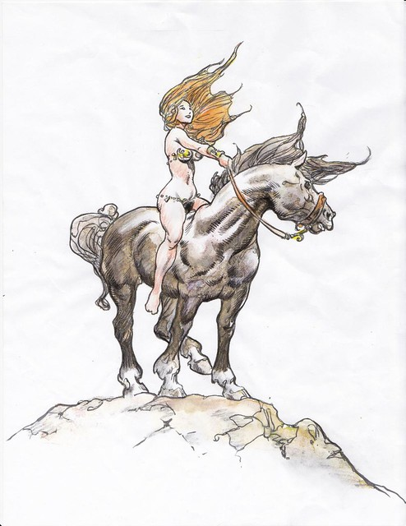
I set her on my pacing steed,
And nothing else saw all day long;
For sideways would she bend, and sing
A faery's song
I put her up on her prancing horse
And gazed at her in adoration all day
She bent down from the horse to sing to me
A fairy's song.
Note: In mediaeval stories, the knight would be the one on the prancing horse, here the situation is reversed. Does this tell us the lady is in charge? That she is the one with the power? It is worth noting too that she seems to be choosing what they do, all the verses now start with 'She'. The lady is leading the knight, not the other way around. Still, there is no implication that she is deliberately leading him astray.

Slide 10
She found me roots of relish sweet,
And honey wild, and manna dew,
And sure in language strange she said,
"I love thee true!"
She fed me wild fruits
and honey and dew
and in her strange language,
her fairy voice, she told me she loved me.
Note: Again, there are positive images of nature but there is an underlying note of darkness in the lady's 'strange' language. She is haunting and beautiful, certainly, but does her otherworldliness create too much of a gap between her and the knight? Do we sense they will be happy together? Of course, we know they won't be as we have been told at the beginning of the poem that he is wandering around alone, lost and miserable.

Slide 11
She took me to her elfin grot,
And there she gazed and sighed full sore,
And there I shut her wild, wild eyes
With kisses four.
She took me to her fairy cave
And there she cried sadly
And I soothed her and kissed her wild eyes
With four kisses (two for each eye).
Note: Again, the lady is leading the knight. Now the action has moved to a fairy cave, a place which we imagine to be cold and dark. This imagery foreshadows the unhappiness that the love affair will cause the knight.

Slide 12
And there she lulled me to sleep
And there I dreamed - Ah! woe betide –
The latest dream I ever dreamt
On the cold hill side.
And there she soothed me to sleep
And I dreamt- Oh dreadful memory!
The last dream I ever dreamt
On the cold hill side
Note: Now we are nearing the answer, what is it that has distressed the knight so much? He is clearly horrified at the memory and has been haunted by it since. Indeed, he has not slept since. Has he been afraid of a repeat of the dream?

Slide 13
I saw pale kings, and princes too,
Pale warriors, death-pale were they all;
Who cried -"La belle Dame sans Merci
Hath thee in thrall!"
I saw many ghostly figures of kings and princes
They were horribly pale, clearly dead.
They cried that the beautiful lady without mercy had put me under a spell,
I was her slave, bound to her by love.
Note: Now the true horror of the knight's story begins to emerge. He is not the first to fall victim to the lady, she has led others to their fate also. Still, we don't know if she did this deliberately or if it was an unavoidable consequence of mortals and immortals falling in love.

Slide 14
I saw their starved lips in the gloam,
With horrid warning gaped wide,
And I awoke and found me here,
On the cold hill side.
I saw their pale, starved lips in the twilight
Their mouths gaped wide in a horrifying warning
And I woke up and found myself
On the cold hill side
Note: The ghosts are starved, perhaps of love? Or of life? The knight wakes and finds himself alone on the cold hill side. The hill is 'cold', again an image of death or a reflection of the lady's love.

Slide 15
And that is why I sojourn here,
Alone and palely loitering,
Though the sedge is withered from the lake,
And no birds sing.
And that is why I stay here
Alone and pale and wandering without purpose
Although the plants by the lake have died
And the birds are not singing.
Note: The poem has come in a full circle, the words in the last stanza are almost identical to those in the first. This may reflect the endless wandering of the night, the circular nature of the ballad is an echo of the loop in which the knight finds himself, doomed to wander the hill endlessly and possibly to join the legions of the ghostly kings and princes who found themselves in the same predicament. Their warning came too late, it could not save him.

Slide 16
Theme
The theme of this poem is how difficult it is to find true love in the real world. The knight believes for a while that he has found it but it is not real, it is not of this world.

Slide 17
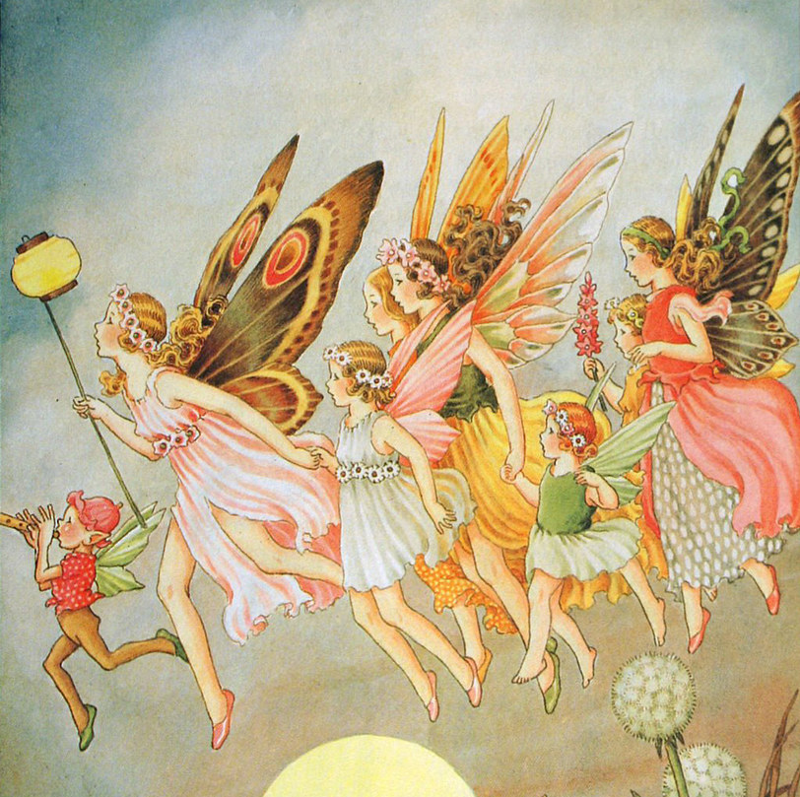
Imagery
The imagery in this poem is interesting. Traditional images; flowers, fairies, knights, beautiful ladies, meadows and garlands of flowers are turned into images, not of love, but of death and sadness. The references to the cold hillside, the fairy cave, the dead plants and the silence of the birds give us a sense that all is not well. They are sad, gloomy images.
This Photo by Unknown Author is licensed under CC BY-NC

Slide 18
Structure
This is a ballad. Note also the use of incremental repetition, a feature of English and Scottish ballads; the first and second stanzas begin in the same way but the end of the second stanza is different. This reinforces the ideas raised in the first stanza and adds to the musical quality of the poem.
This Photo by Unknown Author is licensed under CC BY-SA-NC

Slide 19
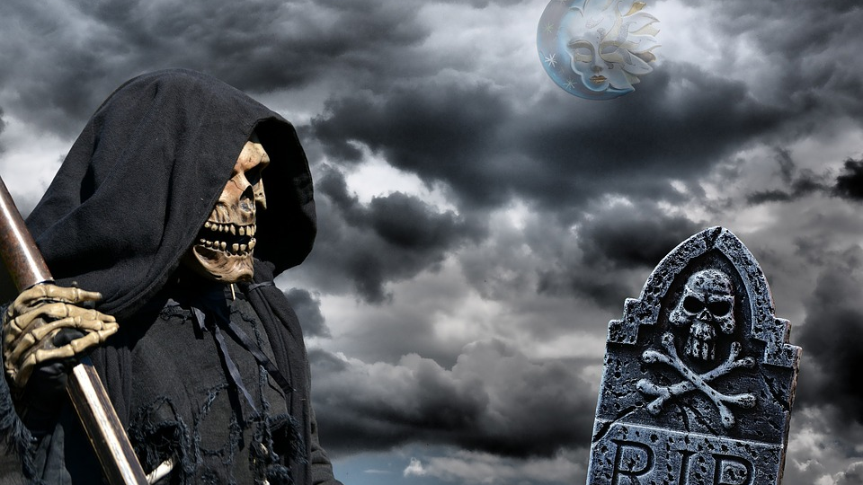
Tone
The tone is gloomy and sad, full of references to death. There is no note of hope in the poem - instead, the hopelessness of ideal, courtly love is highlighted.

