Slide 1
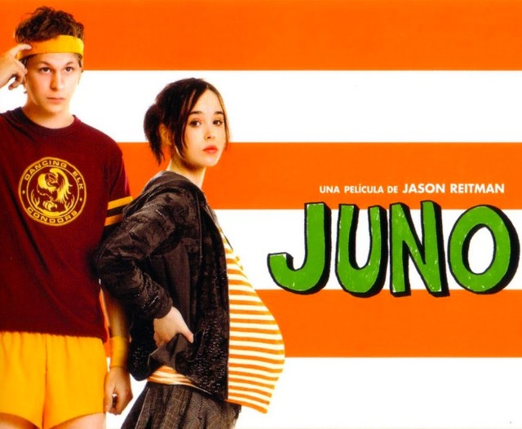
Juno - Jason Reitman
General Vision and Viewpoint

Slide 2
1 – Beginning of ‘Juno’
The beginning of the text offers a somewhat negative view of life, as Juno is unwilling to accept the reality of her situation, instead adopting an escapist view of the world whereby she hopes not to be pregnant despite have consistent and repeated knowledge that this is the case.
The audience thus views an individual overburdened by a newfound occurrence which they are unable to accept and incorporate into their life, alerting us to Juno’s young age and the lack of support she has at present, as her family are not aware of her pregnancy.

Slide 3
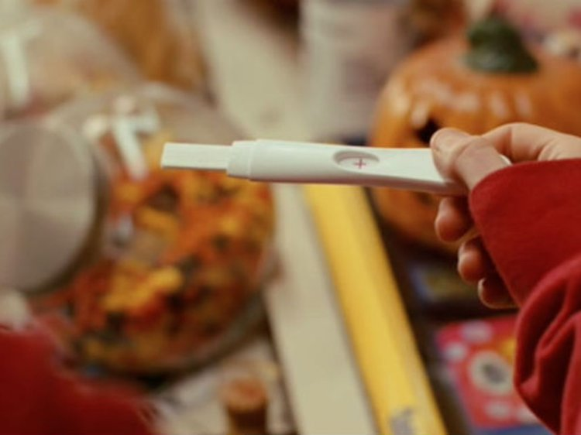
When the film returns to the present after the flashback scene Juno is shown arriving at the drugstore, where the clerk Rollo announces the protagonist’s intent to ignore her pregnancy.
This is made obvious by the protagonist’s purchasing of various pregnancy tests to attain a preferable result: “Well, well. If it isn’t MacGuff the Crime Dog! Back for another test?”

Slide 4
Juno’s response implies her unwillingness and inability to accept that she is pregnant, and her resulting desire to create a fantasy where she is not so: “I think the last one was defective. The plus sign looked more like a division sign.”
Rollo’s skeptical response however bleakly sums up that Juno is ignoring a reality that she will eventually have to confront, which only reinforces her age and initial discomfort at learning of her pregnancy: “This is your third test today, Mama Bear. Your eggo is preggo, no doubt about it!”

Slide 5
2. World of the text - is it conducive to a certain mindset, optimistic or pessimistic?
As shown earlier, the world of the text is initially revealed as one where individuals are affected by unwanted and unexpected occurrences which overshadow and dominate their lives.
However, despite such despair, we see a hopeful view of life in how individuals respond to such events, as many refuse to allow their living experiences to be affected, and rather look for alternative ways to progress as they desire.

Slide 6
The Lorings display such resolve when they apply to adopt Juno’s unborn child: they are unable to have children by natural means, made clear as Vanessa can only speak of pregnancy by what she learns from others who have experienced this firsthand: “The tough part’s almost over for you. I mean, my girlfriends always tell me the first couple months are the hardest.”

Slide 7
However this does deter them from forming a family, which leads to them meeting Juno and welcoming an infant into their home in a different way to pregnancy, seen as they set forth plans for raising Juno’s child as their own: “It means they’d send annual updates, photos, let Juno know how the baby is doing as he or she grows up. Of course, Juno’s legal rights would be terminated…”

Slide 8
3. How individuals respond to such a world
The world of the text is one where individuals can have their living condition changed instantly, without any prior warning or indication that such could occur.
However, many people do not allow such happenings to dominate their lives and find alternative ways to progress: this produces an optimistic outlook on life as we see individuals’ mindsets changing from initially troubled to settled as they realize that all is not lost and there is hope for the future.

Slide 9
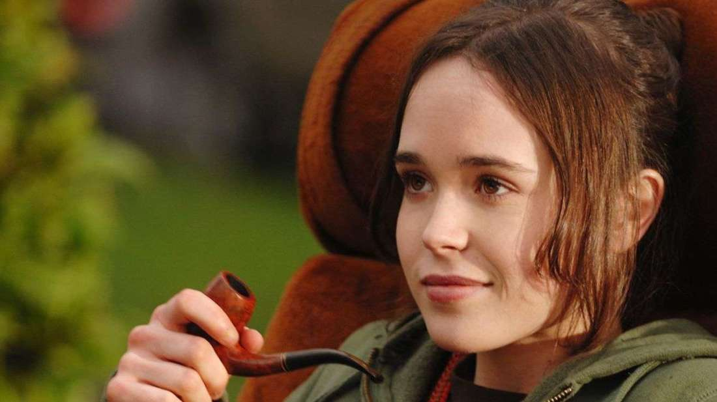
Earlier Juno was shown as unwilling to accept her pregnancy when buying multiple pregnancy tests, implying an inability and unwillingness to accept this newfound development. However, when she does realize and acknowledge her pregnancy she is not overawed or dismayed, and instead plans to act accordingly.

Slide 10
Juno’s straightforward and calm response, revealed to her parents, shows how her mindset has changed, as she no longer attempts to ignore reality but rather shape it in a manner that will not trouble her: “I’m pregnant… But, uh, ah, I’m going to give it up for adoption and I already found the perfect couple, they’re going to pay for the medical expenses and everything. And in… what, ah… thirty-odd weeks we can just pretend that this never happened.”

Slide 11
4. Support of others (or lack thereof)
As the text progresses we see individuals rallying around to support Juno during her pregnancy. This provides a hopeful outlook on life, especially as many of these individuals are somewhat distanced from Juno: their heightened care and compassion implies that many individuals are naturally inclined to help others when required.
An example is seen when Bren cares for Juno during her pregnancy. It would not be wholly unsurprising if she did not offer much support, for the protagonist attempts to maintain a distance from her, represented by her referring to the new maternal figure in the household by her first name.

Slide 12
Bren, presumably aware of this, however does not even consider such behavior when the time comes to support Juno during her pregnancy.
When the ultrasound technician attempts to reduce Juno to a mere stereotype, declaring “I just see a lot of teenage daughters come through here.
It’s obviously a poisonous environment for a baby to be raised in”, Bren immediately defends her stepdaughter, representing a subconscious desire to do so.

Slide 13
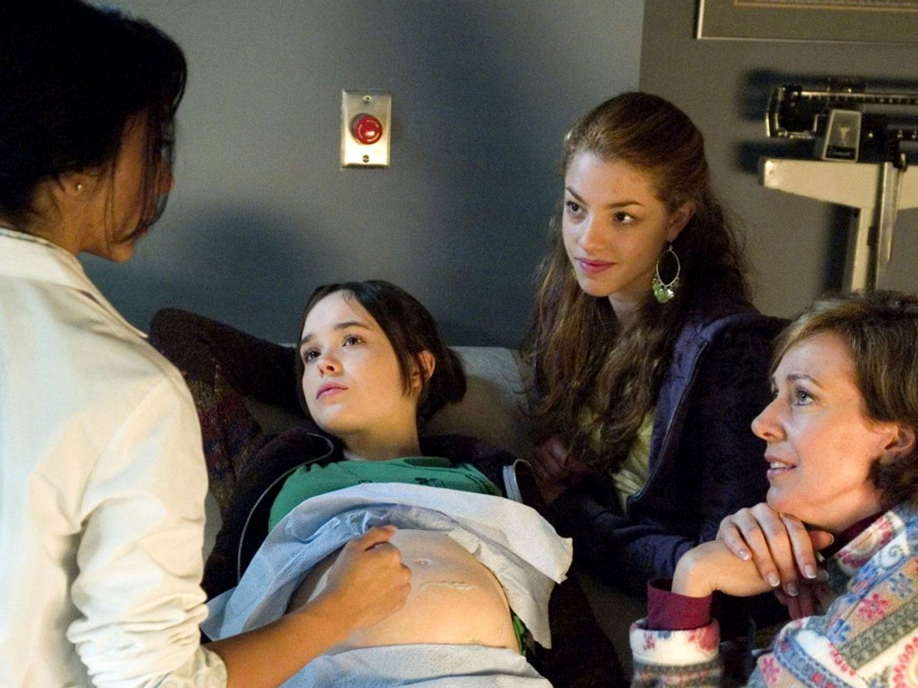
She challenges the technician on such a statement, unwilling to allow such a slanderous remark to remain, questioning whether all adoptive parents can be trusted: “They could be utterly negligent. Maybe they’ll do a far shittier job of raising a kid than my dumbass stepdaughter ever would. Have you considered that?”

Slide 14
5. Relationships and their effect
Relationships are shown to have a detrimental effect in the film, as they are shown as suffocating and thus unsettling for those involved.
The result is a depressing view on life as such bonds are thought to be the very basis for emotional connection, so as to counter potential loneliness and isolation, however the suggestion here is that some individuals may be better off without relationships.

Slide 15
Mark shows that he is not suited for a potential relationship with a child, and that this will only cause him bother and misery, as he will be forced to endure responsibilities that he is not interested in carrying out.
This is depressing as the introduction of a newborn into a family setting should be a source of contentment and joy regardless of any difficulty this may bring (as any drawbacks will be overshadowed by happiness of a new family member), with the prospect of raising a family, however it is obvious that this will only inflict discomfort on Mark.

Slide 16
He admits that he is only focused on certain aspects of the relationship and thus that the more bothersome parts, such as caring for the child late at night or during illness, are not of interest to him, when a father should be aware of and willing to undertake such duties: “Sure, why not? I mean, every guy wants to be a father. Coach soccer, help with science projects and… I don’t know. Fatherly stuff.”

Slide 17
6. Key Moment
The moment that Juno and Mark’s growing bond irreconcilably splits is a somewhat depressing moment, amidst the heartwarming nature of the film, as it shows how escapism and fantasy in life is inevitably dashed by reality.
Throughout the film Mark forms a bond with Juno so as to ignore his somewhat unwanted present, as he is able to return to his youthful past in a manner of speaking, which allows a more heightened experience than the nostalgia he engaged in before her arrival.
But this does not last the entirety of the film, confirming that such escapism is not long-lasting and thus that unwanted reality will always overpower fantastical desires.

Slide 18
Mark announces his plan to leave Vanessa, outlining his intentions to continue growing his bond with Juno: “It’s just not working out, but I’m getting my own place in the city… and I’ve got it all planned out. It’s something I’ve wanted to do for a long time.”
However, Juno dashes the dream by revealing that she does not want to be part of an actual relationship with Mark, and instead wants to keep things as they are: “I don’t know. I just liked being your friend. I sort of liked becoming furniture in your weird life.”

Slide 19
The fantasy where each enjoyed the other’s company is immediately dashed when Mark attempts to progress and establish this (indicative of a growing reality and thus its detrimental nature), as he realizes Juno’s youthfulness and that his desired relationship will never occur, due to the age gap and thus their differing viewpoints: “God, you’re so young.”
Reality now sets in, as he realizes that while he is looking for a return to his youth Juno is enjoying this, and that both versions are incompatible, meaning that their approaches to life differ radically.

Slide 20
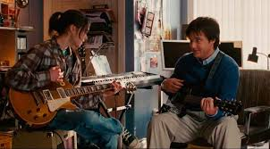
The protagonist even confirms this, with her dismissal of his musical preferences confirming that the different time zones in which they grow up make common interests, a basis for any relationship, ultimately impossible: “Oh and by the way, I bought another Sonic Youth album and it’s the worst thing I’ve ever heard! It’s just noise, man!”

Slide 21
7. Resolution (close of text)
The close of the text produces a hopeful outlook on life, as we see that individuals who are caring and kind towards others eventually receive a proper reward for doing so, in the form of a family that will satisfy their desire for emotional connection.
Near the beginning of the film Juno agreed that the Lorings could adopt her child as a couple, believing that the duo could offer a full and secure family environment for the child while growing up.

Slide 22
However, when Mark opts out Juno is not deterred by the prospect of the child being raised by Vanessa as a single parent, as the protagonist realizes that the woman’s care and compassion more than makes up for the absence of Mark, who does not want a child.

Slide 23
Vanessa and Mark clash over the prospect of having a child near the close of the film, and their marriage ends as a result. Juno however is not put off by such a development, despite this affecting the terms of the adoption agreement, for as the text progressed she saw firsthand how devoted Vanessa was to having a child, which thus proved her maternal qualities and devotion to such a role.

Slide 24
She thus leaves a note for Vanessa confirming that the adoption is still going ahead, with Vanessa later framing this letter and hanging it in the nursery, which the camera zooms in on: “Vanessa: If you're still in, I’m still in - Juno.”
This is a fitting end for the film for, as Mark’s exit was clearly expected due to his growing concern over having a child, Vanessa’s obvious capability as a mother was increasingly shown, thus proving that good people get what they deserve in the end.

