Slide 1
Junior Cycle English
CBA 1 : Oral Presentation

Slide 2
What is it?
A presentation where you must talk for three minutes approximately
This can be on any topic you would like
You can have notes/ props etc. but remember… it is the PRESENTATION that matters – so you must make eye contact and use the appropriate body language

Slide 3
This can be done in groups but, in my opinion, you are more likely to get a higher grade descriptor if you do it on your own.

Slide 4
Research
Your topic must be well researched – you will need to engage well with it – don’t just copy and paste something from the internet and read it off a sheet
Keep a list of the websites you used for your research in your Copy Book

Slide 5
You will have to fill in a research plan

Slide 6
Format – You Can:
Write and recite your own poem
Act out a scene you wrote – or a scene from a play/ tv show you like
Talk to us about your favourite hobby
Review your favourite book / film
Tell us about a pet or family member
The possibilities are endless

Slide 7
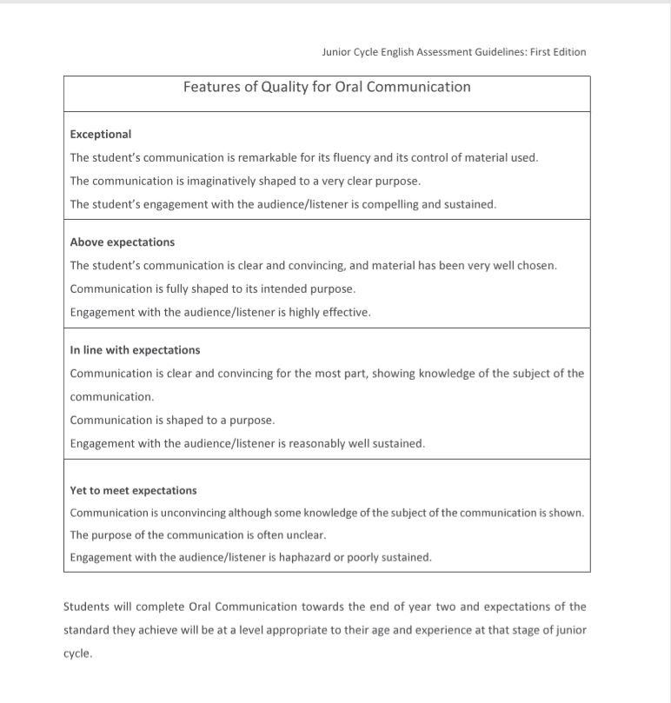
Grading

Slide 8
You will be awarded one of the four Grade Descriptors above – and this will appear on your Junior Cycle Profile of Achievement

Slide 9
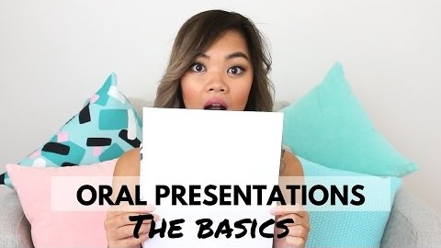
The Dos and Don’ts of Presentations

Slide 10
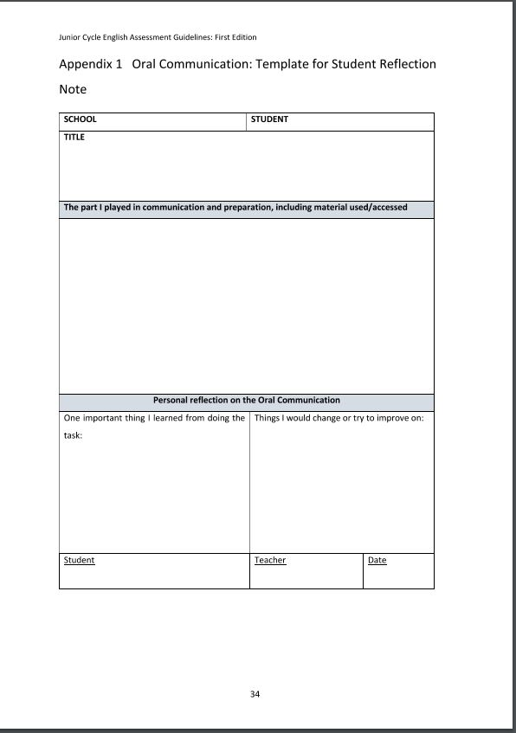
Time to reflect…
When you are finished you will be asked to fill in a reflection sheet.

Slide 11
A look at some others:
https://www.curriculumonline.ie/Junior-cycle/Junior-Cycle-Subjects/English-(1)/Examples-of-Student-Work/Examples-of-Oral-Communication-(2nd-year)/
Click on this link, you might get to see some other students’ work

Slide 12
Best of luck! Any questions just ask!

